Slide 1
de
MRIzero
Hi all,
what if MRI sequence programming is just a game that we can win like winning Go using reinforced learning?
The rules are the Bloch equations.
The sequence is our strategy.
The k-space is our feature extraction
And the difference to the correct image is the cost function.
If you want to participate in this complete side project, come for a quick discussion round on Tuesday Jan, 16th 3 pm in the MRZ seminar room.
It would be great to have all your expertise united to think about this a little further.
If you think more people would be interested, let me know.
Best,
Moritz
9.1.2018

Slide 2
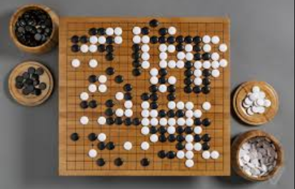
AlphaGo
AlphaGo uses a Monte Carlo tree search algorithm to find its moves based on knowledge previously "learned" by extensive training, both from human and computer play.
In October 2015, AlphaGo became the first computer Go program to beat a human professional Go player
In March 2016, it beat Lee Sedol in a five-game match, the first time a computer Go program has beaten a 9-dan professional without handicaps.
https://en.wikipedia.org/wiki/AlphaGo

Slide 3
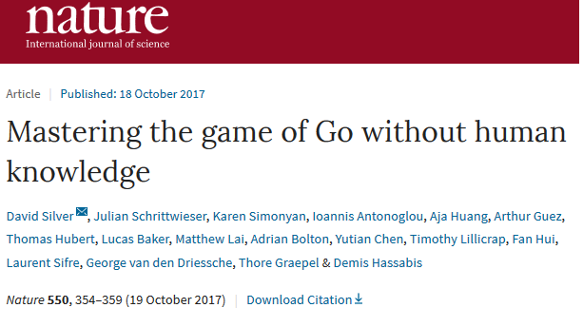
Alpha Go Zero
AlphaGo was initially trained to mimic human play by attempting to match the moves of expert players from recorded historical games, using a database of around 30 million moves.^{[18]} Once it had reached a certain degree of proficiency, it was trained further by being set to play large numbers of games against other instances of itself, using reinforcement learning to improve its play.^{[2]}
AlphaGo Zero is a version created without using data from human games, and stronger than any previous version. By playing games against itself, AlphaGo Zero surpassed the strength of AlphaGo Lee in three days by winning 100 games to 0, reached the level of AlphaGo Master in 21 days, and exceeded all the old versions in 40 days.^{[2]}
Nature on 19 October 2017
https://en.wikipedia.org/wiki/AlphaGo

Slide 4
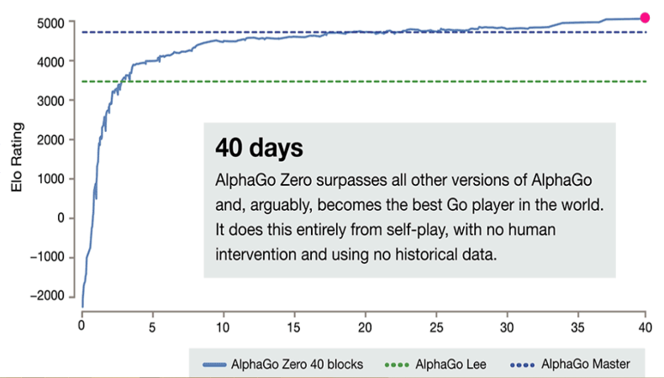
Figure 2: The relative skill levels of AlphaGoZero given by the Elo rating as a function of the number of training days⁴. The dashed lines show previous AlphaGo versions that were trained with human training data but played already superhuman.

Slide 5
MRI zero –
Reinventing MRI without human knowledge
„Human“ MRI?

Slide 6
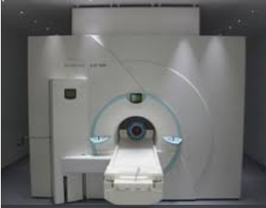
MRI and GO
Rules
Strategies
Win
Competition/Game between player
Bloch-equations
Sequences
Win: best and fastest image
Competition / Game between research groups

Slide 7
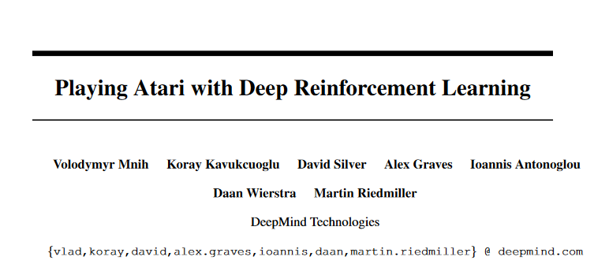
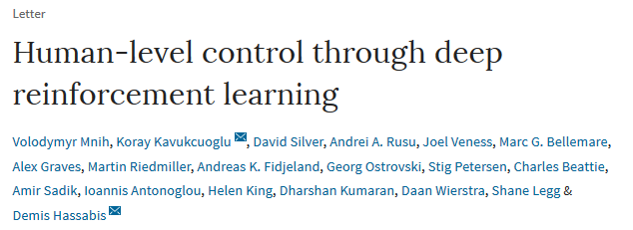
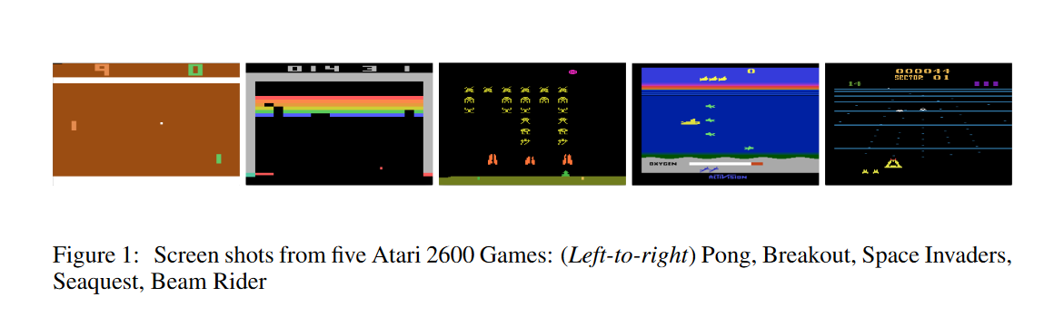
Atari games: no “enemy”
Nature 518, 529–533 (26 February 2015) doi:10.1038/nature14236

Slide 8
->Alex‘ MRIzero approach description

Slide 9
RESULTS for some simple problems / sanity
Adaptive k-space sampling
  set k-space part to 0 -> do not sample
  Increase noise -> sample more in the center
Variable flip angles (FID)
  Give SS signal at Ernst angle as target, but transient sequence as task -> does it learn the flip angle variation to avoid blurring?

Slide 10
RESULTS 1: Adaptive k-space sampling

Slide 11
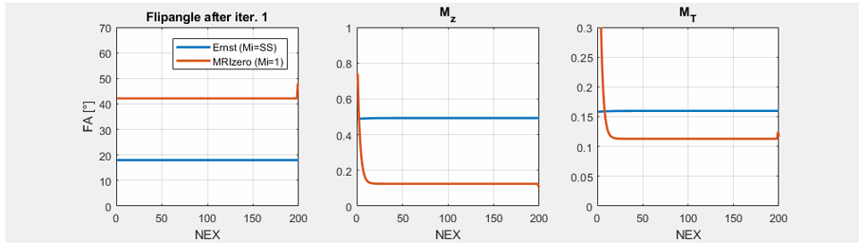
RESULTS 2 : Variable flip angles (FID)
Target: T1=1s, TE=1ms, TR=50ms, FA=FA_{Ernst}=18°, M_{i}=M_{ss}
Task: same fixed TE,TR, free FA, and M_{i}=1, initial const. FA=42°

Slide 12
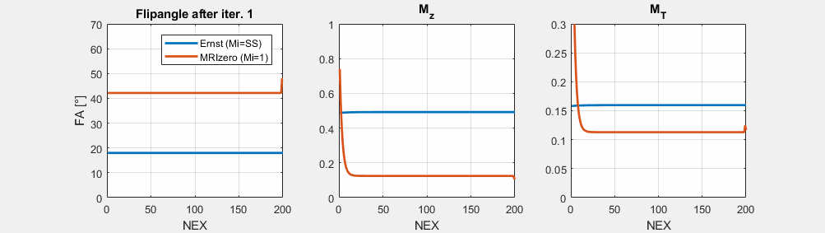
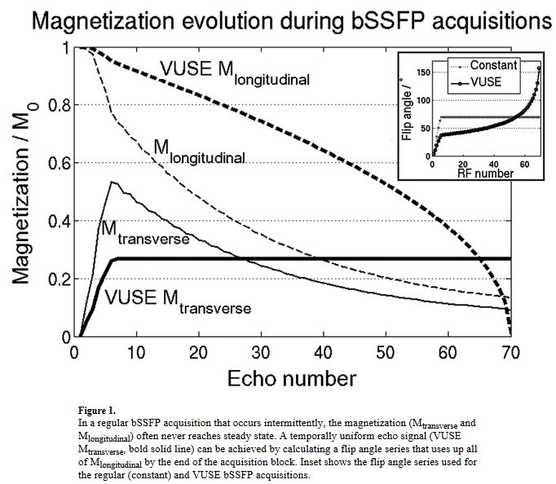
RESULTS 2 : Variable flip angles (FID) animated

Slide 13
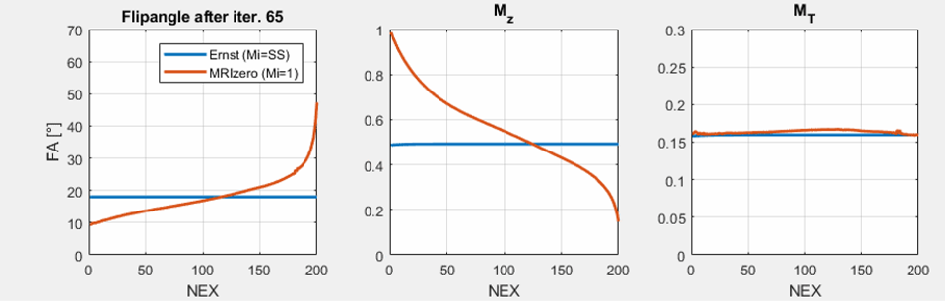
RESULTS 2 : Variable flip angles (FID)

