Slide 1
de
MRIzero
Hi all,
what if MRI sequence programming is just a game that we can win like winning Go using reinforced learning?
The rules are the Bloch equations.
The sequence is our strategy.
The k-space is our feature extraction
And the difference to the correct image is the cost function.
If you want to participate in this complete side project, come for a quick discussion round on Tuesday Jan, 16th 3 pm in the MRZ seminar room.
It would be great to have all your expertise united to think about this a little further.
If you think more people would be interested, let me know.
Best,
Moritz
9.1.2018

Slide 2
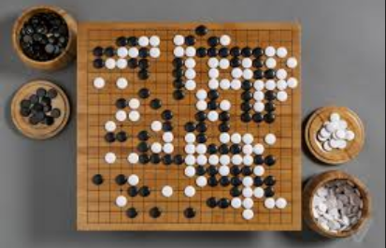
AlphaGo
AlphaGo is a computer program that plays the board game Go. It was developed by Alphabet Inc.'s Google DeepMind in London.
AlphaGo uses a Monte Carlo tree search algorithm to find its moves based on knowledge previously "learned" by machine learning, specifically by an artificial neural network (a deep learning method) by extensive training, both from human and computer play.
In October 2015, AlphaGo became the first computer Go program to beat a human professional Go player without handicaps on a full-sized 19×19 board.[2][3] In March 2016, it beat Lee Sedol in a five-game match, the first time a computer Go program has beaten a 9-dan professional without handicaps.
https://en.wikipedia.org/wiki/AlphaGo

Slide 3
Alpha Go Zero
AlphaGo was initially trained to mimic human play by attempting to match the moves of expert players from recorded historical games, using a database of around 30 million moves.^{[18]} Once it had reached a certain degree of proficiency, it was trained further by being set to play large numbers of games against other instances of itself, using reinforcement learning to improve its play.^{[2]}
AlphaGo Zero is a version created without using data from human games, and stronger than any previous version. By playing games against itself, AlphaGo Zero surpassed the strength of AlphaGo Lee in three days by winning 100 games to 0, reached the level of AlphaGo Master in 21 days, and exceeded all the old versions in 40 days.^{[2]}
Nature on 19 October 2017
https://en.wikipedia.org/wiki/AlphaGo

Slide 4


Slide 5
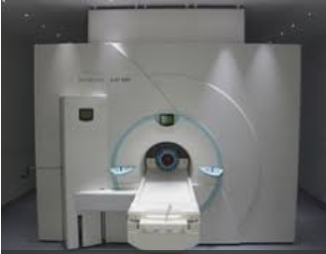
MRI and GO
Rules
Strategies
Win
Competition/Game between player
Bloch-equations
Sequences
Win: best and fastest image
Competition / Game between research groups
MRIzero: leave away human ideas and get 100 times better?

Slide 6
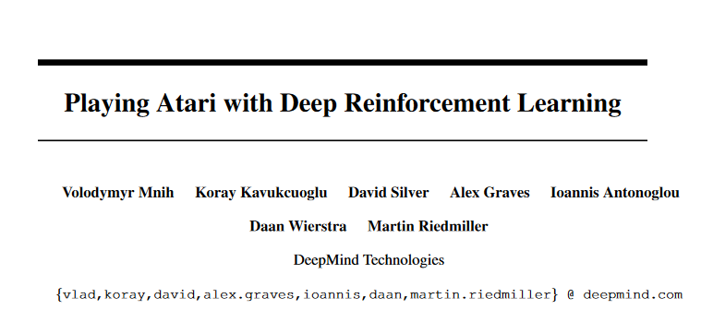
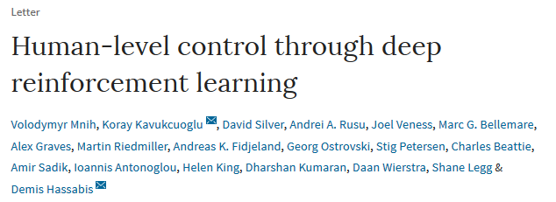
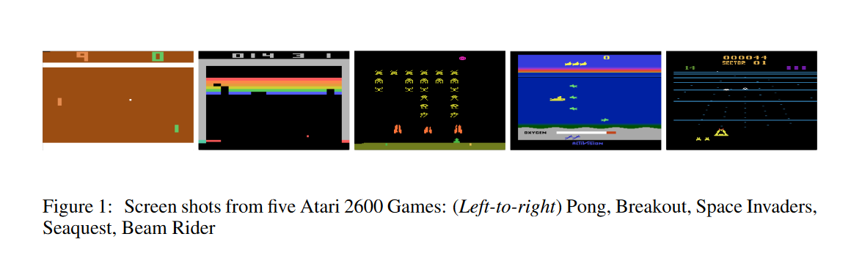
Atari games: no “enemy”
Nature 518, 529–533 (26 February 2015) doi:10.1038/nature14236

Slide 7
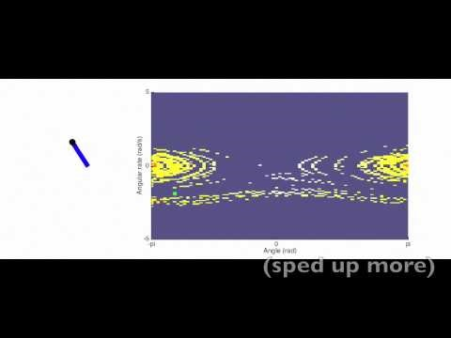
Reinforced learning inverse Pendulum
States (angle α and angle velocity ω)
Actions (torque left, or torque right)
Q-learning: find for each state a optimal action to increase reward
Reward – least squares difference: 1- [ (α - α₀)²+(ω- ω₀) ²]

Slide 8
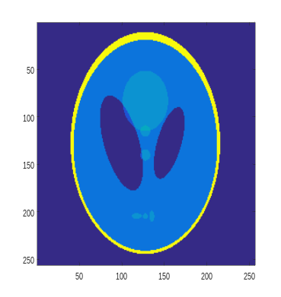

Reinforced learning MRI
States (k-space?, current image?, last ADC?)
Actions (gradients, RF, ADCs)
Reward – least squares difference: 1- [ (Img - Img₀)²+(t_{acq}) ²]
Wanted state
Intermediate states

Slide 9
Idea
Inputs / Actions
RF vector
ADC vector
3 Gradient vector
Output / State
Signals in k-space
Regrid to 6/8 carthesian k-space + grappa acceleration 4
FT->image
Target / State
2D model in silico

Slide 10
What we need / what we have
Inputs / Actions
RF vector
ADC vector
3 Gradient vector
Output / State
Regridding+ Grappa reco algorithms
Target / State
2D Bloch-simulation
In silico
Deep learning / Reinforcement learning formulation

Slide 11

NEXT step
Can we distribute some requirements we need? Building interfaces?
Bloch-Simulation? Input/Output
Reconstruction Input/Output
Q-learning? Input/Output
( )

Slide 12
Remarks
MRI rarely uses already acquired data. In reinforced learning this is actually need: best next acquisition step according to already acquired data?
Shall we use Cartesian reco or leave it completely free using deeplearning?

Slide 13
Vector RF, amp and phase
Vector Gx, Gy
ADC
1s, 1 ms , 10x10 pixels
Methods:
Optimal control papers (moritz)

