Slide 1
Mentorness Project 1
Salary Predictions

Slide 2
Outline
Context
Dataset
Data Preparation
Exploratory Data Analysis
Machine Learning Model Development
Machine Learning Model Deployment
Conclusions

Slide 3
Context
A dataset is given, containing general information about data professionals who work at a company (e.g. first name, last name, age, salary, etc…).
PROBLEM: How can the dataset be used to predict the salaries of data professionals?

Slide 4
Dataset
File name: salaries.csv
Columns:
COLUMN NAME | DATA TYPE | SIGNIFICATION
FIRST NAME | string | Employee’s first name
LAST NAME | string | Employee’s last name
SEX | string | Employee’s gender
DOJ | date | Employee’s start date
CURRENT DATE | date | Data’s current date
DESIGNATION | string | Employee’s job role
AGE | integer | Employee’s age
SALARY | float | Employee’s salary
UNIT | string | Employee’s department
LEAVES USED | integer | Number of leaves used
LEAVES REMAINING | integer | Number of leaves remaining
RATINGS | float | Employee’s performance rating
PAST EXP | integer | Employee’s number of years of past experience

Slide 5
Exploratory Data Analysis
Preparation: The dataset was cleaned – its columns were converted to the right data types and missing values were removed.
Key findings:
The employees’ salaries varied greatly against their number of years of past experience and designation.
Many pairs of features were highly correlated (e.g. age and years of past experience), hence seemed redundant when predicting salary.
Several features had no obvious relationship with salary (e.g. gender).

Slide 6
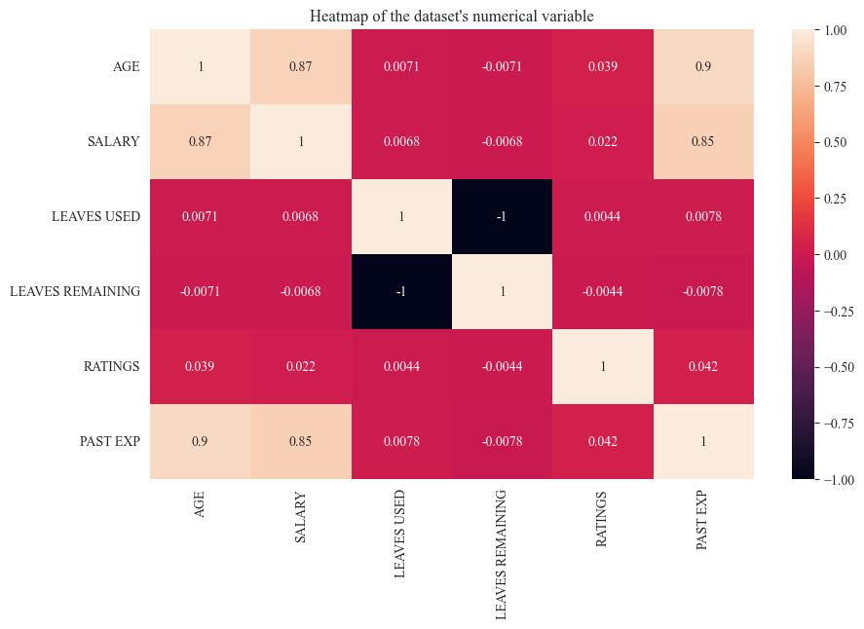
Exploratory Data Analysis

Slide 7
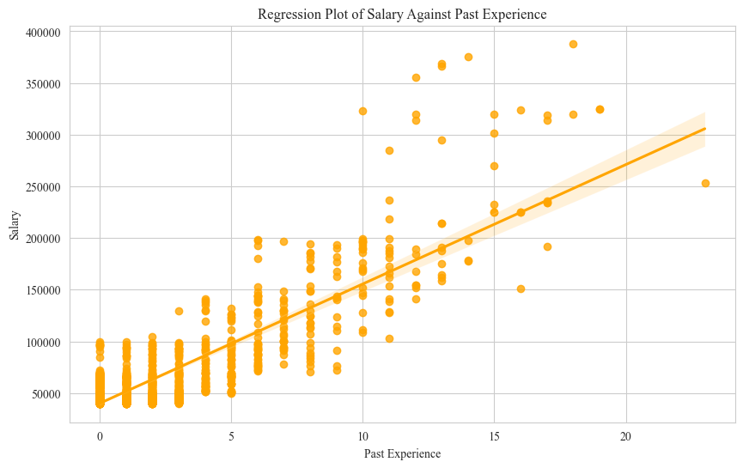
Exploratory Data Analysis

Slide 8
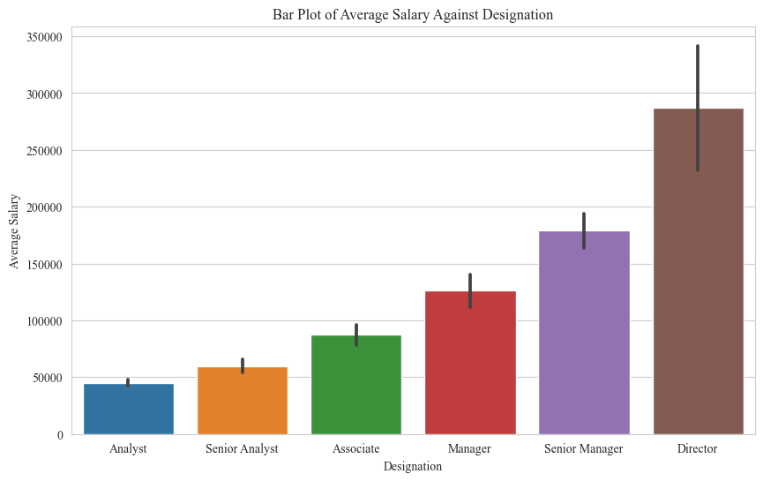
Exploratory Data Analysis

Slide 9
Machine Learning Model Development
Steps:
Model Selection: Select three linear regression models: Ordinary Least Squares Linear Regression, Ridge Regression and Lasso Regression.
Feature Selection: The “DESIGNATION” and “PAST EXP” columns of the dataset have been selected as predictor variables, and the “SALARY” column has been selected as the target variable.
Feature Transformation: Transform the “DESIGNATION” column using one-hot encoding and transform the “PAST EXP” and “SALARY” columns using standard scaling.
Train-Test Splitting: Split the dataset into a training set and a testing set with an 80-20 distribution.
Hyperparameter Tuning: Apply 10-fold cross-validation on the dataset for each of the three models.
Model Evaluation: Select the best performing model (in this case, the one with the lowest root-mean square error).

Slide 10
Machine Learning Model Development
Result: The Lasso regression model, with parameters alpha = 0 and max_iter = 5, was found to be the best performing model with a root mean square error of roughly 0.185354.

Slide 11
Machine Learning Model Deployment
Open the app.py file, located in the pipeline folder above this directory.
Run the app.py file.
The terminal will then run the app.py file and display a hyperlink. Click on that hyperlink, and;
Read the instructions written on the newly-opened webpage and follow them accordingly.
The end result will be the prediction of the machine learning model from the user’s inputs.

Slide 12
Conclusion
The salaries of data professionals seem to be accurately predicted by two variables:
Their job roles (e.g. analyst, senior analyst, associate, manager, senior manager, director), and;
Their numbers of years of past experience.

