Slide 1
Mentorness Project 2
FasTag Fraud Detection

Slide 2
Outline
Context
Dataset
Exploratory Data Analysis
Machine Learning Model Development
Machine Learning Model Deployment
Conclusions

Slide 3
Context
A dataset is given, containing general information FasTag Transactions (e.g. transaction amount, amount paid, location, etc…).
PROBLEM: How can the dataset be used to predict whether or not a given FasTag transaction is fraudulent?

Slide 4
Dataset
File name: fastag.csv
Columns:
COLUMN NAME | DATA TYPE | SIGNIFICATION
TRANSACTION ID | integer | Unique transaction identifier
TIMESTAMP | datetime | Transaction date and time
VEHICLE TYPE | string | Type of vehicle (e.g., bus, car, etc…)
FASTAG ID | string | Unique FasTag identifier
TOLL BOOTH ID | string | Unique toll booth identifier
LANE TYPE | string | Type of lane (e.g. regular, express)
VEHICLE DIMENSIONS | string | Size of vehicle (e.g., small, medium, large)
TRANSACTION AMOUNT | float | Transaction cost
AMOUNT PAID | float | Amount paid by customer
GEOGRAPHICAL LOCATION | string | Geographical coordinates of the transaction
VEHICLE SPEED | float | Recorded speed of the vehicle during the transaction
VEHICLE PLATE NUMBER | string | Vehicle license plate number
FRAUD INDICATOR | boolean | Indicates whether or not the transaction is fraudulent

Slide 5
Exploratory Data Analysis
Preparation: The dataset was cleaned – its columns were converted to the right data types and a column with missing values was removed.
Key findings:
The amount paid by a customer did not always equal the transaction cost, indicating possible underpayment.
The quarter of the year in which the transaction took place seems to bear some relation with whether or not a transaction is fraudulent.
There seems to be a small, but non-negligible relationship between the vehicle speed and whether or not a transaction is fraudulent.

Slide 6
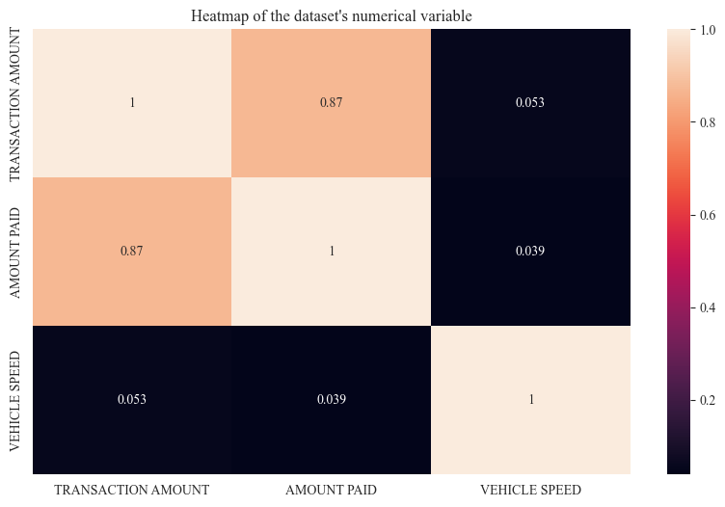
Exploratory Data Analysis

Slide 7
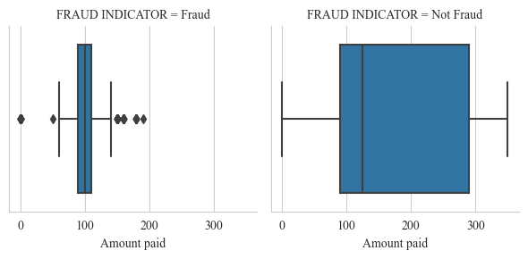
Exploratory Data Analysis

Slide 8
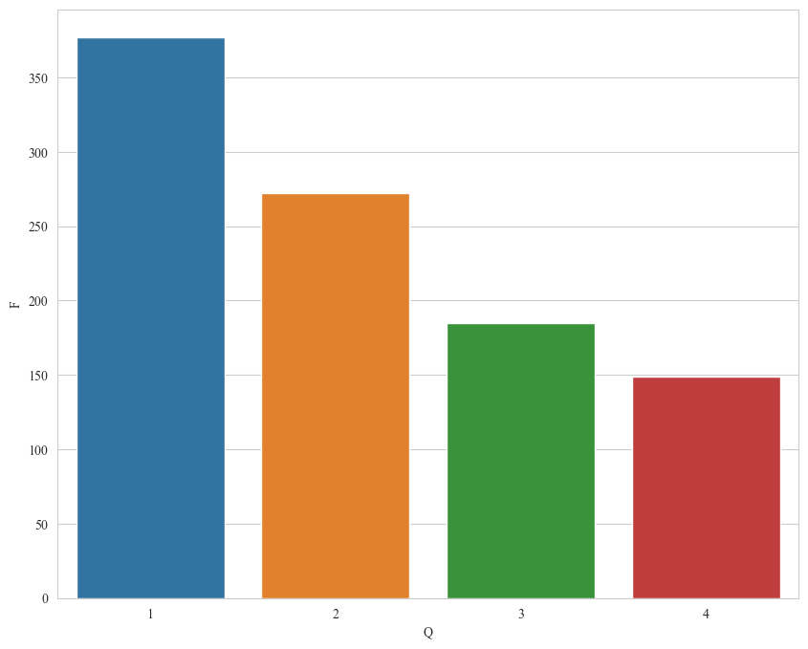
Exploratory Data Analysis

Slide 9
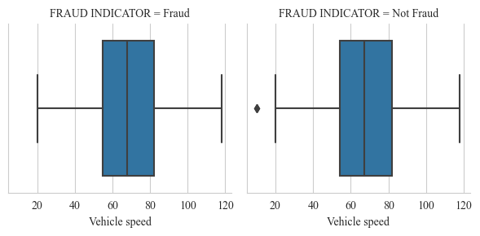
Exploratory Data Analysis

Slide 10
Machine Learning Model Development
Steps:
Model Selection: A hard voting classifier between three binary classification models: a logistic regression, a random forest classifier and a support vector machine.
Feature Creation: Two columns, “UNDERPAID TRANSACTION” (e.g. whether or not a transaction is underpaid) and “QUARTER” (e.g. the quarter of the year in which the transaction took place), are created.
Feature Selection: The “TRANSACTION ID”, “TIMESTAMP”, “TRANSACTION AMOUNT”, “AMOUNT PAID”, “GEOGRAPHICAL LOCATION” and “VEHICLE PLATE NUMBER” columns are removed, as are deemed weak predictors of the “FRAUD INDICATOR” column.
Feature Transformation: Of all remaining features, the categorical variables are transformed via one-hot encoding and the numerical variable (“VEHICLE SPEED”) is transformed via standard scaling. The target variable (“FRAUD INDICATOR”) is converted to integer type (e.g. 1 for “Fraud” and 0 for “Not Fraud”)
Train-Test Splitting: Split the dataset into a training set and a testing set with an 80-20 distribution.
Hyperparameter Tuning: Apply 5-fold grid search cross-validation on the dataset for each of the three models.
Model Evaluation: Select the best parameters for each model (e.g. those yielding the highest accuracy score), incorporate the resulting three models in the voting classifier and compute the accuracy score, the precision score, the recall score and the F1-score.

Slide 11
Machine Learning Model Development
Result: The best performing model is a voting classifier with the following parameters for each of the incorporated models:
Logistic Regression: C = 0.1, max_iter = 5, tol = 0.001
Random Forest Classifier: max_depth = 3, max_features = “log2”, min_samples_leaf = 10, min_samples_split = 10, n_estimators = 100
Support Vector Machine: C = 0.1, max_iter = 100, tol = 0.001
Scores:
Accuracy Score: 0.993
Precision Score: 0.968
Recall Score: 1.000
F1-Score: 0.984

Slide 12
Conclusion
Whether or not a FasTag transaction is fraudulent can be accurately predicted be the following variables:
Whether or not the transaction has been underpaid;
The vehicle’s type, speed and dimension;
The toll booth in which the transaction took place, and;
The quarter of the year in which the transaction took place.

