Slide 1
Product Sales Report
Zakaria Zerrouki

Slide 2
Contents
Introduction
The Business Problem
Metric of Interest
Work Undertaken
Findings
Conclusions and Recommendations

Slide 3
Introduction
Company: Pens and Printers (est. 1984)
Product: New line of office stationery
Sales Methods for Each Customer:
1) “Call”:
~30-minute phone call
2) “Email + Call”:
Sending an email, followed by a ~10-minute phone call
3) “Email”:
Sending an email only

Slide 4
The Business Problem
How should the sales team go about promoting the new product?

Slide 5
Metric of Interest
Business Goals: Generate as much revenue as possible, for as little effort as necessary
Metric chosen: Revenue’s distribution and evolution over time, split by sales method
Justification: Different methods generate different amounts of revenue and take different amounts of effort on the team’s part

Slide 6
Work Undertaken
Dataset: “product_sales.csv” (CSV file)
Steps:
1) Data Validation / Cleaning
2) Exploratory Data Analysis
3) Interpretation

Slide 7
Findings
Number of customers by method:
“Call”: 4962
“Email”: 7466
“Call + Email”: 2572
Revenue distribution: Heavily influenced by sales method
Most profitable method: “Call + Email”
Least profitable method: “Call”

Slide 8
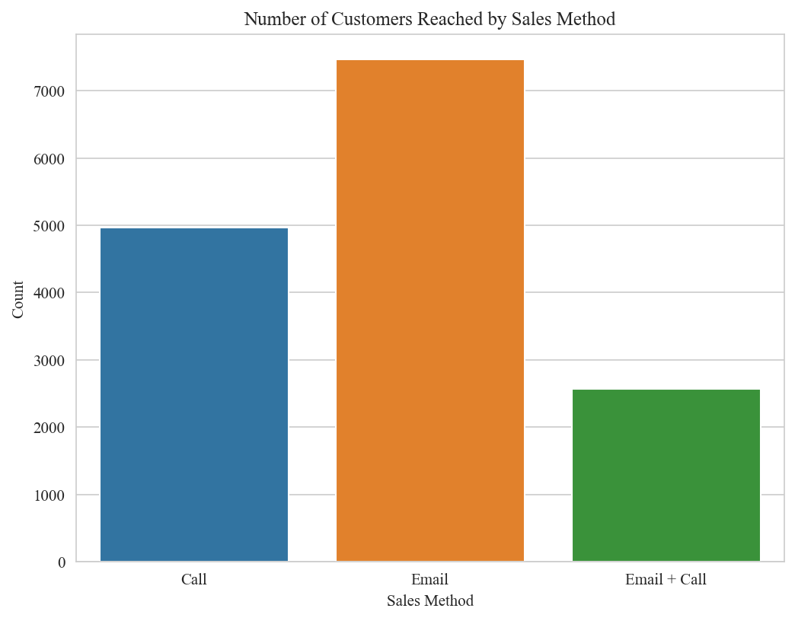
Finding 1

Slide 9
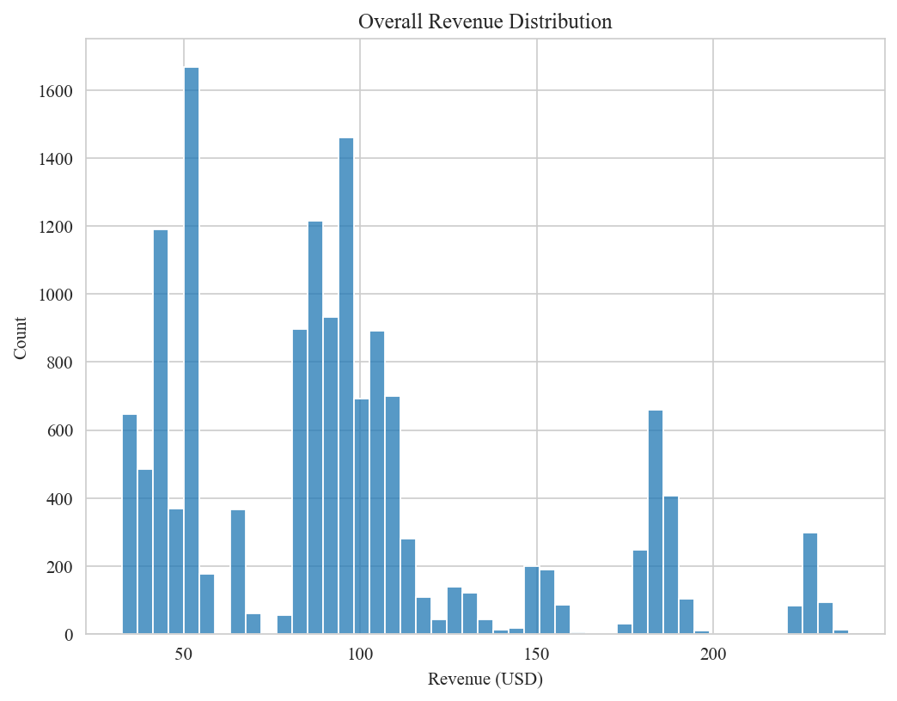
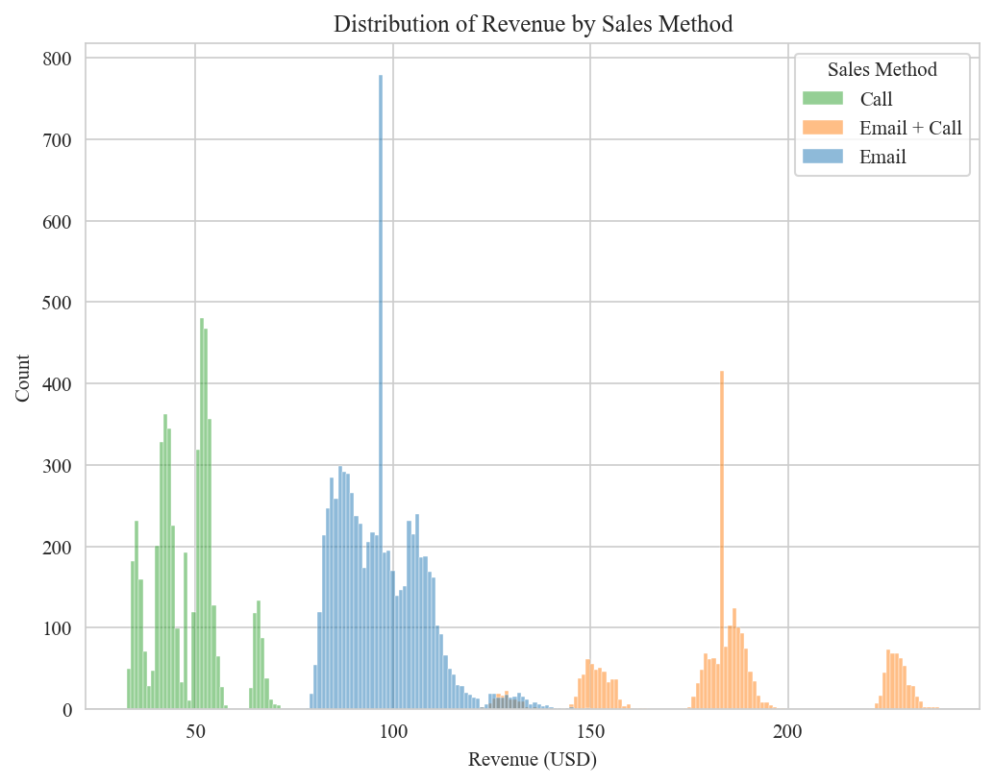
Finding 2

Slide 10
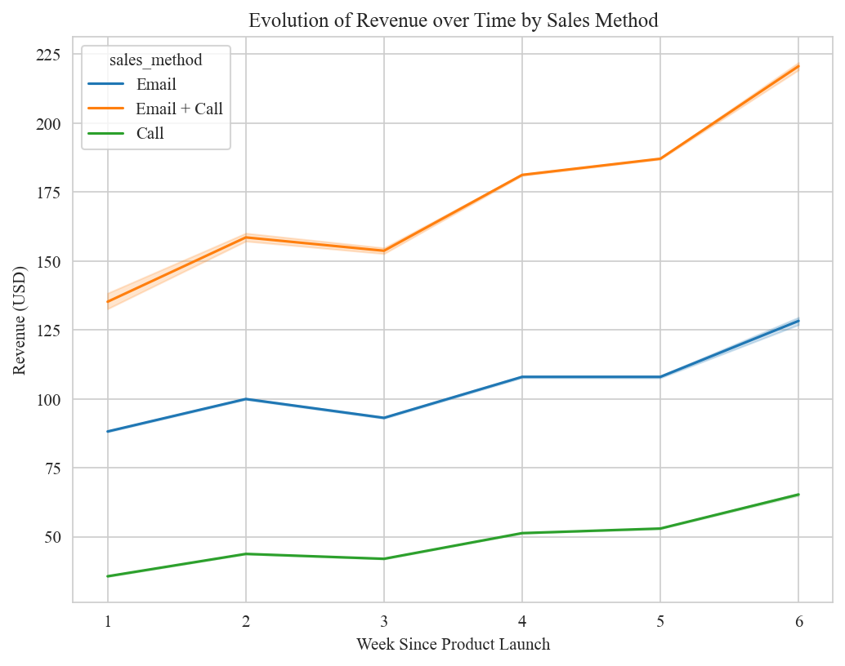
Findings 3 and 4

Slide 11
Conclusions and Recommendations
Recommendations:
1) Completely abandon the “Call” method.
2) Replace it with the “Call + Email” method.
3) Consider doing the same for the “Email” method.
Benefits:
1) Increase time saved.
2) Decrease workload.
3) Increase revenue.

