Slide 1

Python :
An Easy to Learn Programming Language
Instructors:
Marzia Zaman Andrew Foster

Slide 2
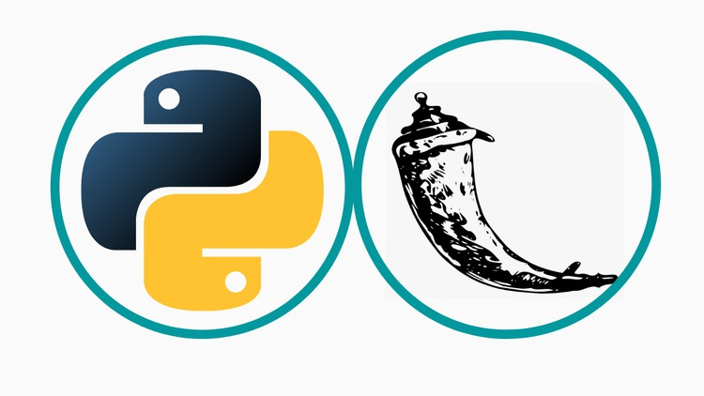
What is coding or programming?
Coding, or programming, is the process of writing instructions (code) in a programming language to create software, applications, scripts, or other computational artifacts. Programmers use coding to design algorithms, manipulate data, control hardware devices, or build user interfaces, among other tasks.

Slide 3
Why do we do conding?
We code to tell computers what to do. Computers are incredibly powerful machines, but they need instructions to perform tasks. These instructions are written in programming languages, which are like special languages that both humans and computers can understand.
When we write code, we're essentially giving the computer a set of step-by-step instructions to follow. These instructions can be as simple as telling the computer to add two numbers together or as complex as creating an entire website or video game.

Slide 4
Programming Basics
Variables
Data Types
Functions
Logic Building
Looping (repetitive)
Decision making
Software Structure
Functions/Methods
File/Class
Debugging and Testing
Fixing and finding issues

Slide 5
Programming/Python Basics
Variables: Used to store information
Data Types: Way to store information
Loop Construct: for
Decision Construct: if elif else
Structure: function (e.g. def xyz:)

Slide 6
Python Data Types
Integer
Float
String
Boolean
Array/List
Dictionary
Set

Slide 7
Let’s Think and Answer 1
Write a program to multiply every 2 subsequent digits upto 10 starting from 1
i.e 1x2, 2x3, 3x4 and so on upto 9x10 and print them
print(1x2, 2x3, 3x4,…)
Now let’s say I have to do it upto 100 or 1000.
What construct we are likely to use?
We need a loop construct called for

Slide 8
Let’s Think and Answer 2
Write a program to multiply every 2 subsequent digits upto 10 starting from
i.e 1x2, 2x3, 3x4 and so on upto 9x10 and print them
Skip the ones if one of the number is a multiple of 10
print(1x2, 2x3, 3x4,…)
Now let’s say I have to do it upto 100 or 1000.
What constructs are we likely to use?
We need a loop construct called for

Slide 9
Let’s Think and Answer 3
Write a program to get user’s favorite color and print the word “Yellow” if user’s color is“Yellow”, otherwise print “Not Yellow”
What constructs are we likely to use?
v = input(“Please input your favourite color:”)
If (v==“Yellow”):
print((“Yellow”)
else:
print(“Not Yellow”)

Slide 10
Setting up Integrated Development Environment (SDE)
What is IDE?
An Integrated Development Environment (IDE) is a software application that provides comprehensive facilities to programmers for software development.
Essentially, an IDE is a software suite that combines several tools into a single integrated environment, streamlining the process of writing, debugging, and deploying software.
Download Anaconda
https://www.anaconda.com/download/

