Slide 1
BSCS 506-Modeling and Simulation (2+1)
Course Instructor: Humera Azam
Averill M. Law, Simulation Modeling & Analysis, Chapter 1

Slide 3
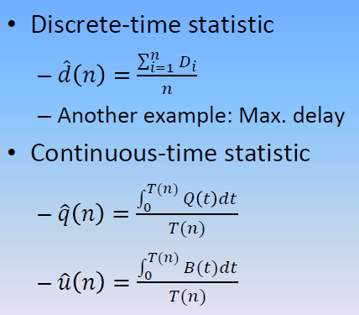
Recap of Performance Measure

Slide 4
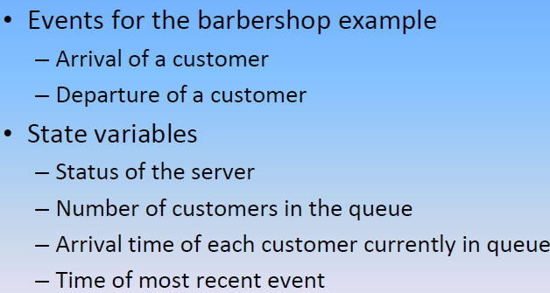
EVENT AND STATE Variables

Slide 5
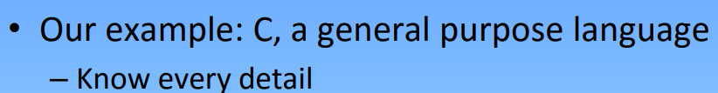
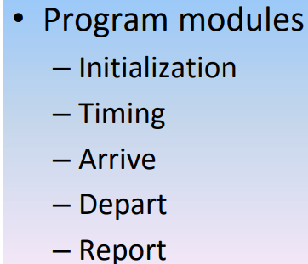
Writing a simulation program

Slide 6
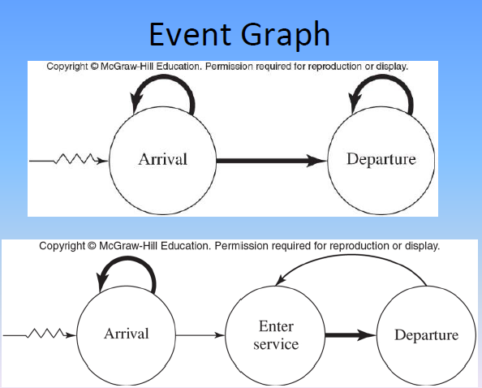
Event –Graph Method

Slide 7
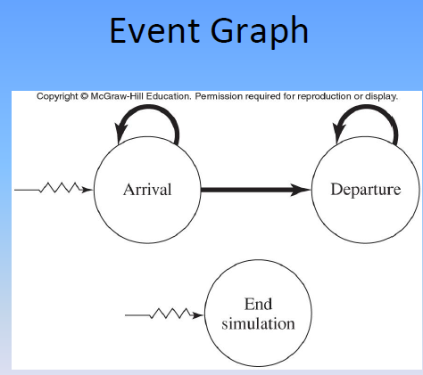

Slide 8

Simulation of a Single Server-QS model
Will be study in following two different respect:
The simulation will end when n=1000 delays in Queue have been completed.
The inter arrival and service times will now be modeled as independent random variables from exponential distributions with mean 1 minute for the interarrival time and mean=0.5 minute for service time.
P.d.f of exp dist:

Slide 9
The single server queue with exponential interarrival and service times is commonly called M/M/1 queue.

Slide 10
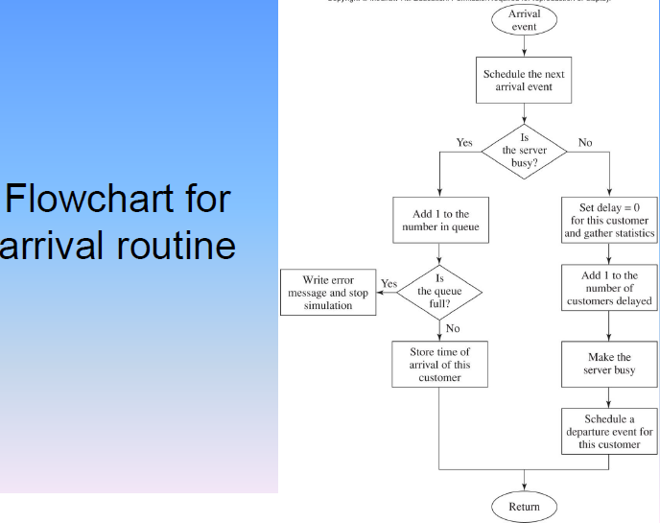

Slide 11
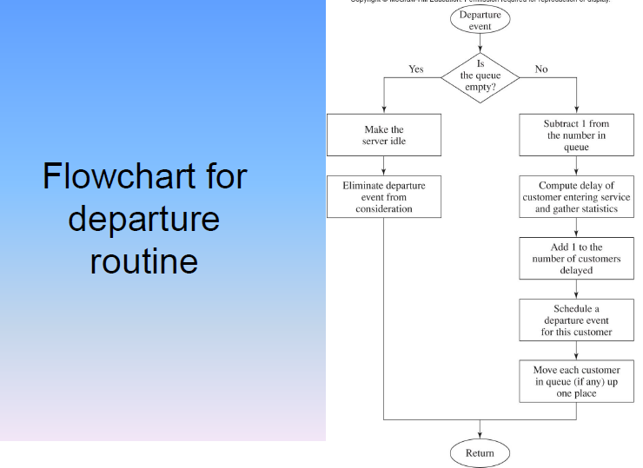

Slide 12
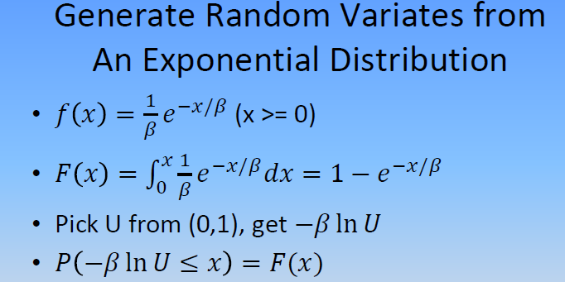

Slide 13
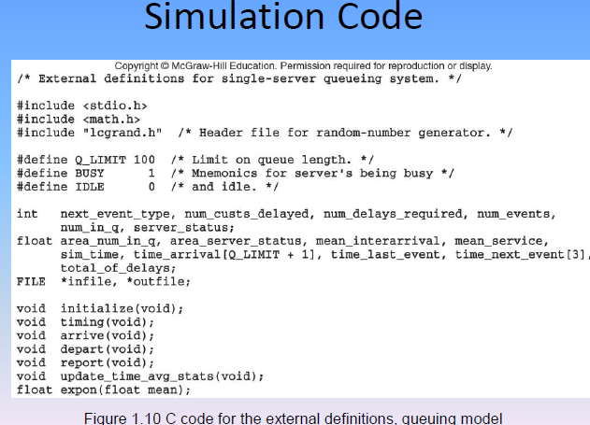

Slide 14
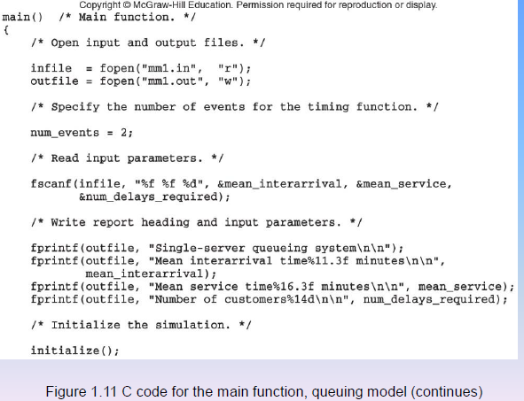

Slide 15
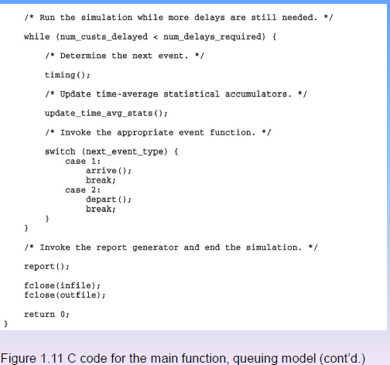

Slide 16
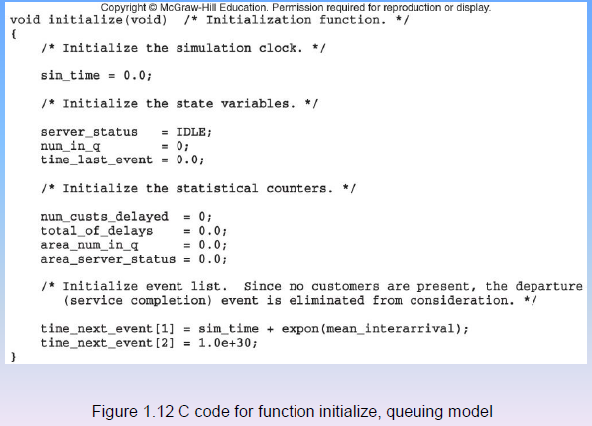

Slide 17
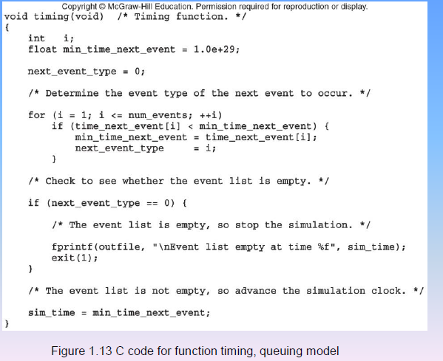

Slide 18
Simulation Output Discussion

