Slide 1
BSCS 506-Modeling and Simulation (2+1)
Course Instructor: Humera Azam
Averill M. Law, Simulation Modeling & Analysis, Chapter 1

Slide 2
What Is A Model ?
A Representation of an object , a system, or an idea in some form other than that of the entity itself.
(Shannon)
Or
A model is a static representation of the system
Models can have many forms i.e. mathematical equations, Graphical representation (diagrams), physical representaions, etc.

Slide 3
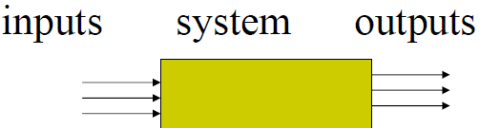
Systems
A system is any set of interrelated components / entities e.g. people or machines that acting / interacting together to achieve a common objective i.e. object of Interest.
Systems is of different types as Systems vary in size, nature, function and complexity.
Boundaries of the system is determined by the scope of the study
Common techniques can be used to treat them.

Slide 4
Discrete vs. Continuous System
Systems can be discrete, where the state variables change “instantaneously” at separate points in time (think the number of customers in a bank),
or continuous, where the state variables can change continuously in regards to time (think an airplane flying through the air, with velocity, altitude, etc variables).

Slide 5
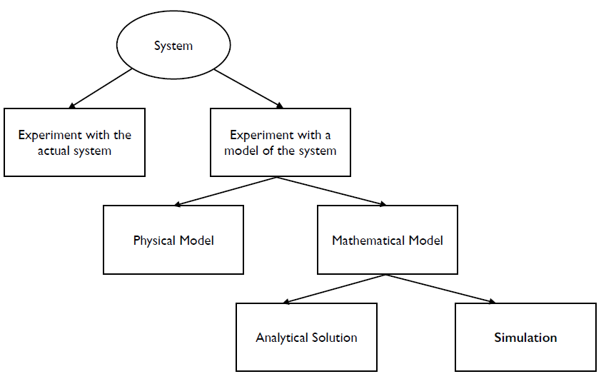
Ways in which System can be studied

Slide 6
Actual Systems vs. Models
In some cases, the actual system can be modified and examined, so this case (so long as the costs and doing so is feasible) is usually ideal, as the actual system can be measured so you know the results are valid.
However, these cases are rare, typically due to the costs involved or that it would be too disruptive to the system to actually perform the modifications. Sometimes the system might not even physically exist (or at least the parts we want to better understand). In these cases a model of the system needs to be build to do the analysis.

Slide 7
Physical(iconic) vs. Mathematical Models
It is often possible to make miniature (or even to scale) physical models of a system, which is common in engineering fields. Think about putting airplane wings in a wind tunnel, etc. For some systems, there may not be accurate enough mathematical models so a physical simulation may be required.
However, most models are mathematical, as having an abstract model tends to be easier to modify and to more easily test different variations.

Slide 8
Analytical Solution vs. Simulation
Some mathematical models are simple enough to obtain exact answers. Suppose our system involves a satellite traveling through deep space (simplifying things). We can determine the distance of the satellite by the function:
d = rt
where d is the distance, r is the rate of travel (velocity), and t is the time spent traveling.
However, this is rarely the case, for example, what if the satellite is traveling within our solar system. It’s velocity (and acceleration) will be altered by all other astronomical bodies due to their gravity, and all those other bodies are also moving. This makes it quite difficult to analytically solve the distance/where the satellite will be (although this is exactly what early “human” computers at NASA would do 1,2).
1. “Human computers.” http://crgis.ndc.nasa.gov/historic/Human_Computers
2. “She was a computer when computers wore skirts”. http://www.nasa.gov/centers/langley/news/researchernews/rn_kjohnson.html

Slide 9
What is Simulation?
A simulation is the imitation of the operation of real-world process or system over time. … Generation of artificial history and observation of that observation history.
OR
A simulation uses Computer to Evaluate a mathematical model over time numerically by gathering data.

Slide 10
Simulation Models
We have a mathematical model to be studied by means of simulation referred to as a simulation model.

Slide 11
APPLICATIONS
Examples
  Manufacturing facility
  Bank operation
  Airport operations (passengers, security, planes, crews, baggage)
  Transportation/logistics/distribution operation
  Hospital facilities (emergency room, operating room, admissions)
  Computer network
  Freeway system
  Business process (insurance office)
  Criminal justice system
  Chemical plant
  Fast-food restaurant
  Supermarket
  Theme park
  Emergency-response system

Slide 12
CLASSIFICATION OF SIMULATION MODELS
Static vs. Dynamic Simulation Models:
Static simulation models are representations of a system time, or representations where time plays no role (e.g., some types of Monte Carlo simulation).
Dynamic simulation models represent systems as they evolve or change over time (e.g., our previous satellite example, a conveyor sat a particular ystem in a factory, a packet network simulation, etc.).
Estimation of π
Risk Analysis in Business
Water Level in a Dam

Slide 13
Deterministic vs. Stochastic Simulation Models
A deterministic simulation model does not contain any probabilistic (random) components. In this type of a simulation, if you start it with the same set of initial
conditions and parameters, the end result will always be the same.
A stochastic simulation model (also called a random simulation model or nondeterministic simulation model) does contain probabilistic or random components. In these simulations, even if you start with the same set of initial conditions and parameters there is no guarantee that the end result will always be the same.
Example: Bank with customers and tellers
As the output of a stochastic simulation model is also random, it can only be treated as an estimate of the system; and in many cases this means that many simulations must be run to get an appropriate estimate of what can happen in the system (this also happens to be one of the major drawbacks in simulation).

Slide 14
Continuous vs. Discrete Simulation
Models
Similar to systems, simulation models can be continuous or discrete.
It is possible to have some components in a simulation be continuous while others
are discrete, so mixed simulation models are also possible.
For example with a traffic flow simulation, it is possible to model traffic as individual cars with their own characteristics and movement. It may also be possible (given the scale and amount of data) to model the cars in aggregate as flows, in a continuous manner.
In hydrodynamics simulations this is also common, it is possible to model these systems with individual particles (as in smoothed particle hydrodynamics and lattice Boltzmann simulations); or as flows (in computational fluid dynamics simulations which are based on calculating differential equations).

Slide 15
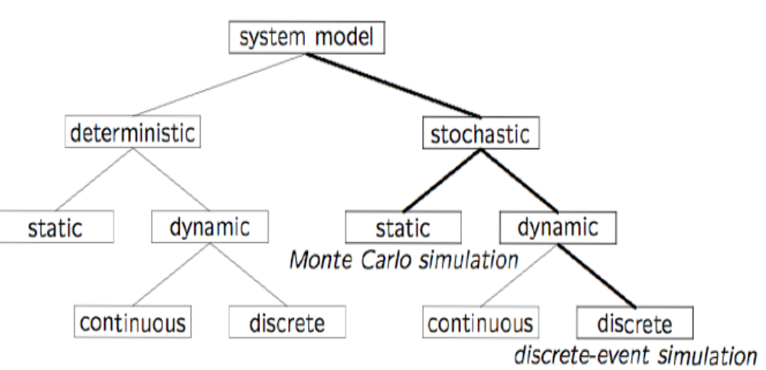
Model Taxonomy

Slide 16
Discrete Event Simulation:
Stochastic: some state variables are random
Dynamic: time evolution is important
Discrete-Event: significant changes occur at discrete time instances

