Slide 1
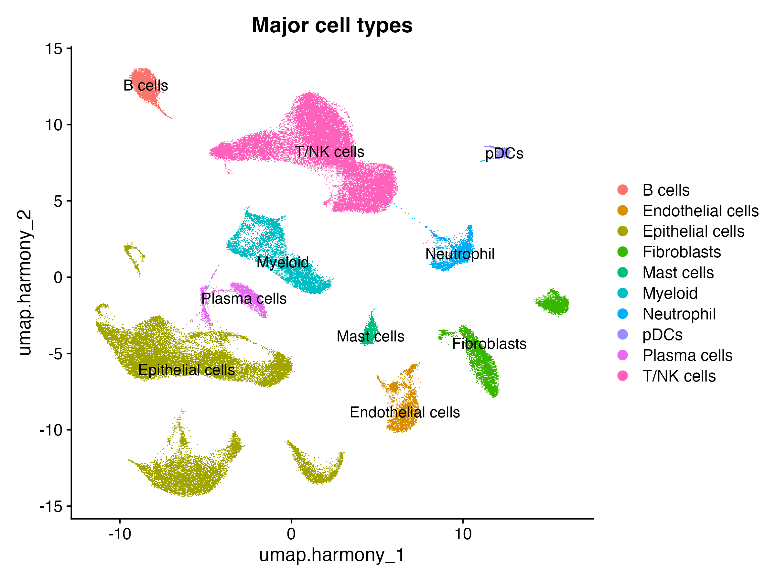
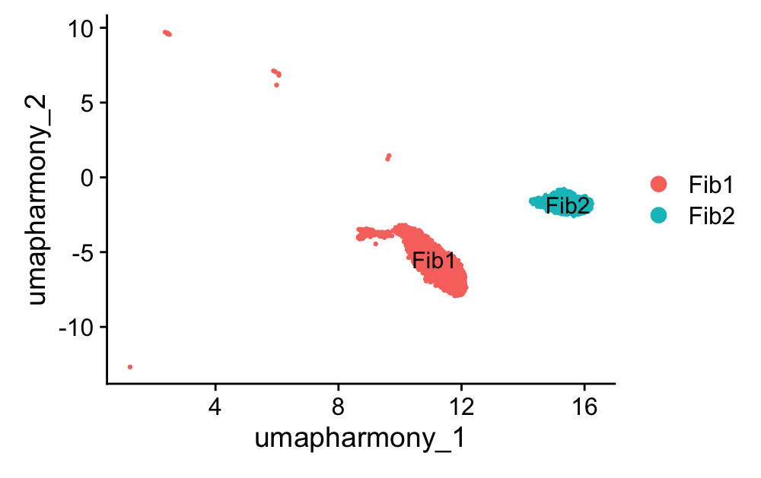

UMAP Showed Two Distinct Islands in Fibroblast Cells

Slide 2
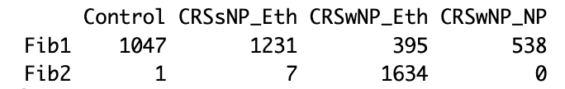
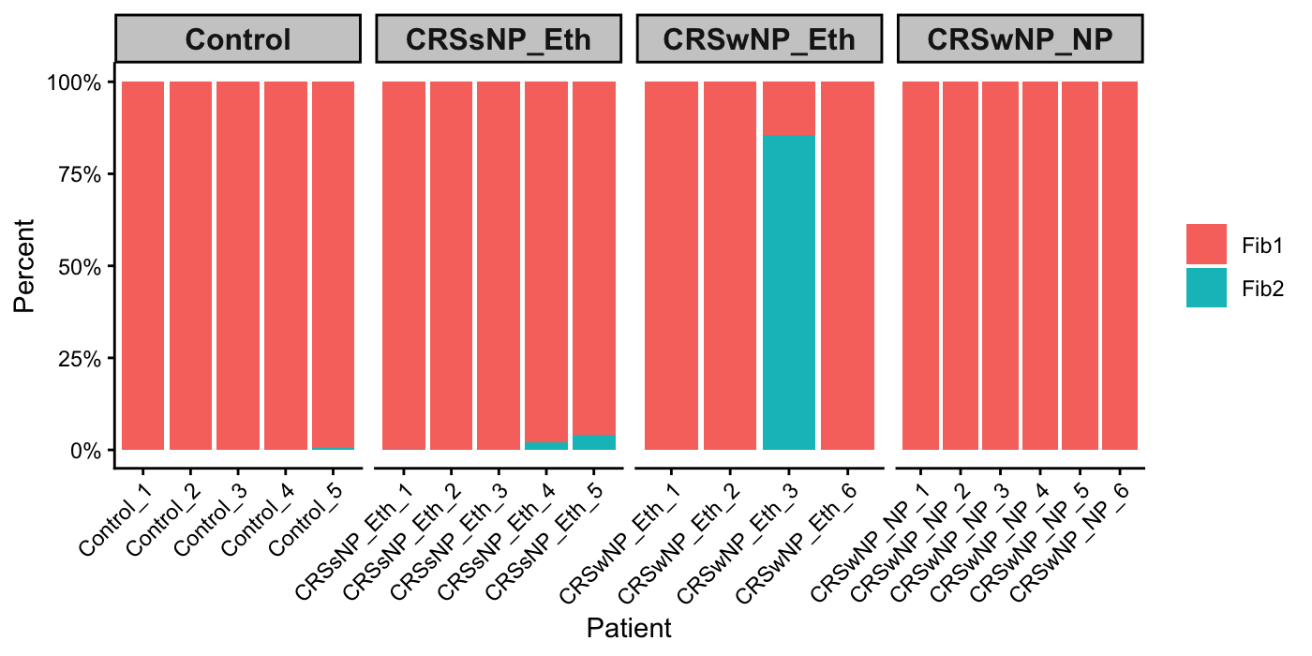
Fib2 is Predominantly Derived from a Single Sample (CRSwNP_Eth_3)

Slide 3
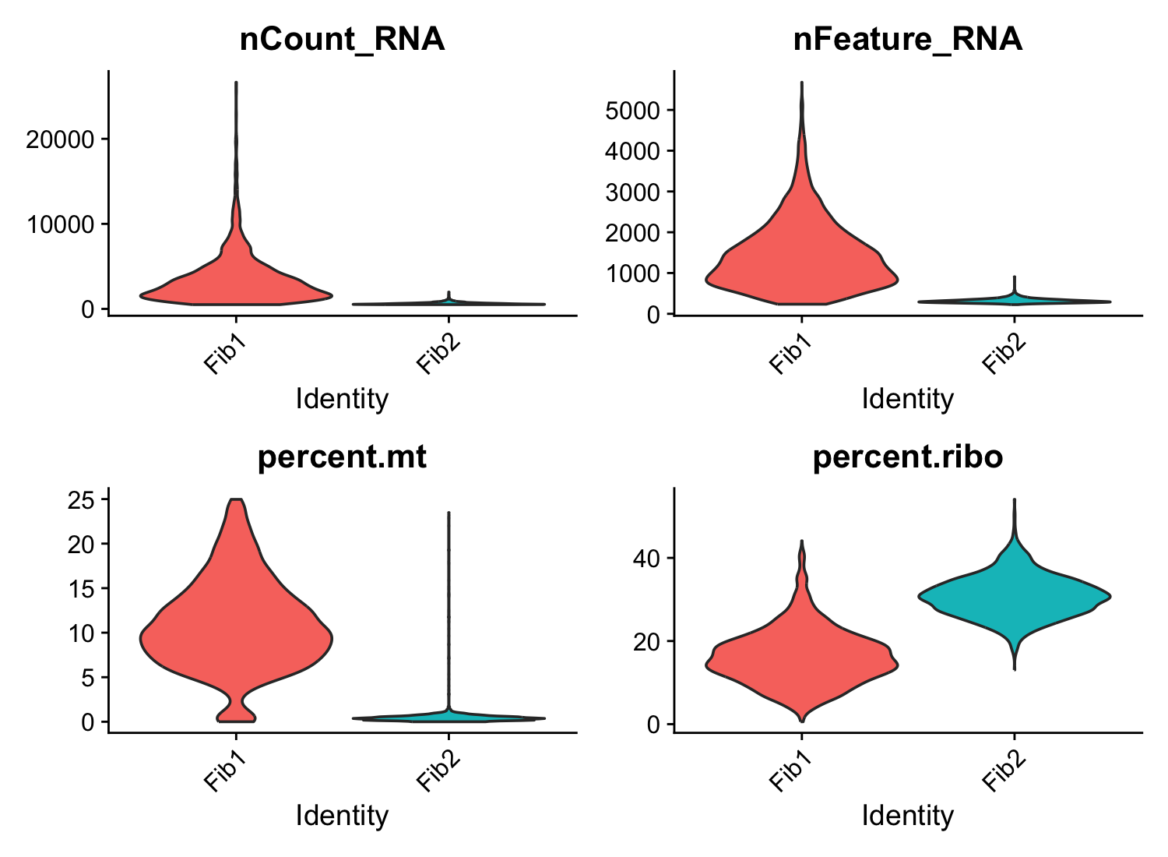
Fib2 is Characterized by Reduced Transcriptomic Complexity and Elevated Ribosomal Expression

Slide 4
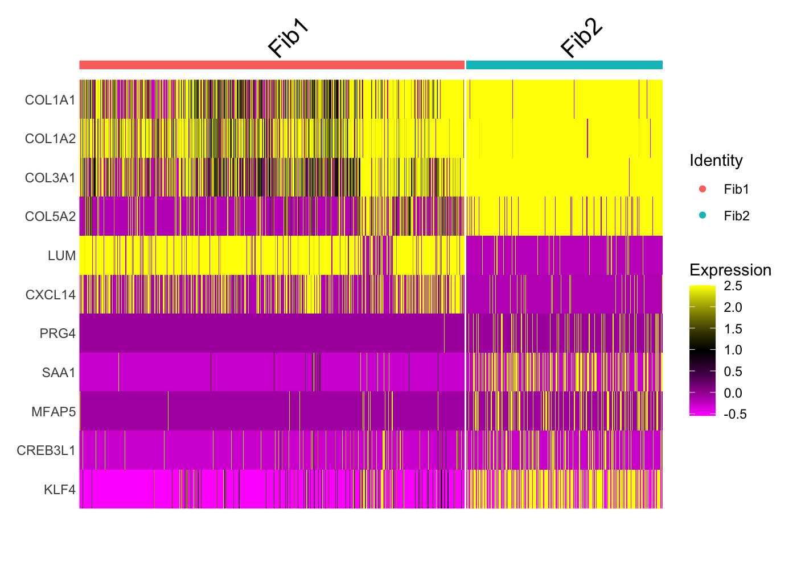
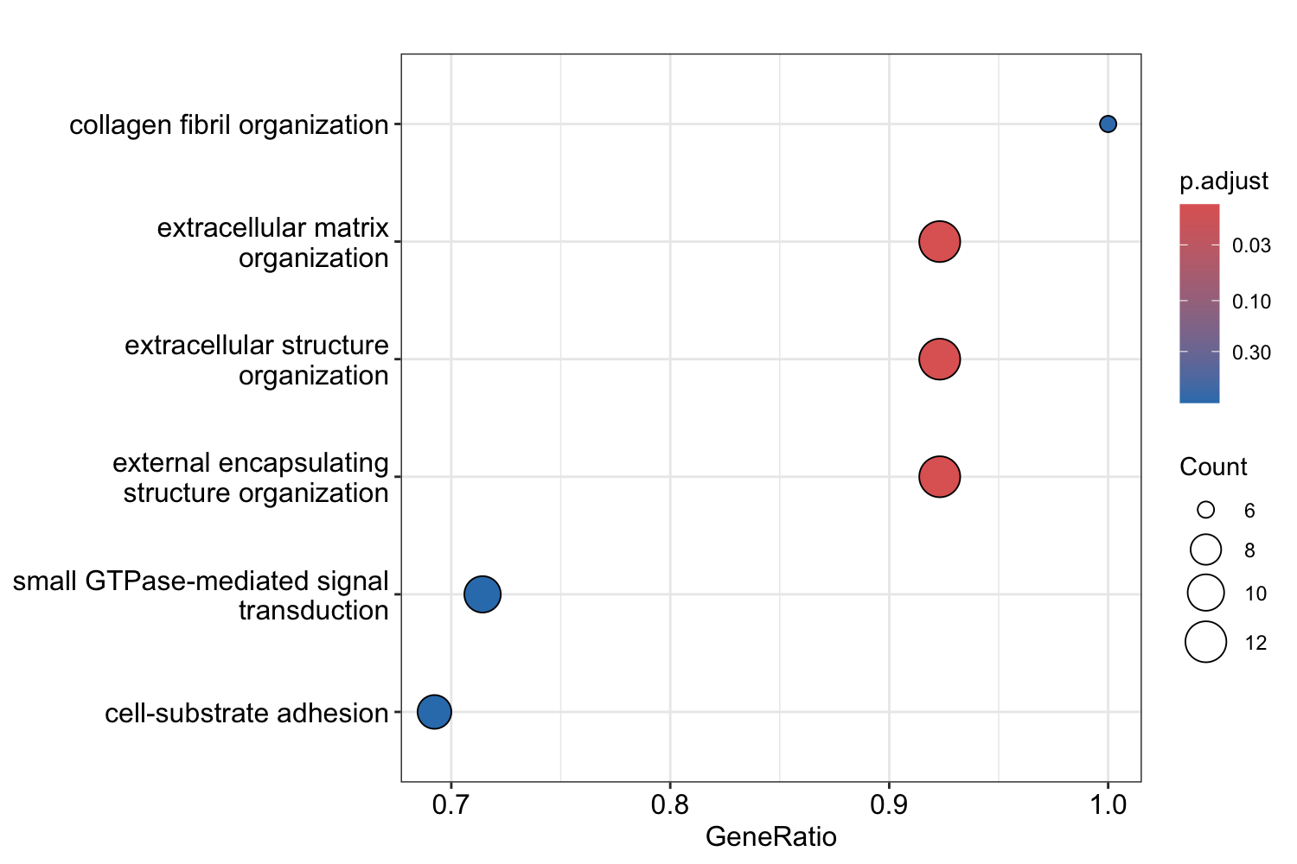
Fib2 Exhibits a Collagen-Rich Extracellular Matrix Program
Selected terms
Fib2 may represent a collagen-producing fibroblast state associated with tissue modeling (PRG4, KLF4), extracellular matrix organization (MFAP5, CREB3L1), and a localized inflammatory microenvironment (SAA1)

Slide 5
Summary
Fibroblasts segregated into two transcriptionally distinct populations
Fib1 was present across all conditions and exhibited canonical fibroblast markers
Fib2 was almost exclusively detected in a single CRSwNP_Eth sample, suggesting a sample-specific fibroblast state
Fib2 displays reduced transcriptomic complexity compared to Fib1
Fib2 showed significantly lower nCount_RNA, nFeature_RNA, MT_pct and elevated Ribo_pct
But Fib2 did not show hallmarks of low-quality cells (so as the whole sample)
Fib2 was characterized by a collagen-rich extracellular matrix program
Biological significance of Fib2 remains to be determined
Fib2 likely represents a sample-specific, collagen-rich fibroblast state, low proliferative, PRG4+/SAA1+ status. The CRSwNP_Eth_3 sample may have captured a distinct anatomical niche, potentially enriched for areas adjacent to the basement membrane, fibrotic lesions, or tissue remodeling sites.
Interesting, CRSwNP_Eth_3 was also the few samples exhibiting IL13 signaling, although fibroblasts cells showed limited IL13 receptors. Taken together, Eth3 sample may harbor a unique immune niche or tissue microenvironment.

