Slide 1

Wine Quality
AN UNsupervised machine learning approach
July 15th 2022
Mohamed MZAOUALI

Slide 2
outline
Introduction
Exploratory Data Analysis
Feature Engineering
Model Selection
Data Analytics
Conclusion
References

Slide 3
Introduction
Objective:
Clusteting
Data Source:
Unsupervised Machine learning algorithms
Quality level clusters
Wine quality data set

Slide 4
EDA
DATA SET:
Shape:
Null Values:
Missing Values:
NaN Values:
Independent Variables:
12 numerical features.
Dependent Variable:
'Quality' Column with levels from 3 to 9.
6497 Lines by 13 Columns.
None.
None.
None.

Slide 5
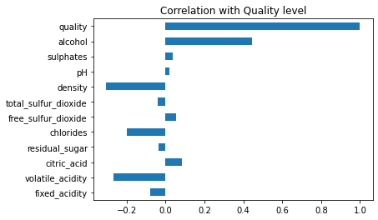

Slide 6
Feature engineering
Data Cleaning
Normalizing distribtions
NaN, Na & Null Values.
Scaling numerical features
Standard Scaler.
Log Transfomation.
Encoding Categorical features
'Color' and 'Quality' features.

Slide 7
Model selection
Clustering Models
K-means
Hierarchical Agglomerative Clustering
Results
Failure to recognize clusters
Very low predictive power
DBSCAN

Slide 8
Data Analytics
K-means
Precision: 0.24
Recall: 0.06
Precision: 0.30
Recall: 0.14
Density-Based Spatial Clustering of Applications with Noise (DBSCAN)
Clusters: 46
Noise points: 6196
Hierarchical Agglomerative Clustering

Slide 9
Conclusion
Failure to capture clusters:
Future Improvements:
Multi-class regression approach
Inadequate Approach
Deep Learning Approach
Insufficient data points &/or features

Slide 10
Reference
The full approach is presented in the following ipynb:
https://github.com/mzaoualim/Coursera_IBM_Machine_Learning_Professional_Certificate/blob/main/Unsupervised_Machine_Learning/Unsupervised_ML_Project.ipynb

