Slide 1

STAFF TURN OVER
A supervised machine learning approach
July 6th 2022
Mohamed MZAOUALI

Slide 2
outline
Introduction
Exploratory Data Analysis
Feature Engineering
Model Selection
Features Importances
Conclusion
References

Slide 3
Introduction
Objective:
Classification:
Data Source:
Classification Algrithms Variations
Employee will leave
Employee will not leave
HR Data Set

Slide 4
EDA
DATA SET:
Shape:
Null Values:
Missing Values:
NaN Values:
Independent Variables:
15 numerical features.
Dependent Variable:
'Class' Column with 1 or 0 values.
15781 Lines by 16 Columns.
None.
None.
None.

Slide 5
Feature engineering
Data Cleaning
Spliting Data Set
NaN, Na & Null Values
Stratified 80/20 Split
Balancing Data
SMOTE Algorithm

Slide 6
Model selection
Classification Models
Logistic Regression
Decision Tree Classifier
XGBoost Classifier
GridSearchCV
Logistic Regression
Accuracy: 71%
Recall:52.5%
Best results

Slide 7
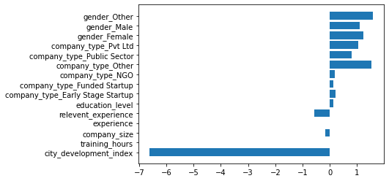
Features importances

Slide 8
Conclusion
Major sources of Turn Over
Low city development
New recruits
Future Improvements:
Multiple Balancing techinques
Robust Ensemble models
Small & medium sized private companies

Slide 9
Reference
The full approach is presented in the following ipynb:
https://github.com/mzaoualim/Coursera_IBM_Machine_Learning_Professional_Certificate/blob/main/supervised-machine-learning-classification/Project_Classification.ipynb

