Slide 1

Doctoral Dissertation by
Hongying Du
University of South Carolina
Department of Computer Science & Engineering
Doctoral Student
Advised by Dr. Michael Huhns
Feb 14th, 2014

Slide 2
Outline
Overview and Motivation (6min)
Case studies (21min)
A Multiagent System Approach to Grocery Shopping
Simulating a Societal Information System for Healthcare
Determining the Effect of Personality Types on Human-Agent Interactions
Summary (3min)
Questions

Slide 3
Overview and Motivation
Overview and Motivation
Social Challenges
Factors: size, intersection, consequences
Scarce resource allocation
Societal Information Systems
Technical Help

Slide 4
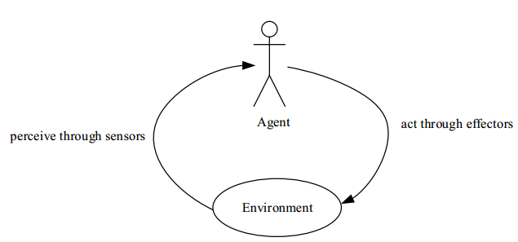
Overview and Motivation
Overview and Motivation
Agents and Multiagent Systems
agent: intelligent and autonomous
Mixed Human-Agent Societies

Slide 5
Outline
A Multiagent System Approach to Grocery Shopping
Introduction
Background
Analysis and Simulation
Results and Discussion
Conclusion

Slide 6
Introduction
A Multiagent System Approach to Grocery Shopping
Stores experiment on customers and want to maximize their profits, while customers have little information to help reduce their cost
Imagine an online system where customers post the prices they paid for their groceries (this could be automated by querying the RFID tags of the items) and QoS information
Notes:
Aided by information systems for analyzing customer buying data, supermarket chains continually alter the prices of items to maximize their profits. They do this by, in essence, experimenting on their customers. For example, the price of an item might be raised at one store until customers stop buying it. This maximum price is then used at all of the stores in the chain. The customers at the supermarkets, however, do not have any comparable information systems that might aid them in price comparisons and are often at the mercy of the stores. Most stores do not post their prices online, so that consumers have to visit each store to find the prices of groceries, which makes comparison shopping prohibitive.

Slide 7
Introduction
A Multiagent System Approach to Grocery Shopping
A prospective shopper enters a grocery list and obtains a pointer to the store(s) with the lowest total price (and best service)
Each customer has an agent representing his/her interests and interacting with the agents of the other customers.

Slide 8
Background
A Multiagent System Approach to Grocery Shopping
Shopbot: an intelligent software agent to implement comparison shopping
The first well-known shopbot: BargainFinder 1995
Now: Google’s Google Product Search, eBay’s shopping.com, Amazon’s tracktor.com
Notes:
Price comparison services (also known as comparison shopping services) allow people
to query a product’s prices at online stores. The services list the product’s prices in
all of the stores and sort the prices to provide customers with support for their online
shopping.
researchers
are developing better algorithms to improve the behavior of shopbots and making
their performance more robust to changes in the stores’ websites, such as by using
Semantic Web concepts [37]. Other related studies involve consumer search costs and
benefits [9] [60] and price-setting strategies [23].

Slide 9
Analysis and Simulation
A Multiagent System Approach to Grocery Shopping
Overall goal model
Notes:
\item[-]creating shopping list: a customer creates a shopping list based on his/her needs. He should specify items/products and the quantities of the items. \item[-]finding stores: find a series of available stores according to store hours, locations, the customer's preference and other possible factors. \item[-]deciding stores: decide which store(s) to go to with the help of an assistance agent. \item[-]transacting: drive to the store(s) and make transactions.

Slide 10
Analysis and Simulation
A Multiagent System Approach to Grocery Shopping
Parameters
customer input
customer location
store location
item price
item quantity
default setting
12 stores, 30 items
a customer wants to buy 10 items
Notes:
Customer input is a customer shopping list that contains the items the customer wants to buy and the quantity of the items. Store location and customer location are used to calculate the fuel cost when driving to and from the stores. Item prices are those either reported by customers or by stores. We assume the quantity of a specific item in a store is either zero or infinity.
If the customer just goes to the stores with the lowest price for each item, the customer might need to go to many stores and spend more on fuel. So we search in all the stores and find the lowest price and the second lowest price of each item the customer wants to buy. The combinations of these two prices of the items may lead to the most economical way for shopping by reducing the fuel cost. We considered all the possibilities of combination of the two prices and calculate the total cost including grocery cost and the fuel cost. When calculating the fuel cost, we assume the customer goes to the nearest store he needs to go to where he has not already shopped until he gets all the items. For comparison, we also calculate the cost if the customer chooses to go to stores using three other strategies: (1) choose one store randomly and buy all the items at that store, (2) go to the nearest store, or (3) randomly go to one of the five nearest stores. Then we calculate the ratio of the grocery cost and the total cost of these three methods over that of our method to see the difference.

Slide 11
Analysis and Simulation
A Multiagent System Approach to Grocery Shopping
Our method
Find the lowest price and the second lowest price of each item the customer wants to buy.
Consider all the possibilities of combination of the two prices and calculate the total cost including grocery cost and the fuel cost.

Slide 12
Analysis and Simulation
A Multiagent System Approach to Grocery Shopping
Comparison with
choose one store randomly and buy all the items at that store
go to the nearest store
randomly go to one of the five nearest stores.
Evaluation
The ratio of the grocery cost and the total cost of these three methods over that of our method
Vary each parameter and get the mean of 100 simulations

Slide 13
Analysis and Simulation
A Multiagent System Approach to Grocery Shopping
Robustness
deceptive stores
customers reported the prices wrong

Slide 14
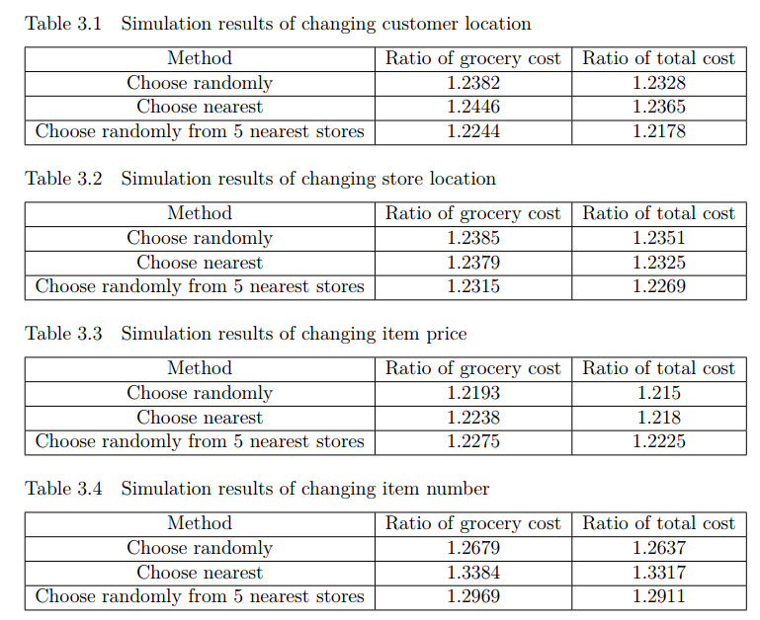
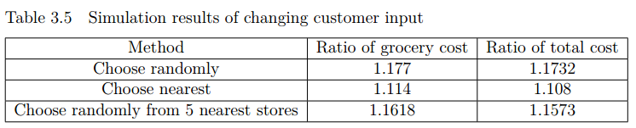
Results and Discussion
A Multiagent System Approach to Grocery Shopping
With simulated price data
Save 21% or more, except when varying customer input

Slide 15
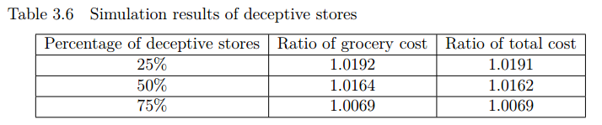
A Multiagent System Approach to Grocery Shopping
Results and Discussion
Deceptive stores
Still save more than 19.1%!

Slide 16
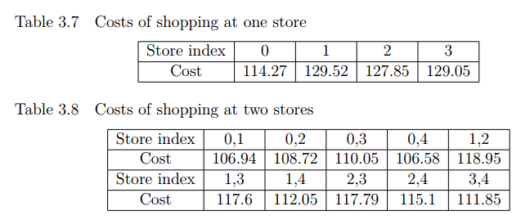
A Multiagent System Approach to Grocery Shopping
Results and Discussion
The cost of buying each item at its lowest price is 98.44, which is more than 13% lower than going to one store
Go to two stores: the lowest cost of 106.58, which is 6.7% lower than going to just one store

Slide 17
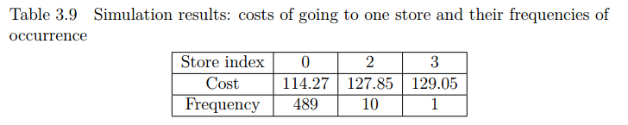
A Multiagent System Approach to Grocery Shopping
Results and Discussion
Customers reported wrong price: each digit of a price a 9% possibility to change to other digits randomly
500 simulations
One store
2.2% possibility that the customer would go to another store
Average cost: 114.57

Slide 18
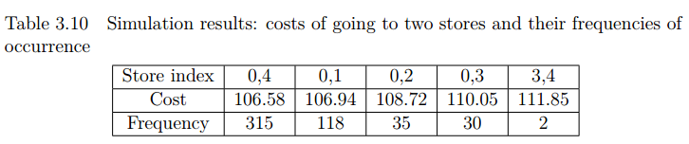
A Multiagent System Approach to Grocery Shopping
Results and Discussion
Two stores:
37% possibility that a customer would go to different stores other than the best combination of two stores
Average cost: 107.04
Still save 6.3% by going to two stores compared to going to just one store

Slide 19
Conclusion
A Multiagent System Approach to Grocery Shopping
A societal grocery shopping system as described in this chapter would be useful and practical, because it helps customers obtain a savings of 21% or more according to our simulation.
Even with deceptive pricing by stores or incorrect price data reported by other customers, it will still be helpful for obtaining some savings.

Slide 20
Outline
Simulating a Societal Information System for Healthcare
Introduction
Methodology
Evaluation
Conclusion

Slide 21

Simulating a Societal Information System for Healthcare
Introduction
Individualized Healthcare
There are IT systems for assisting hospitals and caregivers, but not patients
Patients
Hospitals and
Insurance Providers
Caregivers

Slide 22
Methodology
Simulating a Societal Information System for Healthcare
Prototype the design of a simulation of a societal information system for healthcare
The method we use for prototyping is Agent-Oriented Modeling (AOM), which is open, adaptive, and intelligent
Notes:
This article focuses on designing societal information systems of a particular kind – societal information systems for finding an appropriate physician and finding out the benefits to do so. We use the case study method and explore by rapid prototyping the design of a simulation of a societal information system for healthcare. Rapid prototyping stands for implementing a proof-of-concept prototype in an agile way by directly mapping the modeling constructs to the constructs of a scripting environment like Netlogo or some agent-oriented environment like JADE. The method we use for prototyping is agent-oriented modeling.

Slide 23
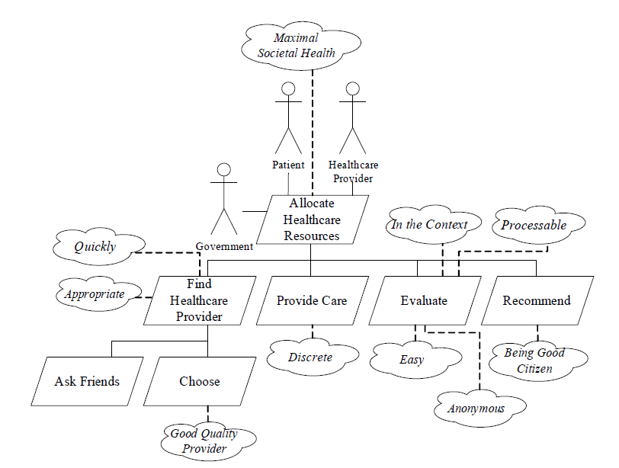
Simulating a Societal Information System for Healthcare
Methodology
The goal model

Slide 24
Evaluation
Simulating a Societal Information System for Healthcare
Three networks
Random network
Small-world network
Most nodes are not neighbors to one another, but most nodes can be reached from any other node by a small number of hops
Scale-free network
The shortest paths between nodes flow through hubs, and if a peripheral node is deleted, it is unlikely that this will interfere with passing a message between other peripheral nodes
Notes:
for representing the relationships among the members of the society

Slide 25
Evaluation
Simulating a Societal Information System for Healthcare
Strategies of choosing a physician
Random strategy
The “Choose one” strategy
Best physician are chosen according to the patient’s evaluations for physicians and friends’ recommendations
The “Borda voting” strategy
A physician is given points which equal to the number of physicians whose evaluations are worse than the evaluations of the given physician. Thereafter the agent adds up all the points gained by the physician in question. The physician with the highest score is chosen
The “Add and minimize” strategy
All the non-zero evaluations are added up and the mean value of them for each physician is calculated. Then the Assistant Agent chooses the physician with the minimum mean evaluation
Notes:
- Random strategy. The patient’s Assistant Agent
randomly chooses a physician.
- The “Choose one” strategy. The patient’s Assistant
Agent chooses the best physician according to the patient’s
evaluations for physicians. If the patient has no evaluations,
his/her Assistant Agent asks his/her friends’ Assistant Agents
for recommendations. The Assistant Agent acting on behalf
of the patient’s friend may deal with the request in one of the
following ways:
o Reply with a recommendation.
o Provide the requesting agent with the address of the
Assistant Agent of one of its principal’s friends if there is no
recommendation to give. This process continues recursively
until the first recommendation is received or until all the
friends down to the maximum forwarding depth have been
asked. The forwarding depth is defined as follows: the
originator’s friends are at depth 1; the originator’s friends’
friends at depth 2, and so on.
- The “Borda voting” strategy. The patient’s Assistant
Agent asks his/her friends’ Assistant Agents, who are closer
than a specified limit, for recommendations. A friend’s
Assistant Agent may choose to answer or refrain from
answering just like with the “Choose one” strategy. After the
patient’s Assistant Agent has received all the responses, it
calculates for each physician the Borda count [a singlewinner
election method in which voters rank candidates in
order of preference, named for the 18th-century French
mathematician and political scientist Jean-Charles de Borda,
who devised the system in 1770], according to which a
physician is given a number of points equal to the number of
physicians whose evaluations are worse than the evaluations
of the given physician. Thereafter the agent adds up all the
points gained by the physician in question. The physician
with the highest score is chosen.
- The “Add and minimize” strategy, which has the same
procedure for getting recommendations as the “Borda
voting” strategy. After the patient’s Assistant Agent has
received all the responses, it adds up all the non-zero
evaluations and calculates the mean value of them for each
physician. Then the Assistant Agent chooses the physician
with the minimum mean evaluation. Choosing the physician
with the minimum value is due to the way we define the
evaluation, as described in Section IV in the paper.

Slide 26
Evaluation
Simulating a Societal Information System for Healthcare
Waiting strategies
Waiting
No waiting
Waiting with limit
If the physician chosen is not available, the patient’s Assistant Agent will check whether the physician could be reached in a certain number of days. If it is possible, the patient will make an appointment and wait. If not, the Assistant Agent will choose another physician according to the rules of the same waiting strategy
Notes:
- Waiting. The patient’s Assistant Agent chooses the best
physician by adopting one of the strategies of choosing a
physician explained above and sticks to this choice. If the
physician is busy, the patient will still make an appointment
with the physician and will wait until the physician becomes
available.
- No waiting. If the physician chosen is busy, the
patient’s Assistant Agent will choose a physician randomly
according to the “Random” strategy or the next best
physician according to the other physician-choosing
strategies until it finds an available physician.
- Waiting with limit. If the physician chosen is not
available, the patient’s Assistant Agent will check whether
the physician could be reached in a certain number of days.
If it is possible, the patient will make an appointment and
wait. If not, the Assistant Agent will choose another
physician according to the rules of the same waiting strategy.
If no physician is available in a certain number of days, the
Assistant Agent will choose a physician who has the smallest
number of days required for waiting.

Slide 27
Evaluation
Simulating a Societal Information System for Healthcare
Simulation settings
The Capacity knowledge entity
number of patients per day that a given physician can handle
The Efficiency knowledge entity
the number of days that it takes for a given physician to cure a patient
The Evaluation knowledge entity
The number of days the physician in question failed to handle a given patient
The value of the efficiency knowledge entity
A random component representing that different patients evaluate the same physician differently
Notes:
- The Efficiency knowledge entity –This number of days is generated for each physician according to a normal distribution whose mean and standard deviation can be adjusted in the user interface.
- The Evaluation knowledge entity– example here:
A patient’s evaluation for a specific physician is
calculated by adding these three factors. For example, let us
assume that a patient gets sick today and decides to visit a
physician chosen by her Assistant Agent, but the physician is
busy and cannot see the patient until tomorrow. In this case,
the value of the first factor – the number of days the
physician in question failed to handle a given patient – is 1,
because the patient had to wait for 1 day to see the physician.
The second factor – the number of days that the physician
requires to cure the patient – is a fixed number related to the
physician in question. The third factor – the random
component expressing the subjective factor – is a random
value that varies between -0.5 and 0.5.

Slide 28
Evaluation
Simulating a Societal Information System for Healthcare
365 days, 5,000 patients, 13 physicians
64 random people get sick every day
The Capacity knowledge entity of each physician’s agent was set to 8 patients per day
The Efficiency knowledge entity of each physician’s agent was determined randomly according to a normal distribution (mean: 3, derivation: 2.0)
To make our simulations more realistic, a friend would ignore the patient’s request with a probability = 20%
The results from simulations are in terms of the annual sick days per person and leftover patients who were not taken care of by the end of the last day simulated
Notes:
To make our simulations as realistic as possible, we used
the following statistical data by the Centers for Disease
Control and Prevention (CDC) from the year 2008 [18]:
- The number of physician office visits per 100 people
per year: 320.1.
- The number of physicians per 10,000 people: 26.
Based on the above data, we obtained the average number
of people who get sick every day by dividing the number of
visits per 10,000 people by 250, which is the standard
number of working days in a calendar year in the U.S. As a
result, 128 people out of a population of 10,000 get sick
every day.

Slide 29
Conclusion
Simulating a Societal Information System for Healthcare
Our prototype revealed that if a patient adopts the “Waiting” strategy, the “Random” strategy will outperform all the other strategies of choosing a physician. On the other hand, with the “No-waiting” strategy, all the other strategies will outperform the “Random” strategy
If the “Waiting with limit” strategy is adopted, the “Choose one” and “Add and minimize” strategies will show the best performance. By adopting the “Choose one” or “Add and minimize” strategy, in the “No-waiting” and “Waiting-with-limit” cases, the average number of sick days can be reduced by 0.42-1.84 days or 6.2%- 27.1%

Slide 30
Conclusion
Simulating a Societal Information System for Healthcare
Difference from other physician recommending websites
Different criteria
Websites: punctuality, medical knowledge, time spent on a patient, etc., which are more subjective
Our work: time it takes to cure a patient, which is more objective and meaningful
People who make the recommendations
Websites: strangers may rate the doctors
Our work: only refer to friends, which are more reliable
Notes:
Our societal information system differs from RateMDs
and other similar websites where people can rate and find
physicians in the way that people rate the physicians and
patients interact. It is difficult to compare the effect of these
websites and that of our system, mostly because there are no
objective evaluation statistics on the websites, such as the
length of time each patient takes to get cured during a period.
Such websites use more flexible criteria on which different
people might have different opinions, such as punctuality,
medical knowledge, and time spent on a patient, while our
system uses the time it takes to cure a patient as a criterion,
which is more objective and meaningful. Although patients
might access more ratings online, they usually do not know
the people who have rated the physicians and there is a
higher possibility that the ratings will not be truthful and
accurate. In our system, a patient relies on friends’
recommendations, which are typically more reliable.

Slide 31
Outline
Determining the Effect of Personality Types on Human-Agent Interactions
Motivation
Experiment
Personality Types
“Who Gets More Cake?” Game
Analysis
Conclusion

Slide 32
Motivation
Determining the Effect of Personality Types on Human-Agent Interactions
Because agents affect the everyday life of humans
To understand how humans would treat agents in a mixed human-agent society
To find answers to two questions: whether humans possess different attitudes towards other humans and agents, and whether and how the personality type of a human influences his decisions
Notes:
Because of the large number of agents and robots beginning to affect everyday life of humans, it is important to understand how humans would treat agents in a mixed human-agent society.
We all know persons have different personality types and they behave very differently. Does this matter when they deal with agents?
We designed an experiment to find it out.

Slide 33
Experiment
Determining the Effect of Personality Types on Human-Agent Interactions
Test the subjects’ personality types using the Keirsey Temperament Sorter-II (KTS-II)
The subjects play the ”Who Gets More Cake?” game
73 students participated in the experiment

Slide 34

Experiment - Personality Types
Determining the Effect of Personality Types on Human-Agent Interactions
KTS-II classifies people into four temperament groups according to two basic dimensions of personality: what people say (communication) and what people do (action)
The temperaments are Artisan, Guardian, Rational, Idealist
D. Keirsey, “Please Understand Me II,” Prometheus Nemesis, 1998
Notes:
Idealists speak mostly of what they hope for and imagine might be possible for people, and they want to act in good conscience, always trying to reach their goals without compromising their personal code of ethics.
Mohandas Gandhi and Princess Diana.
Guardians speak mostly of their duties and responsibilities, of what they can keep an eye on and take good care of, and they're careful to obey the laws, follow the rules, and respect the rights of others.
George Washington and Mother Teresa.
Rationals speak mostly of what new problems intrigue them and what new solutions they envision, and always pragmatic, they act as efficiently as possible to achieve their objectives, ignoring arbitrary rules and conventions if need be.
Hillary Clinton and Stephen Hawking.
Artisans speak mostly about what they see directly and what they can get their hands on, and will do whatever works or whatever gives them a quick payoff, even if they have to bend the rules.
Michael Jordan and Marilyn Monroe

Slide 35
Experiment - Personality Types
Determining the Effect of Personality Types on Human-Agent Interactions
Myers-Briggs Type Indicator (MBTI)
Four dichotomies
Extraversion (E) - Introversion (I)
Sensing (S) - iNtuition (N)
Thinking (T) - Feeling (F)
Judging (J) - Perception (P)
The result of the MBTI assessment is a four-letter personality type, with one letter coming from each dichotomy
Each temperament of KTS-II test has four variants, corresponding to 4 of the 16 MBTI types
Myers and P. Myers, Gifts Differing: Understanding Personality Type,
Davies-Black Pub., 1980.
Notes:
KTS-II temperament KTS-II character type MBTI type
Artisan (SP)
Promoter ESTP Crafter ISTP Performer ESFP Composer ISFP
Guardian (SJ)
Supervisor ESTJ Inspector ISTJ Provider ESFJ Protector ISFJ
Rational (NT)
Fieldmarshal ENTJ Mastermind INTJ Inventor ENTP Architect INTP
Idealist (NF)
Teacher ENFJ Counselor INFJ Champion ENFP Healer INFP

Slide 36
Experiment - “Who Gets More Cake?” Game
Determining the Effect of Personality Types on Human-Agent Interactions
Variant of the classic cake-cutting game
Three players try to divide the cake:
The human subject/participant
A simulated human
An agent/robot (the robot has a way to convert the cake into the energy it needs to move)
Players indicate how they would like to cut the cake into three pieces, by drawing two lines/cuts on their own picture of the cake
Each participant plays the game 3 times with different simulated humans and different cakes
Notes:
introduce the cake-cutting game first: In the classic cake-cutting game, players want to divide a cake in such a way that all of them believe they have received a fair amount of the cake. There are two basic measurements for a solution of the cake-cutting problem: fairness and envy-freeness. Fairness means anyone gets at least the amount that he believes is fair, while envy-freeness means anyone believes no one gets more than he has and he won't want to exchange his cake with others. If the cake is divided between two players, there is a fair and envy-free solution, which is to have one player cut the cake into two pieces and the other player choose his piece of the cake first.
At the beginning of each game, participants were asked to type a greeting sentence to the simulated human and the simulated human will type some greetings too. It takes our simulated human some time to think and draw cuts on the cake, each game with different amount of delay to mimic human thinking.
By different simulated humans, we mean simulated humans with different names.

Slide 37
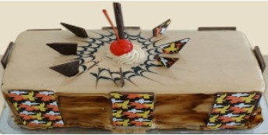
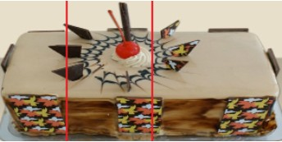
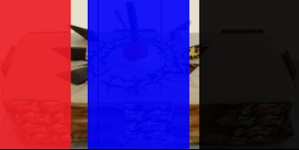
Experiment - “Who Gets More Cake?” Game
Determining the Effect of Personality Types on Human-Agent Interactions
To decide how the cake is divided (a fair protocol proposed by Iyer and Huhns):
Whoever has drawn the left-most cut will get the left side of the cake from the edge to this cut
Of the remaining two players, whoever has drawn the right-most cut will get the right side of the cake from this cut to the right edge
The third player will get the portion in the middle indicated by that player's two cuts
At last, the subjects are asked to whom they would like to give the leftover cake
K. Iyer and M. N. Huhns, “Multiagent negotiation for fair and unbiased resource allocation,” in OTM Conferences, Lecture Notes in Computer Science. Springer, 2005
Notes:
We follow a protocol proposed by Iyer and Huhns, which is proved to be fair for dividing a resource among n agents,

Slide 38
Analysis
Determining the Effect of Personality Types on Human-Agent Interactions
Two aspects
Tendency
Consistency
Statistical measures
Pearson’s chi-squared test or Fisher’s exact test, which evaluates the degree of independence between two nominal variables
Cramer’s V, which is an effect size measure of association between two nominal variables
Goodman and Kruskal’s lambda, to check whether knowing a person’s personality would help to predict his choice in the game (λ₁) and vice versa (λ₂)

Slide 39

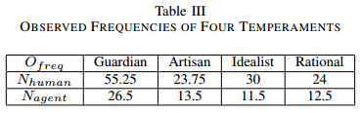
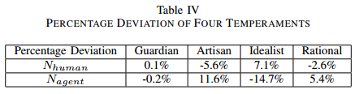

Analysis - Tendency
Determining the Effect of Personality Types on Human-Agent Interactions
For KTS-II temperaments
λ₁=0, λ₂=0
Notes:
\item[-]The number of games in which the participants give the leftover cake to the simulated human, denoted by $N_{human}$;
\item[-]The number of games in which the participants give the leftover cake to the agent, denoted by $N_{agent}$;
They measure the tendency that a participant would prefer either a person or an agent under some circumstances, which might indicate whether he would like to interact with a person or an agent.
First thing to notice: Nhuman twice Nagent
The data of four temperaments are show in the table III, called observed frequencies
H0: The participants’ KTS-II temperaments and the choices they made are independent.
Thus we get the expected frequencies (Efreq ) proportionally
Then we use the formula there to get the Percentage deviation
We can see that Artisan, Idealist deviates from the general public more, but since P>0.05, we can’t reject our hypothesis and say …
Cramer’s V: can’t say there’s any relationship
From lambda1 and lambda2, there is no difference whether or not knowing a person’s temperament when predicting his choice. Also we found out lambda of predicting a person’s temperament
from his choice (lambda2) is 0, which means knowing a person’s choice won’t do any good to predicting the his temperament

Slide 40
Conclusion
Determining the Effect of Personality Types on Human-Agent Interactions
Humans treat other humans and agents differently
Humans with different KTS-II temperaments behave differently on both the tendency and consistency aspects
It is very possible that the Thinking–Feeling dichotomy of Myers-Briggs Type Indicator (MBTI) and the tendency results are not independent
7% error could be reduced when predicting a person’s type in Thinking-Feeling dichotomy with his game choice known compared to that with his choice not known
There is a correlation between the Extraversion–Introversion dichotomy and the consistency results
Fair is more important than personality

Slide 41
Summary
Summary
Challenges
Technical help from multiagent systems
Three case studies
A Multiagent System Approach to Grocery Shopping
Simulating a Societal Information System for Healthcare
Determining the Effect of Personality Types on Human-Agent Interactions

