Slide 1

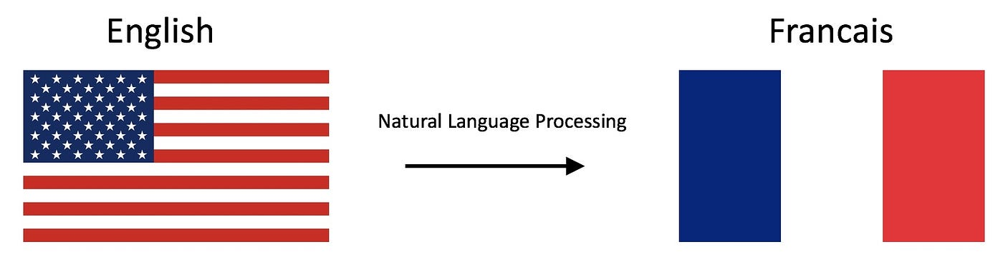
English to French Machine Translation
Abdelrahman Tarek Zaki
Mazen Gaber Mahmoud

Slide 2
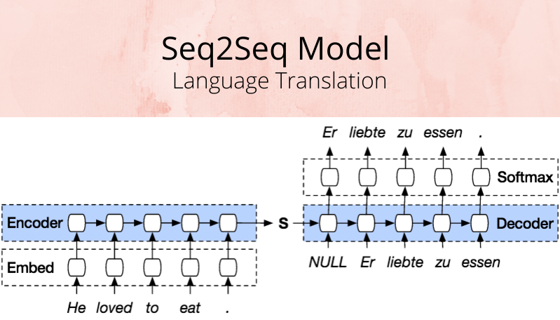
Project Overview
Web-based translation service with API and UI
Dual-model approach: Seq2Seq LSTM and T5 Transformer
Built with FastAPI, TensorFlow, and PyTorch
Complete pipeline from training to deployment

Slide 3
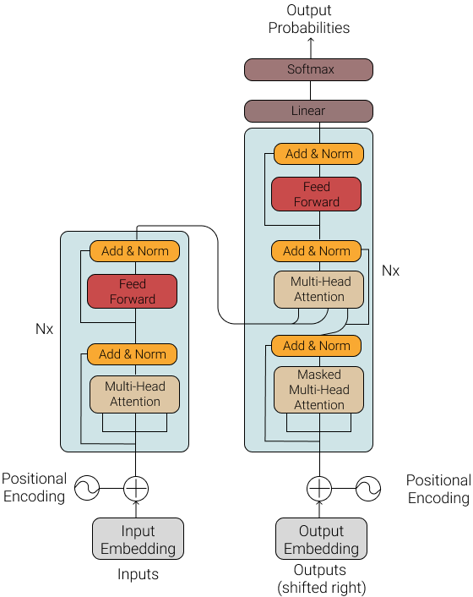
Architecture
Three-tier architecture:
Presentation layer (Web UI)
Application layer (FastAPI)
Model layer (Translation engines)
Modular design with clear separation of concerns
Configuration-driven approach with environment variables

Slide 4
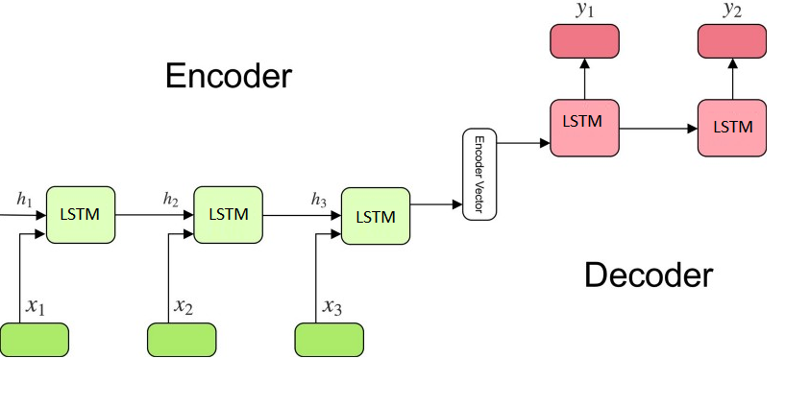
1)Seq2seq lstm
Traditional sequence-to-sequence architecture
Encoder-decoder with LSTM cells
256-dimensional embeddings, 512 LSTM units
Custom inference process for sequence generation
Trained on Kaggle's English-French dataset

Slide 5
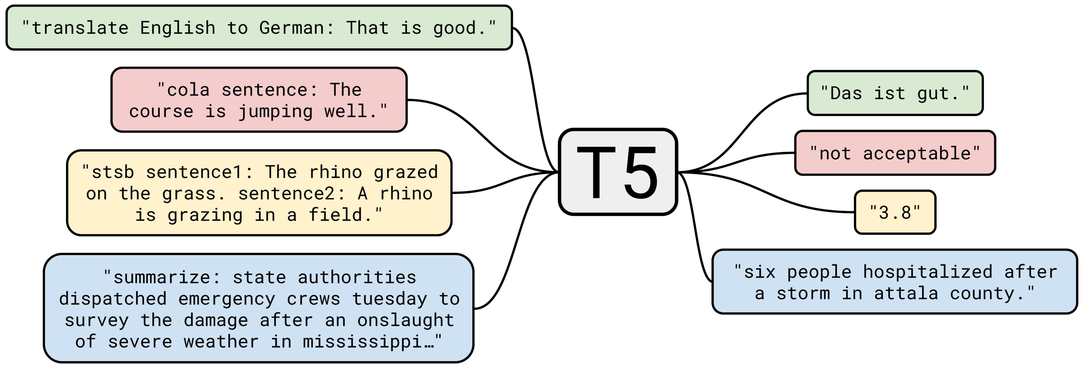
2)T5 Transformer
Modern transformer-based approach
Based on Google's T5 architecture
Pretrained model fine-tuned for English-French translation
Advanced features: attention mechanism, beam search
Superior handling of complex sentences and context

Slide 6
API Design
RESTful API with FastAPI
Key endpoints:
POST /translate: Main translation endpoint
GET /health: Service health monitoring
Structured request/response models with validation
Request logging and timing middleware
Comprehensive error handling

Slide 7
WEB interface
Clean, responsive UI
Input area for English text
Model selection dropdown
Real-time translation results
Performance metrics display
Asynchronous requests with loading indicators

Slide 8

Development tools
Code quality assurance:
Black for code formatting
Ruff for linting
MyPy for static type checking
Pre-commit hooks for consistency
Jupyter notebooks for model training
Version control with Git

Slide 9
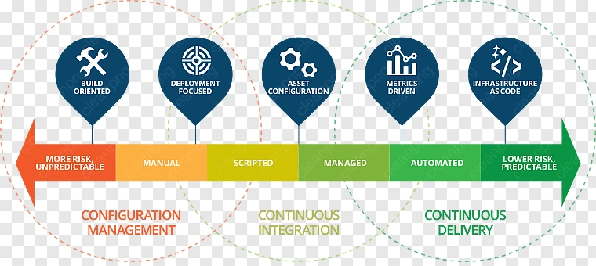
Configuration system
Flexible environment-based configuration
Support for .env files
Typed configuration with validation
Key parameters:
Model selection and paths
API settings
Inference parameters
Debug mode toggle

Slide 10
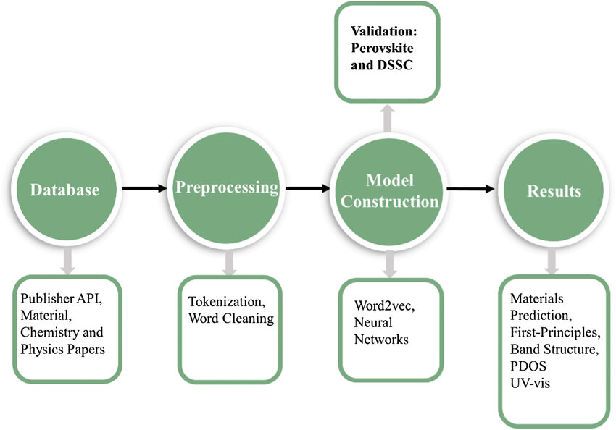
Training process
Well-documented training pipelines
Data preparation and cleaning
Model architecture definition
Training and validation loops
Evaluation metrics
Artifact generation for inference

Slide 11
Performance comparison: t5 transformer
Higher accuracy (~92%)
Better with complex sentences
Larger model size (250MB+)
Slower inference (300-500ms)

Slide 12
Performance comparison: Seq2seq lstm
Lower accuracy (~85%)
Better with simple phrases
Smaller model size (~50MB)
Faster inference (100-200ms

Slide 13
Future improvements
Support for additional language pairs
Larger training datasets
Advanced models (T5-large)
Domain-specific training
Caching for common translations
Enhanced UI with additional features
Mobile application integration

Slide 14
CONCLUSION
Successful implementation of dual-model translation system
Complete pipeline from training to deployment
Clean architecture enabling future extensions
Balance of accuracy and performance
Production-ready with proper error handling and logging
Demonstration of full-stack ML application development

