Slide 1
بِسْمِ اللَّهِ الرَّحْمَنِ الرَّحِيم
COMPUTER ORGANIZATION AND ASSEMBLY LANGUAGE PROJECT: *********J.D.T*********
Group Members:
M Zeeshan Zafar - BSCSA-21-37
Ammar Shahid - BSCSA-21-40
Ahsan Umar - BSCSA-21-44
Huzaifa Mushtaq - BSCSA-21-45

Slide 2

CONTENTS
Introduction
Brief Description
Main Functionalities
Detailed Functionalities
Flow Chart Diagram of Tool
Coding, logics and execution
Improvements – What to extend ?

Slide 3
JDT!
JDT is an assembly tool that can be configured or converted into any weight base sales system very easily…

Slide 4
Our use case
For this project we are assuming that JDT is being used on a MEAT SHOP, thus we have set the variables and statements accordingly...

Slide 5
MAIN FEATURES
01
02
03
04
AUTHENTICATION
INT 10H BASED UI
JDT is configured with a tiny hashing algorithm
Includes main and submenus using INT 10H
WEIGHT CALCULATOR
MULTIPLE CURRENCIE
Performs billing on the basis of weight + Qty
Allows billing in multiple currencies + Transaction history

Slide 6
01
Authentication
JDT requires users to login in order to use it

Slide 7
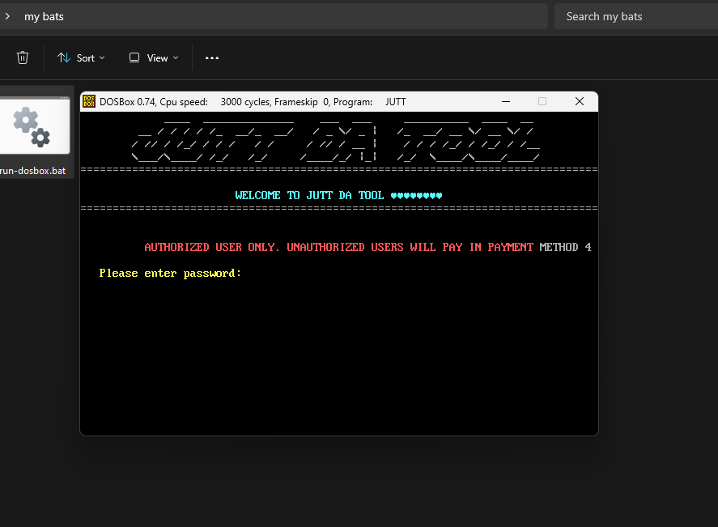
LOGIN PROMPT

Slide 8
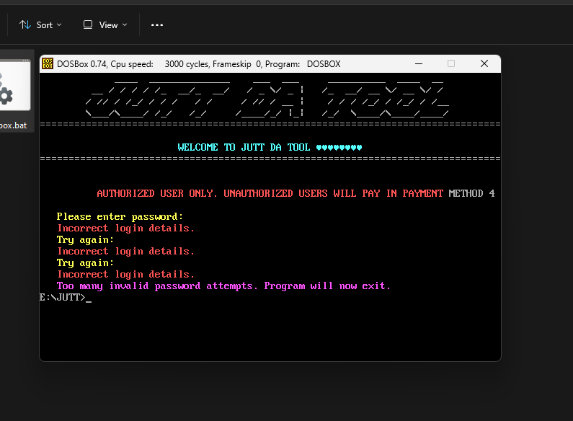
LOGIN PROMPT

Slide 9
02
Main Menu
After successful login user gets redirected to main menu of JDT

Slide 10
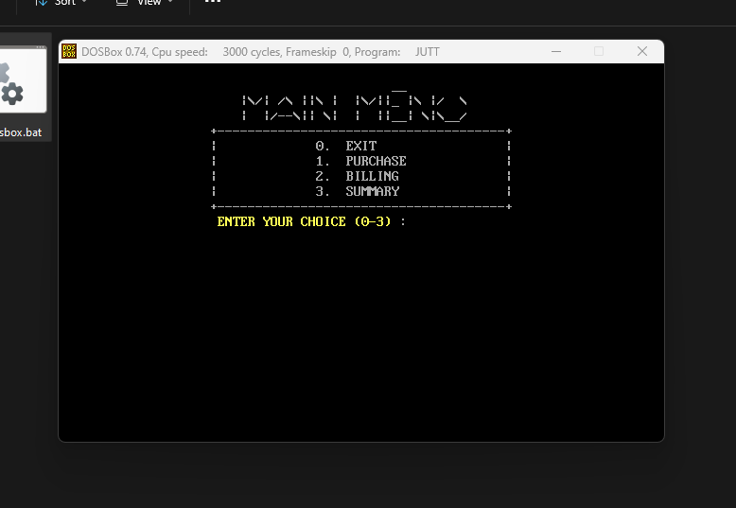
MAIN MENU

Slide 11
03
PURCHASE
This is the market section of JDT where products reside

Slide 12
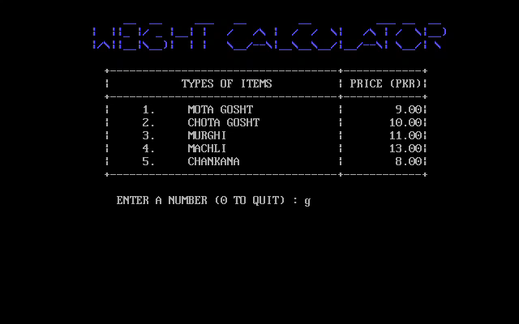
PURCHASE

Slide 13
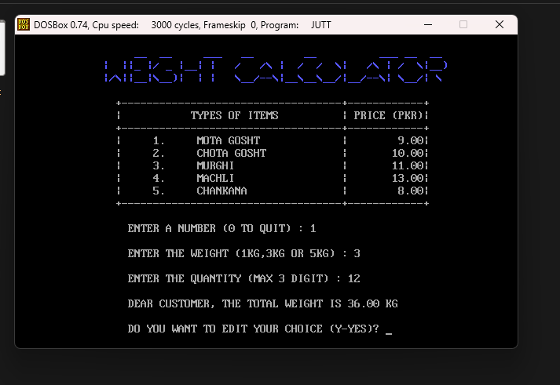
PURCHASE

Slide 14
04
BILLING
This is the counter section where payments are done

Slide 15
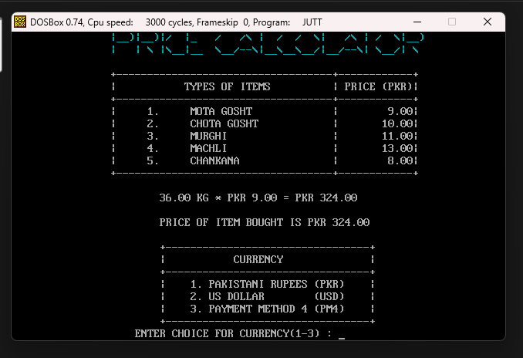
BILLING

Slide 16
05
CURRENCY
In this section user selects and pays in any of the given currencies

Slide 17
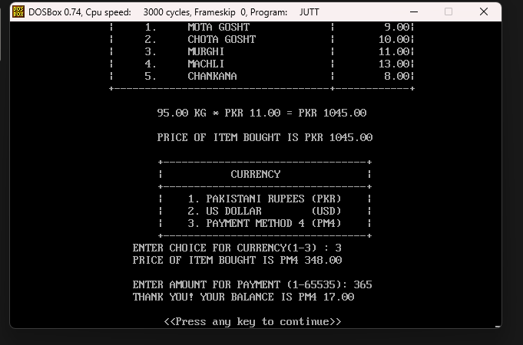
CURRENCY

Slide 18
06
SUMMARY
This section show the transaction history of JDT

Slide 19
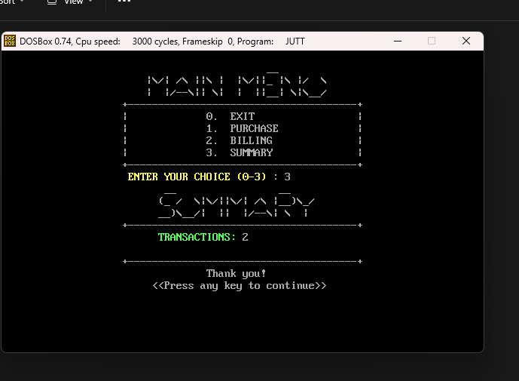
SUMMARY

Slide 20
FLOW CHART

Slide 21
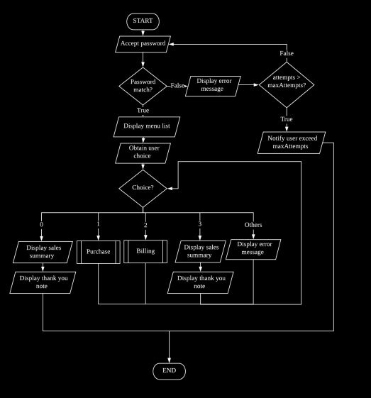

Slide 22
CODE

Slide 23
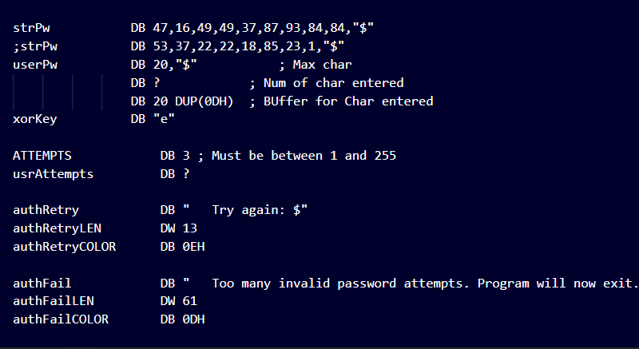
AUTH VARS

Slide 24
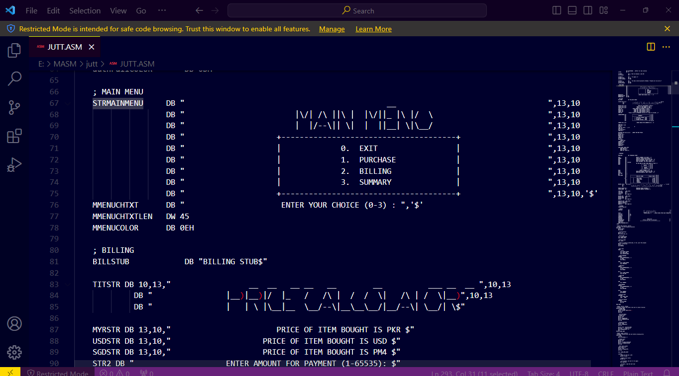
MENUS AND LOOPING

Slide 25
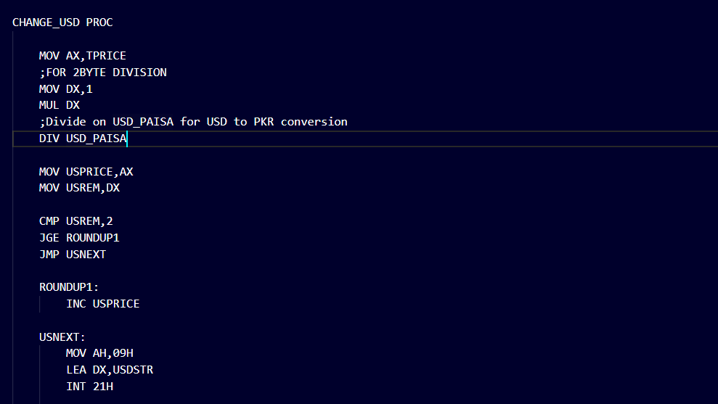
CURRENCY CONVERTING

Slide 26
IMPROVEMENTS

Slide 27
AUTH AND SAVE
USE HASHING
STORE ON FILE
Did you notice something in data section while I showed you the code ? 😶
Use a file to store transactions on exit and load next time on startup 😎

Slide 28
COMBINE MD5 AND SHA256
Currently we are only using a XOR for our authentication
BOTH
A combination of MD5 and SHAW25 is just like iron and kryptonite combined
MD5
SHA256
A cryptographic protocol used for authenticating messages
Help secure SSL/TLS (Transport Layer Security) certificates by creating a digital signature

Slide 29
PROCEDURES FOR PERSISTENCE
RECORD
On exit we can save the transactions and record on files and reuse next time
PASSKEY
We can allow user to put custom hash in file and then use it for authentication
TXT MSG
Similarly we can store success and alert
Messages in a file and then use them
CURRENCY
Allow user to change currency values without assembling JDT again and again

Slide 30

That's all from us, have any suggestions or questions ? Please Share 🤔

Slide 31
RESOURCES
You can get everything related to this project at:
DISCORD:
Everything is available on my Discord
You can join the server anytime b/w 9-5
GITHUB:
Close up programmer sitting at desk
Visit mzeeshanzafar28@github for source
GDRIVE:
generalzodx28 gdrive acc

Slide 32
THANKS!
Do you have any questions?
Mzeeshanzafar28@gmail.com
+92 312 4421761 | zeeshan.axonteam.pk

