Slide 1


Orquestación de containers
Manuel Zegarra
https://github.com/mzegarras

Slide 2
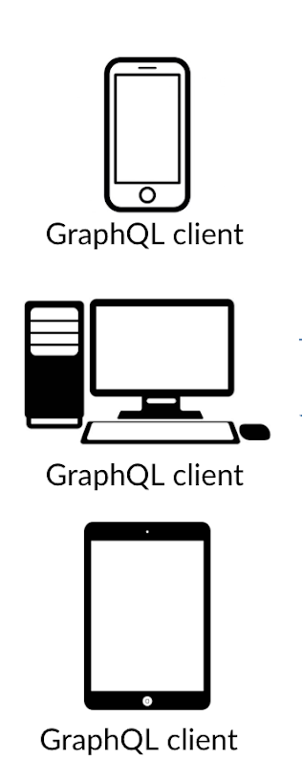



GET /accounts?type=DNI&number=11111111
GET /accounts/100000002/transactions
Accounts
Customers
GET “CLIENTES + CUENTAS + MOVIMIENTOS”
GET /customers?type=DNI&number=11111111
POST /customers
GET “CLIENTES + CUENTAS”

Slide 3
GET /accounts?type=DNI&number=11111111
GET /accounts/100000002/transactions
Accounts
Customers
GET “CLIENTES + CUENTAS + MOVIMIENTOS”
GET /customers?type=DNI&number=11111111
POST /customers
GET “CLIENTES + CUENTAS”

Slide 4



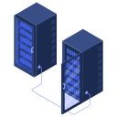

Matriz requerimientos
 | Local | DEV | QA | PROD
Mongo Server
Java Server
NodeJS Server

Slide 5
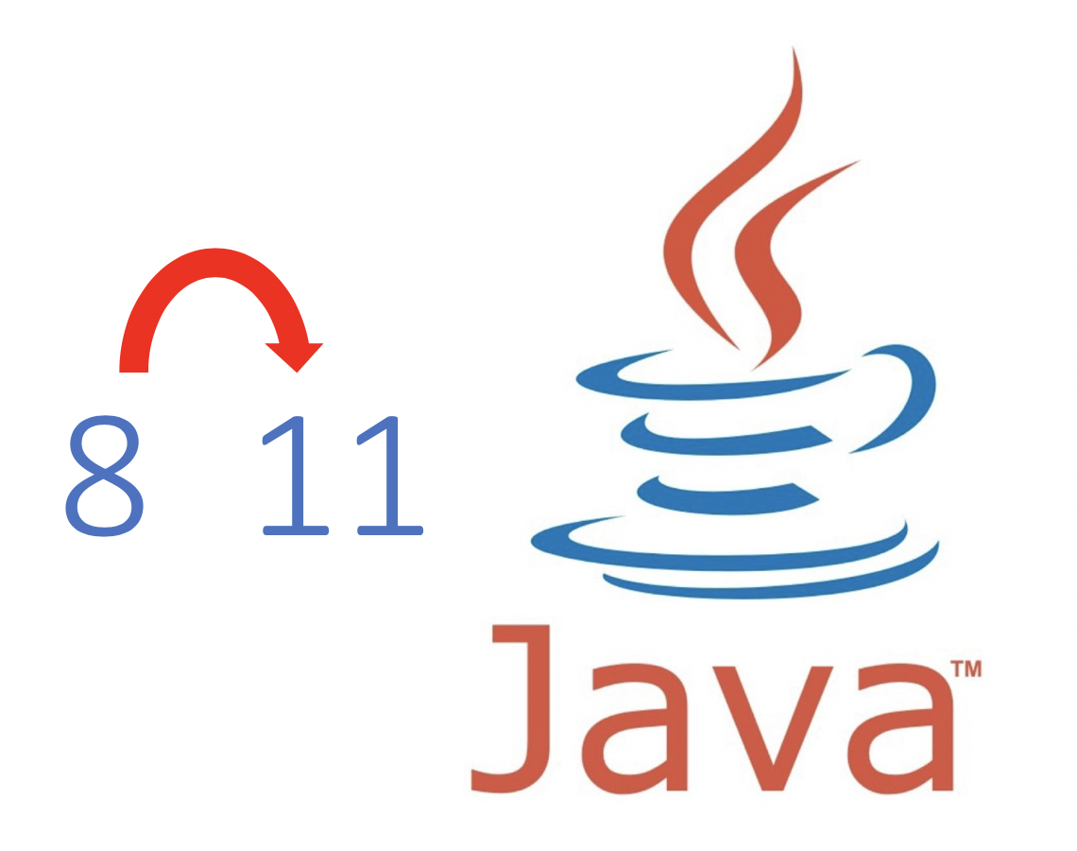
Matriz requerimientos
 | Local | DEV | QA | PROD
Mongo Server
Java Server
NodeJS Server

Slide 6
Matriz requerimientos
 | Local | DEV | QA | PROD
Mongo Server
Java Server
NodeJS Server

Slide 7
Matriz requerimientos
 | Local | DEV | QA | PROD
Mongo Server
Java Server
NodeJS Server

Slide 8

Matriz requerimientos
 | Local | DEV | QA | PROD
Mongo Server
Java Server
NodeJS Server

Slide 9

Matriz simplificada
 | Local | DEV | QA | PROD
Mongo Server
Java Server
NodeJS Server

Slide 10

GET /accounts?type=DNI&number=11111111
GET /accounts/100000002/transactions
Accounts
Customers
DEMO
GET /customers?type=DNI&number=11111111
POST /customers

Slide 11
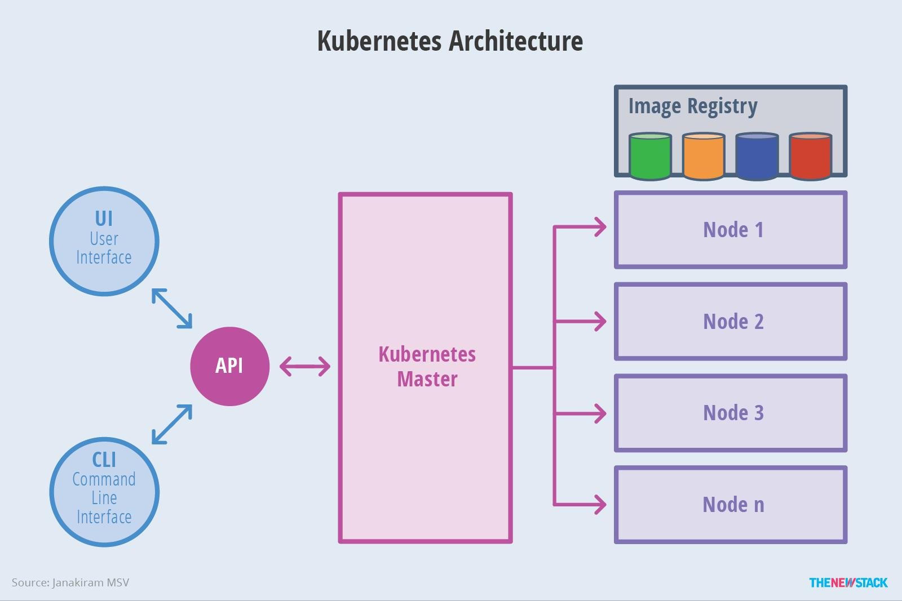

Slide 12




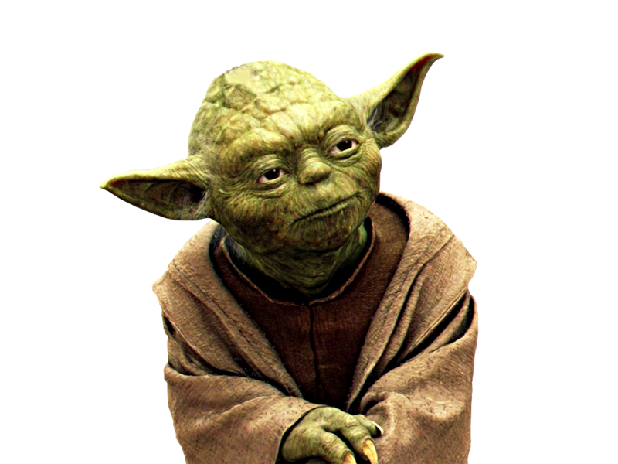
Master
Node 1
Node 2
Node 3
Node 4
Node 5
Node 6

Slide 13
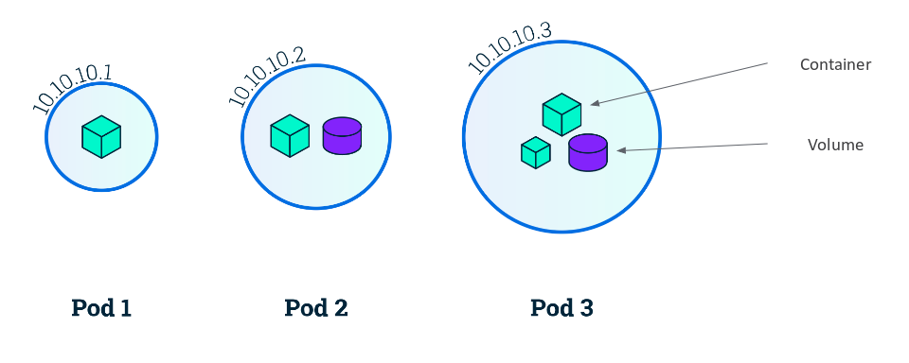
Pods

Slide 14
Service
GraphQL
Graphql
Graphql
Graphql

Slide 15

GET /accounts?type=DNI&number=11111111
GET /accounts/100000002/transactions
Accounts
Customers
GET /customers?type=DNI&number=11111111
POST /customers

Slide 16
GET /accounts?type=DNI&number=11111111
GET /accounts/100000002/transactions
Accounts
Customers
GET /customers?type=DNI&number=11111111
POST /customers

Slide 17

Accounts
Customers

Slide 18




https://github.com/mzegarras/microservices-graphql

