Slide 1

“As-you-go” instead of “after-the-fact”
Chris Hartgerink (Twitter, GitHub)
Marino van Zelst (Twitter, GitHub)
Hans van Dijk
Slides at: http://bit.ly/sgmeawop

Slide 2
To be communicated
To be communicated

Slide 3


To be communicated
To be communicated
What we communicate (at best)

Slide 4
Theory
Integration
Predictions
Discuss
Design
Synthesis
Materials
Results
Data
Code

Slide 5
Theory
Integration
Predictions
Discuss
Design
Synthesis
Materials
Results
Code

Slide 6
Studies conducted
Published = statistically significant + consistent
Not pub = statistically significant + inconsistent
Not pub = statistically nonsignificant + consistent
Not pub = statistically nonsignificant + inconsistent
Not pub = genuine design mistake

Slide 7
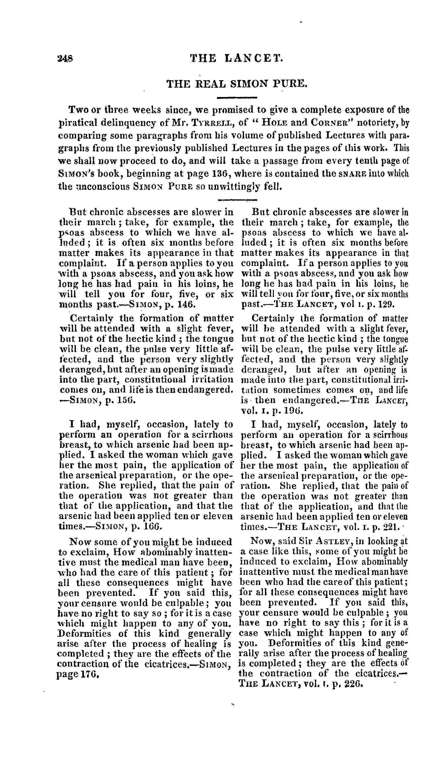

Slide 8
1824!

Slide 9
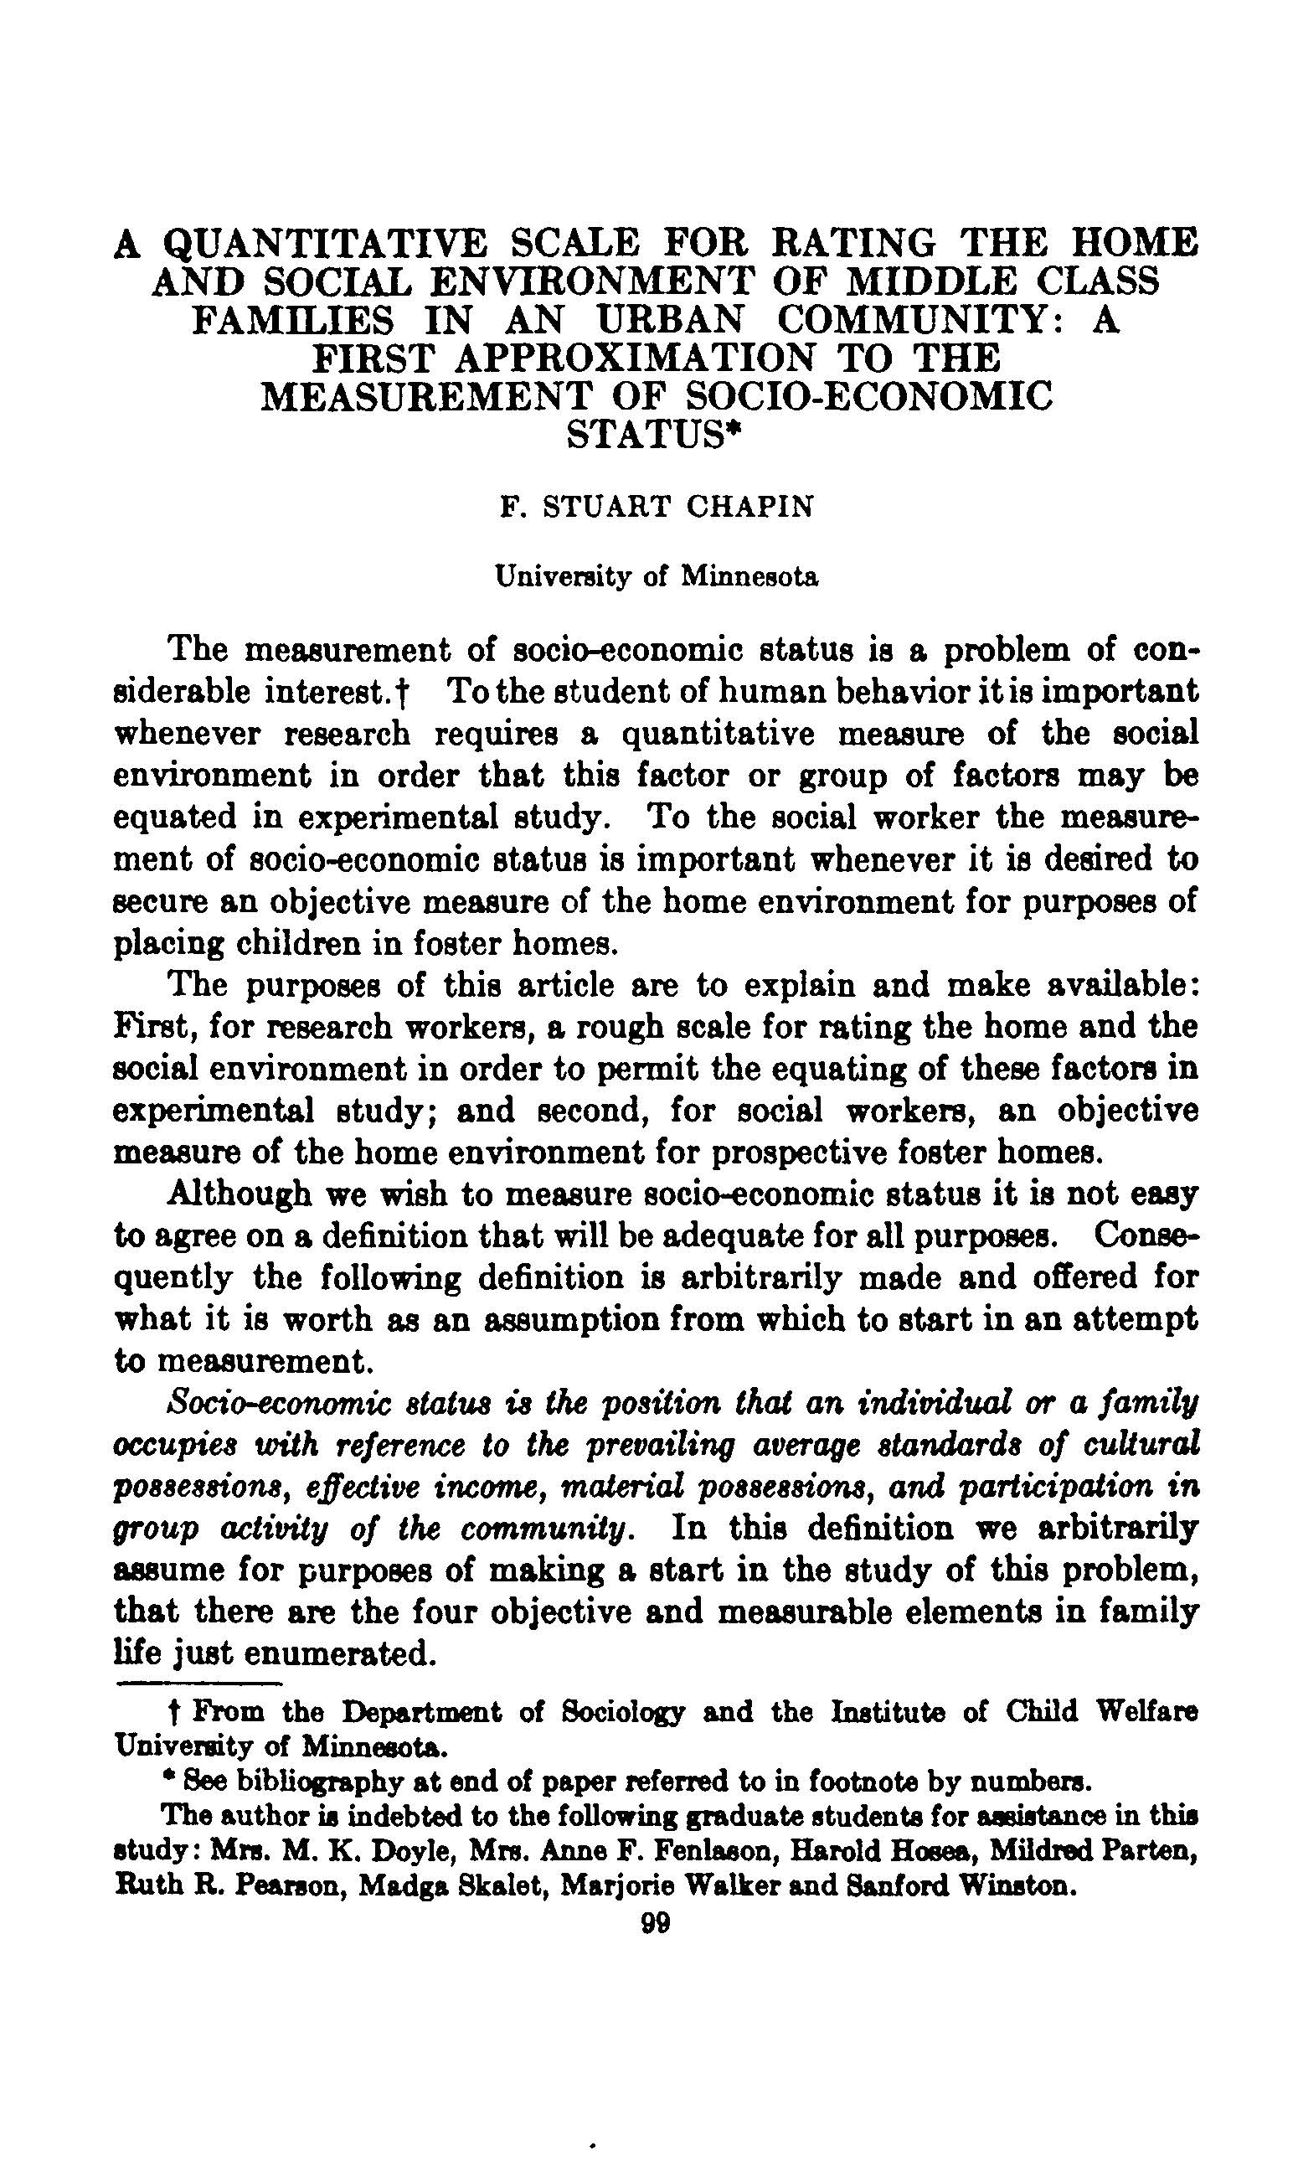

Slide 10
1928

Slide 11


Slide 12
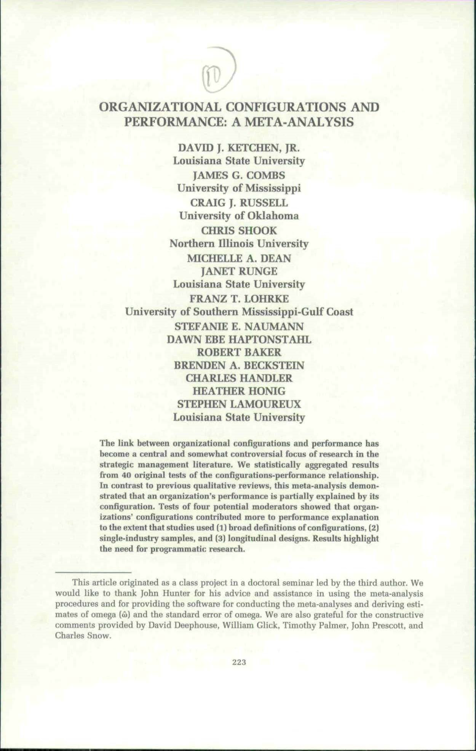
1997

Slide 13
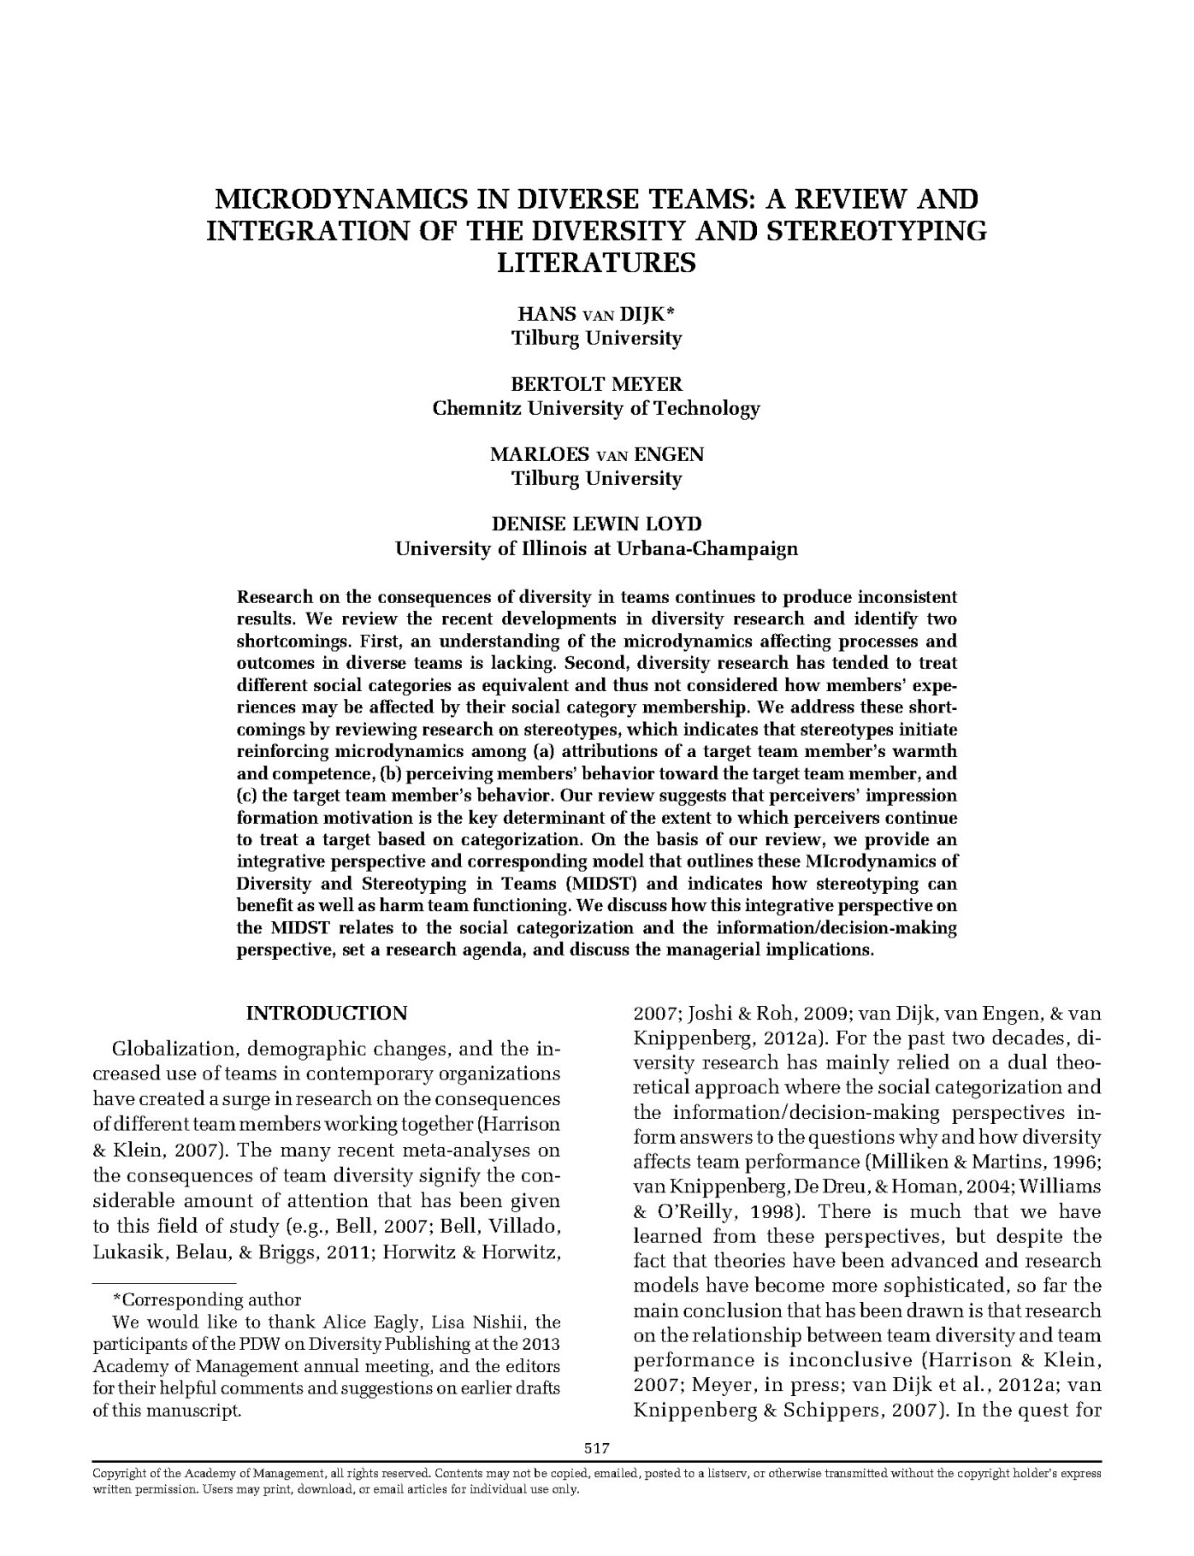
2017

Slide 14
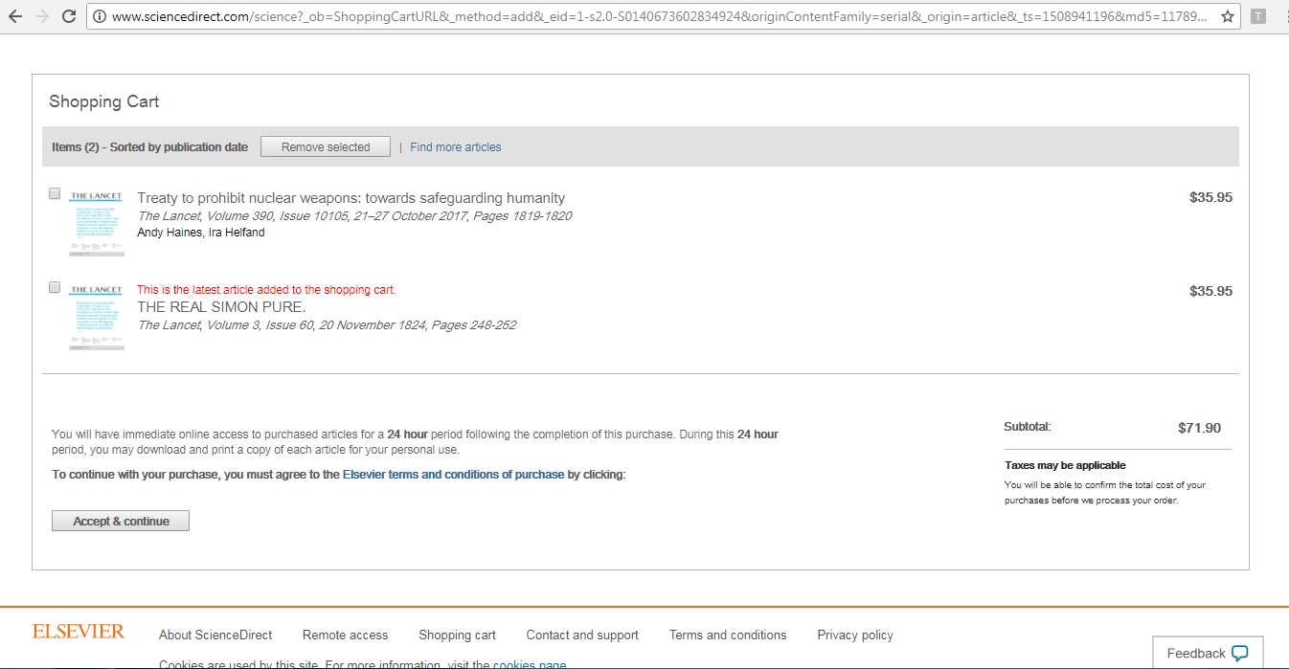

Slide 15
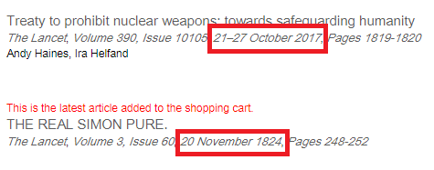


Slide 16





Slide 17
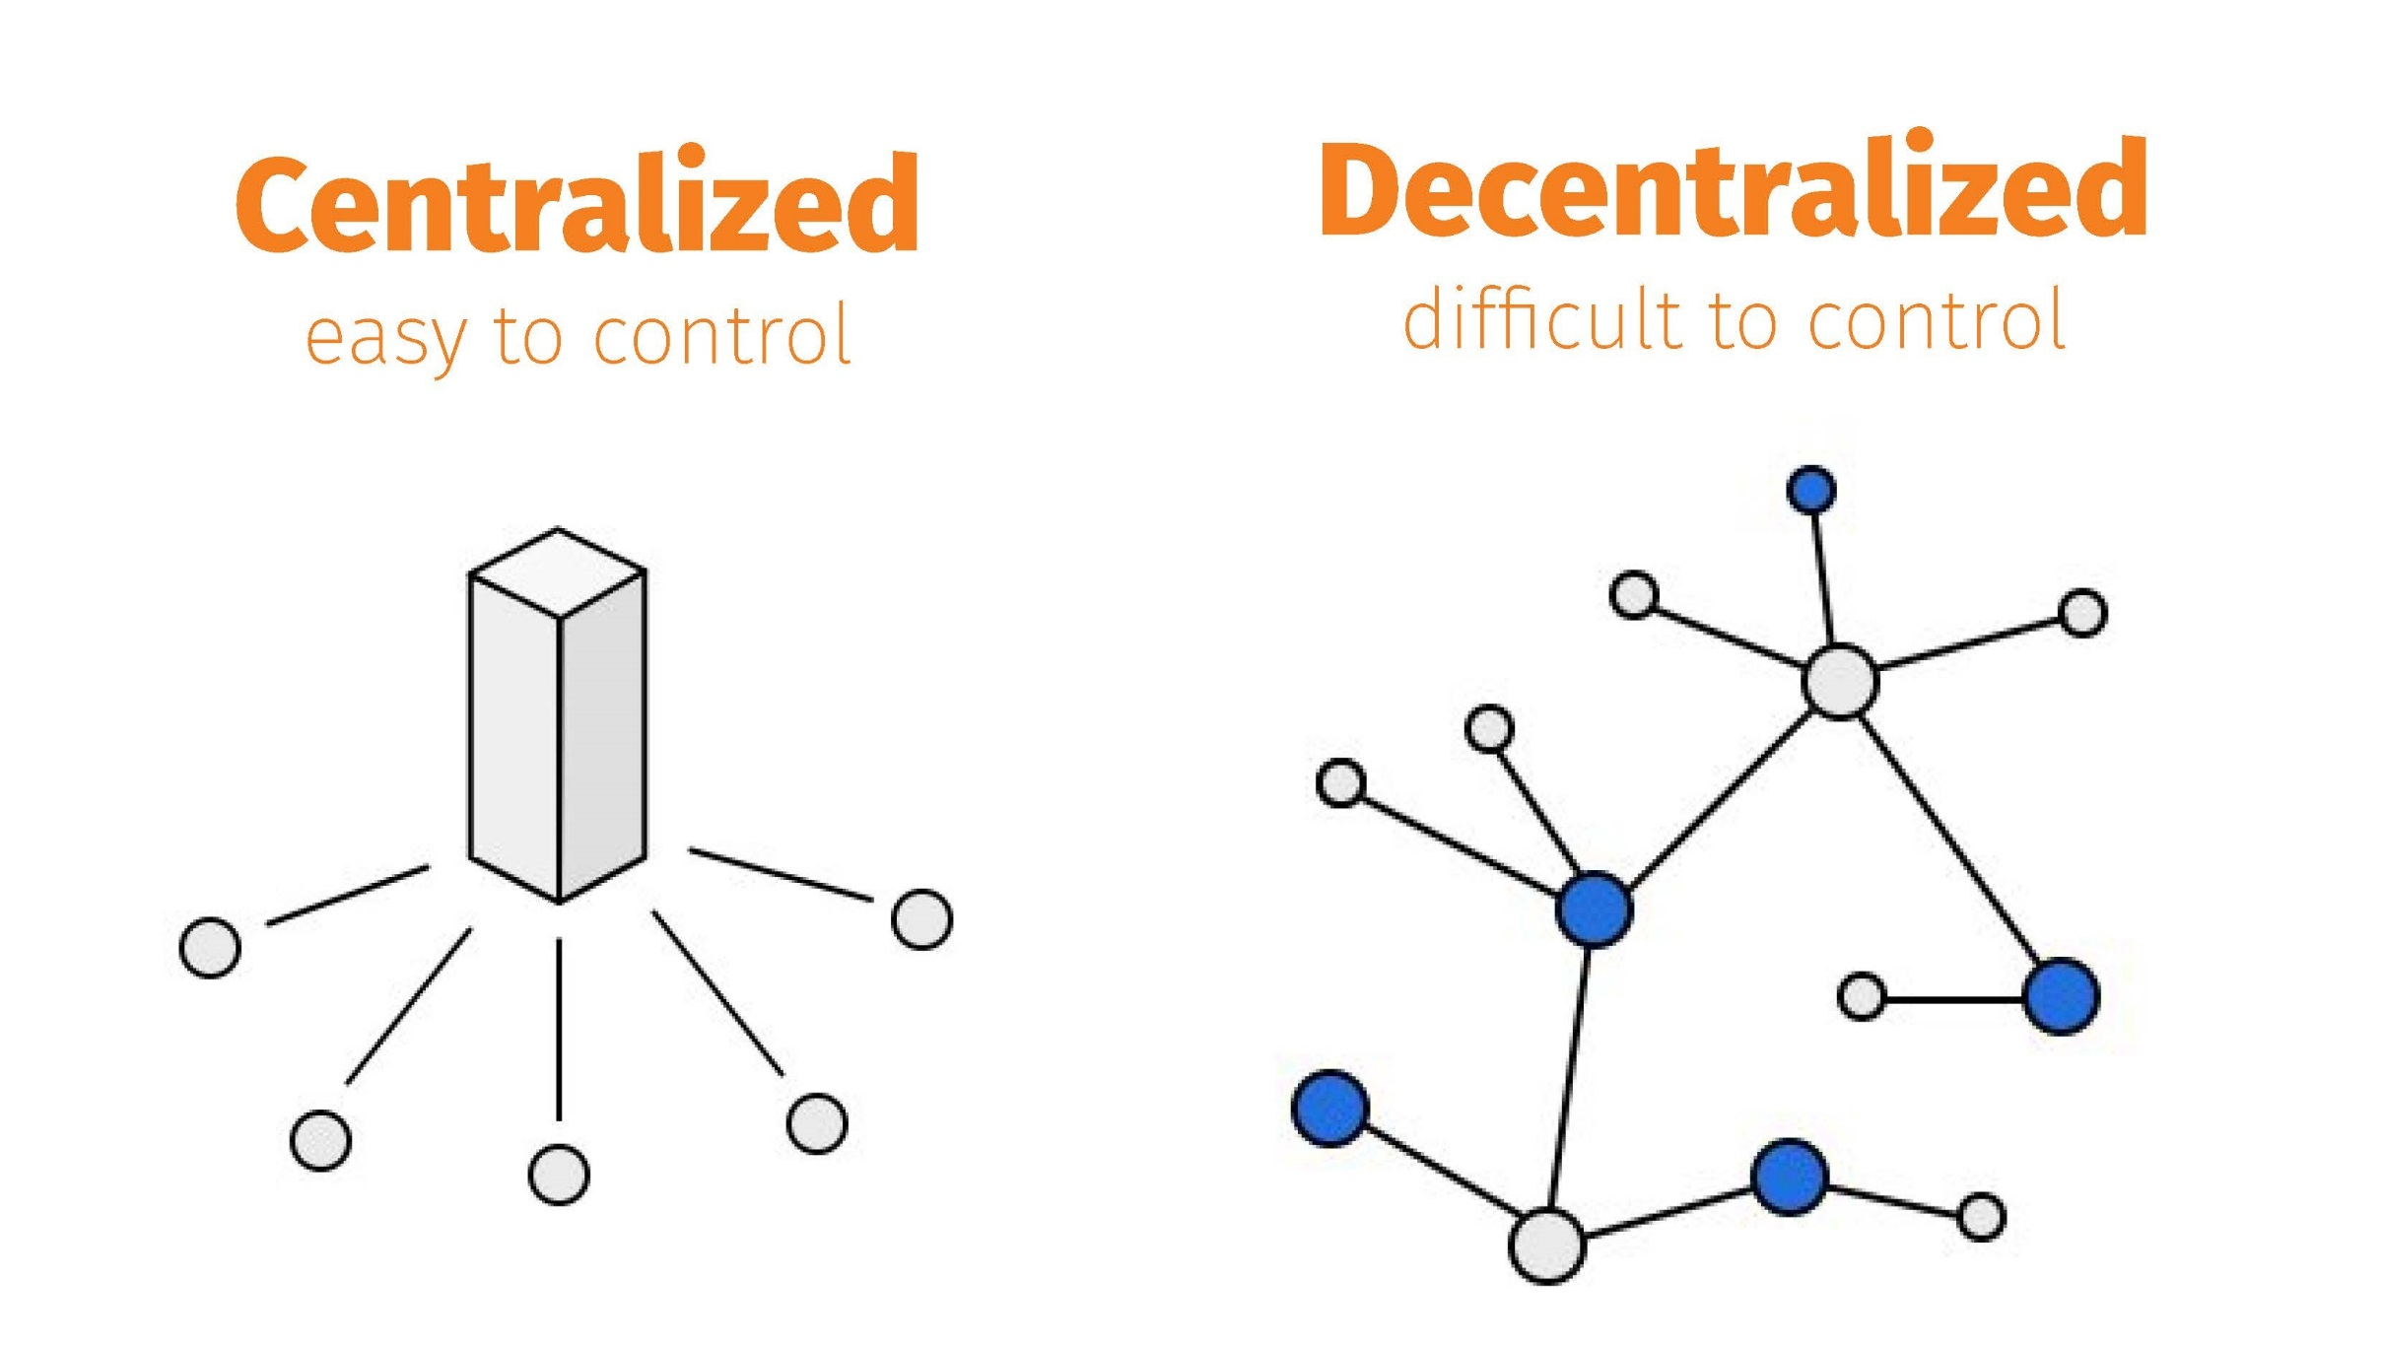

Slide 18
To be communicated
To be communicated
What we communicate

Slide 19
To be communicated
To be communicated
What we communicate

Slide 20
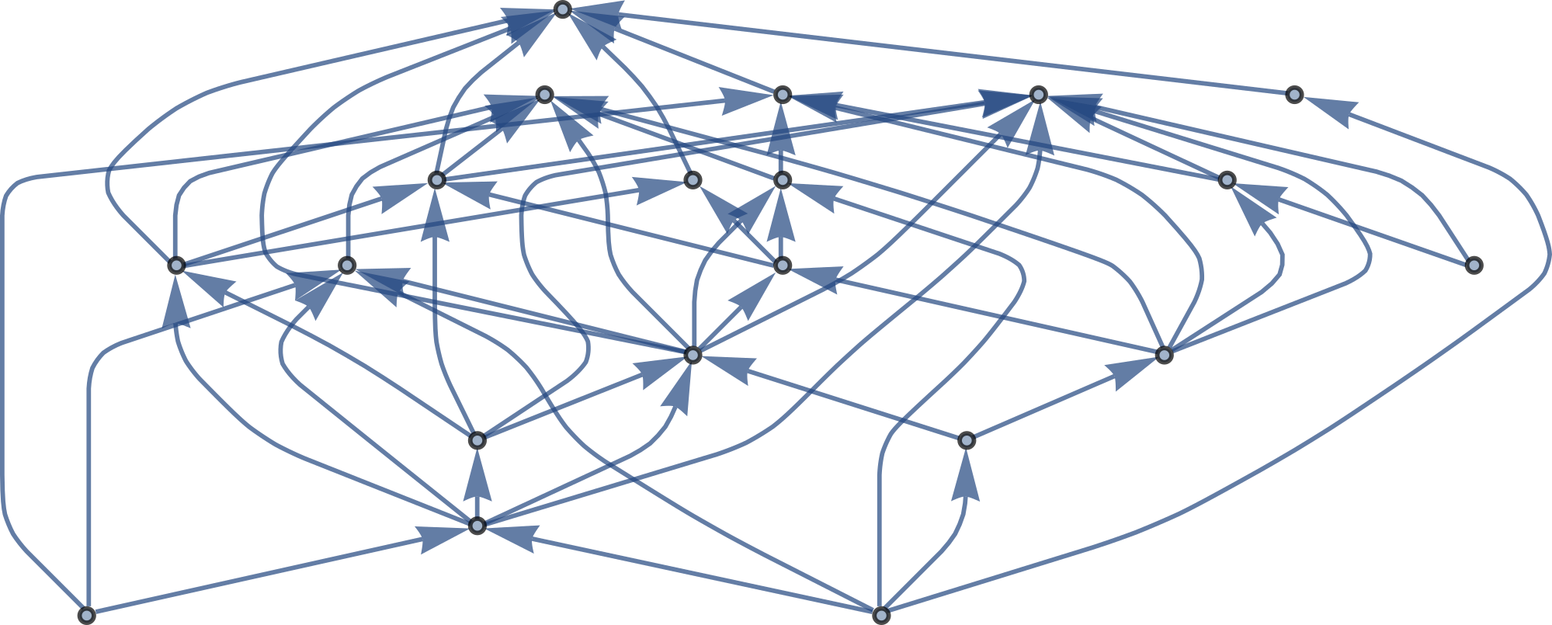
More details on evaluation? See our preprint

Slide 21
3 child modules
More details on evaluation? See our preprint

Slide 22
6 child modules
3 child modules
More details on evaluation? See our preprint
Notes:
This is different from citatoin because we focus on provenance (direct descendance) instead of relatedness (citatoins)

Slide 23

Notes:
theory
predictions
design
materials
data
code
results
discussion
summary

Slide 24




Notes:
theory
predictions
design
materials
data
code
results
discussion
summary

Slide 25





Notes:
theory
predictions
design
materials
data
code
results
discussion
summary

Slide 26
Notes:
theory
predictions
design
materials
data
code
results
discussion
summary

Slide 27
Demo
dat://proto-chris.hashbase.io

Slide 28
Evaluation
 | Current system | Proposal
Outputs | Papers | Research modules
Indicator | JIF / h-index / citation counts | Network indicators
Temporality of evaluation | Backward-looking | Backward-looking + forward-looking
Rewards | Where you publish | Contributions + impact

Slide 29
Take aways (didn’t cover everything)
Modular comms can change evaluation and incentive structures
Continuous communication prevents questionable research practices and selective publication
Communication before article outside of publisher’s realm of influence, within researcher’s realm
Researcher decides when and what to communicate (discussion + revision still possible)
Long term, stable, and open archiving with p2p protocols
P2p protocols = open by design => creator = owner
Sell new ways to discover/consume information instead of selling access
Slides at: http://bit.ly/sgmeawop

