Slide 1
Why I hope that Statcheck is useless within one year: A case for dynamic documents
Marino van Zelst

Slide 2
Dynamic documents in R Markdown
Massive disclaimer: I seriously do not know what I’m doing. I try stuff and it works at times. Please consider trying stuff too. It’s fun.

Slide 3

I’m serious

Slide 4
Dynamic reporting in R Markdown
Massive disclaimer: I seriously do not know what I’m doing. I try stuff and it works at times. Please consider trying stuff too. It’s fun.

Slide 5

Bing

Slide 6
A short history
  Literate programming (Knuth, 1984)
  Dynamic documents in R (Xie, 2015)
  Sweave: Integration of R into LaTeX documents
  knitr: Sweave + RMarkdown format, caching, + other language support (Python, C++, etc.)
  knitr is backbone of R Markdown –> Focus of today

Slide 7
Why should everybody document dynamically - A tripartite
  Statistical inconsistencies are everywhere.. (Nuijten et al., 2016)
  Reproducibility = life
  Doing manual work in 2018 seems rather silly

Slide 8
Statistical inconsistencies are everywhere
  Inconsistencies in psych: it’s bad (Nuijten et al., 2016). Replication in management: same/worse (van Zelst et al., work in progress)
  Reasons are well-known: typos, copy-paste errors, incorrect rounding, etc.
Solution 1: Statcheck
  But statcheck can only read APA
  Statcheck shows where you were wrong, but doesn’t fix it

Slide 9
Statistical inconsistencies are everywhere (2)
Solution 2: tidystats
  R-only, although I’m not sure why this is a problem (:
  Does not yet support most analyses
  Specific output (e.g. CIs) has to be added manually
Also: tidystats solves other problems than R Markdown does
Also: use tidystats and R Markdown together (Sleegers, 2018)

Slide 10
Statistical inconsistencies are everywhere (3)
R Markdown offers some encompassing solutions:
  It’s not after the fact: mistakes are prevented while writing
  Supports all analyses (e.g., I managed to produce CIs in a table from meta-analytic structural equation modeling)
  If R can analyze it, R Markdown can print it
Downside:
  The good old steep learning curve

Slide 11
Reproducibility = problem then, problem now
“God blessed them and said to them,”Be fruitful and reproduce" (Genesis 1:28; 9:1)

Slide 12

Reproducibility

Slide 13
Reproducibility = life
  Will you capable of reproducing your own results in half a year from now?
  Will your co-authors be able to do this?
  Will a colleague that is not a co-author?
  An independent researcher who’s in your field of expertise?
Data package requirement (mandatory!): be able to reproduce all your results in reasonable amounts of time

Slide 14
Reproducibility = life (2)
Remember those methods sections where you seem to be unable to understand what the authors did?
Even if you have the syntax/code, would you be able to figure out which analysis produces which result in the paper?

Slide 15

Reproducibility = life (3)
What did I just read

Slide 16
Reproducibility = life (4)
Complete R Markdown file can be self-contained (including main text, data manipulation, analyses, formatting)
You always understand which number was produced by which analysis at the exact place in your manuscript
  Don’t forget to keep annotating your code: you will forget what you did

Slide 17
Doing manual work in 2018 seems rather silly
“we have to manually copy over statistical results into or out of a manuscript” (Sleegers, 2018)
Manual work situations that can be prevented:
  Redoing analyses when some new data came in (e.g., new papers for your meta-analysis)
  “Can you try this other statistical specification and send me the table with output?”
  “Let’s submit to this other journal which has completely different formatting requirements”
That seems like a serious waste of time..

Slide 18
Conclusion
Several research-process related problems:
  Not all statistics are correctly reported
  Non-reproducible research is not research –> we cannot take it seriously
  Wasting time on non-useful actions
Dynamic documents/dynamic reporting solves this

Slide 19
Some general statements about R Markdown
Able to produce:
  Word / ODT
  PDF (LaTeX)
  html / Github compatible markdown
  Slides for presentation
  Shiny documents
Can import:
  data / other R-files / ‘internet’ files / bib-file / csl-file

Slide 20
R Markdown functionality
R Markdown integrates text (Markdown / LaTeX), data manipulation (R), analyses (R), and formatting (Markdown / LaTeX)
Data analysis workflow becomes:
  Draft intro, theory, methods within Markdown
  Data preparation
  Data analysis
  Write results using code in Markdown file
  Format document within Markdown file
  Print and submit!

Slide 21
R Markdown functionality (2)
How does it work?
You write your normal text (similar to e.g. Word) but add ‘code chunks’ in your text.
Code chunks act like normal R analyses. I actually often write my code in R to try it until it works and then copy paste it to R Markdown.
When you save results to objects (like in R), you can extract the results from those objects in your main text or put them into graphs/tables.

Slide 22
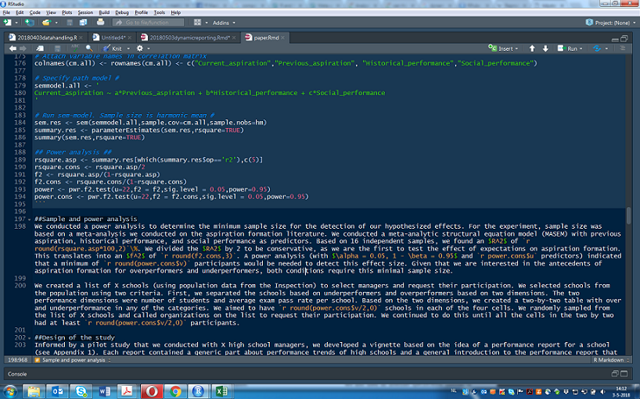
Example

Slide 23
So let’s put this into practice #hoedan
Today, I will show some examples of how to build an R Markdown document, how text drafting looks and how you can insert results and other statistical output in your document.
Fasten your seatbelts.

Slide 24
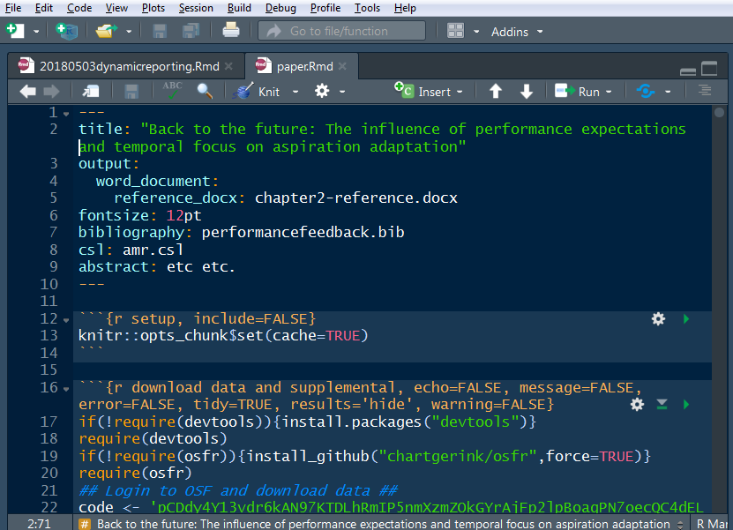
Creating a document
yaml header

Slide 25
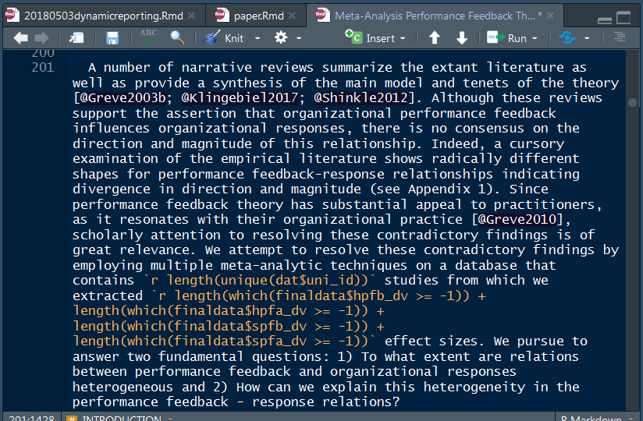
Write your draft
main text

Slide 26
How about analyses?
We’ll start with the Student’s sleep data (again)
res <- t.test(extra ~ group, data = sleep, var.equal = TRUE)
Code:
We found a significant positive effect of drugs on hours of sleep, r*t*(res$parameter) = round(res$statistic,3), p = round(res$p.value,3).
Produces:
We found a significant positive effect of drugs on hours of sleep, t(18) = -1.861, p = 0.079.

Slide 27
Let’s move it up a notch
We conducted a meta-analysis on organizational performance feedback which tests to what extent firms change their strategies in response to negative performance feedback.
Obviously, we wanted to test some moderators and conducted a meta-regression.
spfb.wls <- rma(spfb , mods=~ public + finance*mean_age + service +
hightech + change + search, var, method="DL",
data=dat, test="knha")
res.spfb <- list(spfb.wls)

Slide 28
Writing the results section
Code:
# For social performance feedback, we find that firms are significantly
# more responsive to non-financial performance feedback below the
# aspiration level ($\beta$ = ` round(spfb.wls$b[3],3)`,
# *p*-value = ` round(spfb.wls$pval[3],3)`).
Produces:
For social performance feedback, we find that firms are significantly more responsive to non-financial performance feedback below the aspiration level ($β$ = -0.085, p-value = 0.006).

Slide 29
Producing table
Let’s say you also want to produce a table with the results.
knitr allows for easy table production, if you can configure your code right (this will take (many) trial and error runs)
knitr::kable(data.frame(name=c("Constant","Public firm","Finance",
"Firm age","Service","High-tech","Change","Search","Interaction MetricAge"),
HPFBA = sapply(res.spfb, function(x) x`$`b),
CIlb = sapply(res.spfb, function(x) x`$`ci.lb),
CIub = sapply(res.spfb, function(x) x`$`ci.ub),
Pvalue=sapply(res.spfb, function(x) x`$`pval),
digits=3, col.names=c("Variable","PF < HA","CI~lb~","CI~ub~",
"*p-value*"),
caption = "Table 3: Meta-analytic weighted
least squares for social performance feedback")

Slide 30
Table time
Variable | PF < HA | CI_{lb} | CI_{ub} | p-value
Constant | 0.024 | -0.073 | 0.121 | 0.612
Public firm | -0.158 | -0.203 | -0.114 | 0.000
Finance | -0.085 | -0.144 | -0.026 | 0.006
Firm age | 0.002 | 0.001 | 0.003 | 0.001
Service | -0.027 | -0.080 | 0.025 | 0.299
High-tech | 0.022 | -0.018 | 0.062 | 0.269
Change | 0.073 | -0.008 | 0.154 | 0.075
Search | 0.006 | -0.067 | 0.079 | 0.873
Table 3: Meta-analytic weighted least squares for social performance feedback

Slide 31
So we wanted to plot some meta-analytic interaction. We interact our ‘performance metric’ variable with ‘organizational age’.
require(metafor)
dat$spfb <-0.5*log((1+dat$spfb_dv)/(1-dat$spfb_dv))
spfb.wls <- rma(spfb,mods=~ public + finance*mean_age + service +
hightech + search + change,var,data=dat,
method="DL",test="knha")
wi <- 1/sqrt(dat$var)
size <- 0.5 + 1.5*(wi - min(wi))/(max(wi) - min(wi))
plot(dat$mean_age, dat$spfb_dv, pch=19, xlim=c(0,120), ylim=c(-0.5,0.5), cex=size,
xlab="Firm age (years)", ylab="Correlation", las = 1, bty="l")
preds.nonfinance <- predict(spfb.wls, newmods=cbind(1,0,0:120,0,0,0,0,0))
lines(0:120, preds.nonfinance$pred,col="red",lwd=2)
lines(0:120, preds.nonfinance$ci.lb,lty="dotted",col="red",lwd=2)
lines(0:120, preds.nonfinance$ci.ub,lty="dotted",col="red",lwd=2)
preds.finance <- predict(spfb.wls, newmods=cbind(1,1,0:120,0,0,0,0,0:120))
lines(0:120, preds.finance$pred,col="blue",lwd=2)
lines(0:120, preds.finance$ci.lb,lty="dotted",col="blue",lwd=2)
lines(0:120, preds.finance$ci.ub,lty="dotted",col="blue",lwd=2)
legend("topright", legend=c("Non-financial","Financial"),lty=c("dotted","solid"),col=c("red","blue"),lwd=2)
title("P < SA for public")

Slide 32
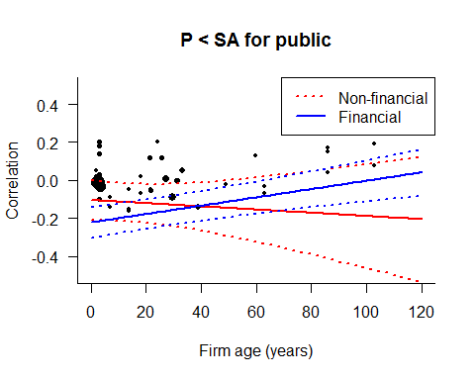
Plot

Slide 33
Reporting statistics
Because all statistics are structured in a manner you devised, it is very easy to write functions that return whatever-style output.
Using code inside your text allows you to specify where you want statistical output, which can be individual tests, tables, graphs, etc.

Slide 34
Self-contained files
Being smart with packages allows you to make a completely self-contained paper within your Rmd file
if(!require(devtools)){install.packages("devtools")}
require(devtools)
if(!require(osfr)){install_github("chartgerink/osfr",force=TRUE)}
require(osfr)
download_files('bj786', private=TRUE) #masterdata.csv
download_files('wqyz2', private=TRUE) #reference file for formatting
download_files('pz3kx', private=TRUE) #20170711studies.csv
download_files('3v9jf', private=TRUE) #csl file for AMR references
download_files('g6xur', private=TRUE) #references
Live example from a conference paper

Slide 35
Limitations of R Markdown
The pesky learning curve:
  Producing a text file with numbers: rather easy
  Producing a formatted docx/PDF with tables: doable’ish
  Producing a presentation with analyses, tables, that is nicely formatted: ????
For PhD students:
  “My supervisor doesn’t understand this”

Slide 36
Concluding thoughts
I think reproduciblity is a daily process. Reproducible research starts today; not when your project is done.
When the TSB Science Committee requests to check your paper, you should be able to send them what they request within five minutes.
R Markdown is a great tool to help you do that.

