Slide 1




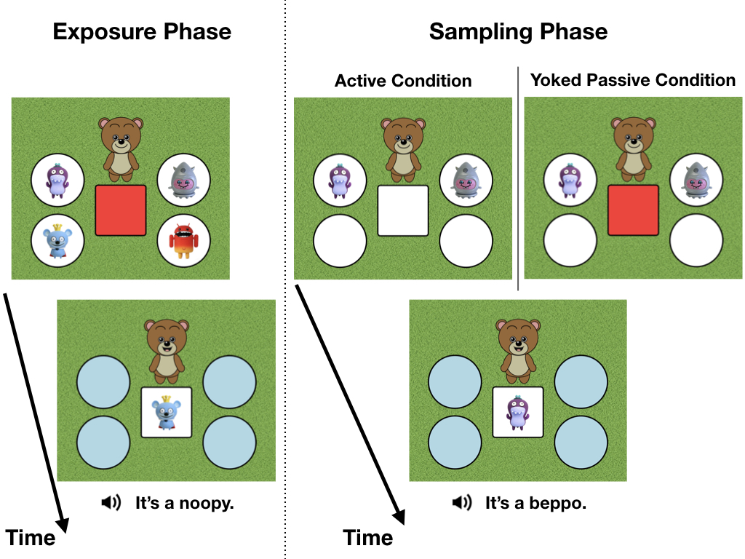
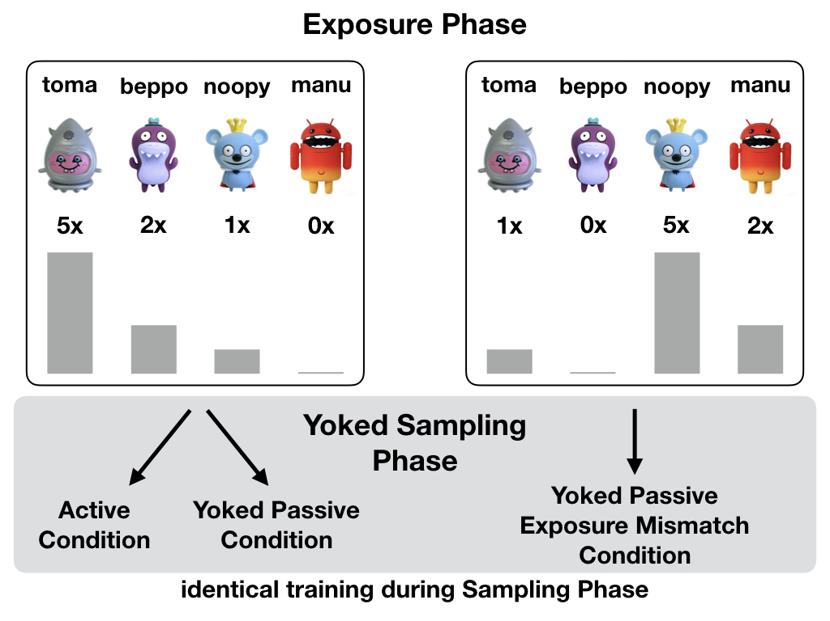
How does active sampling support learning new words?
Martin Zettersten¹, Koeun Choi², Heather Kirkorian³ & Jenny Saffran¹
¹Department of Psychology, ³Human Development and Family Studies Department, University of Wisconsin-Madison
²Department of Human Development and Family Science, Virginia Polytechnic Institute and State University
NSF-GRFP DGE-1256259 to M.Z.
2019 CDS 10-19-2019
DESIGN
SAMPLING
LEARNING
Participants: 226 3-5-year-olds (M = 4.6 years; 117 F)
+1/-1 SEs
Active samples tuned to past word exposure lead to better learning
There is an overall effect of training condition on test accuracy (χ²(2) = 6.46, p = .04).
Exposure Phase: Varied word frequencies
Children viewed 4 novel object-label associations across 8 exposure trials. The exposure frequency varied across the 4 novel words (0, 1, 2, or 5 occurrences).
Active choices depend on exposure frequency/
During the sampling phase, children in the Active condition were more likely to select words they heard less frequently in the Exposure Phase (z = 4.45, p < .001).
Lower-exposure words are selected more frequently.
Pairwise comparisons demonstrate that children in the Active condition consistently selected words with fewer exposures.
95% CIs
Sampling Phase: Active vs. passive learning
Children completed 6 training trials in which they chose between one of two novel word options on a touchscreen (Active condition) or tapped the screen to view the selections of an Active condition participant that had the same exposure (Yoked Passive condition) or a mismatched exposure (Yoked Passive Exposure Mismatch condition).
Children in the Active condition learn novel words better than children learning from the same samples, but with different past exposure.
Pairwise comparisons revealed that children in the Active condition had higher test accuracy than children in the Yoked Passive Exposure Mismatch condition z = 2.52, p = .01)
CONCLUSION
Choices are predicted by label informativeness.
Selections reflect the changes in each word’s informativeness (-log relative frequency) across training (exposure + past sampling).
Children are sensitive to past exposure and make informative selections when choosing what to learn about next. (see also e.g., Sim et al. 2013)
Active samples benefit learning when tuned to past experience. (see also e.g., Partridge et al. 2015)
QR CODE HERE
Test Phase: Word knowledge tested in 8 2-AFC trials
Word knowledge was tested in 8 2-alternative forced-choice (2-AFC) trials on the touchscreen.
z = 6.24, p < .001

