Slide 1
Final Exam Study Guide
IT 306

Slide 2
Final Exam Study
The Exam is cumulative. It covers all the chapters and lectures covered in the class.
The exam is a combination of multiple choice, true/false, short answer, and problem solving questions.
Bring your Mason id to exam.

Slide 3
Sort Algorithm
In a selection sort of n elements, how many times is the swap function called in the complete execution of the algorithm? Explain your answer.
Perform an insertion sort on the following list of integers. Show your work. 0, 15, 7, 27, 4, 5

Slide 4
Files and Exceptions
Suppose that f is a reference to a file with directory "src/MyFiles/file.txt" is used to write data into it. What happens at runtime if the directory "MyFiles" does not exist under directory "src"?

Slide 5
Search Algorithm
Here is an array with exactly 15 elements: 1 2 3 4 5 6 7 8 9 10 11 12 13 14 15 Suppose that we are doing a binary search for an element. Indicate any elements that will be found by examining two or fewer numbers from the array. Explain your answer.

Slide 6
Recursion
Don't change the signature of the method. Write a recursive method with two int parameters, m and n. The precondition requires 0 <= m and m <= n. The method prints a line of m asterisks, then a line of m+1 asterisks, and so on up to a line of n asterisks. Then the same pattern is repeated backward: a line of n asterisks, then n-1, and so on down to n. The only loop allowed in your implementation is a loop to print a line of m asterisks. You may have two copies of this loop in different places of the implementation.
public static void printAsterisk (int m , int n){//TODO...}

Slide 7
Stack
Which of the stack operations could result in stack overflow? Explain.

Slide 8
Binary Search Tree
Suppose that a binary search tree contains the number 42 at a node with two children. Write two or three clear sentences to describe the process required to delete the 42 from the tree.

Slide 9
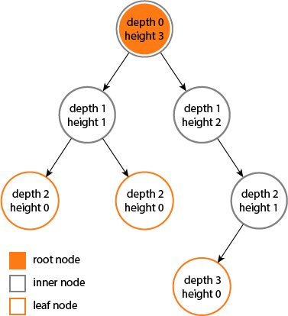
Tree
What is the difference between depth of a node and height of a node in a tree?
The depth of a node is the number of edges from the node to the tree's root node.
A root node will have a depth of 0.
The height of a node is the number of edges on the longest path from the node to a leaf.
A leaf node will have a height of 0.

Slide 10
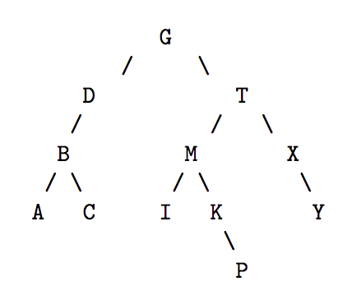
Tree Traversal
what is the result of in-order traversal of this tree?

Slide 11
Big O Notation
What is the order of each of the following tasks? (Choose from O (1), O (log2 n ), O (n ), O (n log2 n ), O (n2 ), O (2n ); each order may appear more than once.)
(a) Popping an item off a stack containing n items.
(b) Inserting a single item into a binary tree containing n items, in the worst case.
(c) Performing a bubble sort on an array of n integers, in the worst case.
(d) Displaying all n elements in a sorted linked list.
(e) Performing a binary search of a sorted array of n strings, in the worst case.

Slide 12
Set
Write some lines of code to store the following information in a way that no duplicate is stored. Do NOT use for-loop to prevent duplicate content. The data structure used to store the array elements should be able to provide the output in a sorted order.
String[] inputs = {"Mary" , "Donna", "Nina" , "Mary" , "Lisa"};

Slide 13
Graph
Fundamentals of Graph
Traversal Algorithms
Lecture material
Complexity of Graph operations

Slide 14
Priority Queues
Operations
Complexity
Applications
Java Library

Slide 15
Heaps and Priority Queues
We can use a heap to implement a priority queue
We store a (key, element) item at each internal node
We keep track of the position of the last node
For simplicity, we show only the keys in the pictures
(2, Sue)
(5, Pat)
(6, Mark)
(9, Jeff)
(7, Anna)

Slide 16
Memory Management
Heap Management
Garbage Collection
Lecture material must be studied.

