Slide 1
Dataset & Business Problem
New Zealand earthquake activity and business continuity
Which regions deserve closer continuity review?
Source | Contribution | Coverage
GeoNet | Earthquake activity | 100,739 rows, 21 fields 2020-2024
Stats NZ | Business locations and employees | 170 regional observations 2016-2025
Official regional boundaries | Common spatial reference | 2025 polygons
Ming Zhao MBI807B
1
Notes:
SLIDE 1
Timing: 0:00-0:45 (45 seconds)
Good morning. I am Ming Zhao. This project asks which New Zealand regions deserve closer business continuity review. GeoNet supplies over one hundred thousand raw records with twenty-one fields, including dates, numbers and categories. I integrate these with Stats New Zealand business data using official regional boundaries. Earthquakes cover twenty twenty to twenty twenty-four. The dashboard uses February twenty twenty-five business locations as planning context. These mean operating sites, rather than separate companies. The sources are authoritative and publicly available.
Presenter action: Introduce the planning question. GeoNet has 100,739 raw rows and 21 fields, exceeding 15,000 rows / 12 columns. Dates, numbers, text and categories are present. The dashboard uses February 2025 business context. Public regional aggregates cannot identify individual premises or measure losses. Geographic units are business operating locations.
Sources and evidence:
- GeoNet. (n.d.). Earthquake catalogue. https://www.geonet.org.nz/data/types/eq_catalogue
- Stats NZ. (2025a). New Zealand business demography statistics at February 2025. https://www.stats.govt.nz/assets/Uploads/New-Zealand-business-demography-statistics/New-Zealand-business-demography-statistics-At-February-2025/Download-data/new-zealand-business-demography-statistics-at-february-2025.xlsx
- Stats NZ. (2025b). Regional Council 2025. https://services2.arcgis.com/vKb0s8tBIA3bdocZ/arcgis/rest/services/Regional_Council_2025/FeatureServer/0
- C:/Users/mzha0/Desktop/Yoobee College/MBI807B_NZ_Earthquake_Business/TechnicalPortfolio/04_Data_Examples/Raw_Data/source_manifest.json
- C:/Users/mzha0/Desktop/Yoobee College/MBI807B_NZ_Earthquake_Business/Report/_MBI807B_Report_NZ_EN.docx

Slide 2
Storage & Architecture
Method | Integrity and security | Cost and scale
CSV / Excel | Manual checks. File permissions. | Low setup effort. Weak shared editing.
SQLite (selected) | Keys and constraints. OS file permissions. | No server setup. One writer at a time.
Managed PostgreSQL | Constraints and managed user roles. | Hosting and admin effort. Concurrent writers.
Implemented architecture
Python loads SQLite. SQL views export clean CSVs.
Power BI imports the CSVs into its semantic model.
Shared regional dimension, separate earthquake and business fact tables
2
Notes:
SLIDE 2
Timing: 0:45-1:30 (45 seconds)
I compared flat files, SQLite and managed PostgreSQL. Files are easy to exchange, but need manual consistency controls and permissions. SQLite avoids server setup and enforces keys and constraints, making it suitable for this portable, single-user project. Its security depends on operating-system file access. PostgreSQL adds managed users and concurrent writes, with hosting and administration costs. The implemented flow is Python to SQLite, then validated CSV exports into Power BI. Separate fact grains prevent business totals from repeating across earthquake records.
Presenter action: SQLite is the portable authoritative store. Power BI imports validated CSVs and does not directly connect to SQLite. File permissions describe the access-control dependency, not newly implemented enterprise authentication. PostgreSQL was evaluated, not deployed. Cost comparison is qualitative: no measured cost or performance claims. Public aggregate scope limits privacy exposure. Future premises data needs permission checks and controlled access. The trade-off is lower setup effort versus central administration, managed roles and concurrency.
Sources and evidence:
- SQLite. (n.d.). Appropriate uses for SQLite. https://www.sqlite.org/whentouse.html
- PostgreSQL Global Development Group. (n.d.). Constraints. https://www.postgresql.org/docs/current/ddl-constraints.html
- PostgreSQL Global Development Group. (n.d.). Database roles. https://www.postgresql.org/docs/current/user-manag.html
- C:/Users/mzha0/Desktop/Yoobee College/MBI807B_NZ_Earthquake_Business/TechnicalPortfolio/01_Database/schema.sql
- C:/Users/mzha0/Desktop/Yoobee College/MBI807B_NZ_Earthquake_Business/TechnicalPortfolio/02_ETL_Code/run_etl.py
- C:/Users/mzha0/Desktop/Yoobee College/MBI807B_NZ_Earthquake_Business/TechnicalPortfolio/02_ETL_Code/prepare_powerbi.py
- C:/Users/mzha0/Desktop/Yoobee College/MBI807B_NZ_Earthquake_Business/Report/_MBI807B_Report_NZ_EN.docx

Slide 3
ETL Process
01
Extract
Check hashes of all 14 supplied source files
02
Clean
Validate UTC dates, numeric fields and event IDs
03
Integrate
Map epicentres to regions. Aggregate before joining business data
04
Load and verify
Check the candidate database before publication
100,739 raw records = 99,779 earthquakes + 960 rejected records
17 checks passed, including raw reconciliation and exact SQL restoration
3
Notes:
SLIDE 3
Timing: 1:30-2:20 (50 seconds)
The ETL process first checks the hashes of fourteen source files. It validates dates, numeric fields and event identifiers. The pipeline retains ninety-nine thousand, seven hundred and seventy-nine earthquakes and rejects nine hundred and sixty other records. No duplicate event identifiers were found. Spatial matching assigns epicentres to official regional polygons, while unmatched events remain visible. I aggregate earthquakes before joining business figures to prevent double counting. The pipeline checks a candidate database before publication. Independent raw-data reconciliation and exact SQL restoration passed.
Presenter action: Rejected records are non-earthquake or unclassified observations. Preserve offshore/unmapped events as category 00. No duplicate Public IDs were observed.
Sources and evidence:
- C:/Users/mzha0/Desktop/Yoobee College/MBI807B_NZ_Earthquake_Business/TechnicalPortfolio/02_ETL_Code/run_etl.py
- C:/Users/mzha0/Desktop/Yoobee College/MBI807B_NZ_Earthquake_Business/TechnicalPortfolio/01_Database/schema.sql
- C:/Users/mzha0/Desktop/Yoobee College/MBI807B_NZ_Earthquake_Business/TechnicalPortfolio/04_Data_Examples/Verification/analysis_results.json
- C:/Users/mzha0/Desktop/Yoobee College/MBI807B_NZ_Earthquake_Business/TechnicalPortfolio/04_Data_Examples/Verification/validation_results.json

Slide 4
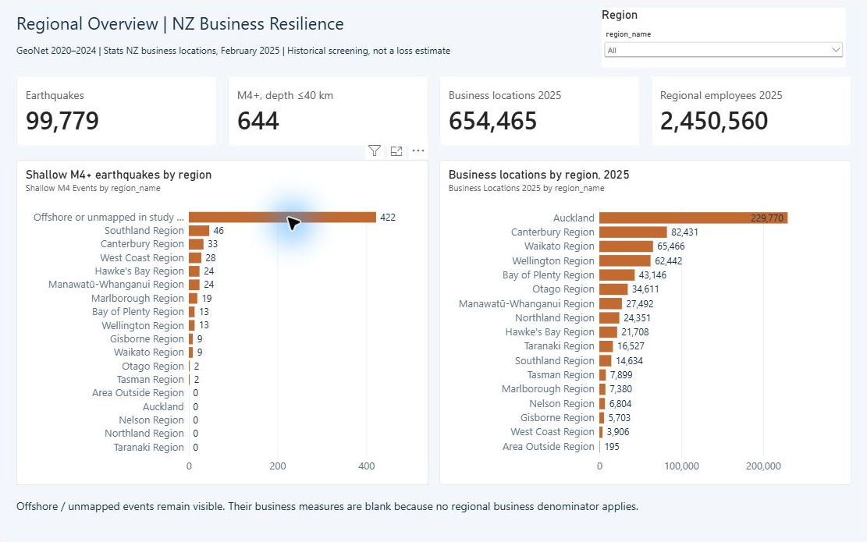
Dashboard Demo
Regional comparison
Canterbury
33 qualifying events
82,431 locations
Auckland
0 qualifying epicentres
229,770 locations
Clear selection
to restore All
Qualifying events: magnitude ≥4 and depth ≤40 km, 2020-2024
4
Notes:
SLIDE 4
Timing: 2:20-3:15 (55 seconds)
The dashboard covers regional comparisons, timing and sensitivity, and supporting evidence. I clear the filter and select Canterbury. It shows thirty-three qualifying earthquakes and about eighty-two thousand business locations. The illustrative filter means magnitude at least four and depth at most forty kilometres. I clear and select Auckland. It has zero qualifying epicentres in this extract, alongside about two hundred and thirty thousand business locations. The commercial concentration still supports broad preparedness. These figures guide different continuity discussions. I clear the filter to restore the overall view.
Presenter action: Before the talk, open the PBIX on Regional Overview with Region=All. At 2:20, switch to that report. Clear any existing selection before choosing Canterbury, then clear and choose Auckland. Finish by clearing back to All and return to slide 5 by 3:15. Each page has an independent slicer. The embedded screenshot supports a fallback explanation if live switching is unavailable. Zero qualifying epicentres in Auckland does not establish future safety. Qualifying means M>=4 and depth<=40 km. These are illustrative analyst choices.
Sources and evidence:
- C:/Users/mzha0/Desktop/Yoobee College/MBI807B_NZ_Earthquake_Business/TechnicalPortfolio/03_Dashboards/NZ_Business_Resilience.pbix
- C:/Users/mzha0/Desktop/Yoobee College/MBI807B_NZ_Earthquake_Business/TechnicalPortfolio/03_Dashboards/Screenshots/PowerBI_01_Overview.png
- C:/Users/mzha0/Desktop/Yoobee College/MBI807B_NZ_Earthquake_Business/TechnicalPortfolio/04_Data_Examples/Verification/analysis_results.json
- C:/Users/mzha0/Desktop/Yoobee College/MBI807B_NZ_Earthquake_Business/Report/_MBI807B_Report_NZ_EN.docx

Slide 5
Risks & Recommendations
Risk | Mitigation | Evidence or next step
Integrity | Hashes and key constraints | 17 checks and SQL restore
Integration | Regional aggregation and category 00 | Periods and epicentres limit inference
Security / scale | Public aggregates. Restrict file access. | Managed PostgreSQL for future shared use
Recommended first steps
Continuity lead: Canterbury review and Auckland outreach
Data owner: approve reconciled refreshes
5
Notes:
SLIDE 5
Timing: 3:15-4:00 (45 seconds)
Hashes and database constraints protect integrity. Seventeen checks and exact restoration provide supporting evidence. Regional aggregation prevents repeated business totals. Offshore events and different source periods remain explicit. Public aggregates reduce privacy exposure. Shared access would require managed permissions. PostgreSQL is a future option. The continuity lead should review Canterbury and broaden Auckland outreach. A data owner should approve reconciled refreshes. Epicentres do not measure site damage. Before site decisions, add verified premises, shaking and dependencies. Loss estimates also require vulnerability and cost evidence. Thank you.
Presenter action: Recommendations assign proposed responsibilities, not an existing organisational operating model. Implemented: source hashes, constraints, region aggregation and retained unmapped group. Tested: 17 checks and exact SQL restoration. Proposed: restricted write access, approved refreshes and migration for shared/sensitive data. The local design reduces setup burden, while an enterprise extension adds roles and administration. Retain recoverable snapshots and test restoration. Epicentres do not measure site shaking or damage. Business context is February 2025, earthquake observations are 2020-2024. There are 17,290 offshore/unmapped events including 422 of 644 qualifying events. Financial loss estimates need vulnerability and cost evidence. End at four minutes, then invite questions.
Sources and evidence:
- National Emergency Management Agency. (n.d.). Get your work ready for an emergency. https://getready.govt.nz/prepared/work
- SQLite. (n.d.). Appropriate uses for SQLite. https://www.sqlite.org/whentouse.html
- C:/Users/mzha0/Desktop/Yoobee College/MBI807B_NZ_Earthquake_Business/Report/_MBI807B_Report_NZ_EN.docx
- C:/Users/mzha0/Desktop/Yoobee College/MBI807B_NZ_Earthquake_Business/TechnicalPortfolio/04_Data_Examples/Verification/analysis_results.json
- C:/Users/mzha0/Desktop/Yoobee College/MBI807B_NZ_Earthquake_Business/TechnicalPortfolio/04_Data_Examples/Verification/validation_results.json

