Slide 2
What kind of claims to ask for records, ?? Limit to relevant providers or procedures

Slide 3
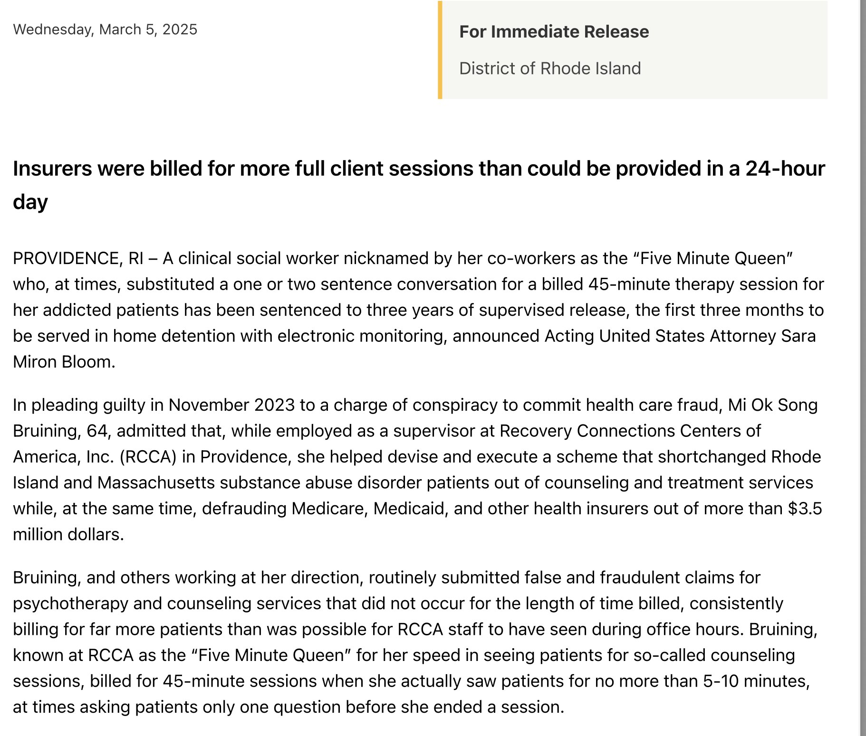
Reported Hours More than Possible

Slide 4
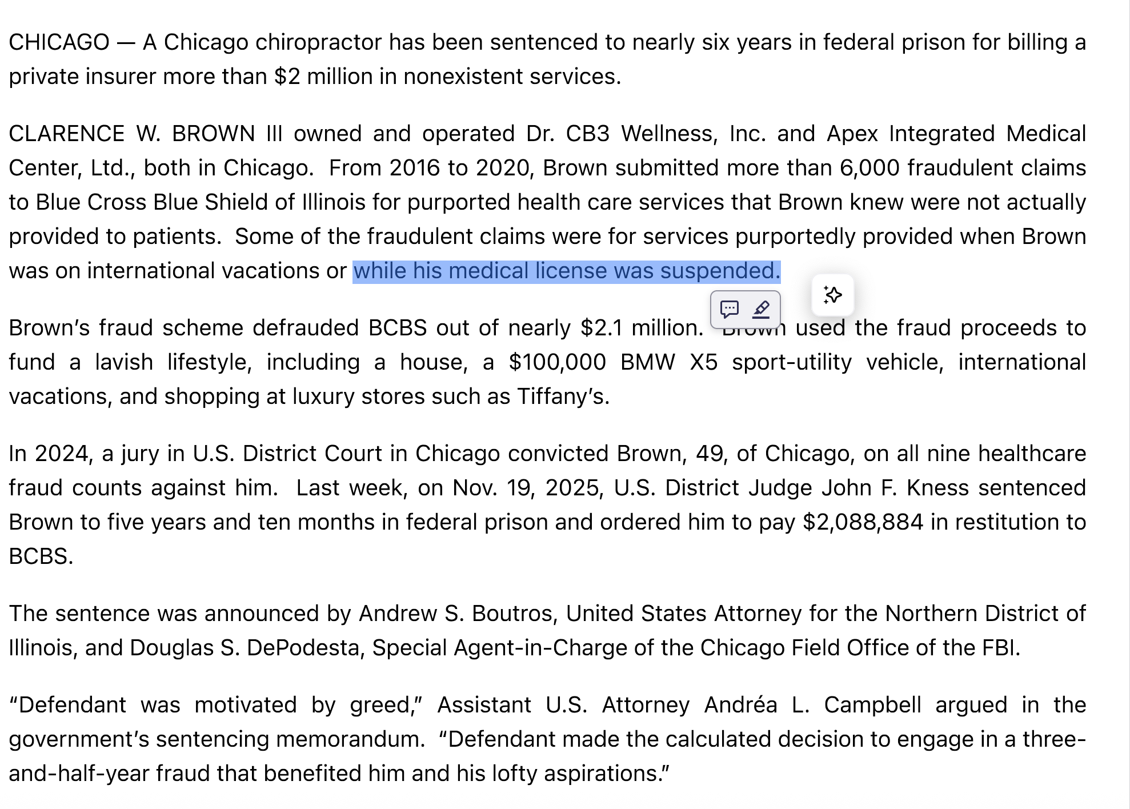
Why CBS-IL does not check the licenses?=

Slide 5
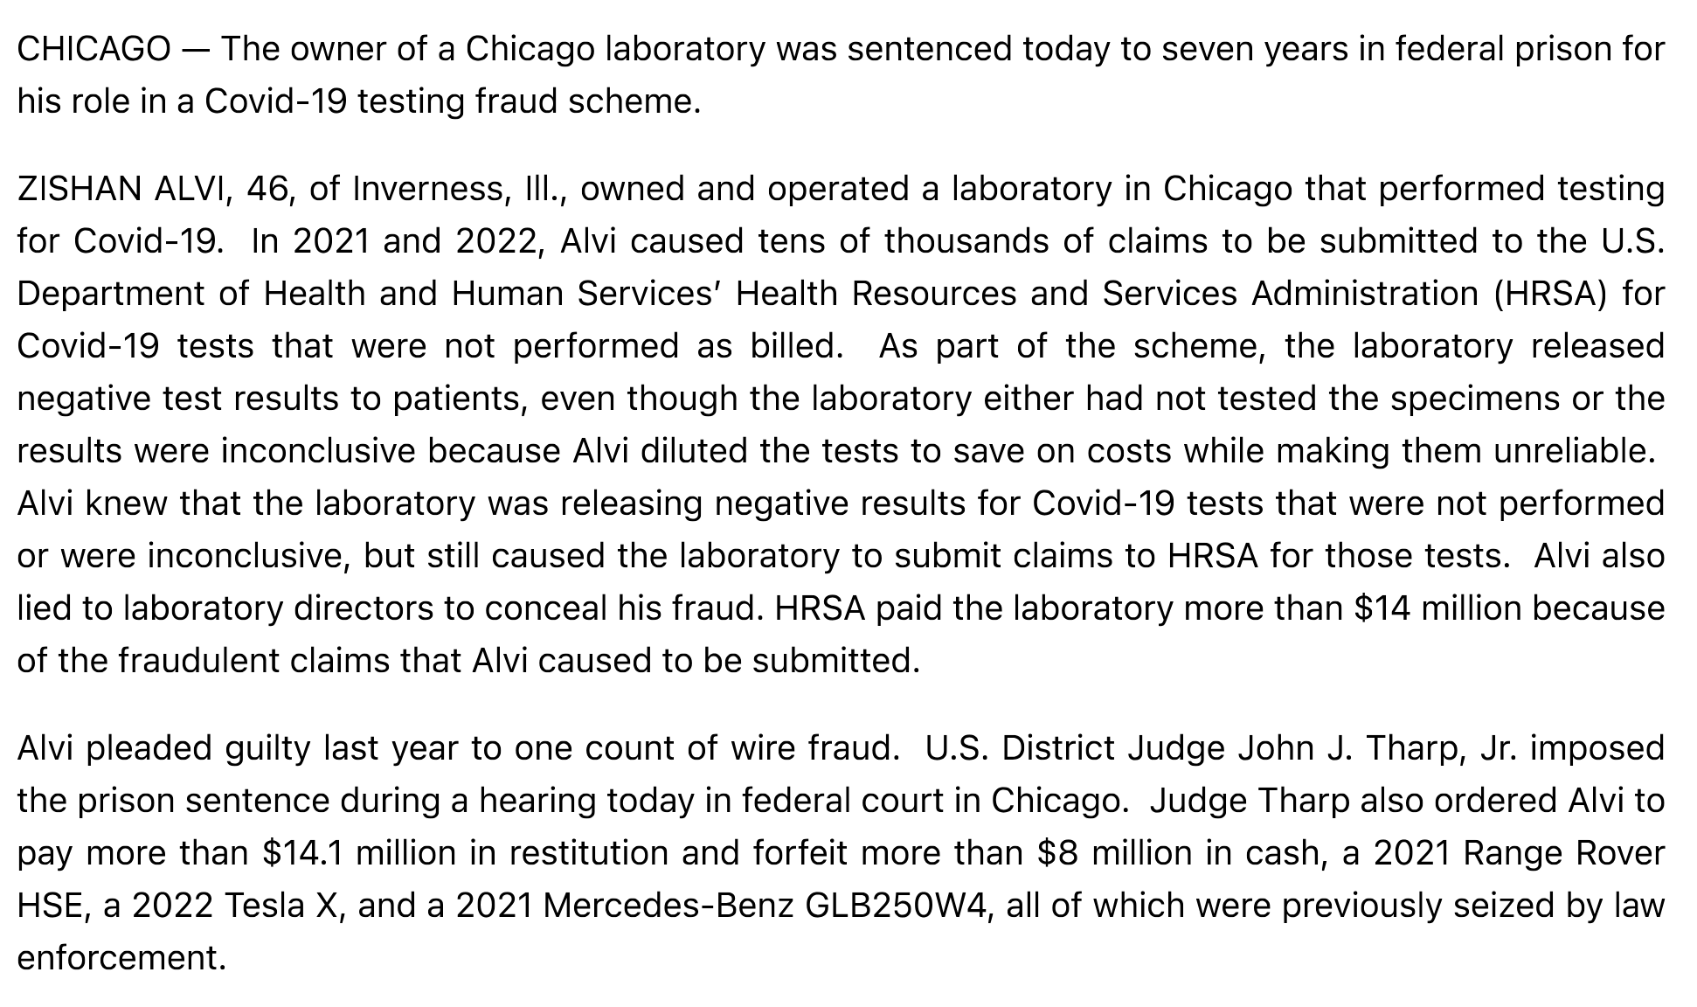
CoVID Fraud, Won’t the Volume shows sign of steep climb?

Slide 6
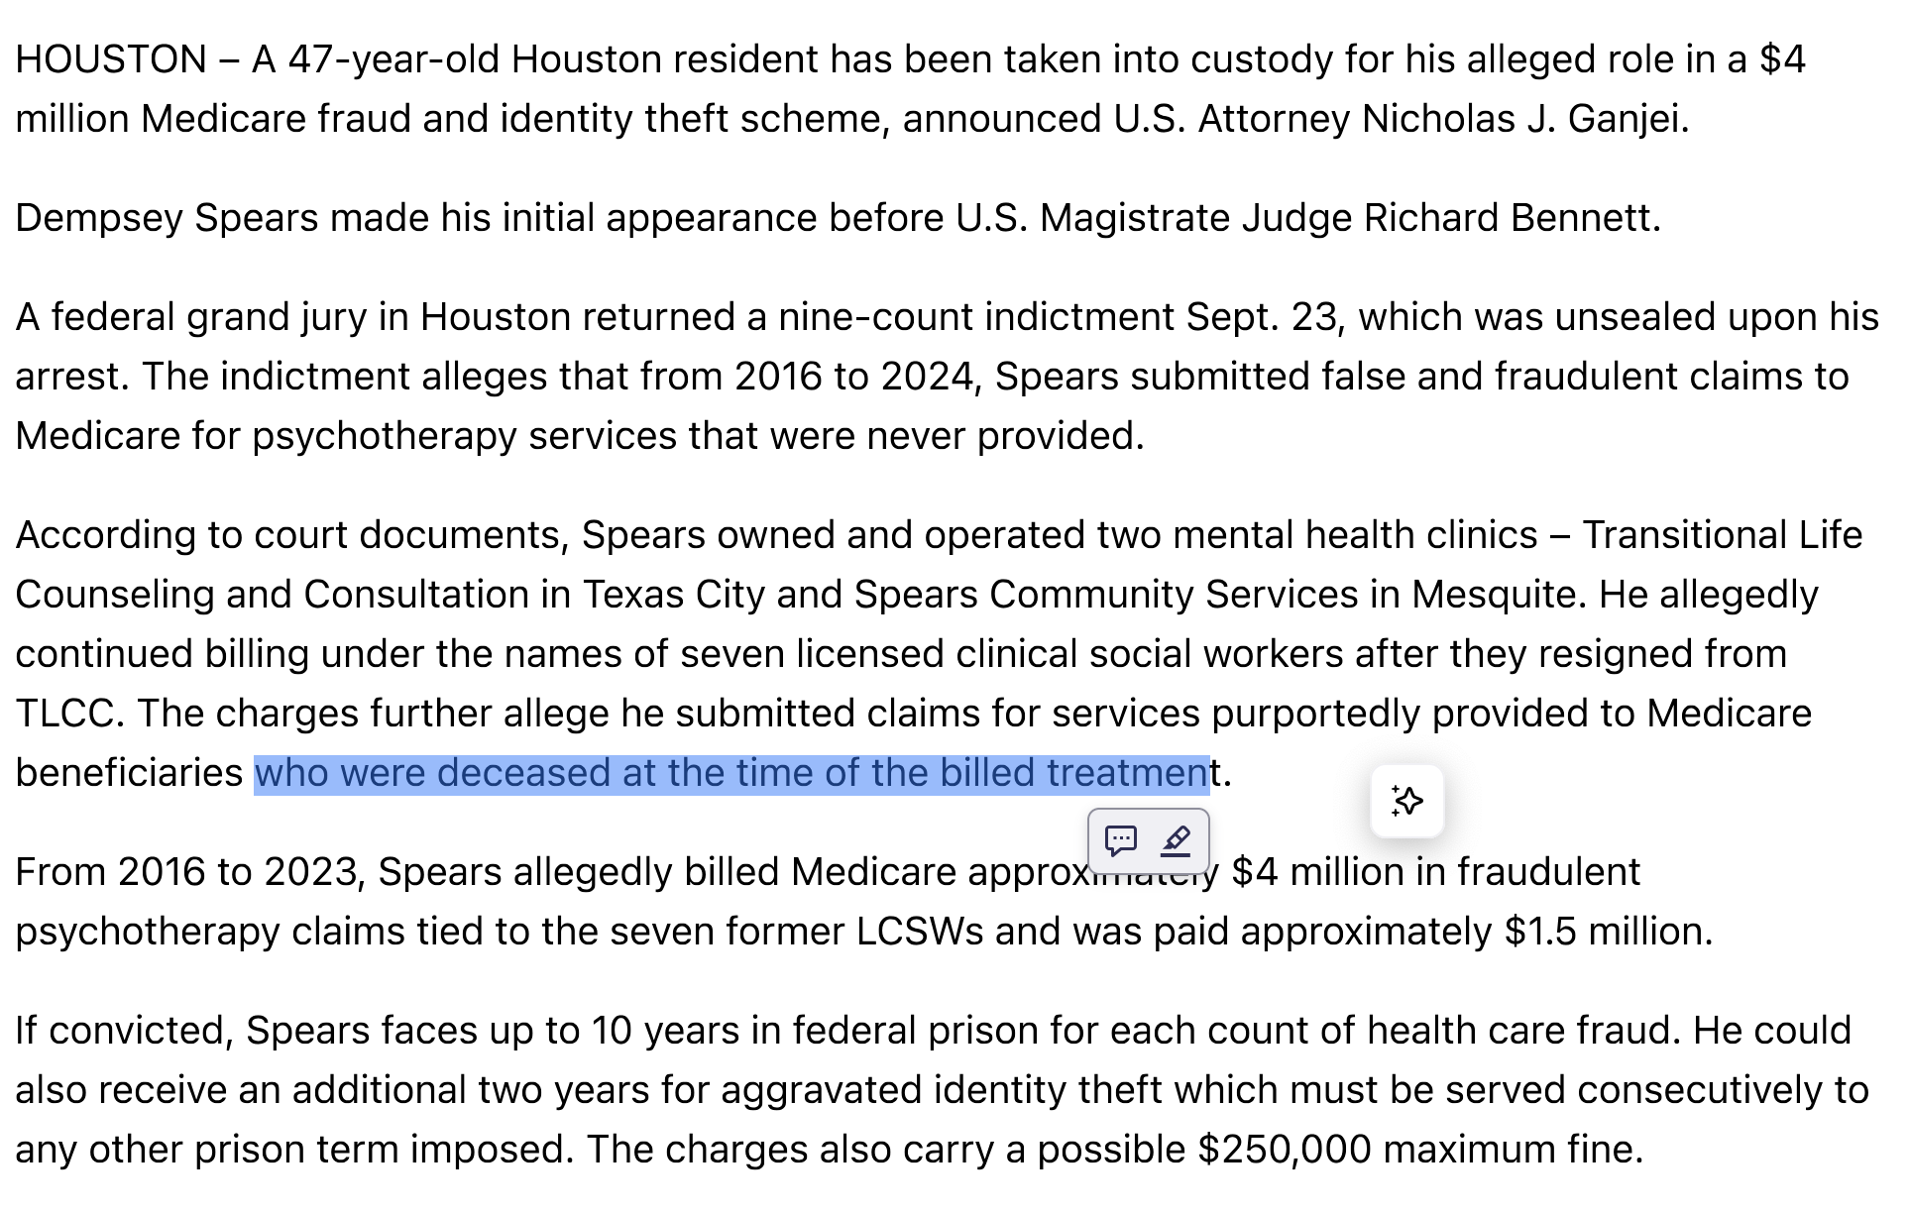
Claims with Deseased Patients

Slide 7
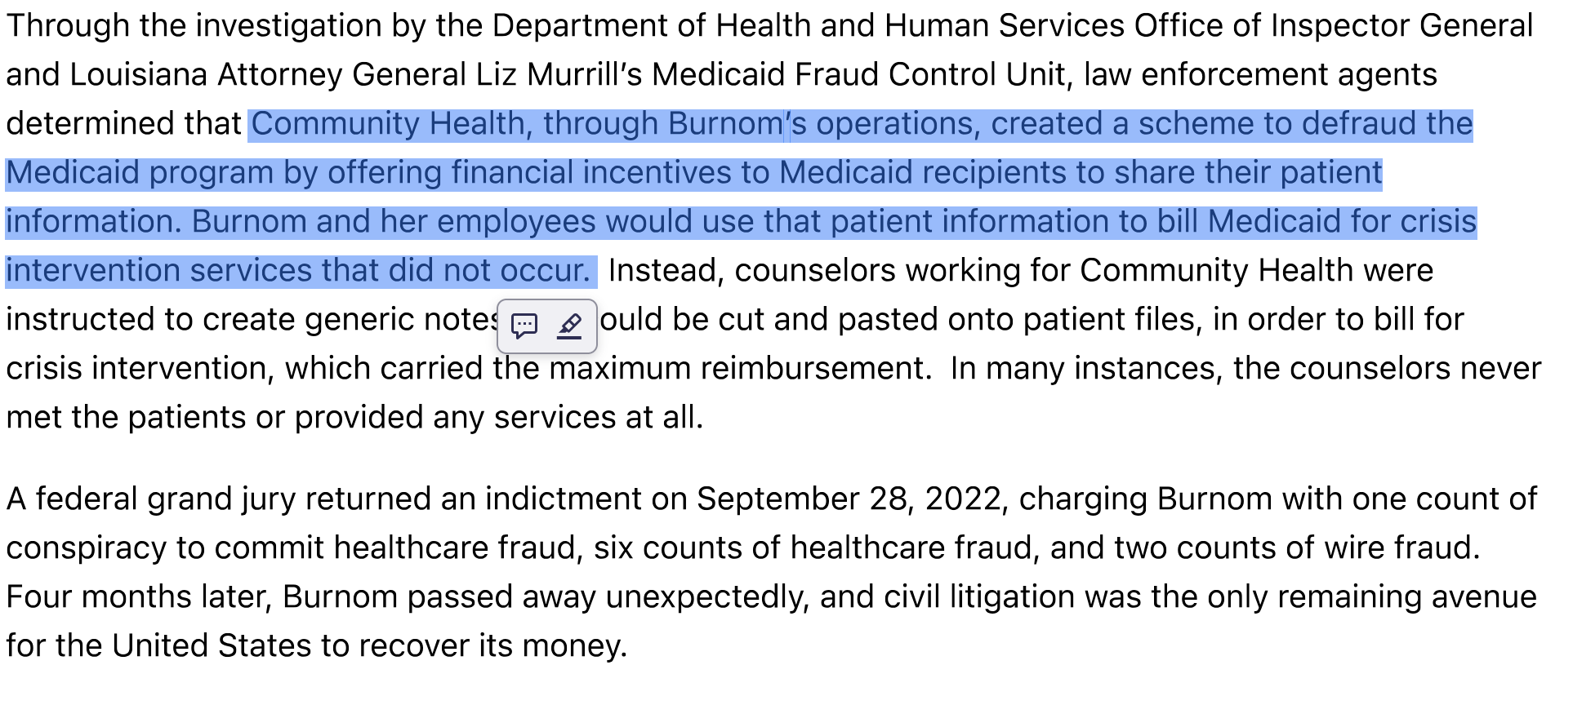
Use real person, but fake the encounter

