Slide 1
How to identify Synthetic Claims

Slide 2
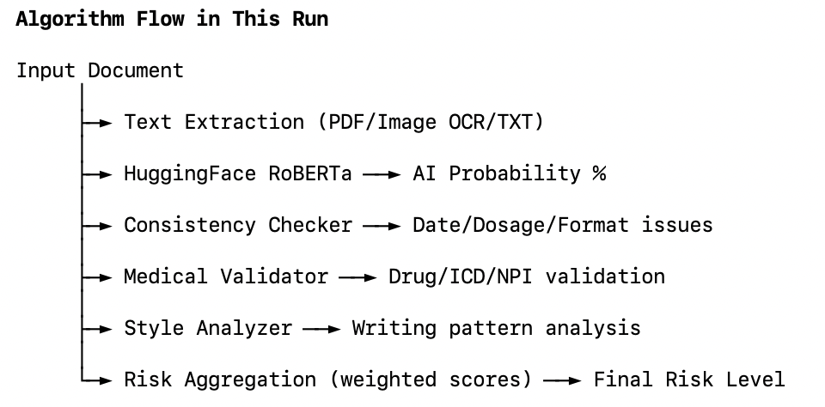
Algorithms: HuggingFace RoBERTa

Slide 3
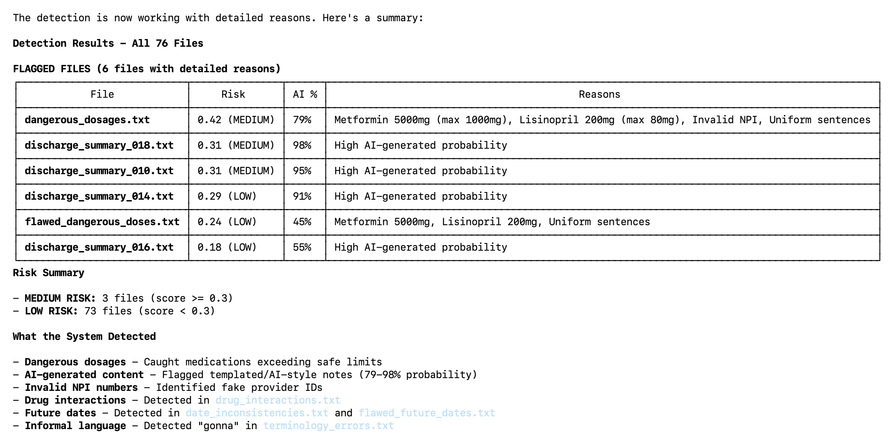
Initial Results:

Slide 4
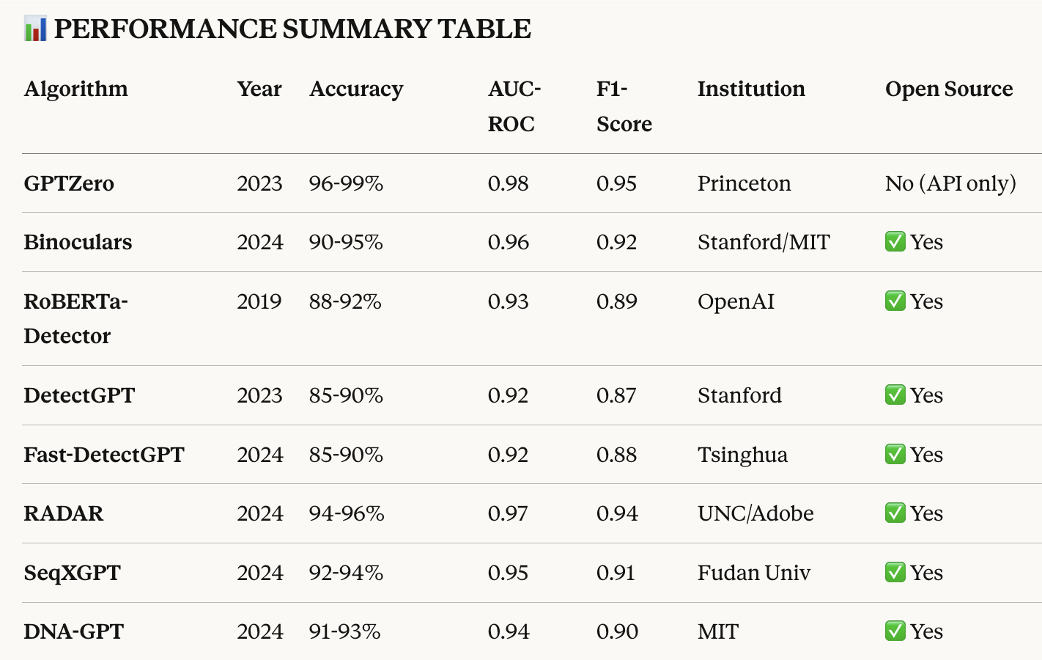
Algorithms for Detecting AI-Created Text

Slide 6
Sythnetic Claims: Definition
Synthetic medical claims are artificially generated healthcare billing records that mimic the structure, statistical patterns, and logical relationships of real medical claims—but contain no real patients, no real providers, and no protected health information (PHI).
They are created using computational models (rule‑based systems, probabilistic models, or generative AI) to simulate how real claims look and behave without exposing any sensitive data.
Synthetic Claims are “Non-Existing Claims” for encounters that nevenr happened. They are definitely Fradulent claims if actually submitted to the payers.
Question:
Are synthetic claims the same as “Fraudulent” claims?
Would the approach applied to “Fraud detection” be also applied to detect “synthetic Claims”?

Slide 7
1. Fully fictional but statistically realistic
ICD‑10, CPT/HCPCS, NPI‑like identifiers, dates, costs, and utilization patterns resemble real-world distributions.
No record corresponds to an actual patient or encounter.
2. Preserve relational structure
Synthetic claims maintain the internal logic of real claims:
diagnoses ↔ procedures
provider specialty ↔ procedure mix
visit type ↔ allowed amounts
temporal patterns (seasonality, chronic care cadence)
3. Safe for research and model development
Because they contain no PHI, synthetic claims can be used for:
fraud‑detection prototyping
algorithm benchmarking
academic research
software testing
training analysts
4. Often include configurable fraud scenarios
High‑quality synthetic datasets can simulate:
phantom claims
upcoding
unbundling
excessive frequency
provider‑level fraud archetypes
This is why they’re so valuable for anomaly‑detection research.

Slide 8
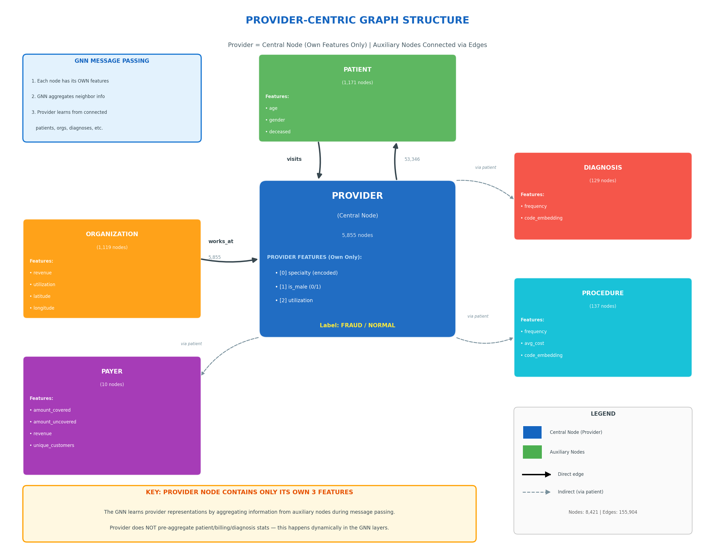

Slide 9
Inconsistency
Within-claim inconsistency
Cross-claim inconsistency or distortion

Slide 10
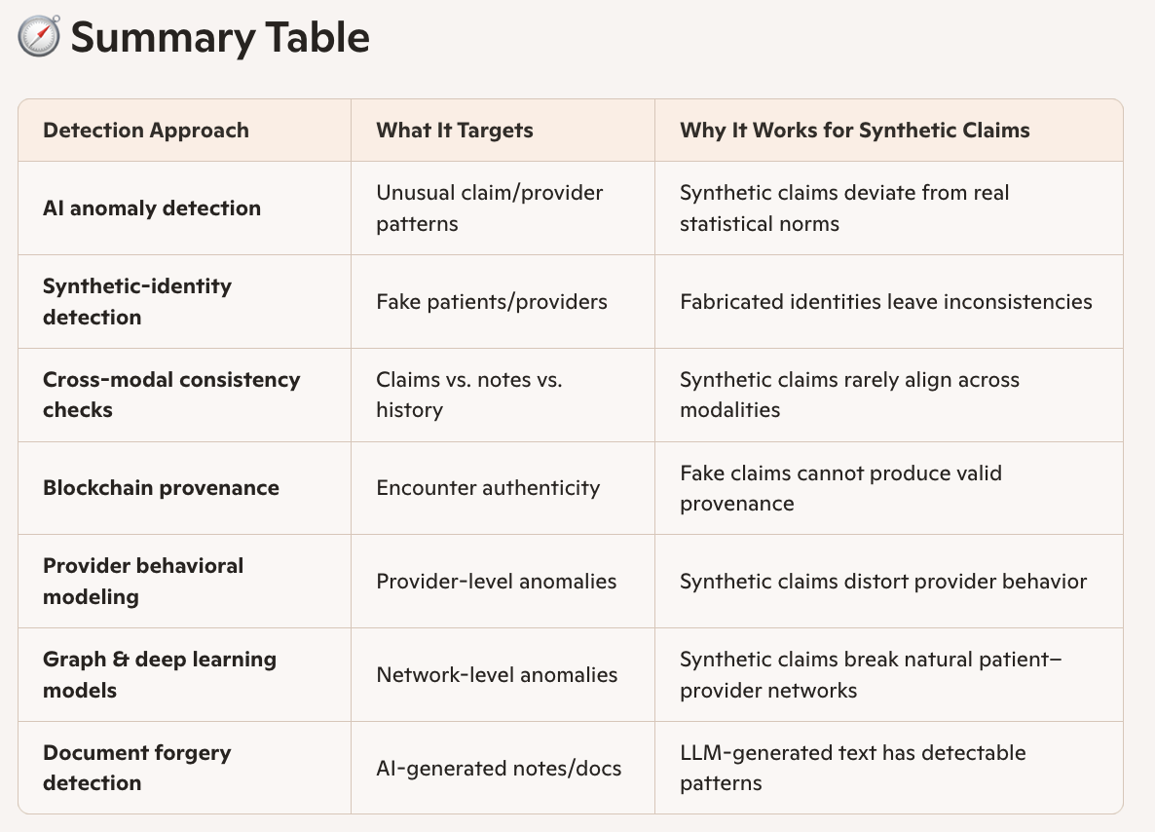

Slide 11
Characteristics of synthetic claims
Patients history inconsistency:
Provider behavioral inconsistency: fake claims distorted providers’ behavioral pattern, ie. suddenly many new patients, out-state patiewnts
Claims appear to be abnormal such as Modifier vs Procedure inconsistency
Claim Inconsistency with Notes, Images, Rx as it is difficult to fake,
Network inconsistency: Patients suddenly see out-network physicians a lot (Patients, provider and payer relationship)
Document forgery – “AI-Powered Media Forensics”
AI-created Audio/Voice: Resemble DETECT-2B achieves 94% - 98% of Ai-Voice
AI-created Images/Video:
Notes (LLM-created text), --- GPTZero identifies 95.7% of AI Texts

Slide 12
Synthetic Claim Detections - High Level Landscape
Anomaly Detection:
Basic Inconsistency Check
Patients/Provider Behavioral Normality Check/Distortion Check
Claims Features Against Document
DeepFake Text/Audio/Image/Video Check

Slide 13
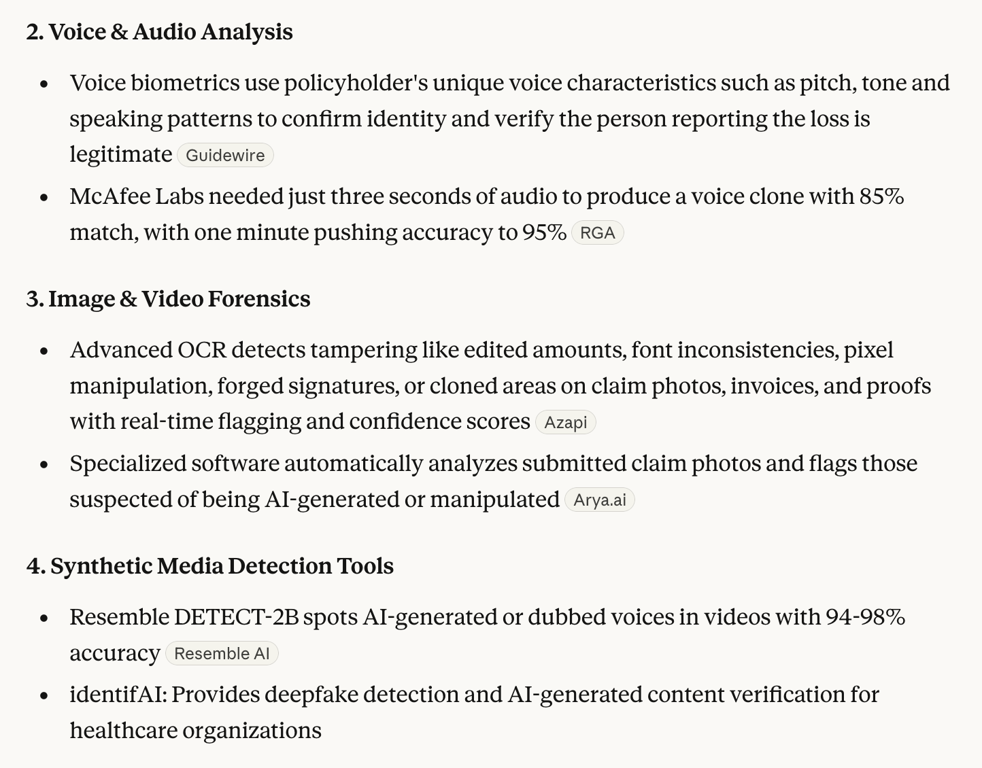
multi-layered, AI-driven forensic ecosystems

Slide 14
Anomaly Detection
Unsupervised Learning. This is what we need
Supervised Learning
Semi-supervised Learning

