Slide 1
Model Parameters
ISE 599: Modeling for Health Policy and Medical Decision Making
Spring 2017

Slide 2
Where To Get Input Parameters
Where do all these values come from?

Slide 3
Model Inputs
For any model, we need to quantify what we already know
Natural History Parameters
Disease progression rates
Prevalence/Incidence
Risk factors
Treatment Parameters
How natural history is modified, and by how much
Screening accuracy
Costs and QALY weights
These can depend on characteristics of the population of interest

Slide 4
Prevalence and Incidence
Prevalence: No. of people found with disease / total no. people alive in the population
Incidence: No. of new cases within a time interval / no. of people in original at-risk population
Often expressed as a percentage or number of cases per 100,000 people
In steady state
Prevalence = (Incidence Rate) x (# ppl at risk) x (Average Duration of Disease)
Mortality
Incidence
Has Disease
Prevalence
Recovery

Slide 5
Data from Multiple Sources
Randomized clinical trials
Other clinical studies
Cohort
Case-control
Disease registries
Expert opinion

Slide 6
Types of studies (used as data sources)
Observational studies – the population is observed without any interference by the investigator
Cheaper and faster
Can examine long-term effects
Hypothesis-generating
Sometimes, experimental studies are not ethical
(e.g., withholding treatment)
Experimental studies – the investigator tries to control the environment in which the hypothesis is tested
The randomized, double-blind clinical trial is the gold standard

Slide 7
Schematic of Study Types
Studies of human subjects
Observational
Experimental
Descriptive
Analytic
Randomized Clinical
Trials
Case series
Cross-sectional
studies
Ecologic
studies
Case-control studies
Cohort studies
Retrospective
Prospective

Slide 8
Cohort studies: basic design
Outcome +
Exposed
Outcome-free cohort
Outcome -
Source population
Outcome +
Not Exposed
Outcome -
TIME
Notes:
-Observational study in which subjects are selected/sampled based on exposure status
-Exposures are determined within a “healthy” cohort (group under study)
-Determine people who develop the disease (outcome) among exposed and unexposed
-Relationship between exposure and outcome is assessed

Slide 9
Prospective cohort study
Investigator
TIME
Exposure(s)
Disease(s)
Population
Notes:
-Information on the exposure status of the cohort members at the time the study begins
-Identification of new cases of disease (or outcome of interest) from that time forward
-The outcome of interest has not yet occurred at the time the investigator begins the study

Slide 10
Retrospective cohort study
Investigator
TIME
Exposure(s)
Disease(s)
Population
Notes:
-Exposure status is determined from information recorded at some time in the past and
-Disease incidence (or incidence of outcome) is determined from then until the present
-The outcome of interest has already occurred at the time the investigator begins the study

Slide 11
Case-control studies
Exposed in past
Disease
(Cases)
Not exposed
Target population
Exposed
No Disease
(Controls)
Not Exposed
Notes:
Two existing groups differing in outcome are identified and compared on the basis of some supposed causal attribute. Case-control studies are often used to identify factors that may contribute to a medical condition by comparing subjects who have that condition/disease (the "cases") with patients who do not have the condition/disease but are otherwise similar.

Slide 12
Case-control study
Investigator
Exposure(s)
Disease
and no disease

Slide 13
Randomized Control Trial
Investigator
Why randomized?
Why blind?
Outcome(s)
Population at risk
Randomized to exposure(s)
Notes:
RCT is used to test the efficacy or effectiveness of various types of medical intervention within a patient population.
Why randomized? Why blind?

Slide 14
C:\Users\suens\Dropbox\aaa_springClass\CourseMaterials\Lectures\gettingParameters

Slide 15
Probabilities and Rates
What’s the difference, and how to use them in models

Slide 16
Rates and Probabilities
Rate
The number of events for a given number of individuals per unit time
Units: number of events / population-time (person-years)
Can be added, subtracted, multiplied, divided
Monthly rate = annual rate probability/12
In continuous time: associated with a density
[0 – ∞]
Also called hazard, instantaneous risk, hazard, force, potential, incidence rate, incidence density
Example: 15 deaths per 100,000 person-years
Probability
Likelihood that event will occur in a specified time period
Cumulative risk over an interval
Can't add, subtract, etc.:
Conditional on being event-free at the beginning of the interval
1 year probability of death != 3 year probability of death divided by 3
In discrete time: not a density
[0 – 1]
Also called risk, likelihood, proportion
Example: 15% of the population screened annually
Example : proportion of people who die by the end of the first year with a disease

Slide 17
Cycle lengths and conversion
Suppose we know the rate at which an event happens (r)
Example: mortality rate = 0.02
What is the probability (p) that the event will happen by the next time period?
What is the probability of death this year?
If we assume the time between events has an exponential distribution
We can use the CDF of the exponential distribution:
p = pr(die before end of the year) = pr(time event happens < t) = 1 – e^{-rt}
We can use this to convert between probabilities and rates
r = -ln(1-p)/t and p = 1 – e^{-rt}

Slide 18
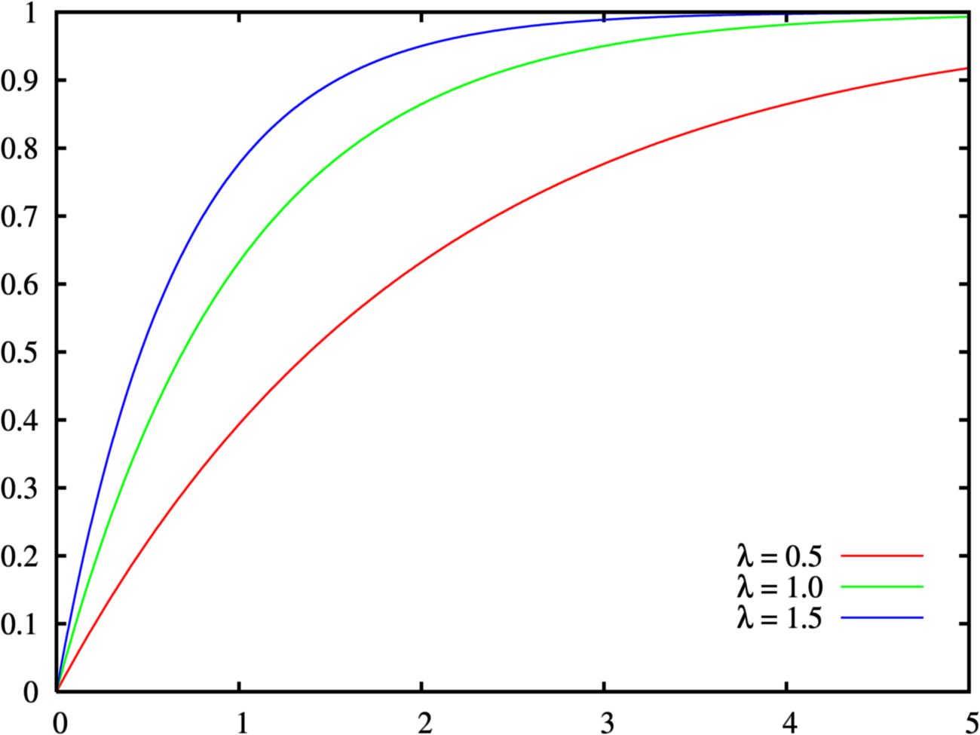
Exponential Distribution
Used to model the time between the occurrence of events
Ex: t = Time from diagnosis of disease to dying of disease
t is an exponential random variable and distribution if:
t > 0.
Memorylessness: one event happening doesn’t change the probability that a second event will occur (events are independent)
The rate at which events occur is constant
Two events cannot occur simultaneously
Pr(t < x)
x
This may not be the case in real life!
Notes:
The rate can’t be higher sometimes and lower other times
These are assuptions

Slide 19
Example of Conversion: Background Mortality
Suppose 0.1 annual rate of death from a given disease and 0.05 annual rate of death from all other causes for 50 year olds
What is the overall probability of death in 1 year?
p = 1 – e^{-rt}
1-exp(-(0.1+0.05)*1) = 0.1392
What is the overall probability of death in 1 month?
1-exp(-(0.1+0.05)*1/12) = 0.0116
What is the proportion of deaths from the disease?
Prop = r1/(r1+r2)
Prop = 0.1/(0.1+0.05) = 0.66
Use rates for calculations, not probabilities!

Slide 20
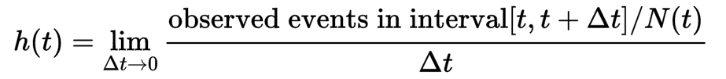
Example: Hazard Rate
Given a patient survives up to t, the probability that he dies in the interval delta t (as delta t approaches 0) → the instantaneous rate of death
Can also be used to describe other events (not just death)
Hazard of disease progression, etc.
Number of people observed at the beginning of the interval

Slide 21
Example: Incidence Rate
Person-time incidence rate is the number of new cases per person time at risk
This measures allows for different follow-up periods between people
Units: cases / person-year
If this event had happened earlier, after year 1, rate would be 2/(1+4+4+1) = 2/10
Event probability would stay the same
Got disease
Died / Study ended
Event Rate: events / person-time = 2 / (3+4+4+1) = 2/12 cases per person-year
Event probability: 2/4
Time (years)
1
2
3
4

Slide 22
Clues in How Value Was Calculated
Often not clear in published paper if it is a rate or a probability
“Prevalence rate”
Read methods definitions carefully
Statistical model can clarify:
Cox model or other survival/failure models
Related to rates
Logit models / binary outcome models
Probabilities / risks

Slide 23
Contrasting Rates and Probabilities
Probability of event happening in 1 year is 90% in both plots
Rate of event is different

Slide 24
Exploring the Constant Rate Assumption
A study reports: “At the end of the first year 40% of subjects enrolled at baseline had died, and at the end of year 5, this % had increased to 92.223%”
Does this support a constant rate assumption?
So if we know 40% have died by 1 year
0.4 = 1-exp(-r*1)
Solve for r to get 0.5108 = annual mortality rate
At the end of year 1, 60% of the original cohort is alive. Between yr 1­‐5, 52.22% of original cohort dies (92.22­‐40)
So the 4 year cumulative risk to the 60% alive at year 1 is 0.52223/0.6
Let’s compute the rate for yr 1‐5
‐1*LN(1‐[(0.52223)/(0.6)])/(5-­1)=0.5108
What to do if this were not the case?

Slide 25
What if the Rate Isn’t Constant?
Quite likely to happen
Mortality rates over age:
Use shorter time intervals where assumption more likely to hold (ex: 1 year intervals)

Slide 26
Life Table Resources
US
hpp://www.cdc.gov/nchs/products/life_tables.htm
hpp://www.cdc.gov/nchs/data_access/VitalStatsOnline.htm
Mainly developed countries
hpp://www.mortality.org/
5‐year tables for all countries
hpp://apps.who.int/whosis/database/life_tables/life_tables.cfm

Slide 27
Hazard Ratios and Survival Curves

Slide 28
Hazard Ratios (HR)
Defined as the hazard rate in the exposed groups divided by the hazard rate in the unexposed groups
HR = rate₁/rate₂
Ex: HR = 0.7 between treatment and control groups
Mortality Rate

Slide 29
Survival Models

Slide 30
Hazard Ratios are Often Measured Through Survival Analysis Techniques
HR is commonly estimated via survival analysis models
One class of models is the proportional hazards models, which assume changes in covariates multiply the baseline hazard
These models often use some form of:
ln(h(t)) = f(ho(t), β₀ + β₁ X₁ + β₂ X₂ + … + β_{k} X_{k}))
underlying baseline hazard
Linear function of covariates X
(age, sex, taking treatment, etc.)

Slide 31


Many Types of Survival Models
Exponential hazard rate function:
Cox semiparametric hazard rate function:
Model parameters (β’s) usually estimated through maximum likelihood procedure
baseline risk is constant over time

Slide 32

Hazard and Survival
h(t) is the hazard rate at time t
S(t) is the survival probability
Probability of survival beyond time t

Slide 33
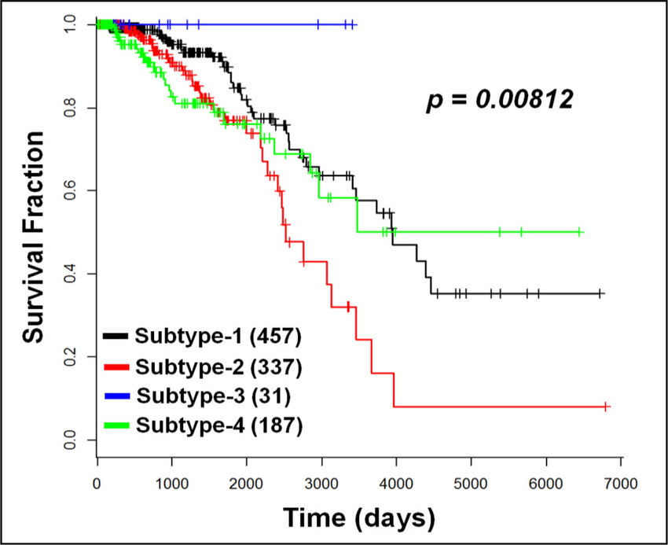
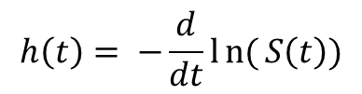
Example Survival Curve
Hazard rate is the negative log of the slope
$$h\left(t\right)= −\frac{d}{dt}ln{(}S\left(t\right))$$
Wang et al. A computational method for clinically relevant cancer stratification and driver mutation module discovery using personal genomics profiles. BMC Genomics 2015,16 (Suppl 7):S6
Notes:
A computational method for clinically relevant cancer stratification and driver mutation module discovery using personal genomics profiles

Slide 34
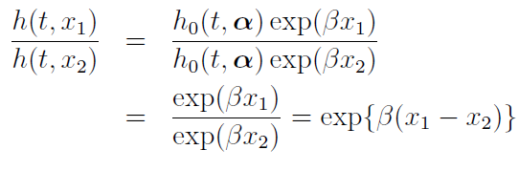
Proportional Hazards and Hazard Ratio
In proportional hazards models, hazards are proportional to each other and do not depend on time
Cox Model Example:
Interpretation of β: Increasing x by one unit scales the hazard rate by exp{β(x+1− x)} = e^{β}
β = increase in log hazard per unit of x
Ex: if x is age and β = 0.1, getting one year older means ln(0.1) increase in hazard rate

Slide 35
Relative Risks

Slide 36
Relative Risk (RR)
Ratio of the probability of disease in an exposed group to the probability of disease in a non-exposed group
RR = p_{treatment} / p_{control}
RR < 1 less at risk, RR > 1 more at risk
Ranges from 0 to infinity
Defined for some observation period
Be careful probabilities do not exceed 1 when using these in your models

Slide 37
Example
Relative risk of 3.2 of smokers to nonsmokers of getting COPD
3.2 pr(nonsmokers get COPD) = pr(smokers get COPD)

Slide 38
Example
Disease (D)
No disease(D-)
Exposure (E)
a
b
a + b
No exposure(E-)
c
d
c + d
a + c
b + d

Slide 39
Odds Ratios

Slide 40
Odds Ratios (OD)
Ratio of the odds of disease in an exposed group to the odds of disease in a non-exposed group
OD < 1 treatment group is less at risk (“treatment is protective”)
OD > 1 more at risk
Ranges from 0 to infinity

Slide 41
Odds Ratios (OR)
Disease (D+)
No disease(D-)
Exposure (E+)
a
b
Odds: ratio of the probability that the event will happen to the probability that the event will not happen
No exposure(E-)
c
d
a + c
b + d
Is the prevalence of exposure higher among disease cases compared to controls?
Odds of exposure among cases
=
=
=
Odds of exposure among controls

Slide 42
Comparing Measures

Slide 43
Rare disease assumption (RR ~ Odds ratio)

Slide 44
Changes in Risk Over Time
Reports that after 3 years, 15% of people in the control group had had an adverse event and 4% of people in the treatment group had had an adverse event
What is the Relative Risk reduction for treatment?
4%/15% = 0.26667
NOTE: this RRR will not stay constant in time

Slide 45
Changes in Risk Over Time
Reports that after 3 years, 15% of people in the control group had had an adverse event and 4% of people in the treatment group had had an adverse event
What is the Hazard Rate reduction for treatment? (Assume constant hazards)
1yr rate in control = -­1*LN(1-­0.15)/3 = 0.05417
0.04 = 1-­EXP(­‐1*0.05417*3*HRR)
LN(1‐0.04)/(-­1*0.05417*3) = HRR = 0.2512
Compare to Relative Risk reduction at 3yrs (0.2667)

Slide 46
Changes in Risk Over Time
Reports that after 3 years, 15% of people in the control group had had an adverse event and 4% of people in the treatment group had had an adverse event
What is the Odds Ratio for treatment?
Odds in control group = p / (1‐p) = 0.15/0.85 = 0.176471
Odds in tx group = p / (1-­p) = 0.04/0.96 = 0.04167
OR = 0.04167 / 0.176471 = 0.236

Slide 47
Comparison of RR, OD, Hazard Ratio
Assumed ratio of event rates constant, so the hazard ratio is constant
However, relative risk and odds ratio are not constant

Slide 48
Inputs for Diagnosis: Test Characteristics

Slide 49
Imperfect Tests for Disease
If the model needs to identify patients for treatment, it is likely the diagnosis test isn’t perfect
This should be incorporated into the model
Comparison of a test result to some underlying “biological truth” – the gold standard
Trade-offs between incorrectly identifying people with the disease and people without the disease

Slide 50
What Do We Call a Positive Test?
For each cutoff value, we have 4 counts
# with disease who test positive
# without disease who test positive
# with disease who test negative
# without disease who test negative
Cutoff
Test -
Test +
Without disease
With disease
Some biomarker

Slide 51
Test Characteristics: Accuracy
Does the test hit the true value?

Slide 52
Test Characteristics: Reliability
How accurate is this highly reliable test?

Slide 53
Test Characteristics: Reliability
Assess the accuracy of the test
Sensitivity: the probability of a positive test in a person with disease
Specificity: the probability of a negative test in a person who is healthy
Calculate the probability of disease given an positive or negative test result

Slide 54
Assessing the Accuracy of a Test
How well a test gets the true value (not of what it is measuring but rather of the true disease status) for people with and without the disease
Type I error
Disease State
+
-
Positive predictive value: TP/(TP + FP)
Negative predictive value: TN/(FN + TN)
+
TP
FP
Test Result
-
FN
TN
Type II error
Sensitivity: TP/(TP + FN)
Specificity: TN/(TN + FP)

Slide 55
Updating the Probability of Disease
Sensitivity (sens): Pr(+|disease)
Specificity (spec): Pr(-|No disease)
Pr(Disease) = number with disease / total pop.
Pr(disease|+)
= Pr(+ and disease) / Pr(+)
= Pr(+|disease)Pr(disease) / Pr(+)
= Pr(+|disease)Pr(disease) / Pr(+|disease)Pr(Disease) + Pr(+|No Dis)Pr(NoDis)
Sens*prev / (sens*Prev + (1-spec)*(1-Prev))
Using Bayes Rule

Slide 56
ROC (Receiver Operating Characteristic) Curves
Test -
(True Positive Rate) TPR
False Positive Rate (FPR)

Slide 57
ROC (Receiver Operating Characteristic) Curves
Test -
Test +
TPR
FPR

Slide 58
ROC (Receiver Operating Characteristic) Curves
Test -
Test +
TPR
FPR

Slide 59
ROC (Receiver Operating Characteristic) Curves
Test -
Test +
TPR
FPR

Slide 60
ROC (Receiver Operating Characteristic) Curves
Test -
Test +
TPR
FPR

Slide 61
What Does a Useless Test Look Like?
TPR
better
worse
FPR

Slide 62
What Does a Perfect Test Look Like?
TPR
Perfect classification
FPR

Slide 63
Area Under the Curve (AUC)
TPR
AUC
Useless test has
AUC = 0.5
Perfect test has
AUC = 1.0
Common test has
0.5 < AUC < 1.0
FPR

Slide 64
Combinations of Tests
Sometimes in a model we wish to evaluate whether multiple tests should be used
Ex: If mammogram is positive, do biopsy
Be careful about test characteristics
If tests are measuring similar biological factors, they may not give independent results
Ex: If two tests both measure platelet levels to determine if patient has disease, test results may be correlated (and be less informative than 2 independent tests)
Use sensitivity and specificity of combinations of tests, if available

Slide 65
Wrap Up

Slide 66
Discrete time models use period probabilities
Save mathematical manipulations for rates
Understand the assumptions you make when you do these manipulations
Test, even in a limited way, the validity of these assumptions

Slide 67
Next Class…
Using inputs for policy: compartmental model examples in CEA

Slide 69
Natural History
Epidemiology is the “study of the distribution and determinants of health-related states or events (including disease), and the application of this study to the control of diseases and other health problems.” (WHO)
Determine magnitude and impact of diseases/conditions in populations
Learn about the natural history and clinical course of diseases
Identify causes of disease

Slide 71
Homework question

Slide 72
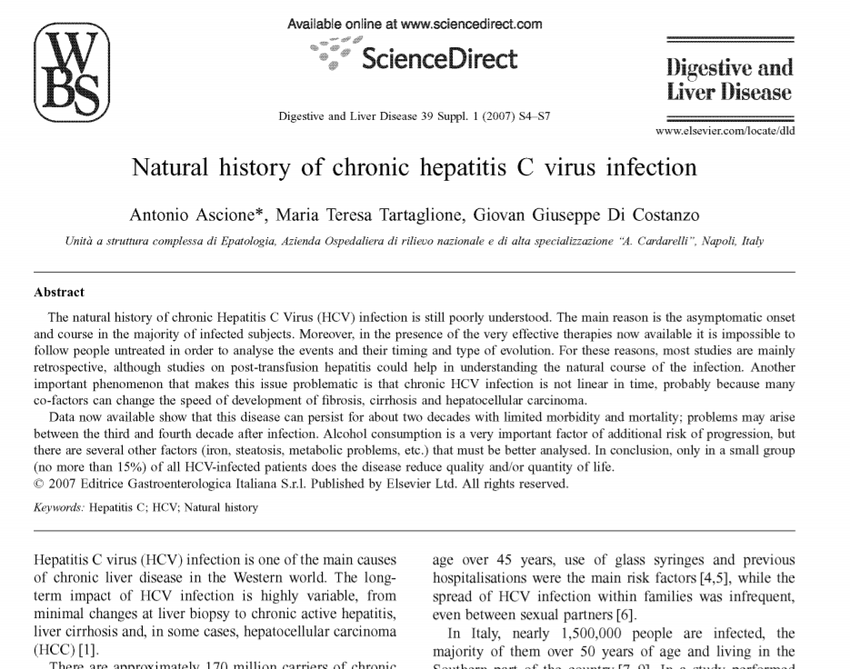
Examples
In fact, in studies dealing with subjects infected by blood transfusion the development of cirrhosis was reported in 24% of cases (range 11-37)
Chronic hepatitis C virus (HCV) infection is typically characterised by slowly progressive hepatic fibrosis, with progression from stage 0 (no fibrosis) to stage 4 (cirrhosis) taking place at approximately 0.10–0.15 fibrosis units (median) per decade.

Slide 73
If these conditions are not true, then the exponential distribution is not appropriate. Alternative distributions such as the Weibull or gamma may give a better fit to the data, or a semi-parametric model, such as the Cox proportional-hazards model, may be required for statistical analysis.

Slide 74
Smooth Changes in Transition Rates Over Age

Slide 75
“Randomized Controlled Trial of Single-AgentPaclitaxelVersusCyclophosphamide,Doxorubicin, and Cisplatinin Patients with Recurrent Ovarian Cancer Who Responded to First-line Platinum-Based Regimens”,Cantu, Parma, Rossi,Floriani,Bonazzi,Dell’Anna,Torri, Colombo. JCO,vol. 20 (5), March 2002, p. 1232.

Slide 76
Stratifying Data: Use as HW question
Solving using a relative risk
What assumptions are you making when you do this?

Slide 77
This works out nicely basically because of the constant hazard assumption of the exponential model

Slide 78
I think he means constant hazard isn’t always valid

Slide 79
Meta-Analysis

Slide 80
Meta-analysis
A type of systematic review where statistical methods are used to combine comparable independent clinical trials
Different statistical techniques for difference measures (continuous mean difference, odds ratios, RR, etc)

Slide 81
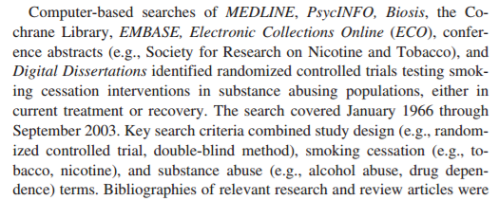
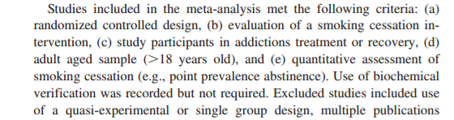
General Procedure
Authors systematically search for literature on the topic
And describe inclusion / exclusion criteria:

Slide 82
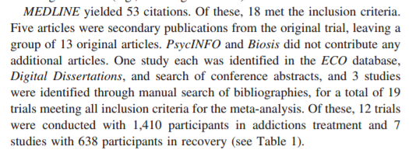
General Procedure
The final publications are chosen
And the data extracted

Slide 83
statistical analysis that combines or integrates the results of several independent clinical trials considered by the analyst to be combinable

Slide 84
General procedure for continuous measures
Transform
magnitude and direction of the effect – same scale for all studies
Weight – inverse variance gives more ʻweightʼ to larger studies
– sample size is key ("n = "precision) – standard error • means, correlations, proportions, odds – not well-suited to complex procedures like multiple logistic regression

Slide 85
Why Weight Effect Sizes? • Studies vary in size. • ES based on 100 subjects assumed more “precise” estimate of population ES than ES based on 10 subjects. • Larger studies should carry more “weight”. • Weighting by the inverse variance optimal approach

Slide 86
Why weight by inverse variance? • The standard error (SE) is a direct index of ES precision. – influenced by sample size – used to create confidence intervals. • The smaller the SE, the more precise the ES. • Optimal weights for meta-analysis (Hedges): 1/(se^2)

Slide 87
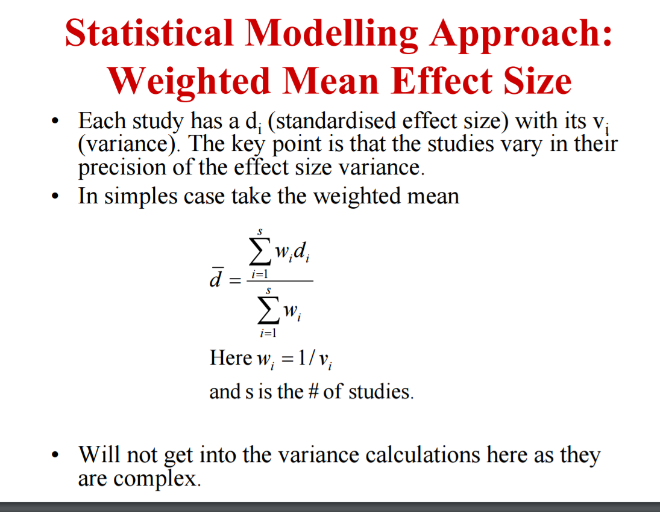

Slide 88
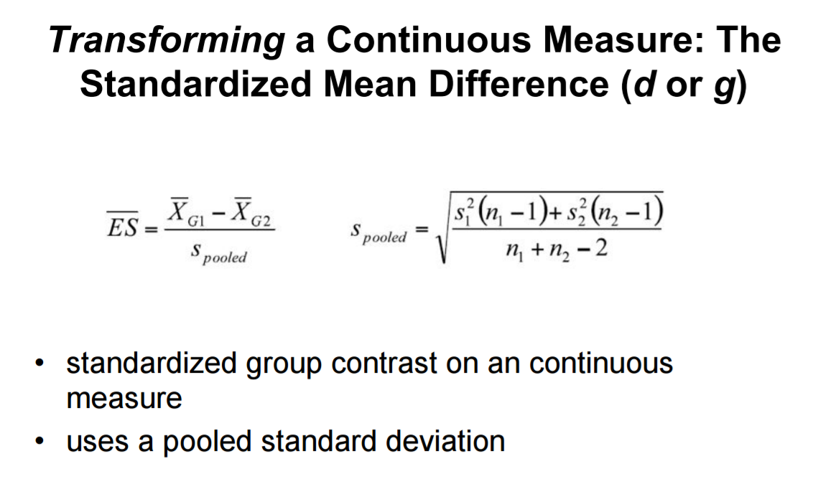

Slide 89
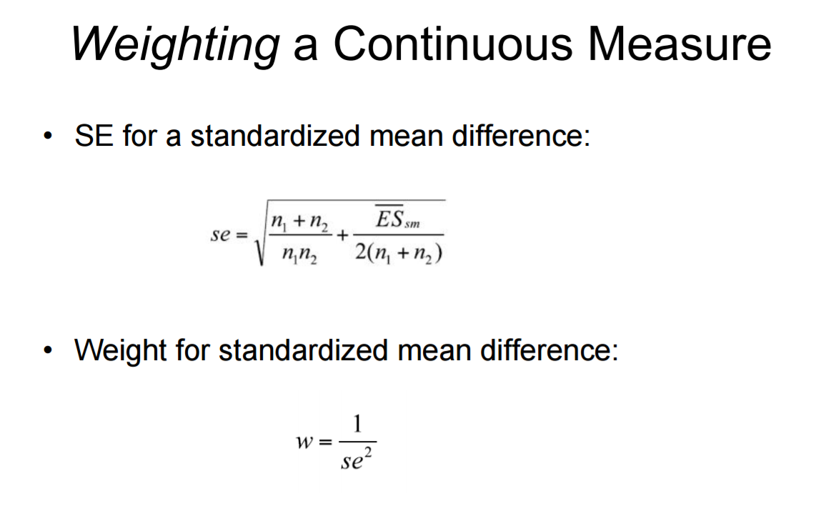
Metaanalysis 2011 columbia

