Slide 2
Model Overview

Slide 3
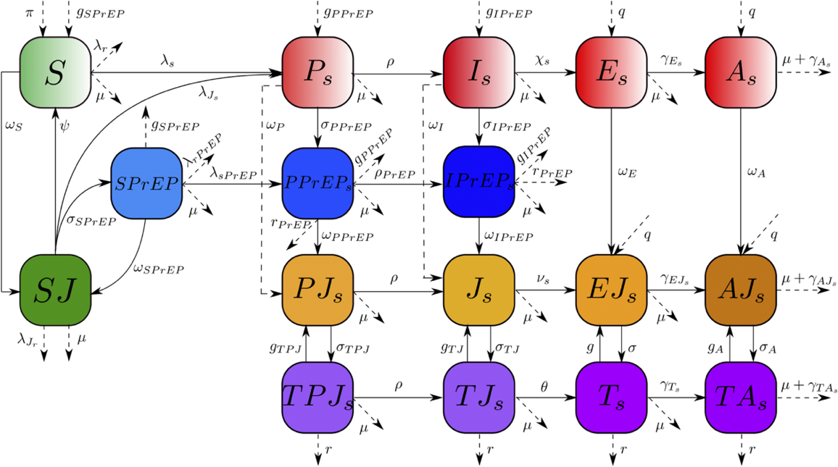
Model Overview

Slide 4
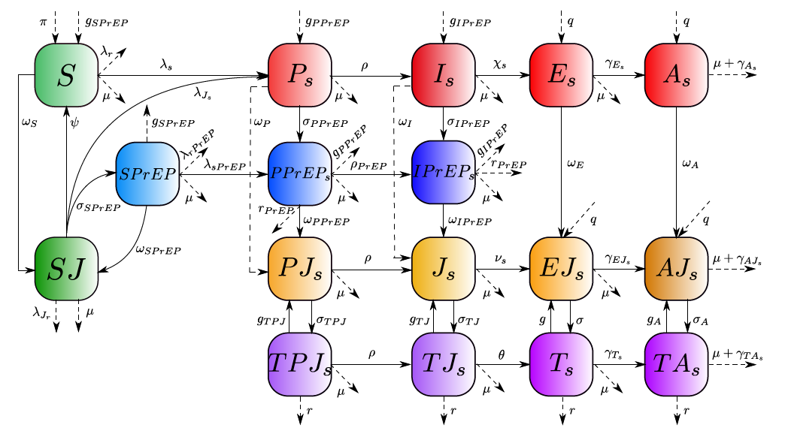
Flow Diagram of the HIV Transmission Model
Then can transition between health states, including:
Uninfected
Primary
Asymptomatic
Symptomatic
AIDS

Slide 5
Flow Diagram of the HIV Transmission Model
MSM are also tracked based on their awareness of sero-status through testing, and their treatment status
Unaware
Treated (PrEP)
Aware
Treated (ART)

Slide 6
Demographic, Behavioral, and Geographic Characteristics
Age
Race
Sex (Male)
Sexual Orientation (MSM)
Geographical Areas (26 Health Districts)
STIs (Syphilis)

Slide 7
Model Capabilities (and Data Requirements)
Interventions
Implementation characteristics, intensity of intervention, population affected
Prevalence, incidence, diagnoses, treatment/PrEP, mortality
Demographic data, epidemic data, testing rates/treatment/linkage to care, adherence
Resource Use: costs
Fixed and variable costs (clinic, equipment, etc.) by service
Quality of life (QALYs)
From literature and clinical trials

Slide 8
Policy-making Tools
Frontier CE plot

Slide 9
Cumulative HIV Incidence For Different Strategies
PrEP and Test-and-Treat are very effective at reducing HIV transmission
But do not eliminate HIV
(’000s)
9
Notes:
The model fits well the data

Slide 10
Tailoring Model to HIV/AIDS Strategy for 2020 and Beyond
Priority Interventions?
PrEP
TaSP
Linkage to Care Improvements
HIV/Syphilis Co-infection Prevention
Behavioral/Nudging interventions
Data Requirements
CD4 and VL at diagnosis and over time
CD4 and VL among diagnosed
Viral suppression among the diagnosed
Linkage to care and Retention in care
Adherence to ART and PrEP
STI diagnoses
Mortality rates for PLWH
Cost data from DHSP
HIV testing and counseling costs
CD4 and VL monitoring costs
ART cost
PrEP costs
Administrative costs

Slide 11
Potential Model Outputs
Map of intervention effects by change over time in
Disease incidence
Disease prevalence
Deaths averted
Combination and intensity of interventions needed to achieve 2020 goals
Optimal combination of interventions
Cost-effectiveness analysis
Budget impact analysis

