Slide 1

A C Primer (4) : Functions [ABC Chapter 5]
Ion Mandoiu
Laurent Michel
Revised by M. Khan and J. Shi

Slide 2


Building blocks for larger programs
Effective programming requires problem decomposition into manageable pieces
A C program is made of functions
Starting from main()
Idealized view: a function is a black box…
It SPECIFIES what the computation will do
It ABSTRACTS AWAY how the computational process works
It takes INPUTS
It produces an OUTPUT
f
Input 1
Input 2
Output
Input 3

Slide 3
Function definitions
type function_name ( parameter_list ) {
declarations & statements
}
No nesting (cannot define functions in a function)
Return type can be “void” (no return value expected)
If missing, compiler assumes int
Return statements
Execution also terminates if end of function body reached
Returned value undefined
No nested function (i.e., cannot define functions in a function)
return; // terminate execution and return control to caller
return expr; // terminate and pass value of expr back to caller

Slide 4

Function declarations (prototypes)
Functions can be defined in any order
Declare a function before first use if definition comes later
Function prototypes often placed in header files (and reused)
#include <stdio.h>
int fahrToCelsius(int);
int main() {
for(int fahr=0; fahr <= 300; fahr += 10)
printf("%d F is %d C degrees\n",fahr,fahrToCelsius(fahr));
return 0;
}
int fahrToCelsius(int degF) {
return 5 * (degF - 32) / 9;
}
Declaration
Definition

Slide 5
Example: computing b^{n}
Power function:
Returns an int
Two parameters: base b and exponent n, both int
Functions can declare local variables
Parameters and local variables can only be accessed inside the function
Storage class “auto” by default, i.e., discarded when function returns
Parameters are passed by value
n is changed in the power function but i DOES NOT change
int power(int b, int n)
{
int rv = 1;
while (n>0) {
rv *= b;
n--;
}
return rv;
}
int foo ()
{
int i = 10;
return power(2, i);
}

Slide 6
Static and global variables
Static local variables
Not visible outside function but retain value across function calls
Global variables
Declared outside functions; retained for entire duration of program
Storage class “extern” by default
➔Can be accessed from functions in other files
Static global variables
➔Visible only in functions defined in the same file following variable declaration

Slide 7
Be cautious with static and global variables
“Nice” functions only depend on their inputs
Static and global variables have side-effects
Retain values across function calls
Change the meaning of the function at each call!
You cannot understand the function without holding all the code in your head
Unless you have really good reasons and really know what you are doing, do not use static or global variables.
Notes:
Any deviation from the gospel is dangerous

Slide 8
Function call context
Function call context includes
Copies of function arguments (call-by-value)
(Auto) local variables
Return address, …
Call contexts managed automatically using the execution stack
A stack frame is created automatically for each function call
The frame lasts for the duration of the call
Discarded automatically when the function terminates
NOTHING in the frame survives the call

Slide 9
Memory organization
Memory….
Every Process has an
Address Space
0xffffffff
High
Low
0x00000000

Slide 10
Memory organization
0xffffffff
Memory….
Every Process has an
Address Space
Executable code is at the bottom
Not exactly from address 0
High
Low
0x00000000

Slide 11
Memory organization
0xffffffff
Memory….
Every Process has an
Address Space
Executable code is at the bottom
Statics and globals are just above
High
Low
0x00000000

Slide 12
Memory organization
0xffffffff
Memory….
Every Process has an
Address Space
Executable code is at the bottom
Statics and globals are just above
Stack is at the top (going down!)
High
Low
0x00000000

Slide 13
Memory organization
0xffffffff
Memory….
Every Process has an
Address Space
Executable code is at the bottom
Statics and globals are just above
Stack is at the top (going down!)
Heap grows from the bottom (going up!)
High
Low
0x00000000

Slide 14
Memory organization
0xffffffff
Memory….
Every Process has an
Address Space
Executable code is at the bottom
Statics and globals are just above
Stack is at the top (going down!)
Heap grows from the bottom (going up!)
Gray no-man’s land is up for grab
Low end may not start from 0.
High end may not be the 0xff…ff.
High
Low
0x00000000

Slide 15
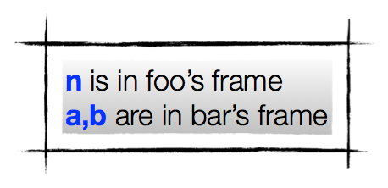
Zooming in on the stack!
0xffffffff
main
foo
n
a
bar
b
int main() { return foo(10); }
int foo(int n) { return bar(n-1,n*n);}
int bar(int a,int b){ return a + b;}
0x00000000
￼

Slide 16
Recursion
Recursive calls are supported
int power(int base,int n) {
int rv = 1;
while (n>0) {
rv *= base;
n--;
}
return rv;
}
int power(int base,int n) {
if (n==0)
return 1;
else {
int p = power(base,n-1);
return base * p;
}
}
Recursive version….
Induction on n
Base case returns 1
Inductive case multiplies by base

Slide 17
Example – Stack Frame and Recursive Call
#include <stdio.h>
int power(int base,int n) {
if (n==0)
return 1;
else {
int p = power(base,n-1);
return base * p;
}
}
int main(int argc,char* argv[])
{
printf("%d^%d = %d\n",2,8,power(2,8));
return 0;
}
main
argc=1,argv=…
power(2,8)
base=2, n=8,p=?
power(2,7)
base=2, n=7,p=?
power(2,6)
base=2, n=6,p=?
power(2,5)
base=2, n=5,p=?
power(2,4)
base=2, n=4,p=?
power(2,3)
base=2, n=3,p=?
power(2,2)
base=2, n=2,p=?
power(2,1)
base=2, n=1,p=?
power(2,0)
base=2, n=0,p=?

Slide 18
Example
#include <stdio.h>
int power(int base,int n) {
if (n==0)
return 1;
else {
int p = power(base,n-1);
return base * p;
}
}
int main(int argc,char* argv[])
{
printf("%d^%d = %d\n",2,8,power(2,8));
return 0;
}
main
argc=1,argv=…
power(2,8)
base=2, n=8,p=?
power(2,7)
base=2, n=7,p=?
power(2,6)
base=2, n=6,p=?
power(2,5)
base=2, n=5,p=?
power(2,4)
base=2, n=4,p=?
power(2,3)
base=2, n=3,p=?
power(2,2)
base=2, n=2,p=?
power(2,1)
base=2, n=1,p=?
power(2,0)
base=2, n=0,p=?

Slide 19
Example
#include <stdio.h>
int power(int base,int n) {
if (n==0)
return 1;
else {
int p = power(base,n-1);
return base * p;
}
}
int main(int argc,char* argv[])
{
printf("%d^%d = %d\n",2,8,power(2,8));
return 0;
}
main
argc=1,argv=…
power(2,8)
base=2, n=8,p=?
power(2,7)
base=2, n=7,p=?
power(2,6)
base=2, n=6,p=?
power(2,5)
base=2, n=5,p=?
power(2,4)
base=2, n=4,p=?
power(2,3)
base=2, n=3,p=?
power(2,2)
base=2, n=2,p=?
power(2,1)
base=2, n=1,p=1

Slide 20
Example
#include <stdio.h>
int power(int base,int n) {
if (n==0)
return 1;
else {
int p = power(base,n-1);
return base * p;
}
}
int main(int argc,char* argv[])
{
printf("%d^%d = %d\n",2,8,power(2,8));
return 0;
}
main
argc=1,argv=…
power(2,8)
base=2, n=8,p=?
power(2,7)
base=2, n=7,p=?
power(2,6)
base=2, n=6,p=?
power(2,5)
base=2, n=5,p=?
power(2,4)
base=2, n=4,p=?
power(2,3)
base=2, n=3,p=?
power(2,2)
base=2, n=2,p=2

Slide 21
Example
#include <stdio.h>
int power(int base,int n) {
if (n==0)
return 1;
else {
int p = power(base,n-1);
return base * p;
}
}
int main(int argc,char* argv[])
{
printf("%d^%d = %d\n",2,8,power(2,8));
return 0;
}
main
argc=1,argv=…
power(2,8)
base=2, n=8,p=?
power(2,7)
base=2, n=7,p=?
power(2,6)
base=2, n=6,p=?
power(2,5)
base=2, n=5,p=?
power(2,4)
base=2, n=4,p=?
power(2,3)
base=2, n=3,p=4

Slide 22
Example
#include <stdio.h>
int power(int base,int n) {
if (n==0)
return 1;
else {
int p = power(base,n-1);
return base * p;
}
}
int main(int argc,char* argv[])
{
printf("%d^%d = %d\n",2,8,power(2,8));
return 0;
}
main
argc=1,argv=…
power(2,8)
base=2, n=8,p=?
power(2,7)
base=2, n=7,p=?
power(2,6)
base=2, n=6,p=?
power(2,5)
base=2, n=5,p=?
power(2,4)
base=2, n=4,p=8

Slide 23
Example
#include <stdio.h>
int power(int base,int n) {
if (n==0)
return 1;
else {
int p = power(base,n-1);
return base * p;
}
}
int main(int argc,char* argv[])
{
printf("%d^%d = %d\n",2,8,power(2,8));
return 0;
}
main
argc=1,argv=…
power(2,8)
base=2, n=8,p=?
power(2,7)
base=2, n=7,p=?
power(2,6)
base=2, n=6,p=?
power(2,5)
base=2, n=5,p=16

Slide 24
Example
#include <stdio.h>
int power(int base,int n) {
if (n==0)
return 1;
else {
int p = power(base,n-1);
return base * p;
}
}
int main(int argc,char* argv[])
{
printf("%d^%d = %d\n",2,8,power(2,8));
return 0;
}
main
argc=1,argv=…
power(2,8)
base=2, n=8,p=?
power(2,7)
base=2, n=7,p=?
power(2,6)
base=2, n=6,p=32

Slide 25
Example
#include <stdio.h>
int power(int base,int n) {
if (n==0)
return 1;
else {
int p = power(base,n-1);
return base * p;
}
}
int main(int argc,char* argv[])
{
printf("%d^%d = %d\n",2,8,power(2,8));
return 0;
}
main
argc=1,argv=…
power(2,8)
base=2, n=8,p=?
power(2,7)
base=2, n=7,p=64

Slide 26
Example
#include <stdio.h>
int power(int base,int n) {
if (n==0)
return 1;
else {
int p = power(base,n-1);
return base * p;
}
}
int main(int argc,char* argv[])
{
printf("%d^%d = %d\n",2,8,power(2,8));
return 0;
}
main
argc=1,argv=…
power(2,8)
base=2, n=8,p=128

Slide 27
Example
#include <stdio.h>
int power(int base,int n) {
if (n==0)
return 1;
else {
int p = power(base,n-1);
return base * p;
}
}
int main(int argc,char* argv[])
{
printf("%d^%d = %d\n",2,8,power(2,8));
return 0;
}
main
argc=1,argv=…
returned Value=256
Output
2^8 = 256

Slide 28
Study the rest of the slides yourself

Slide 29
Example – Variable Scope
a.c b.c
static int i;
int j;
int foo(int n)
{
int rv;
static int k;
// can access i, j, k
}
int bar(int n)
{
// can access i, j
}
// declare j is external
// note the keyword extern
extern int j;
// Cannot define another j
// Can define another i
// this is a different i
static int i;
int f1(void)
{
// can access j (in a.c)
j++;
}

Slide 30
Order of evaluation of arguments
i = 1;
foo(i++, i++); // calling foo
Is it foo(1, 2) or foo(2, 1)?
Do not assume one way or another.

Slide 31
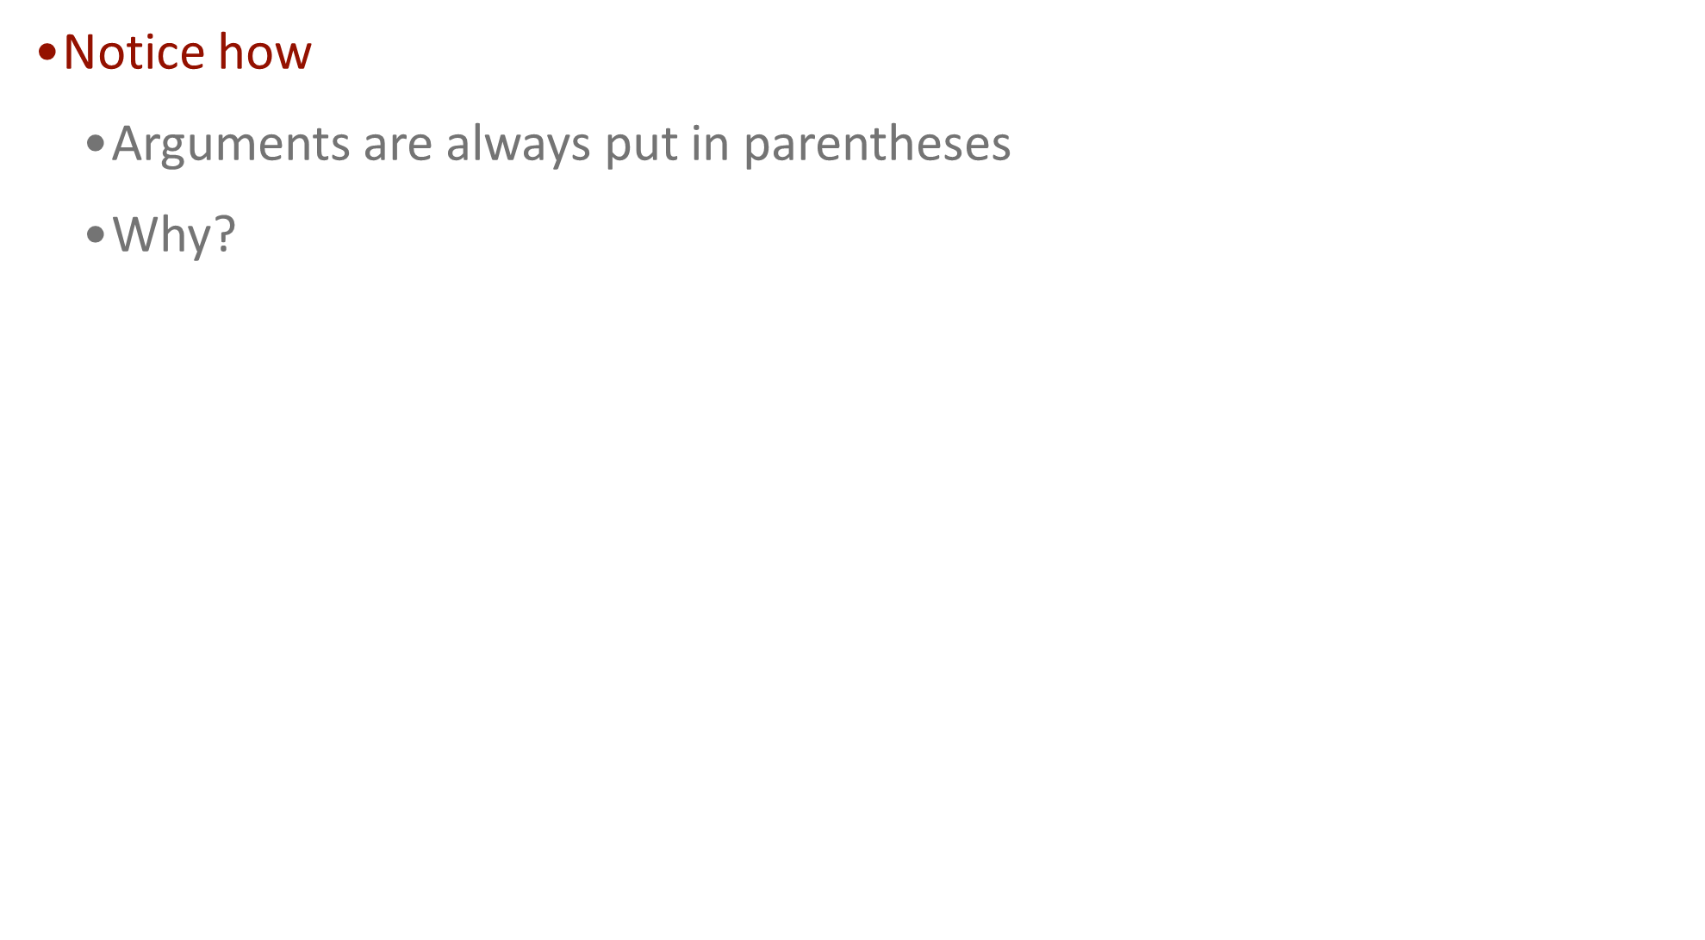
Macros as “fast functions”
Macros can take arguments!
Typical for implementing MIN / MAX
#define MIN(x,y) ((x) < (y) ? (x) : (y))
#define MAX(x,y) ((x) >= (y) ? (x) : (y))
int main()
{
int a = 10, b = 20;
int x = MIN(a,b);
}

Slide 32
Example
#include <stdio.h>
#define MULG(x,y) ((x)*(y))
#define MULB(x,y) (x*y)
int main()
{
int x = MULG(99+1,2);
int y = MULB(99+1,2);
printf("x is %d\n",x);
printf("y is %d\n",y);
return 0;
}
src (master) $ cc macros.c ; ./a.out
x is 200
y is 101

Slide 33
Variable numbers of arguments
printf(“Hello”);
printf(“Hello, %s!”, name);
How can you pass different numbers of arguments?
int foo(int n, ... ); // prototype
int foo(int n, ... ) // implementation
{
// use functions in <stdarg.h> to access the arguments
// va_start(), va_arg()
}

Slide 34
Example: static variable in a function
The “silly” function contains a static declaration
"hidden" is set to 0 only the first time silly is executed
Its value is retained from call to call
The function output no longer depends on its inputs alone!
IN | OUT | hidden | hidden
1 | 2 | 0 | 1
1 | 3 | 1 | 2
1 | 4 | 2 | 3
2 | 7 | 3 | 4
… | … | … | …
int silly(int x) {
static int hidden = 0;
return x * 2 + hidden++;
}

Slide 35
It could be worse
“hidden” variable declared outside silly!
Its value is retained from call to call
The function output no longer depends on its inputs alone!
It (hidden) can be changed by other functions!
static int hidden = 0;
int silly(int x) {
return x * 2 + hidden++;
}
void innocuous(int z) {
hidden = hidden * z + 10;
}
IN | OUT | hidden | hidden
1 | 2 | 0 | 1
1 | 3 | 1 | 2
1 | 4 | 2 | 3
2 | 7 | 3 | 4
… | … | … | …

Slide 36
Opinions about global and static variables
Global Variables Are OK, and In Fact Necessary
http://heather.cs.ucdavis.edu/~matloff/globals.html
We are going to deal with ‘globals’ a lot later in the course
Actually, stack and heap are global
Examples:
Count the number of times a function is called.
Coefficients in FFT.

