Slide 1

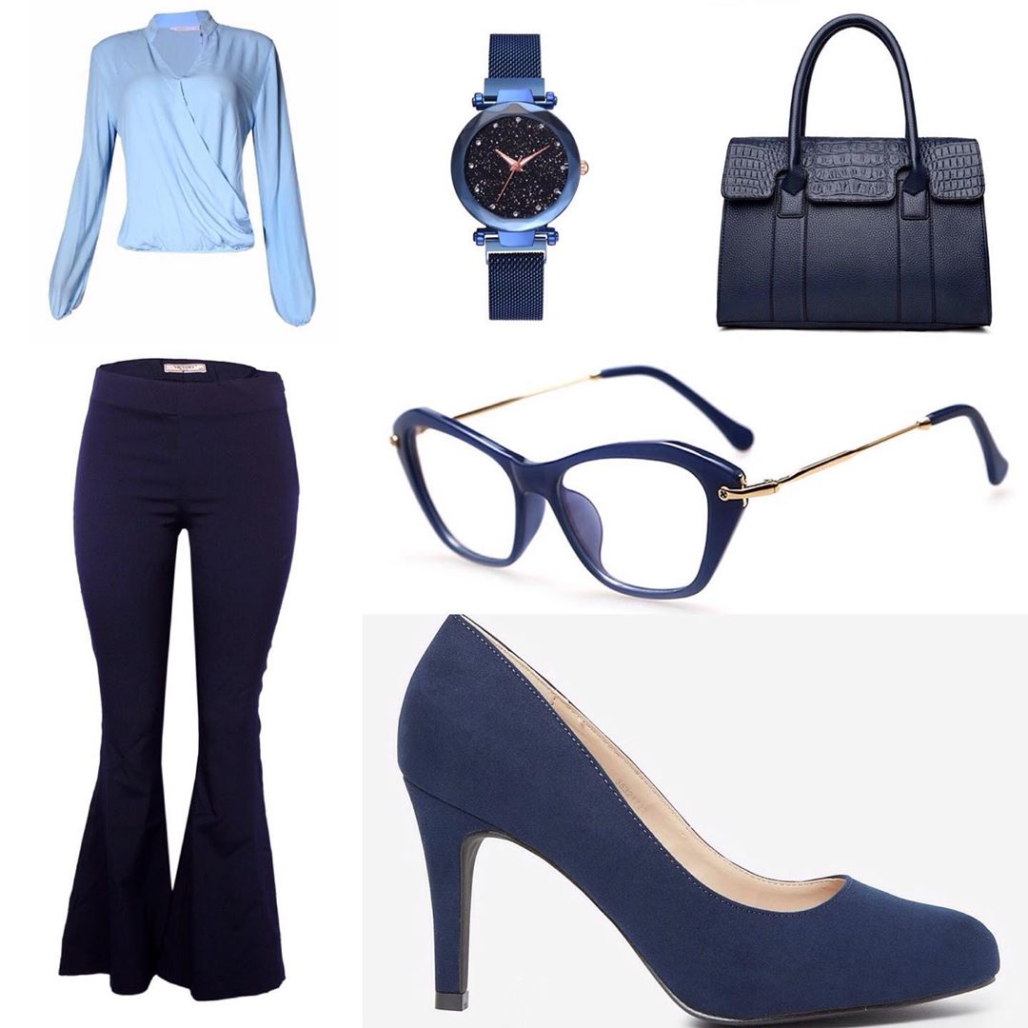
IMG2RECOMMENDER
An Introduction
Mindy Zhou

Slide 2

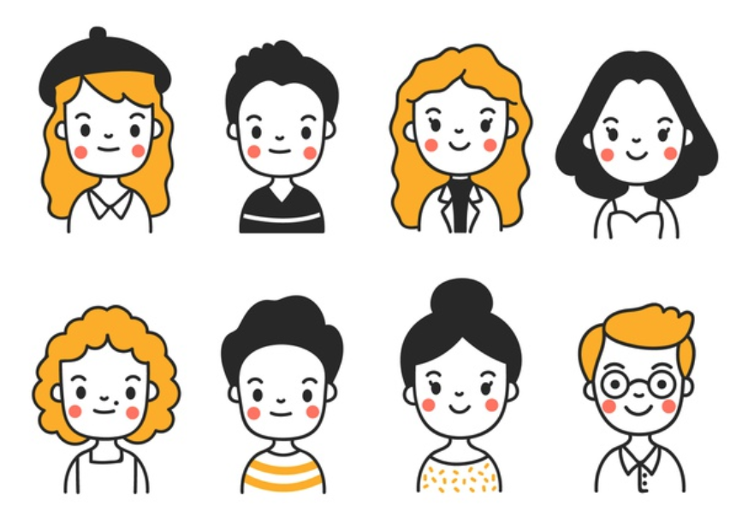


Long Term Business Goals:
This Project:
Images
Face Images
Person Identifier
+
CNN model
Face Cropper
+
Transfer Learning Model
Product
Recommender

Slide 3
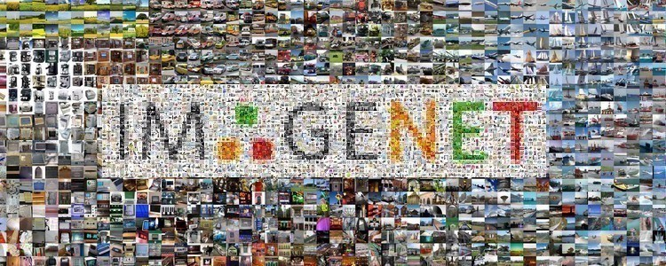

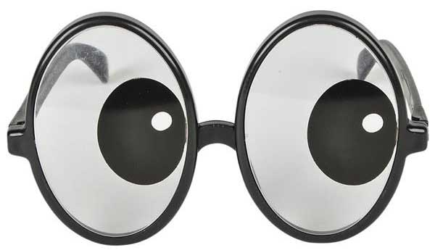

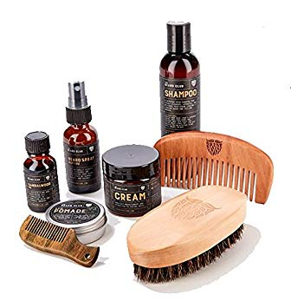

High Level Approach Summary
653 Images
web scraped, labeled, cropped manually
Solution:
Transfer Learning
VGG16
ResNet50
Base Models
Common challenge:
labor intensive and small data set
save best 6 models
3 one vs rest classifier
for multi-classification
(eyewear, hat, and beard)
unfreeze last 5 layers and fine tune the final models

Slide 4
Model Results

Slide 5
Model Improvements

Slide 6
Test Out the Prototype!

