Slide 1
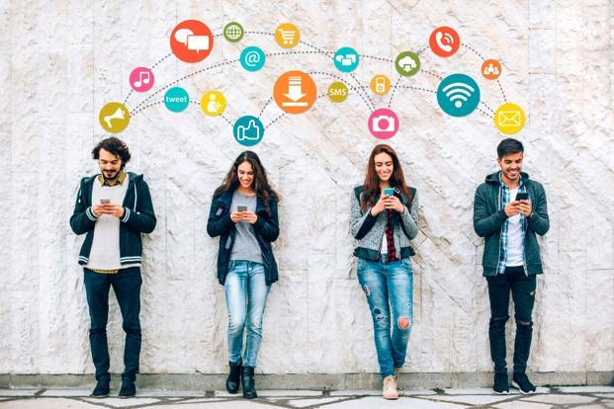
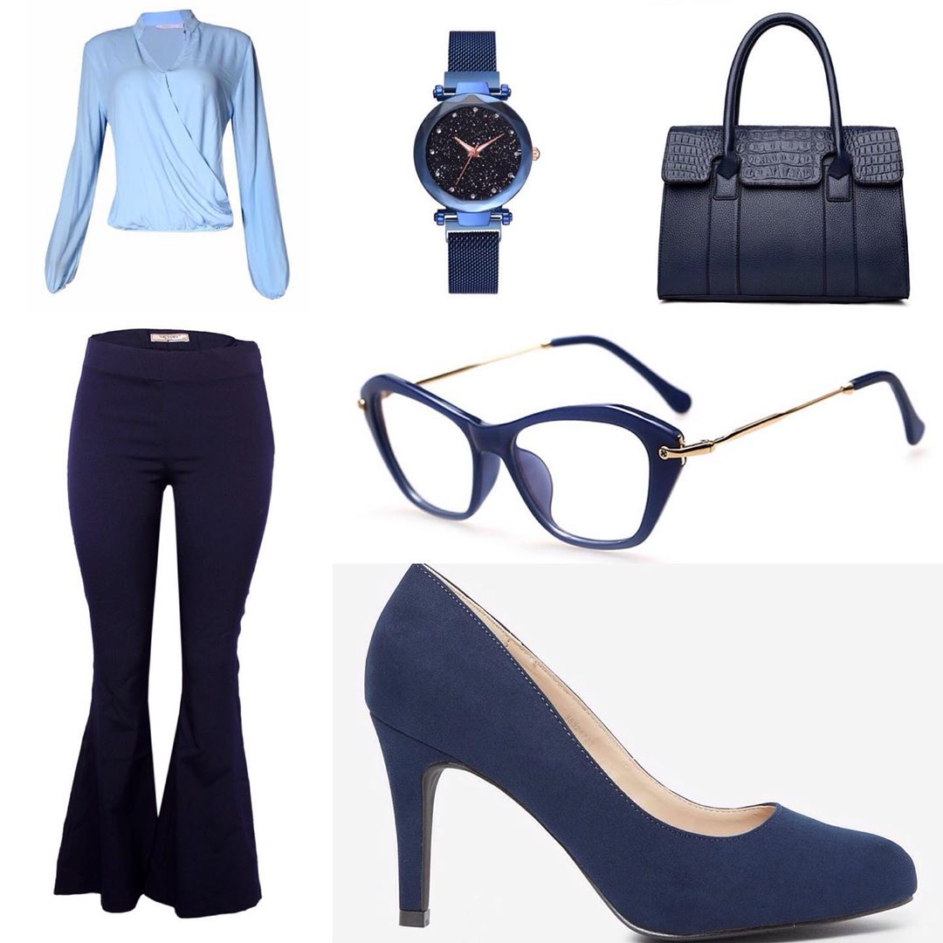
IMG2RECOMMENDER
An Introduction
Mindy Zhou

Slide 2

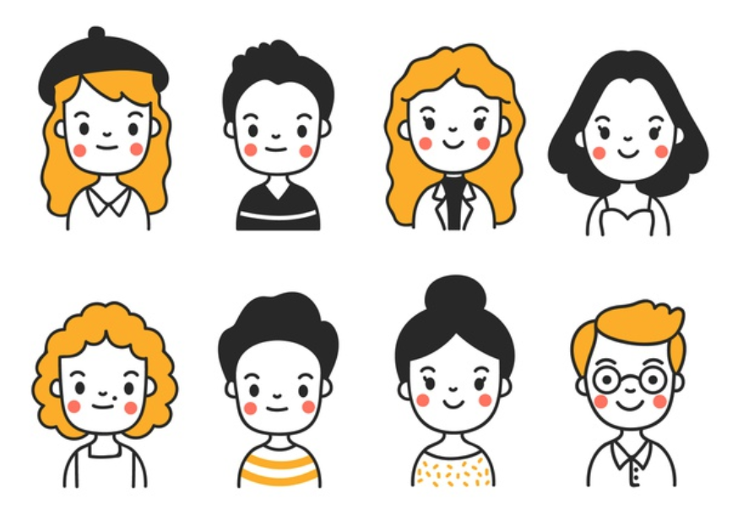


Long Term Business Goals:
This Project:
Images
Face Images
Person Identifier
+
CNN model
Face Cropper
+
Transfer Learning Model
Product
Recommender

Slide 3
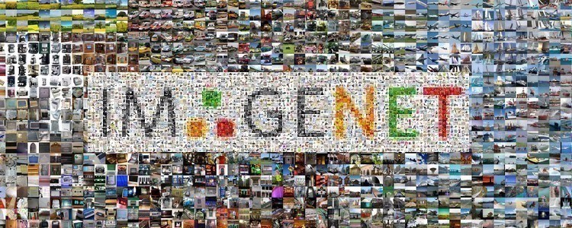

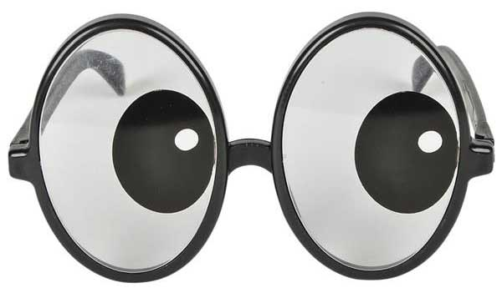

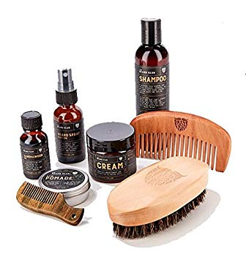

High Level Approach Summary
653 Images
web scraped, labeled, cropped manually
Solution:
Transfer Learning
VGG16
ResNet50
Base Models
Common challenge:
labor intensive and small data set
save best 6 models
3 one vs rest classifier
for multi-classification
(eyewear, hat, and beard)
unfreeze last 5 layers and fine tune the final models

Slide 4
Model Results

Slide 5
Future Plans
Play more with learning rate, momentum,
dropout rate and batch normalization
Increase image data base with time
Unfreeze more model layers with more data
Create extra dense layers
Go from transfer learning to CNN
More complex accurate model to target more products
product and person identifier as a backend app
Advantages:
Less data memory intensive.
Automates marketing search via backend app:
Less labor capital.
No need for cross site tracking:
More security.
Identify potential customers without social media accounts.
Recommends products as both personal usage and gifts.

Slide 6
Test Out the Prototype!

Slide 7
Questions?

Slide 8
Acknowledgements
Talented husband, Dr. Jason N. Dossett for setting up GPU and help with computer hardware.
Dr. Arun S. Maiya for forwarding helpful blog sources.
Flatiron instructors and coaches for discussing and providing helpful insights.
Wonderful students at Flatiron for being positive and encouraging.

Slide 9
Sources:
https://www.pyimagesearch.com/2017/12/04/how-to-create-a-deep-learning-dataset-using-google-images/
https://blog.keras.io/building-powerful-image-classification-models-using-very-little-data.html
https://machinelearningmastery.com/check-point-deep-learning-models-keras/
https://machinelearningmastery.com/save-load-keras-deep-learning-models/
https://medium.com/@sidereal/cnns-architectures-lenet-alexnet-vgg-googlenet-resnet-and-more-666091488df5
https://towardsdatascience.com/understanding-and-coding-a-resnet-in-keras-446d7ff84d33
https://www.kaggle.com/suniliitb96/tutorial-keras-transfer-learning-with-resnet50
https://www.kaggle.com/pmigdal/transfer-learning-with-resnet-50-in-keras
https://towardsdatascience.com/transfer-learning-for-image-classification-using-keras-c47ccf09c8c8

