Slide 1
Final Project
The best location for a high-end restaurant

Slide 2
Toronto
One of the biggest cities in Canada
A multicultural and a international city
People come from different countries
With lots of different style restaurants
Over 900 restaurants

Slide 3
Features to consider
High-end Restaurant
Population (high population bring more customers)
Average Income (high income would bring more return customers)
Competitors ( less competitors bring more customers)

Slide 4
Data
Population and average income
Neighborhood Latitude and Longitude
Foursqaure

Slide 5
analysis:

Slide 6
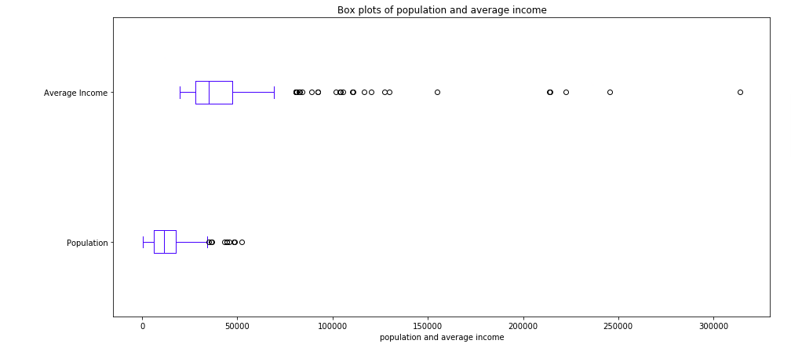
We can see the only few of neighborhood has average income above $100,000. If you have the income that around 75000, you would be the outlier of data. and most of them are at below $50,000 level. Most of population is below 25000.

Slide 7
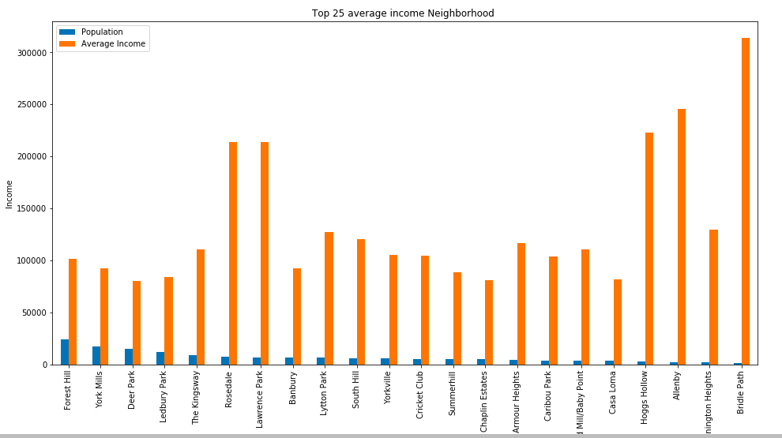
The population in high income area is low.
This hard to tell the relationship between the population and income

Slide 8
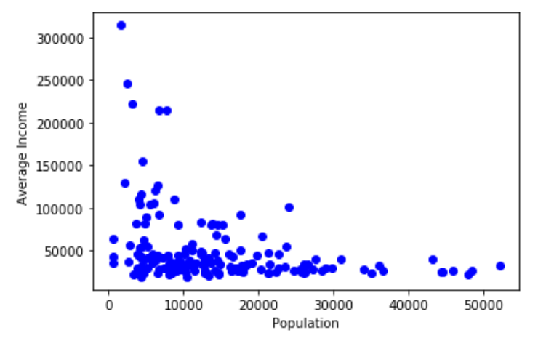
There are no strong relationship between population and average income
The Coefficient is -1.227

Slide 9
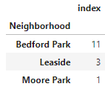
After drop all fast food restaurants, in the high income neighborhood, there are 11 restaurants at Bedford Park, there are 3 restaurants at Leaside and 1at Moore Park

Slide 10
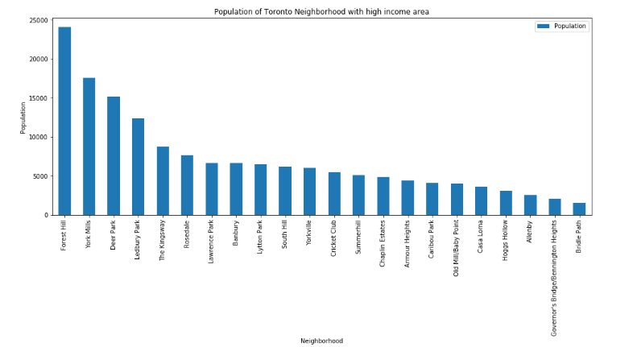
At high income area, Forest Hill, York Mills Deer Park and Ledbury Park have more population than others

Slide 11
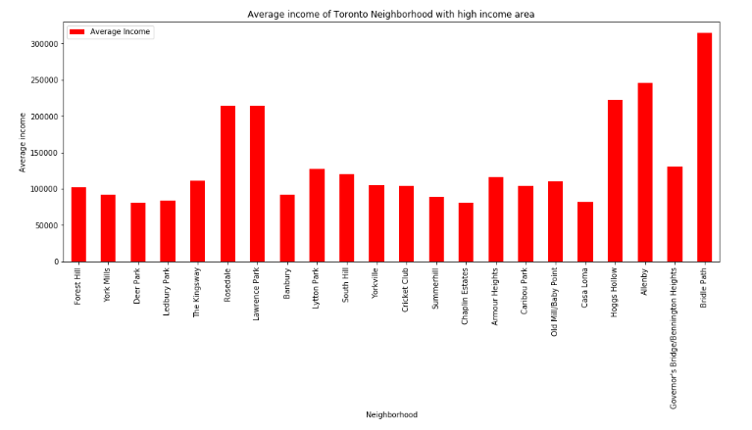
Rosedale and Lawrence Park have relative higher income and population at the same time

Slide 12
Recommendations:
After access population, average income and competitors of each neighborhood
I would consider Forest Hill, York Millis, Deer Park and Ledbury Park firstly
Then Rosedale and Lawrence Park.

