Slide 1
Final Project
The best location for a high-end restaurant

Slide 2
Toronto
One of the biggest cities in Canada
A multicultural and a international city
People come from different countries
With lots of different style restaurants
Over 900 restaurants

Slide 3
Features to consider
High-end Restaurant
Population
Average Income
Competitors

Slide 4
Data
Population and average income
Neighborhood Latitude and Longitude
Foursqaure

Slide 5
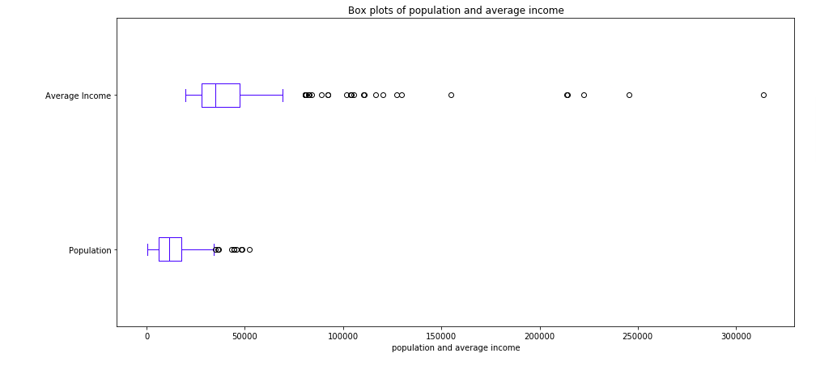

Slide 6
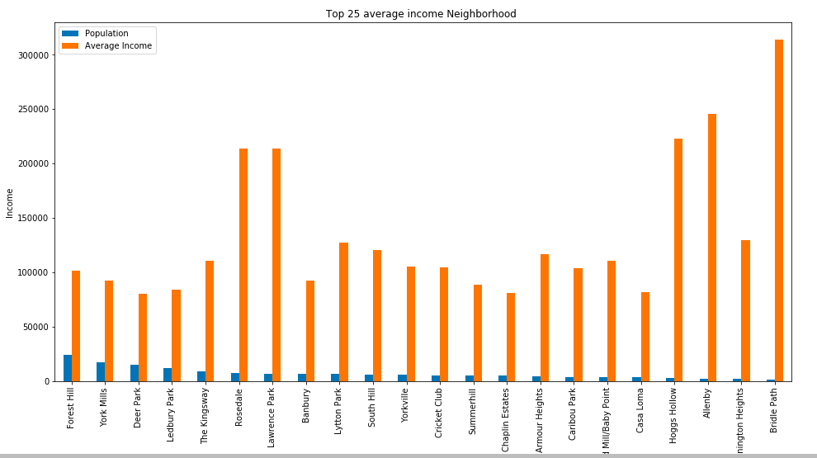

Slide 7
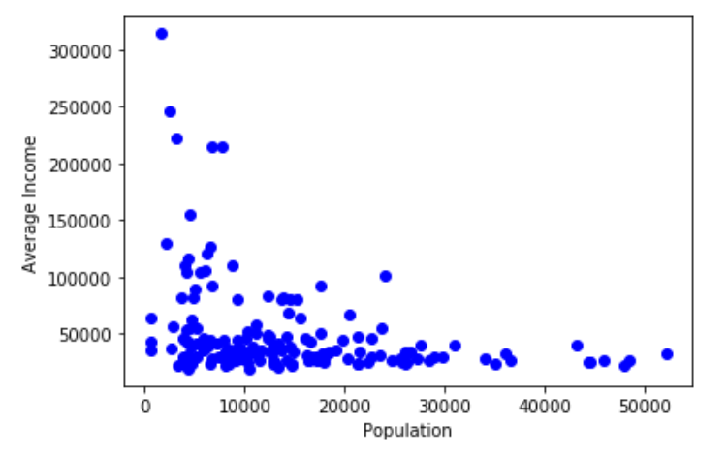
There are no strong relationship between population and average income

Slide 8
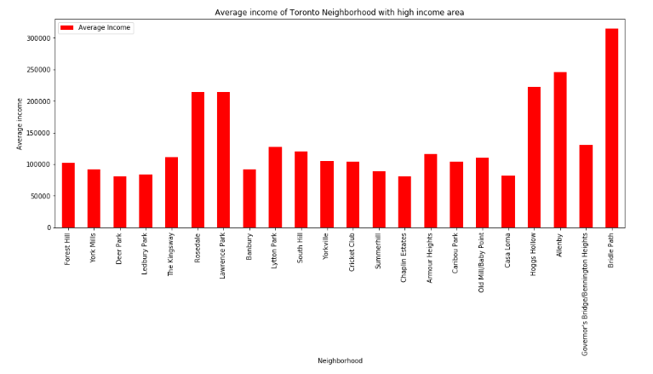
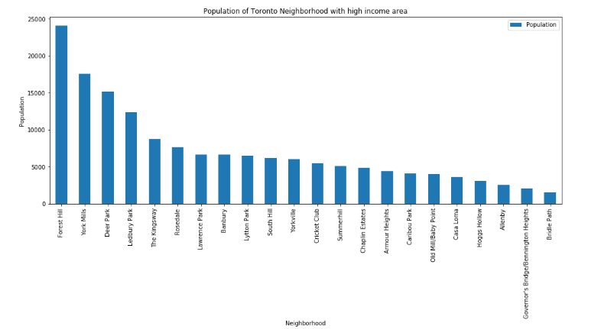
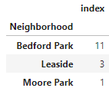

Slide 9
Recommendations:
After access population, average income and competitors of each neighborhood
I would consider Forest Hill, York Millis, Deer Park and Ledbury Park firstly
Then Rosedale and Lawrence Park.

