Slide 1


Team Members
ANALYZING AND TESTING CONCRETE QUALITY USING AI
Business model
Introduction
Problem

Slide 2
Team Members
Business model
1. Mohamed ziad
2. Mohamed Ghonim
3. Hams omar
4. Hager ali
5. Adhm mohamed
Problem
Introduction

Slide 3
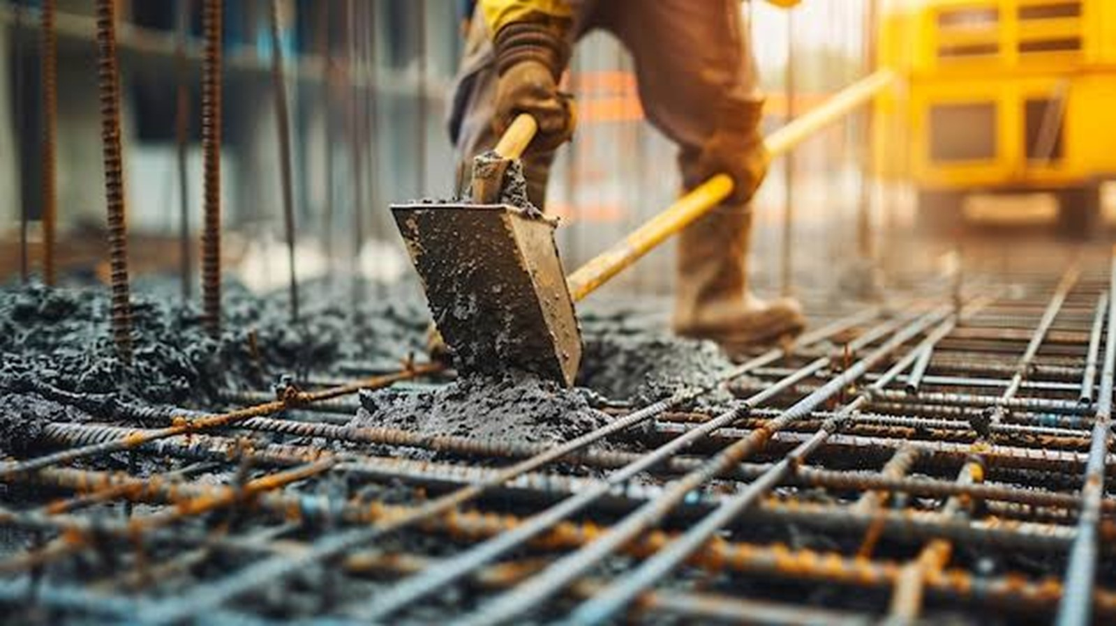
Team Members
Our project addresses a key challenge in construction: improving concrete quality testing through AI technology. By reducing waste and optimizing processes, we aim to make testing faster, smarter, and more sustainable, revolutionizing the construction industry.
Business model
Introduction
Problem

Slide 4
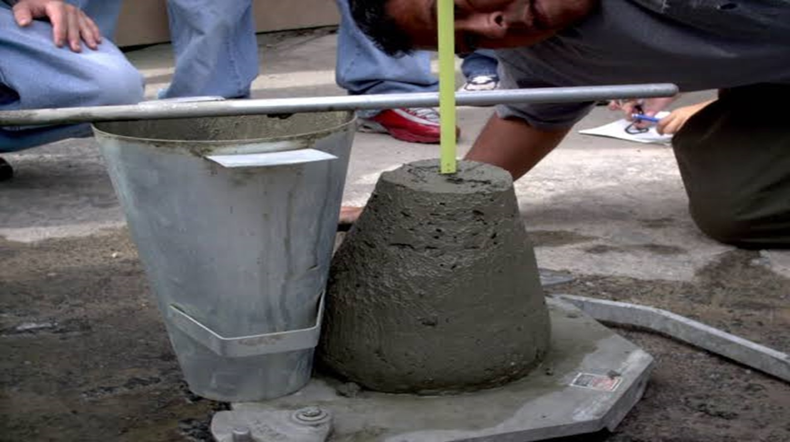
Introduction
Concrete quality testing is inefficient, costly, and time-consuming.
High rejection rates lead to wasted resources, project delays and increased costs. The construction industry urgently needs a faster
More reliable solution to ensure quality and minimize waste.
Team Members
Problem
Solve

Slide 5
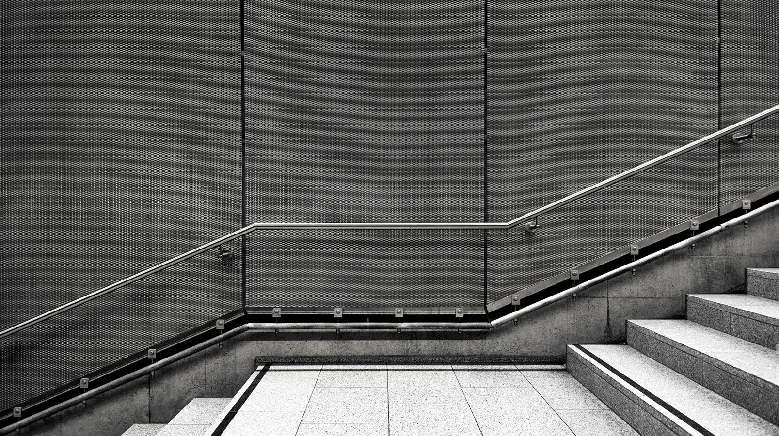
Introduction
Using AI-powered predictive models, we streamline concrete quality testing. By analyzing key mix components and conditions, our solution predicts acceptability before and during casting. This minimizes waste, saves costs, and ensures consistent quality, offering a faster, smarter approach to construction challenges.
Problem
Solve
Methodology

Slide 6

Business model
1. Data Collection
2. Data Preprocessing
3. Model Training
(Artificial Neural Networks -ANN)
4. Prediction
5. Interface Development (Streamlit)
Solve
Methodology

Slide 7
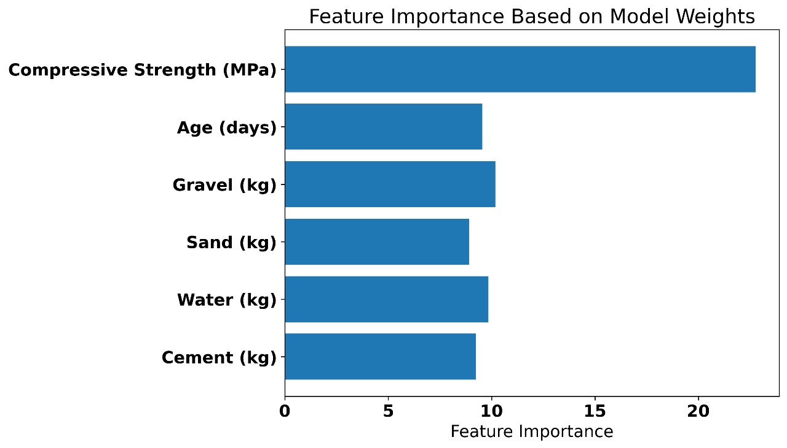
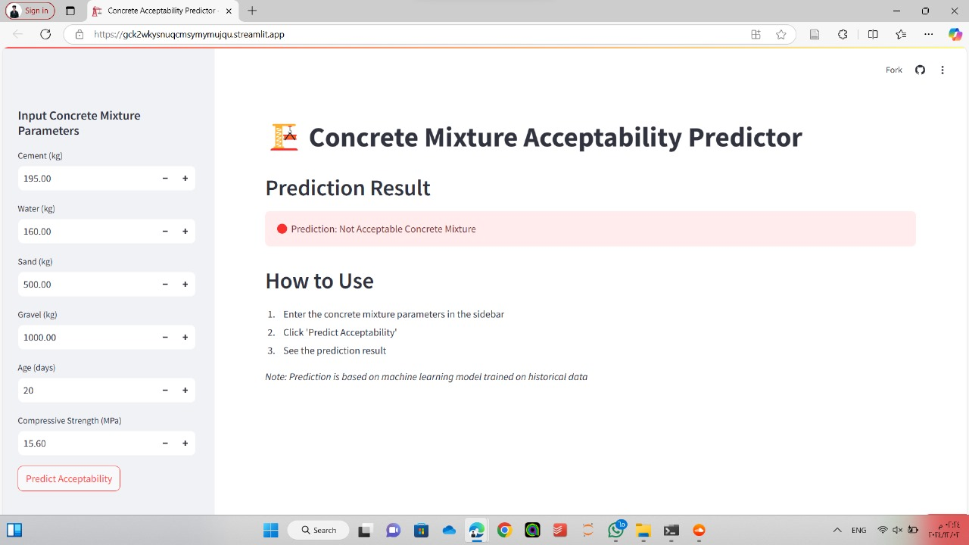
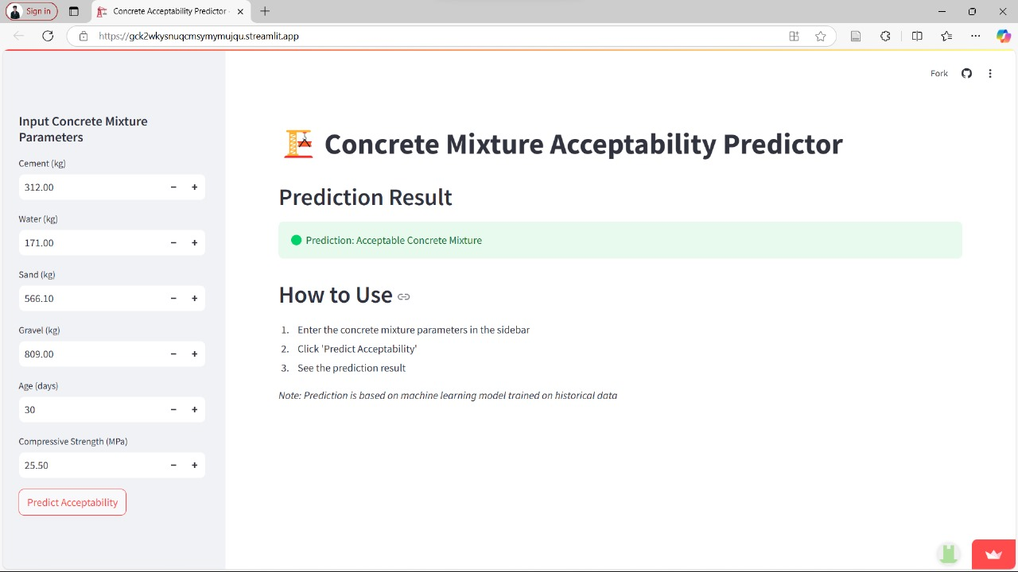
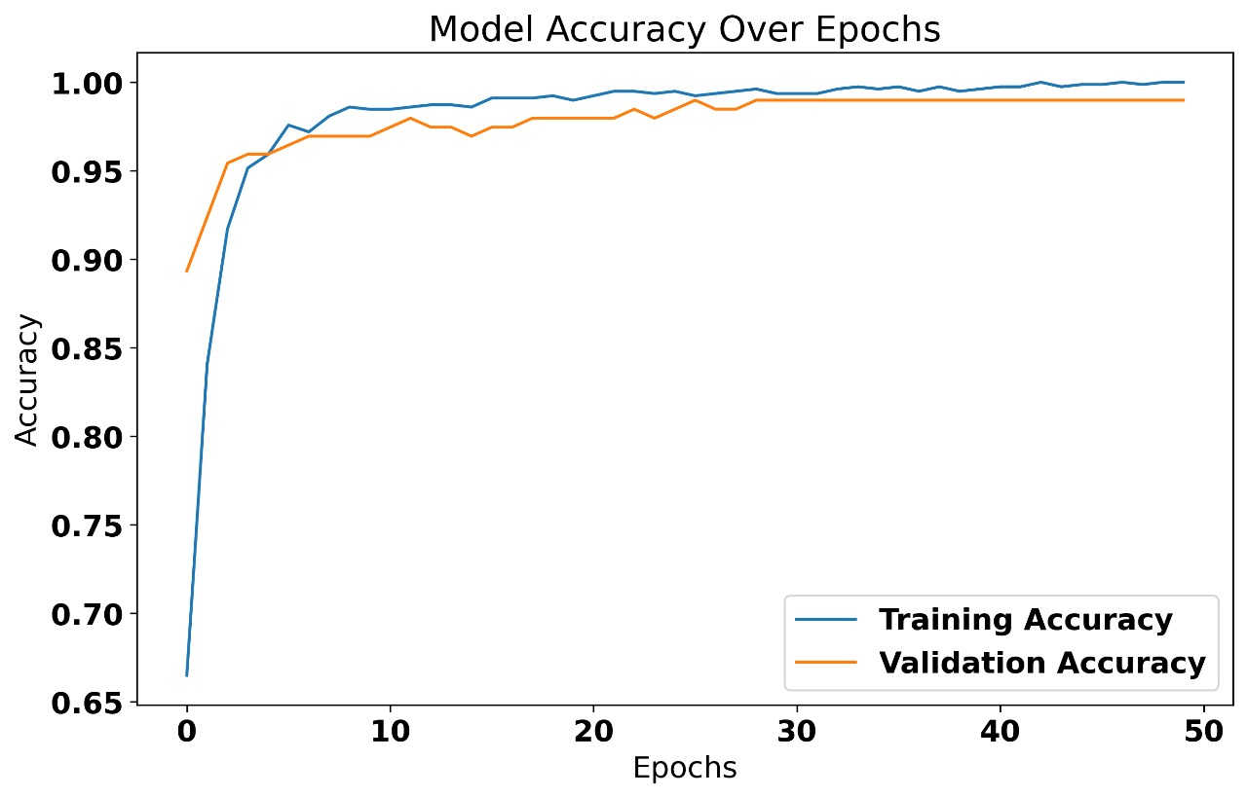
Business model
Solve
Methodology

Slide 8
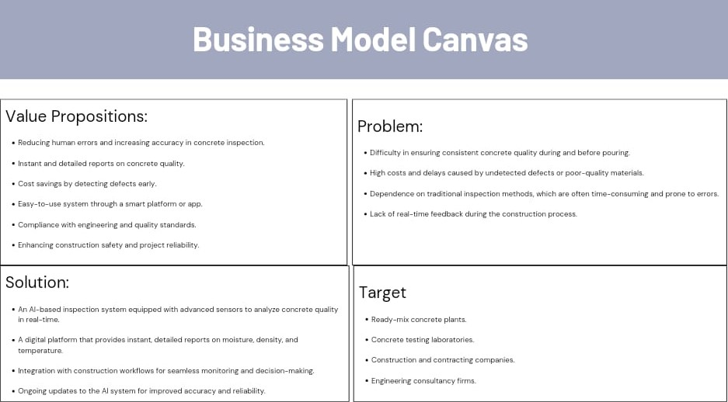
Business model
Methodology
Introduction

