Slide 1
ANALYSIS OF NIGERIAN TRAFFIC CRASHES (2020-2024)
Trends, Causes, and Prevention Strategies

Slide 2
The problem
Context
Problem statement
Between 2020 and 2024, Nigeria witnessed a concerning rise in traffic crashes, leading to significant loss of life, injuries, and economic strain. Contributing factors include poor road conditions, inadequate enforcement of traffic laws, reckless driving, and adverse weather. Despite the efforts of the Federal Road Safety Corps (FRSC) to curb accidents, crashes remain a major public safety issue. This analysis seeks to explore trends, identify root causes, and propose data-driven strategies to reduce traffic crashes and improve road safety across the country.
The rising number of traffic crashes in Nigeria from 2020 to 2024 has become a critical public safety issue, resulting in increased fatalities, injuries, and economic losses. Factors such as poor road infrastructure, inadequate law enforcement, and reckless driving contribute to the high accident rates. This analysis aims to identify key trends and causes of these crashes, providing actionable insights to help reduce incidents and improve road safety.

Slide 3
About the data:
The dataset is a third party data sourced from Akinniyi Akinwande on Kaggle in a CSV file format.
The data is reliable, original, comprehensive, current and not cited.
It provides an analysis of road traffic crashes across Nigerian states from Q4 2020 to Q1 2024.
Each row corresponds to a specific state and quarter, capturing details on the number of crashes, casualties, vehicles involved, and contributing factors like speed violations, adverse weather conditions, fatigue, drinking and driving.

Slide 4
Documentation of data cleaning and manipulation.

Slide 5
Resolved data inconsistencies by converting all text in cells A1-K1 to uppercase and applying bold formatting.
Removed duplicate, inaccurate, and irrelevant data, and used the trim function to eliminate extra spaces.
Calculated the correlation coefficient between total crashes and contributing factors.
Categorised contributing factors of crashes.
1
2
3
4
5
6
7
Adjusted the width of column M to fit the text properly.
Categorized crashes by State and Quarters.
Grouped Casualties.

Slide 6
SUMMARY OF FINDINGS FOR TRAFFIC CRASH ANALYSIS.

Slide 7
The data highlights three predominant causes that consistently contribute to these accidents:
1. Other Factors
2. Speed Violations
3. Fatigue
Leading the list at 38%, a staggering 19,914 crashes are attributed to unknown factors. This suggests a gap in the reporting or investigation process, where the exact causes of crashes are not documented or identified. This could be due to a lack of detailed accident reporting systems, challenges in data collection at crash sites, or incomplete investigations.
Coming in close behind at 38%, speed violations account for 19,634 crashes. This demonstrates that excessive speeding remains a critical issue on Nigerian roads. Despite road safety campaigns and regulations, speeding poses a major risk, contributing significantly to traffic accidents.
Accounts for 24% crashes, Fatigue is responsible for 12,341 crashes, showing that tired or drowsy driving is another leading cause of accidents. Long driving hours, inadequate rest for commercial drivers, and the lack of proper roadside facilities for rest breaks might be contributing factors.

Slide 8
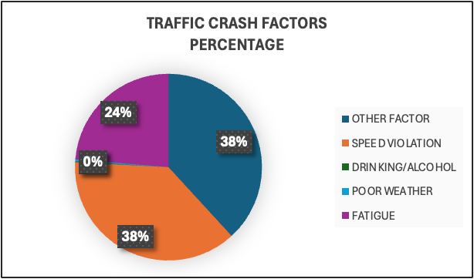
TRAFFIC CRASH FACTORS PERCENTAGE

Slide 9
Top 4 crash prone states with high risk areas and crashes, each exceeding 2,000 are FCT, Ogun, Nasarawa, Kaduna:
1. FCT
2. OGUN
3. NASARAWA
4. KADUNA
FCT has the highest number of crashes at 4852, mainly caused by other factors and speed violations.
Ogun State is the second highest with over 8713 injured people, and the leading cause of crashes in the state is Speed violation and fatigue.
Nasarawa the third state with high crashes is notable for its low number of deaths crash, 75% of crashes here involve multi-vehicle collisions due to other factors and speed violations.
Kaduna is the fourth state with a high number of crashes, it surprisingly has the highest number of injured and killed victims and crashes are mostly caused by speed violations.

Slide 10
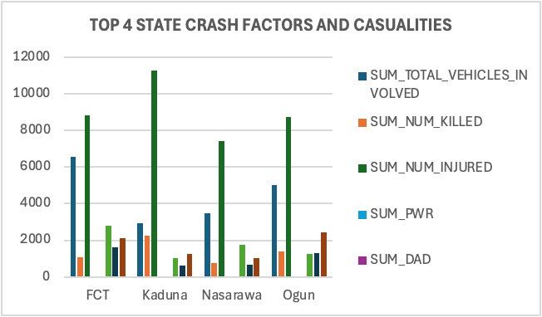
TOP 4 CRASH PRONE STATES

Slide 11
Peak crash quarter:
The quarter with the highest number of crashes is Q4 (October to December), with an average crash rate ranging from 92% to 97% coinciding with the end-of-year celebrations.

Slide 12
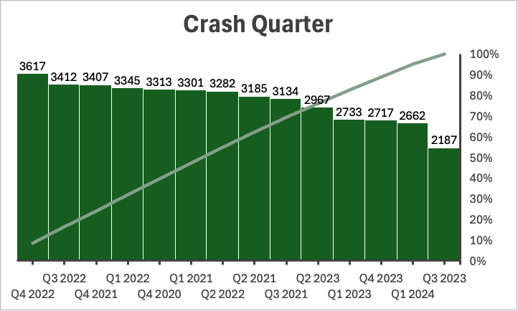
PEAK CRASH QUARTER

Slide 13
Affected vehicle:
A total of 52,146 vehicles were involved in crashes from 2020-2024.

Slide 14
Crash Severity:
Minor/Major Injuries make up 86% of all crash severity.
14% of crashes lead to severe outcomes such as death, with other factors and overspeeding being major contributing factors.

Slide 15
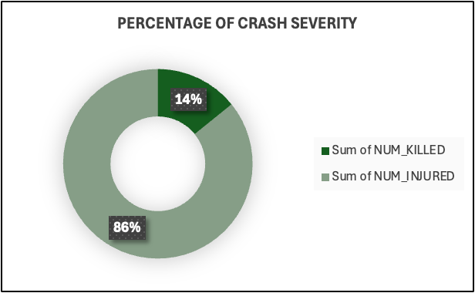
CRASH SEVERITY

Slide 16
PROPOSED ACTIONS OR RECOMMENDATIONS FOR REDUCING TRAFFIC CRASHES.

Slide 17
Address Human Behaviour:
Recommendation: Implement targeted driver education programs and stricter law enforcement.
Justification:
Since human behaviour, such as speed violations and fatigue, plays a significant role in crashes, targeted awareness campaigns should be developed to educate drivers about safe practices.
Additionally, enforcing traffic laws such as speed limits and penalties can deter risky behaviour.
Actions:
Launch awareness campaigns addressing speeding, fatigue and distracted driving, particularly in high-risk areas like FCT, Ogun, Nasarawa, Kaduna and OYO.
Increase law enforcement presence, particularly during peak traffic quarters and in regions with a high frequency of crashes.

Slide 18
Improve Infrastructure:
Recommendation: Upgrade and maintain road infrastructure in high-crash locations.
Justification:
Poor infrastructure, such as bad road conditions, inadequate signage, or poorly designed intersections, is a significant contributor to crashes.
Improving the physical state of roads and enhancing road safety features can reduce accident rates.
Actions:
Conduct regular road maintenance, focusing on high-risk areas where crashes frequently occur.
Improve road signage, lighting, and lane markings to guide drivers, especially in hazardous areas.
Install traffic calming measures (e.g., speed bumps, traffic circles) in accident-prone locations.

Slide 19
Environmental Condition Mitigation:
Recommendation: Implement safety measures to address weather-related risks.
Justification:
Environmental factors like poor weather conditions (e.g., rain, fog) increase crash risk.
Providing timely weather information and improving road design can help reduce weather-related crashes.
Actions:
Ensure weather information is made available to drivers through mobile apps, roadside signs, or media during hazardous conditions.
Install more drainage systems in areas prone to flooding and improve road surfaces that may become slippery during rain.
Increase the visibility of road markings and signage, especially in areas frequently affected by fog or heavy rainfall.

Slide 20
Speed Control and Traffic Law Enforcement:
Recommendation: Strengthen enforcement of speed limits and install speed monitoring systems.
Justification: Speed violations are a leading cause of crashes. Enforcing speed limits more rigorously, especially in high-risk areas, can reduce crashes caused by excessive speed.
Actions:
Install speed cameras in areas with frequent speeding violations and high crash rates.
Increase penalties for speeding to deter drivers from exceeding limits.
Implement automated traffic law enforcement systems (e.g., speed and red-light cameras) to catch violators.

Slide 21
Regular Data Monitoring and Reporting:
Recommendation: Monitor crash data to identify emerging risks and trends.
Justification:
Regular analysis of traffic crash data helps proactively identify new risks and adjust interventions as needed.
Actions:
Develop a centralized system for reporting and analysing crash data across states.
Review and update safety measures regularly based on ongoing data analysis.
Share data with stakeholders, such as government agencies and transport authorities, to improve collaborative efforts to reduce crashes.

Slide 22
These recommendations, when implemented, address the core issues contributing to traffic crashes and focus on reducing risks through education, infrastructure improvements, and targeted enforcement.
By focusing on these targeted, data-driven actions, policymakers and stakeholders can implement meaningful interventions that improve road safety, reduce crashes, and save lives.

