Slide 1
Sentiment Analysis on developers’ reaction to change in API
Mainak Ghosh
Muhammad Zeeshan
Notes:
1

Slide 2
Survey results depicts important factors which causes positive sentiment for the three APIs :
1. Google API
2. Twitter API
3. Facebook API
Notes:
1

Slide 3
Important factors for Google API positive feedback
a. Simple to use
b. Highly Secured
c. Free Access
d. Backward Compatible
e. Return meaningful response
f. Good quality
Notes:
1

Slide 4
Important factors for Twitter API positive feedback
a. Good documentation
b. Simple to use
c. Backward compatible
d. Highly secured
e. Free access
Notes:
1

Slide 5
Important factors for Facebook API positive feedback
a. Simple to use
b. Good document
c. Highly secured
Notes:
1

Slide 6
Combining them to produce a unified importance from the surveys yields following results:
1. Simple to use
2. Good documentation
3. Highly secured
4. Free access
5. Backward compatible
Notes:
1

Slide 7
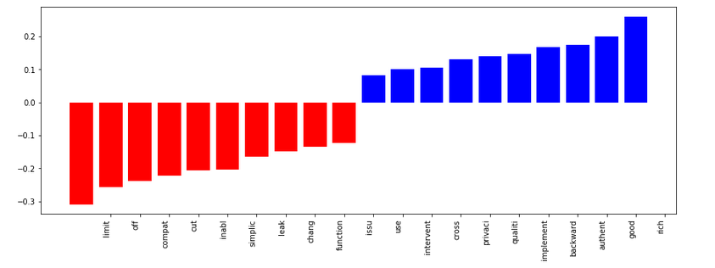
From the model we have found important factors which causes positive classification and negative classification. It is depicted below :
Red stands for negative classification.
Blue stands for positive classification.
Notes:
1

Slide 8
From the previous slide, we can visualize what model extracts as positive and negative factors for sentiments.
Positive factors:
1. Backward compatibility
2. Quality
3. Privacy and Authentication (same as security)
4. Good document
5. Rich information
Negative factors:
1. Limited access
2. Not simple
3. API change
4. Not functioning
5. Less compatible to previous version
We can conclude that these factors are semantically same as the survey depicts.
Notes:
1

Slide 9
THANK YOU
Notes:
1

