Slide 1
Sentiment Analysis on developers’ reaction to change in API
Mainak Ghosh
Muhammad Zeeshan

Slide 2
Contents
Motivation
Research Questions
Analysis
Results
Clustering & Model Generations
Future Tasks
Discussion

Slide 3
Contents
Motivation
Research Questions
Analysis
Results
Clustering & Model Generations
Future Tasks
Discussion

Slide 4
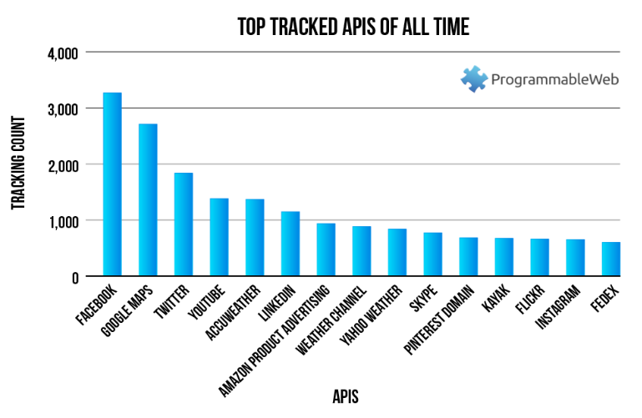
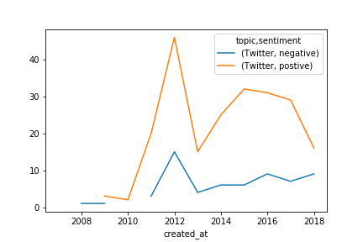
Problem Statement
Popularity does not always imply positive reaction
But sentiment for Twitter API not aligned with popularity => improvement

Slide 5
Problem Statement
Ignorance to dependencies:
Initially Twitter API used to have basic authentication, but implementation of OAuth protocol hampered the developers-Twitter API smooth relation.

Slide 6
Importance of mitigation
APIs are independent & reusable microservices
Provide ease of data accessibility e.g. credit score
Modularizing business features
Revenue generator
So need a continuous feedback model => improve utility

Slide 7
Contents
Motivation
Research Questions
Analysis
Results
Clustering & Model Generations
Future Tasks
Discussion

Slide 8
Research Questions
What kind of API do the developers have positive or negative sentiment for?
Cleaned the text
Used Textblob to identify sentiment
Extracted the API version
Extracted API using regular expression
Extracted HTTP methods
Performed analysis

Slide 9
Research Questions
What leads the developers to give positive reactions for some APIs and negative reactions for others?
Sampled small dataset and extracted few clauses using regex
Fitted the clauses to CountVectorizer to see the pattern
Used TfIdfVectorizer to find out other unique clauses
How does a model built on such dataset perform?
Built the model using the clauses as feature
Need to do the survey in developers‘ community to test

Slide 10
Contents
Motivation
Research Questions
Analysis
Results
Clustering & Model Generations
Future Tasks
Discussion

Slide 11
Architecture Pipeline
Different Types of analysis
Results
Cluster
Y Combinator
Colllection of Data
Pre-processing
Model
stackexchange

Slide 12
Technologies stack
We used python based library, TextBlob to figure out sentiments of the posts.
We used the following packages in R for analysis:
Tidytext, Dplyr, Stringr, Tidyr, Stringi
For text data preprocessing and analytics
GGplot, GGrepel, GridExtra, Knitr, WordCloud
For visualizations
Magick, Yarr, Radarchart, Igraph, GGprah,
For customizing R visualizations and more advanced charts
Shiny, ShinyJS
For our Frontend application

Slide 13
Data Pre-processing
Clean Text
Tokenization
Punctuation Removal
Porter Stemmer
Stopword Removal
Leaving only word stem e.g. reference > refer
traditional > tradit
NLTK‘s list such as I, me, we, myself

Slide 14
Analysis
Performed word count and number of posts analysis per version
Extracted emotions out of the sentiments
Executed analysis of API type & sentiment across versions
Performed clustering
Extracted clauses for positive and negative sentiment
Built model

Slide 15
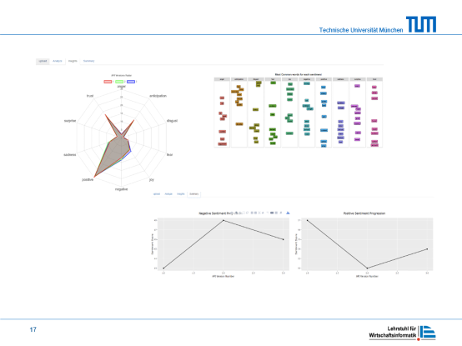
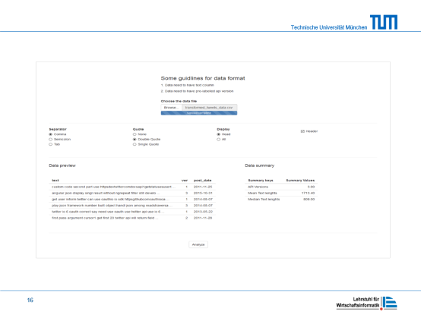
User interface

Slide 16
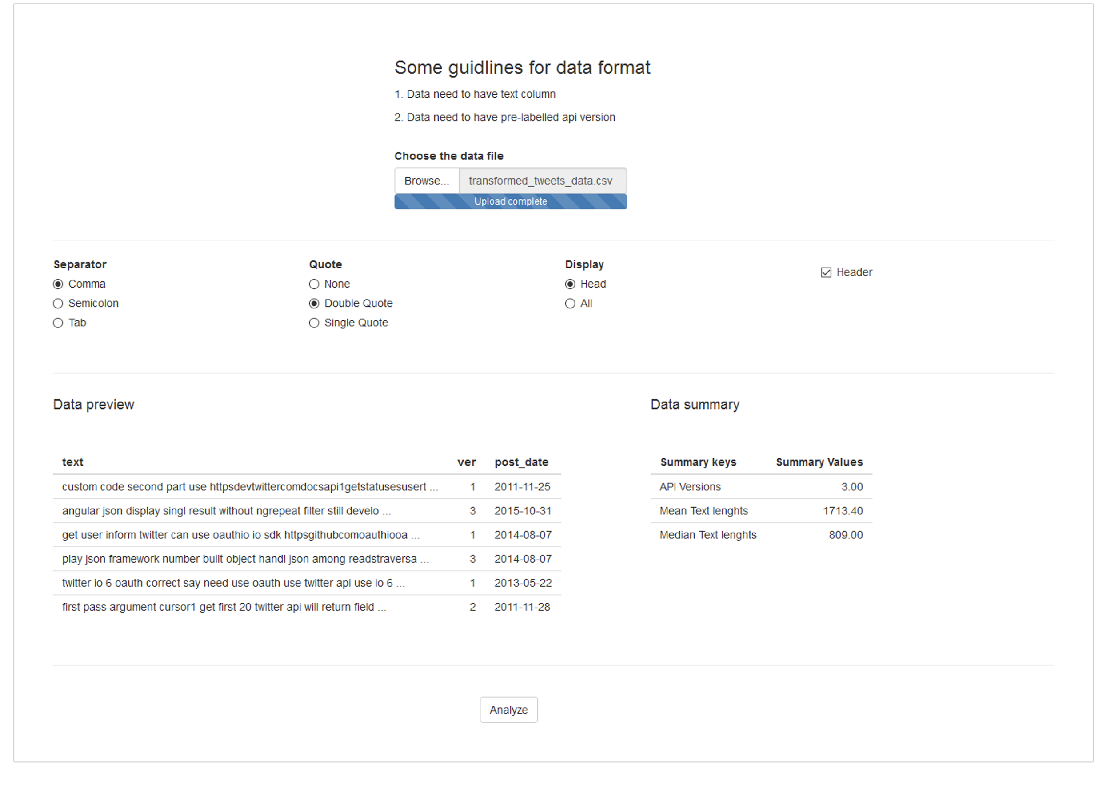

Slide 17
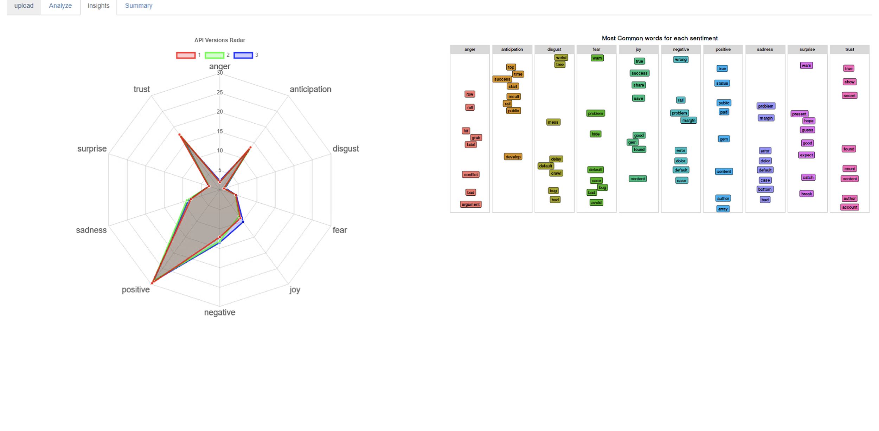
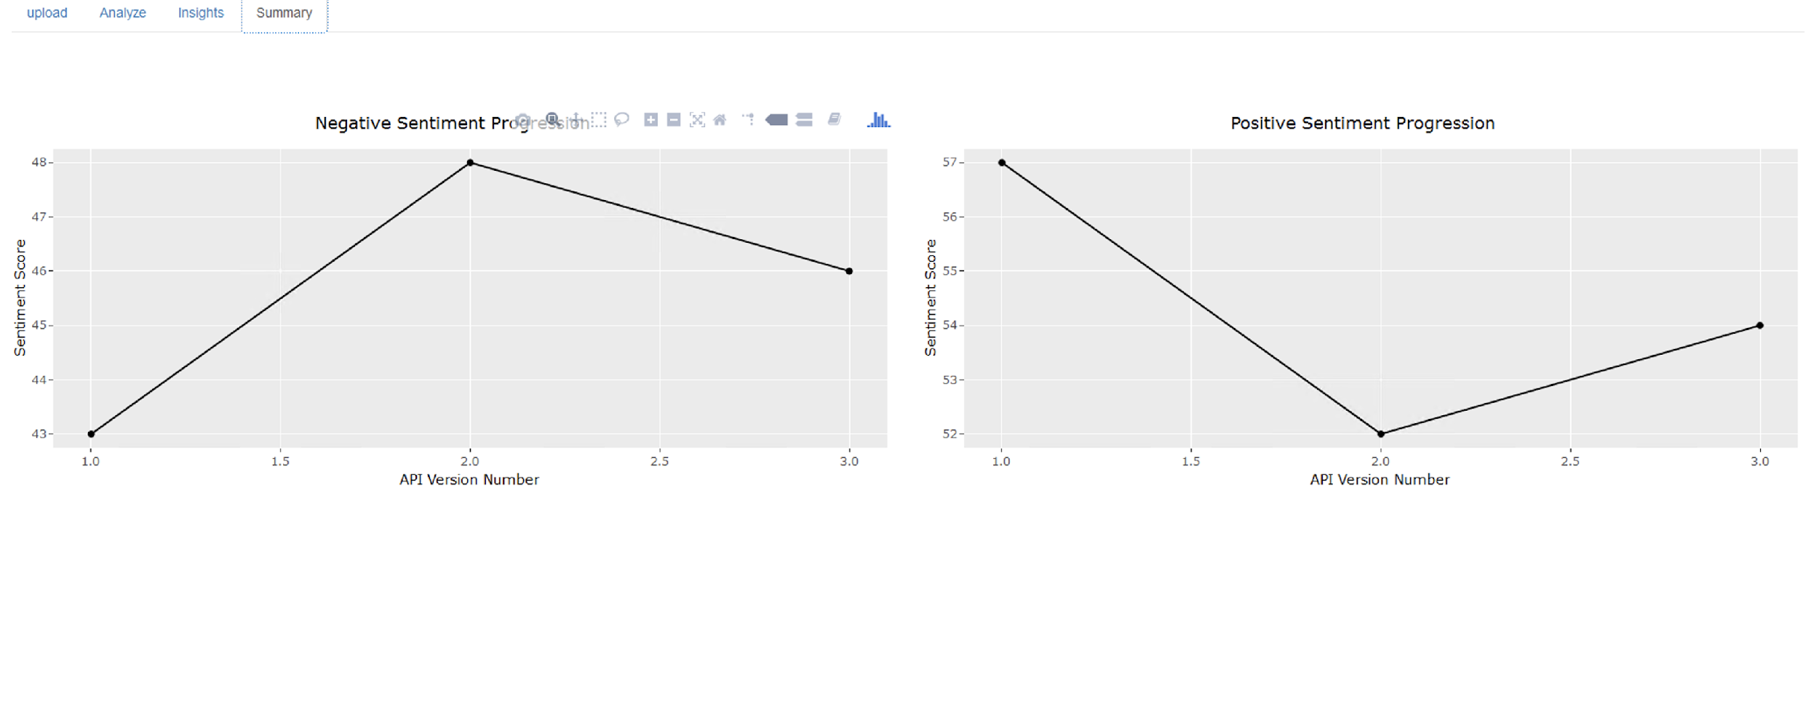

Slide 18
Contents
Motivation
Research Questions
Analysis
Results
Clustering & Model Generations
Future Tasks
Discussion

Slide 19
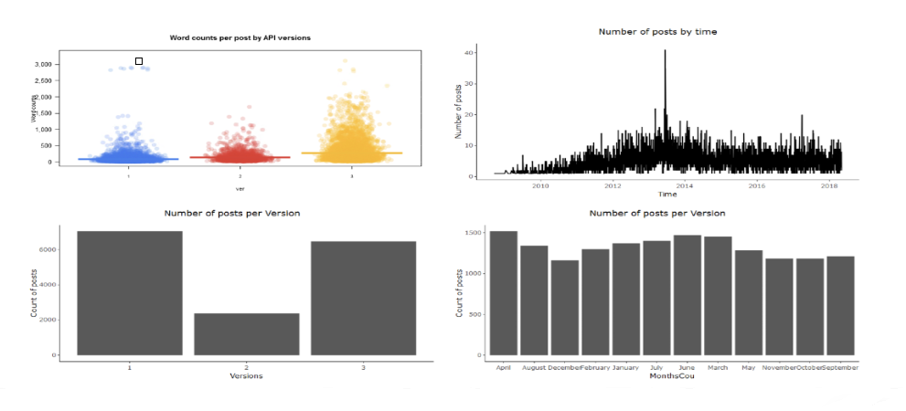
Word count and number of posts analysis

Slide 20
Emotion extraction across versions (Twitter API)

Slide 21
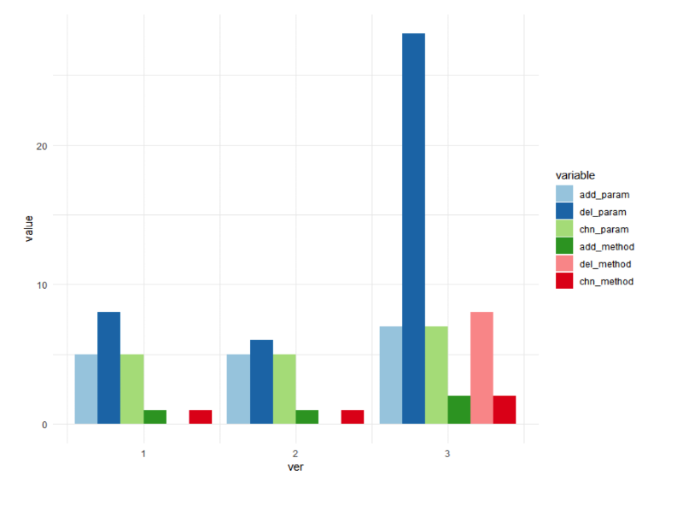
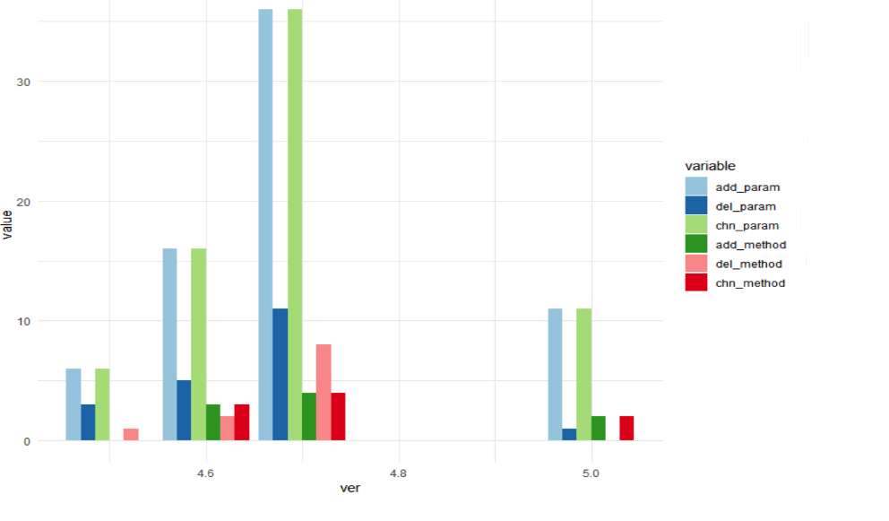
API type across version
Twitter API
ASP.NET API

Slide 22
Twitter API

Slide 23
ASP.NET API

Slide 24
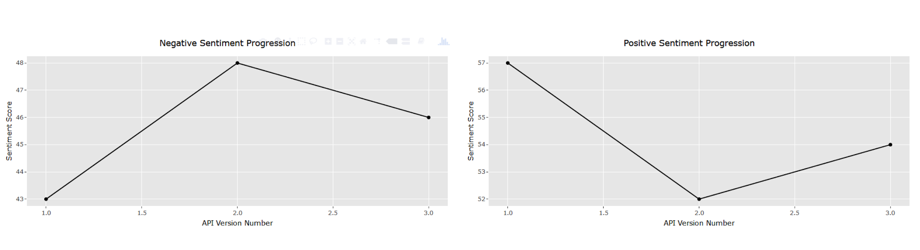
Sentiment trend across version (Twitter API)

Slide 25
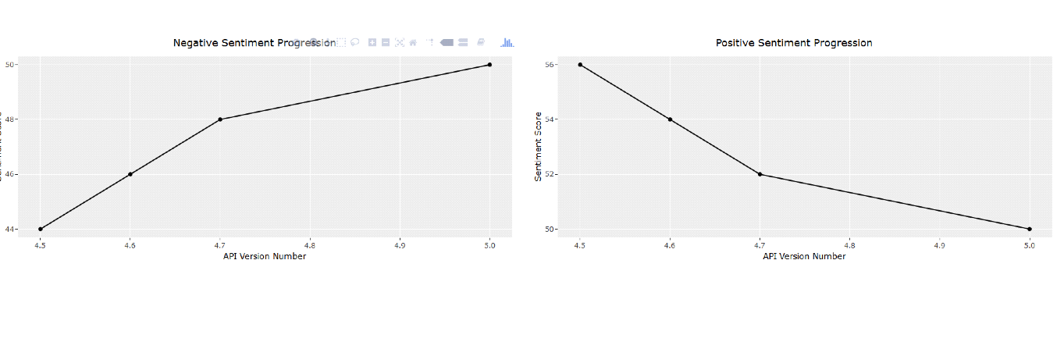

Sentiment trend across version (ASP.NET API)
Could we answer research question 1 now?

Slide 26
Answer to research question 1
Positive Opinion Patterns
Deleted methods in new API versions
Less changes in API endpoints parameters
Longer Post discussions
Large posts Lengths
Negative Opinion Patterns
Less deleted endpoints or functionality
More changes in API endpoints parameters
Smaller discussion or no answers

Slide 27
Contents
Motivation
Research Questions
Analysis
Results
Clustering & Model Generations
Future Tasks
Discussion

Slide 28
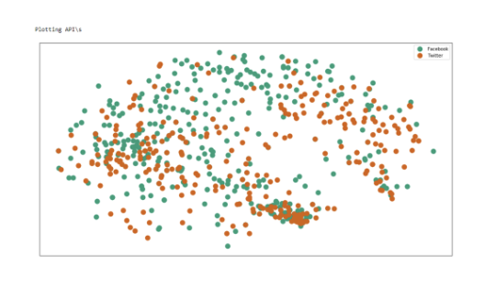
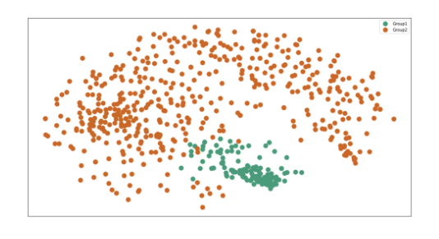
Clustering
Pull similar APIs closer and push away opposite sentiment based on polarity score.
We have used k-means clustering algorithm and t-distributed Stochastic Neighbor Embedding (t-SNE) for visualization.
API comparison with dimensionality reduction
Sentiment polarity and dimensionality reduction

Slide 29
Model Generation
Extracted sentiment clause for positive and negative reactions
Converted textual data to numeric one based on the clauses (bag of words)
Fitted the dataset to SVM classifier
Training Data:60%, Validation Data:20%, Test Data:20%
Optimization Method: Stochastic Gradient Descent
Loss function: Hinge Loss

Slide 30
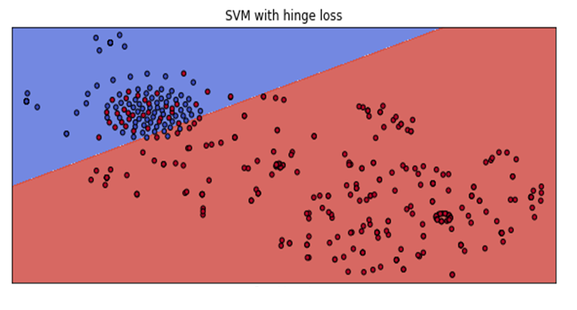
Model with deciding hyperplane

Slide 31
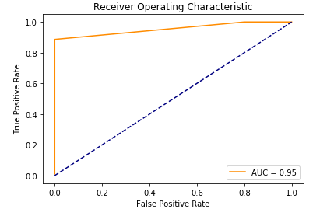
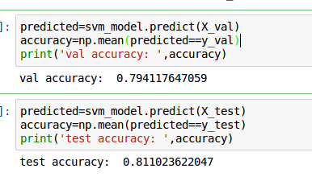
Model accuracy
AUC Value | Interpretation
Close to 1 | Good measure of separability
Close to 0 | Worst measure of separability
0.5 | No class separation capacity

Slide 32
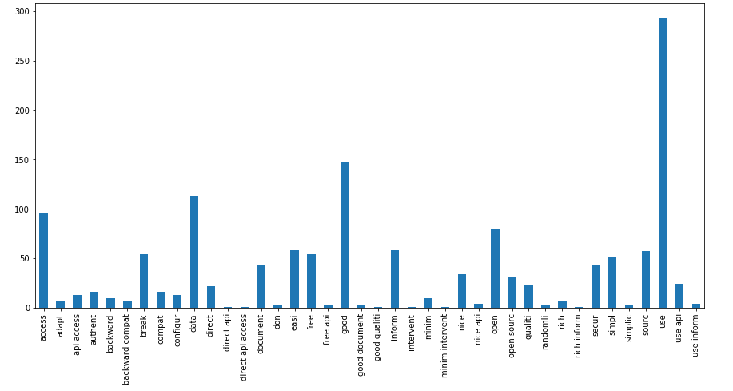
Reason for Positive Sentiment

Slide 33
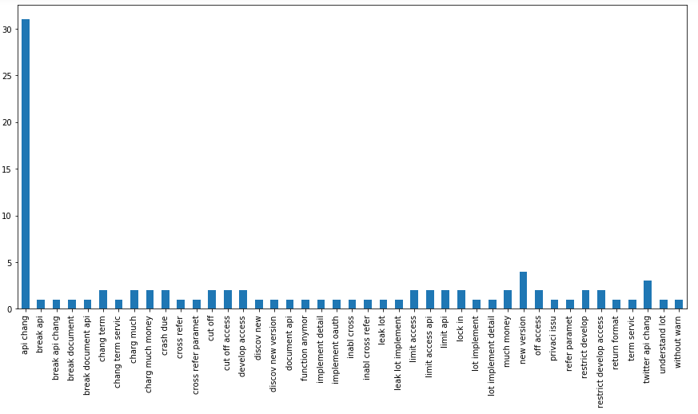
Reason for Negative Sentiment

Slide 34
Answer to research question 2
Reason for positive sentiment
Simplicity
Easier to use
Provide rich information
Quality
Good documents
Free access
Backward compatibility
Rich security

Slide 35
Answer to research question 2
Reason for negative sentiment
Change in response format
Lack of documentation
Limited access to API
Not functional anymore
Privacy issue
Change in terms of service

Slide 36
Contents
Motivation
Research Questions
Analysis
Results
Clustering & Model Generations
Future Tasks
Discussion

Slide 37
Future Tasks
Need to generate questionnaire
Start survey in developers‘ community
Based on the output test the model

Slide 38
Thank you!

Slide 39


