Slide 1
The Split Web Browser
A new way to browse
Ben Montgomery Jim Brusstar
Michael Lee Robert Steen

Slide 2
The Problem With Browsers
Too much information
Too many context switches
Users have no control over presentation

Slide 3
The Solution: Split
Split a page into pieces, keep what you want
All relevant content on one screen
Puts the user in control of presentation

Slide 4
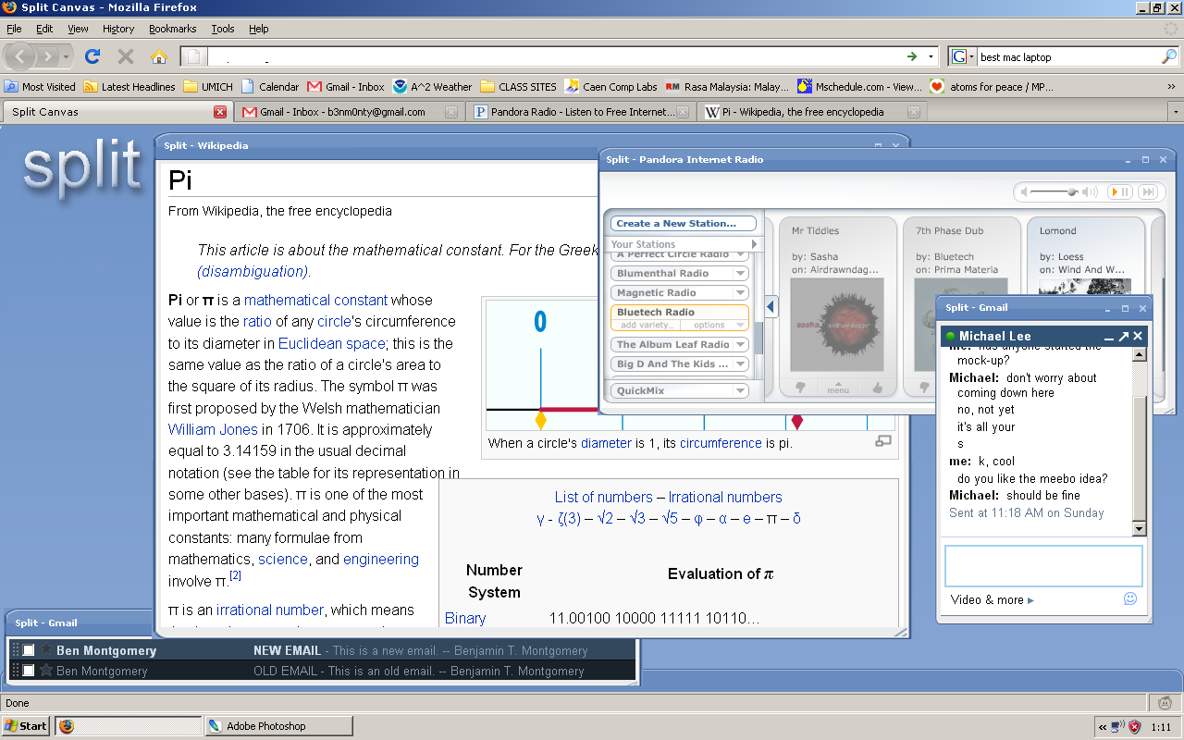
Split

Slide 5
Architecture
Notes:
Split<->Webkit : Request Render / Render Content
Split<->Internet : Request Content / Provide Content
Split<->Users : View Content / Define Content

Slide 6
Architecture

Slide 7
Secret Sauce
Split keeps original layout intact
Shows only user’s preferred content
Full compatibility, regardless of content

Slide 8
Competition
 | Split | Firefox | Safari | Internet Explorer
Render Content | ✔ | ✔ | ✔ | ✔
Tabbed Browsing | ✔ | ✔ | ✔ | ✔
Content Slices | ✔ |  | Only for static content | Only if it’s defined on page

Slide 9
Milestones
Task | Sep 21 | Sep 28 | Oct 5 | Oct 12 | Oct 19 | Oct 26 | Nov 2 | Nov 9 | Nov 16 | Nov 23 | Nov 30 | Dec 7 | Dec 14
Documents
Basic Application
Basic Clipping
Complex Clipping
Web Browsing
Browsing and Clipping

Slide 10
Future Enhancements
Better UI!
More intuitive selection
Content-aware rendering

Slide 11
Contact Us
Jim Brusstar
Michael Lee
Ben Montgomery
Robert Steen
jimbru@umich.edu
mzlee@umich.edu
benmonty@umich.edu
rdsteen@umich.edu

