Slide 1
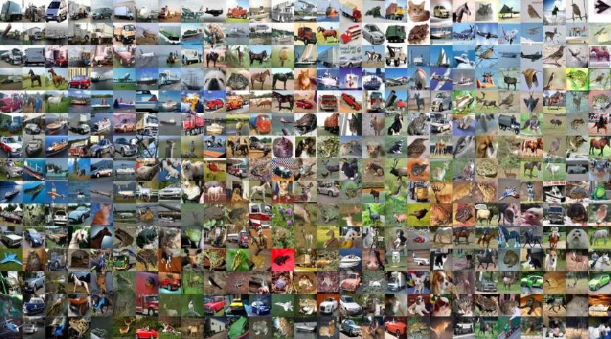

Slide 2
Cifar - 10
Object Recognition in Images

Slide 3
Team info
Friends
Contestants Name & Student ID
Minhazul Zannat :: 1640CSE00_466
Ashrafujjaman :: 1640CSE00_537

Slide 4
Introduction
It’s a collection of images that are commonly used to train computer vision algorithms and also one of the most widely used datasets for deep learning research. It contains 50,000 32x32 RGB color (3 color channels) images in 10 different classes where 5,000 images are from each class. Total test images 300,000 which levels we have to predict.
Why it?
It helps us to learn the way of deep learning and also image handling for that. Its goal is to introduce us with the computer vision algorithms and also with deep learning research as well as teach us the way to process data and handle them on model training so that the model can act what is desired to do.

Slide 5
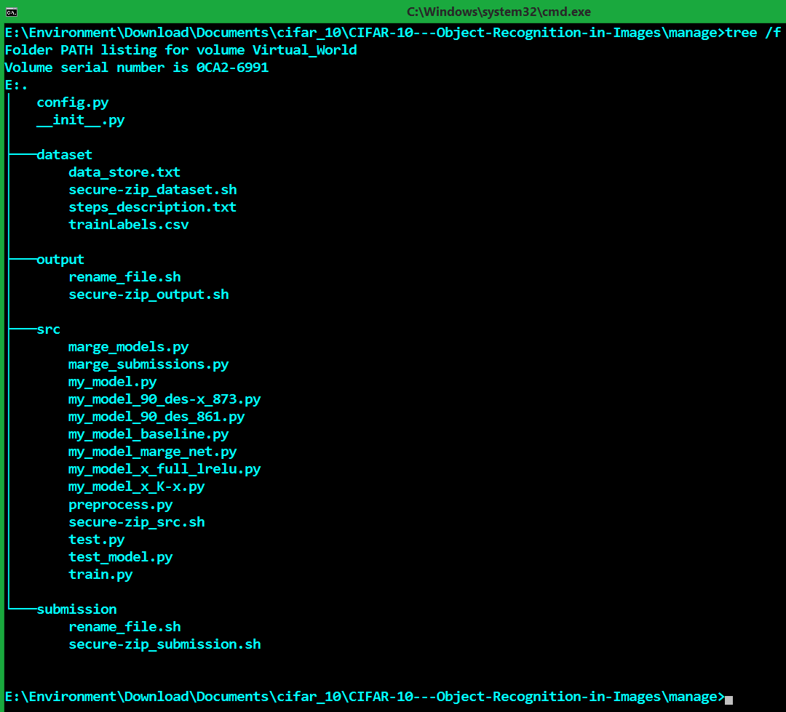
Context
Motion towards the project
Data Preprocessing
Network Architecture
Training Procedure
Result
OS & Environment
Conclusion

Slide 6
Motion towards the Project
Steps and works of us which we have taken already to make our project finished:
Data Preprocessing
Normalization
Reform pixel range :: from (0, 255) to (-1, 1)
Pixel Operation using “mean” & “standard deviation”
Augmentation
Shearing
Zooming
Rotating
Shifting (Towards: width & height)
Flipping (Towards: horizontal)

Slide 7
Motion towards the Project
Data Preprocessing
Normalization
To reduce data redundancy and dependency.
To reshape dataset into a common scale, without distorting differences in the ranges of values.
Reform pixel range :: from (0, 255) to (-1, 1)
Technique: ((pixel / 255) – 0.5) * 2.0
Pixel Operation using “mean” & “standard deviation”
Technique: (data - mean)/ (std + 1e-7)
Here,
data = train / test images
mean = mean of train images = -0.0444
std = standard deviation of train images = 0.4597

Slide 8
Motion towards the Project
Data Preprocessing
Augmentation [Use dot(.) to identify %]
To artificially expand the size of a training dataset by creating modified versions of images.
To improve the performance and ability of the model to generalize.
shear_range=0.2, -> 20% Shearing on image
zoom_range=0.2, -> 20% Zooming on image
rotation_range=15, -> 15° Rotation of image
width_shift_range=0.1, -> 10% shifting of image towards width
height_shift_range=0.1, -> 10% shifting of image towards height
fill_mode='nearest', -> Fill the null values by their nearest true pixel.
horizontal_flip=True, -> Flip image horizontally

Slide 9
Motion towards the Project
Steps and works of us which we have taken already to make our project finished:
Network Architecture
Baseline model
Simple cnn 90%+
Googlenet – Resnet concepts
Approach of model-X

Slide 10
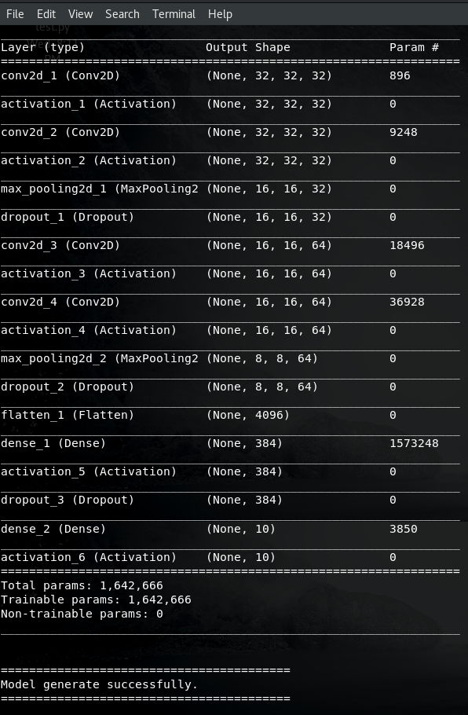
Motion towards the Project
Network Architecture
Baseline model (my_model_baseline.py)
200 batch size
Sequential
4 convolution & 6 activation layers
LeakyReLU(alpha=0.01) activation function
[32, 32, 64, 64] filter size of conv2D (convolution layer)
[0.20, 0.25, 0.30, 0.35] dropout
[ 0. 81270 -- score in Kaggle ]

Slide 11
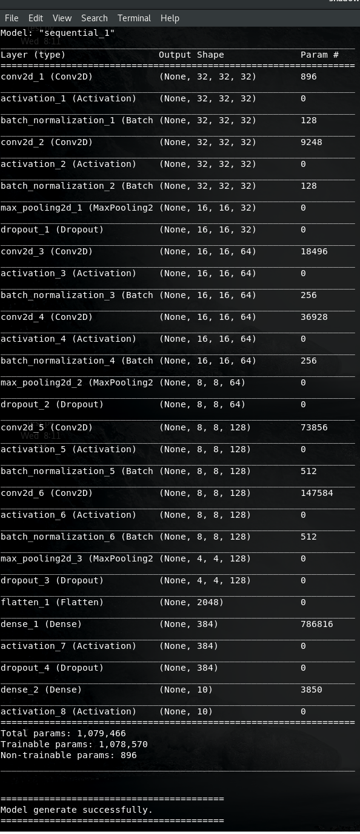
Motion towards the Project
Network Architecture
Simple cnn 90%+ --v1 (my_model_90_des_861.py)
200 batch size
Sequential
6 convolution, 8 activation, 6 batchnormalization, 3 Maxpooling(2,2) layers
LeakyReLU (alpha=0.01) activation function
Extra dense (384)
[32, 32, 64, 64, 128, 128] filter size of conv2D (convolution layer)
[0.20, 0.25, 0.30, 0.35] dropout
[ 0. 86160 -- score in Kaggle ]

Slide 12
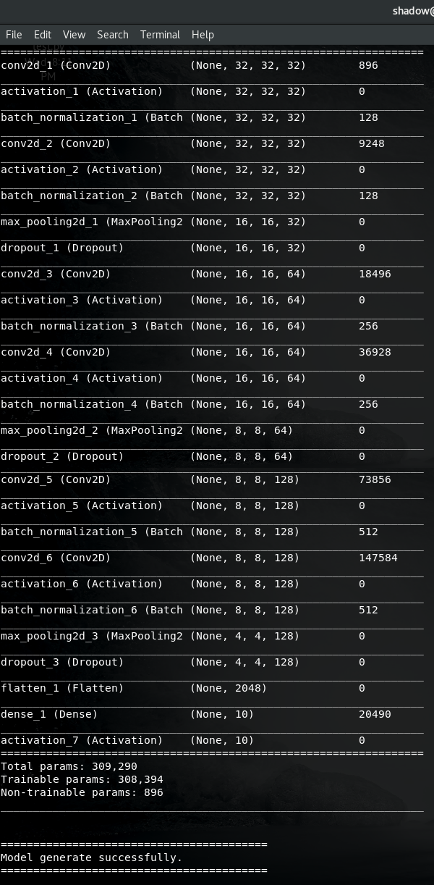
Motion towards the Project
Network Architecture
Simple cnn 90%+ --v2 (my_model_90_des-x_873.py)
200 batch size
Sequential
6 convolution, 7 activation, 6 batchnormalization, 3 Maxpooling(2,2) layers
LeakyReLU (alpha=0.01) activation function
No extra dense
[32, 32, 64, 64, 128, 128] filter size of conv2D (convolution layer)
[0.15, 0.20, 0.25] dropout
[ 0. 87390 -- score in Kaggle ]

Slide 13
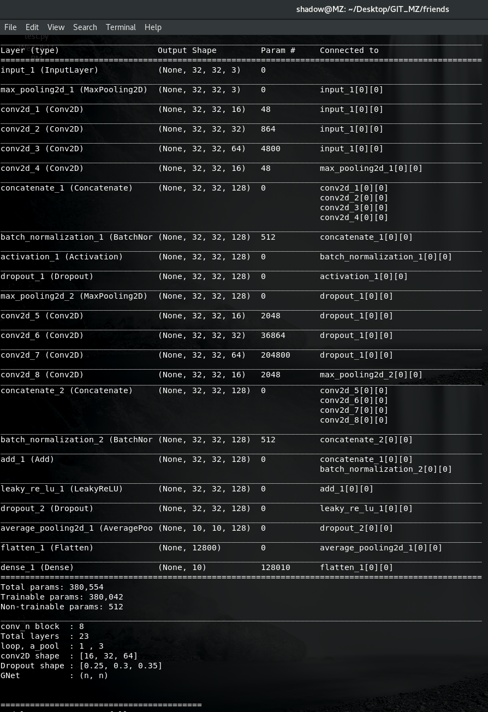
Motion towards the Project
Network Architecture
Googlenet – Resnet concepts (my_model_marge_net.py)
140 batch size
Not Sequential & the implementation form is x = one layer’s work (x)
10 convolution, 13 activation, 2 batchnormalization, 3 Maxpooling(3,3) layers
1 Pooling(n, n) later; can be Max / Average [We have used as Average(3,3)]
2 LeakyReLU(alpha=0.01) activation function for main function block
11 Relu activation function for resnet function block
Use Googlenet concept to shape the Conv2D layers of resnet block.
One epoch requires more than 30 minutes.
[16, 32, 64] filter size of conv2D (convolution layer)
[0.25, 0.30, 0.35] dropout
[ 0. 86970 -- score in Kaggle ]

Slide 14
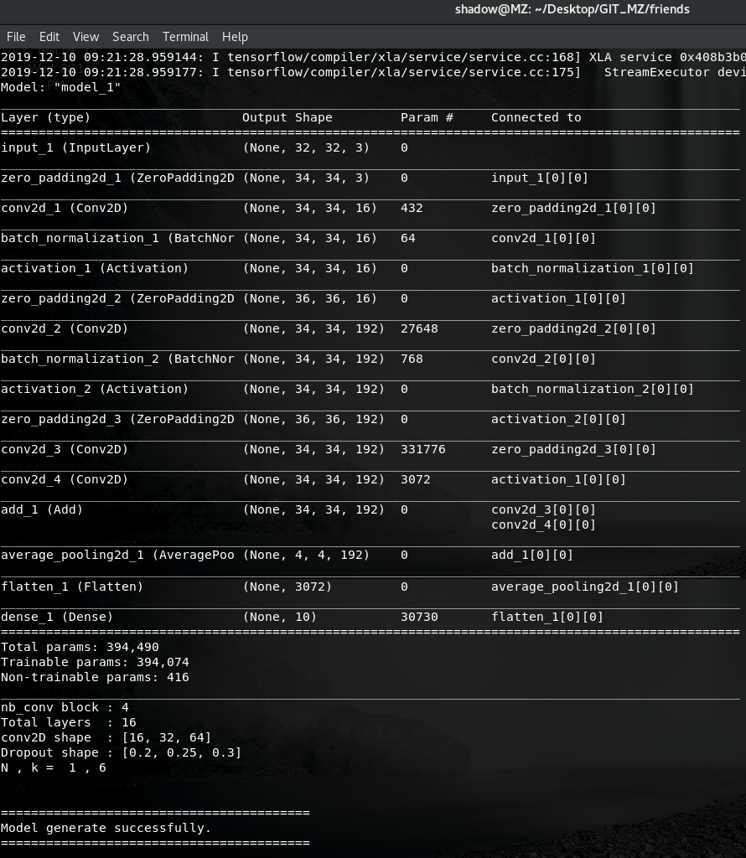
Motion towards the Project
Network Architecture
Approach of model-X (my_model_x_full_lrelu.py)
140 batch size
Not Sequential & the implementation form is
x = one layer’s work (x)
6 convolution, 5 activation, 4 batchnormalization, 1 AveragePooling2D(8,8) layers
LeakyReLU(alpha=0.01) activation function
One epoch requires more than 29 minutes.
[16, 32, 64] filter size of conv2D (convolution layer)
[0.20, 0.25, 0.30] dropout.

Slide 15
Motion towards the Project
Steps and works of us which we have taken already to make our project finished:
Training Procedure
Merge models (marge_models.py)
Merged our models using max voting.
“0. 86160 ", “0. 87390 ", “0. 86970 "; where default was “0. 87390 ”
Merge Submissions (marge_submissions.py)
Merged our submissions using max voting.
"submission_mz.csv", “0. 87390 ", "0.88910"; where default was “0.88910”
Here, "submission_mz.csv“ is the submission file generated by model-X
[ 0. 88910 -- score in Kaggle ]
[ 0. 91440 -- score in Kaggle ]

Slide 16
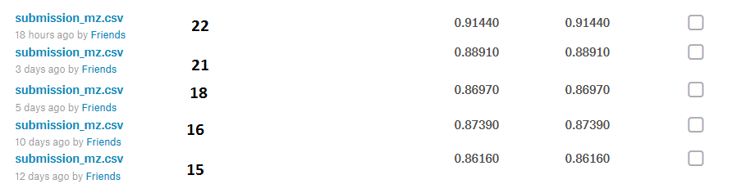
Result of our Project
Result of our project is the highest score in Kaggle for it. But for our competition the score must be achieved within the deadline. So, our score of the project for this competition is as:
Final Submission score of us: “0. 88910”
Total Submissions: 21 times

Slide 17
Information about Operating System & Environment
Our Project was run in one laptop only.
PC model: Acer Aspire V3-572P
OS (Dual boot): Windows_8.1 & Kali-Linux_13.7
Ram size: 6GB
====================================================================
System Type: 64-bit both OS, x64-bit based Processor
Linux Terminal: Genome v-3.26.2
P. Language: Python - 3.6.3 (Using virtualenv in Linux)
Text Editor: Sublime-text-3 (In Win8.1) & VS-code (In Linux)

Slide 18
Conclusion
Some challenging situations we have faced on running those models :
Using larger convolution layers reduces the speed of training with a big rate.
Even using larger filter in convolution reduces speed of training but not as 1.
Higher batch size gives better validation accuracy and less than 30 is danger.
But using higher batch size makes higher ram use.
Our notion after finishing this project:
We have achieved a much knowledge and patience through this project.
Through it we have introduced ourselves with the recent world and the heart of it.
We should implement these achievements in our lives so that we can clarify our position in this race of creativity.

Slide 19
Questions ?

Slide 20
Questions ?
Why normalization?
To reduce operational cost.
Why augmentation?
To remove over fitting & under fitting.
Why leakyReLU?
As it’s relevant with the data range(-1,1)
Why not ReLU?
It breaks data redundancy by removing the negative portion of it.

