Slide 1
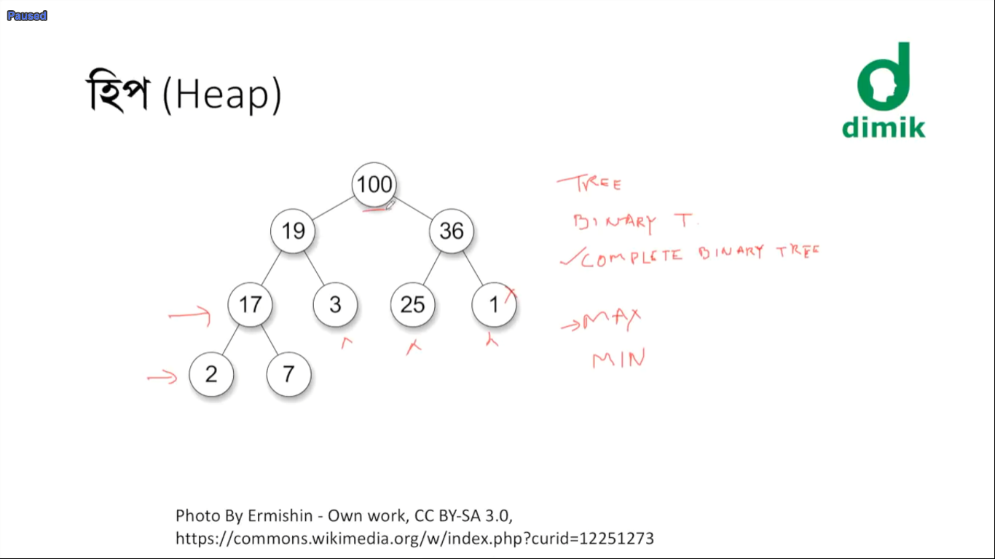
Fig : Complete binary tree

Slide 2
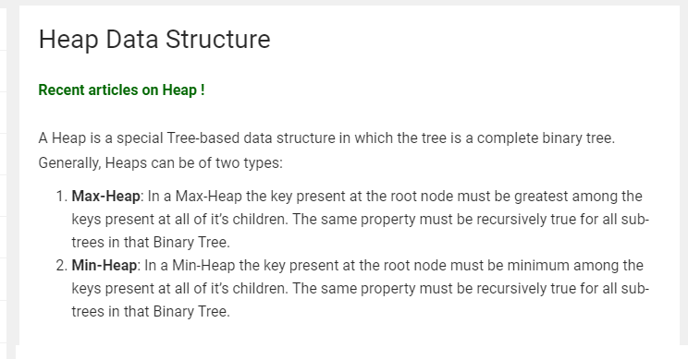

Slide 3
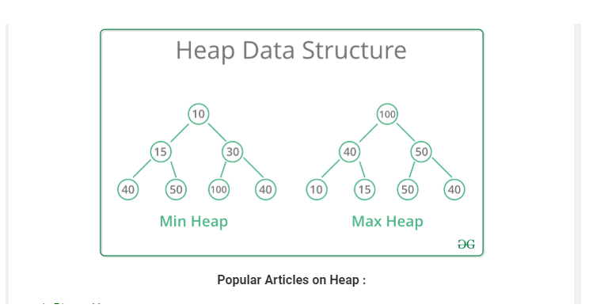

Slide 4
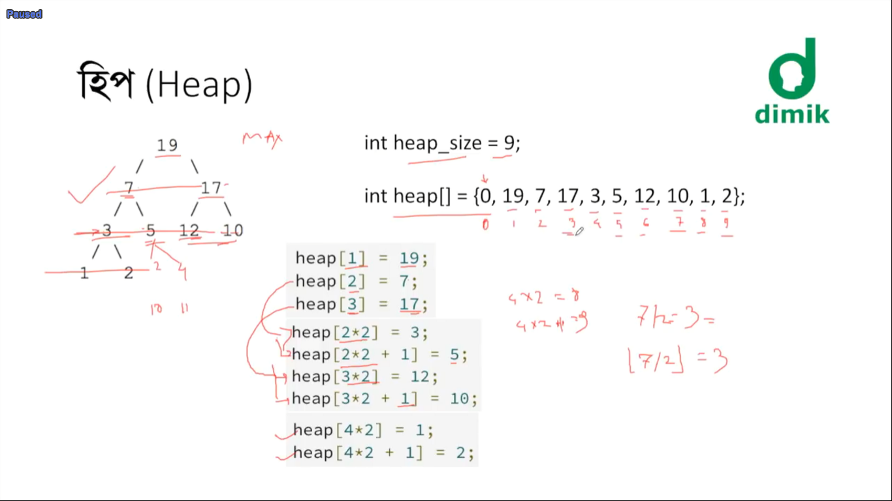

Slide 5
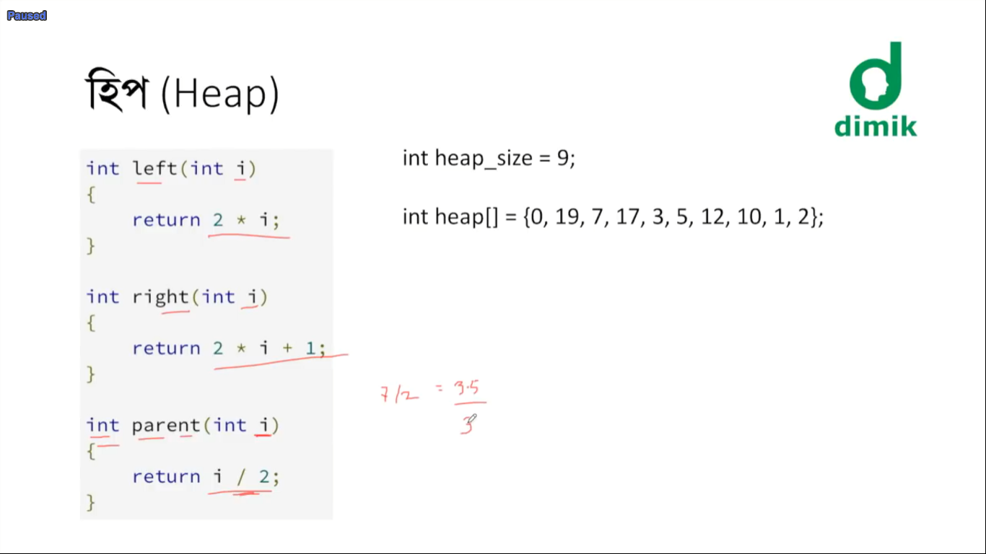
----------------------- Finding left child
-------------------------- Finding right child
-------------------------- Finding parents

Slide 6
