Slide 1
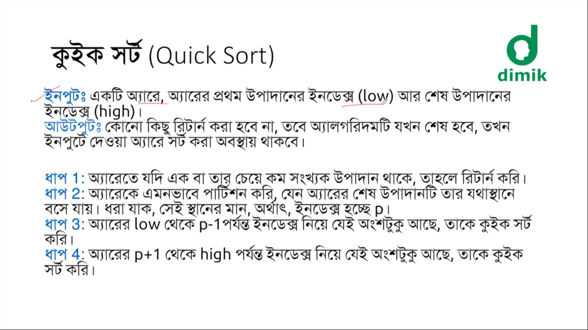

Slide 2
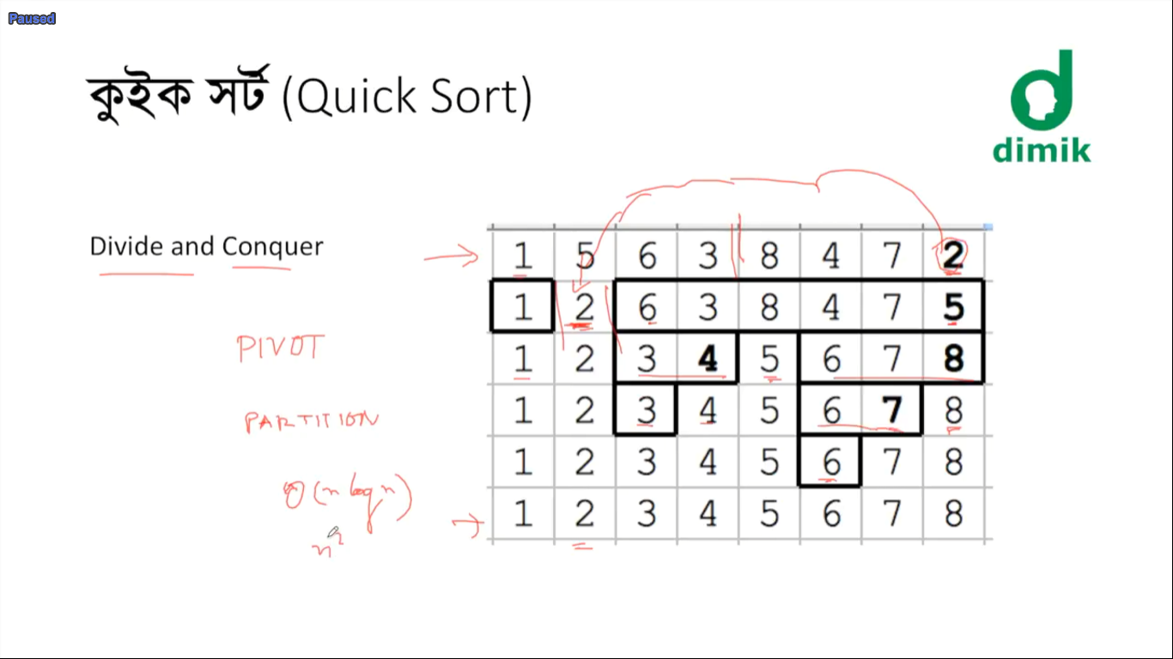
complexity
Average case : O(n log n)
Worst case: O(n²)

Slide 3
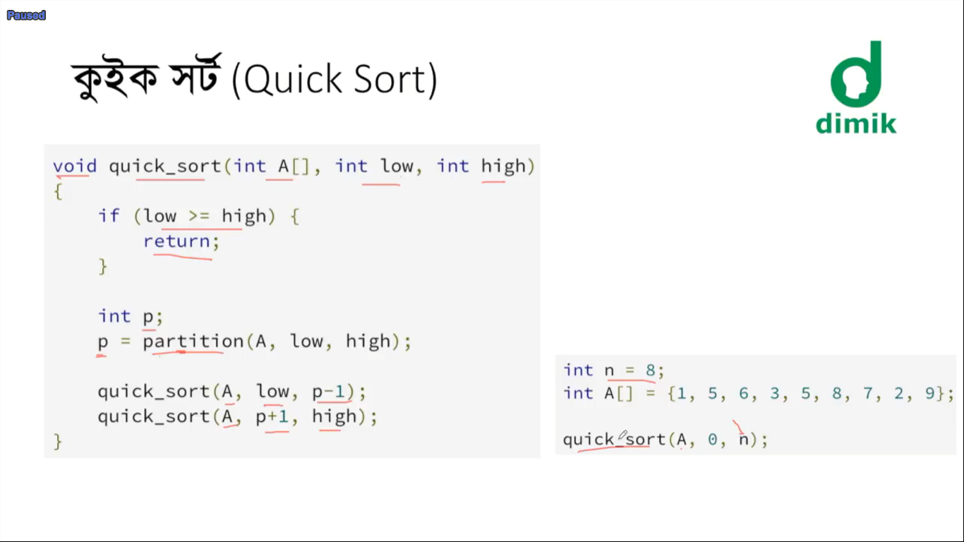

Slide 4
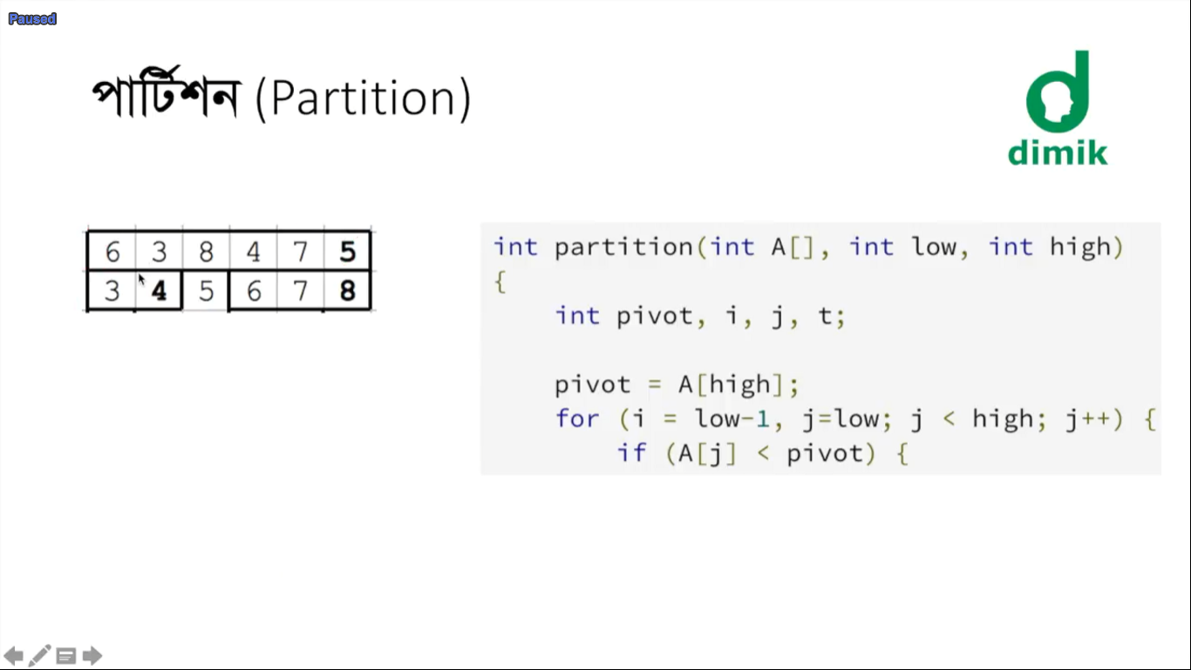

Slide 5
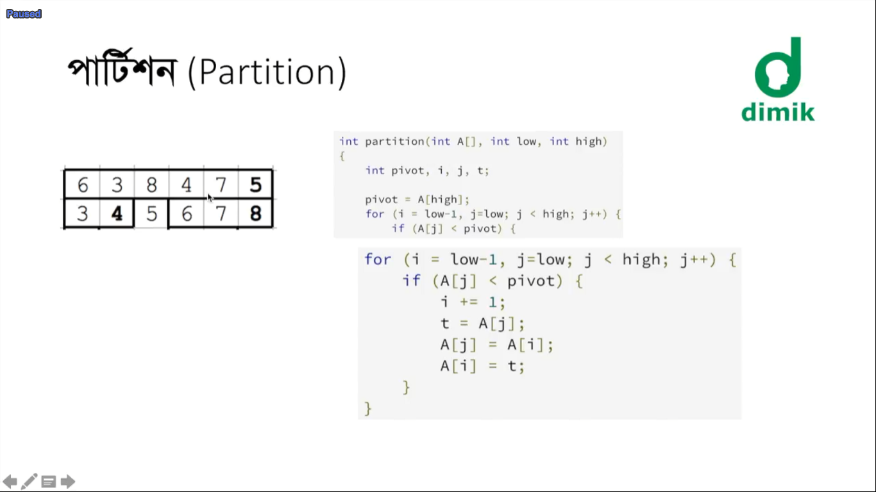

Slide 6
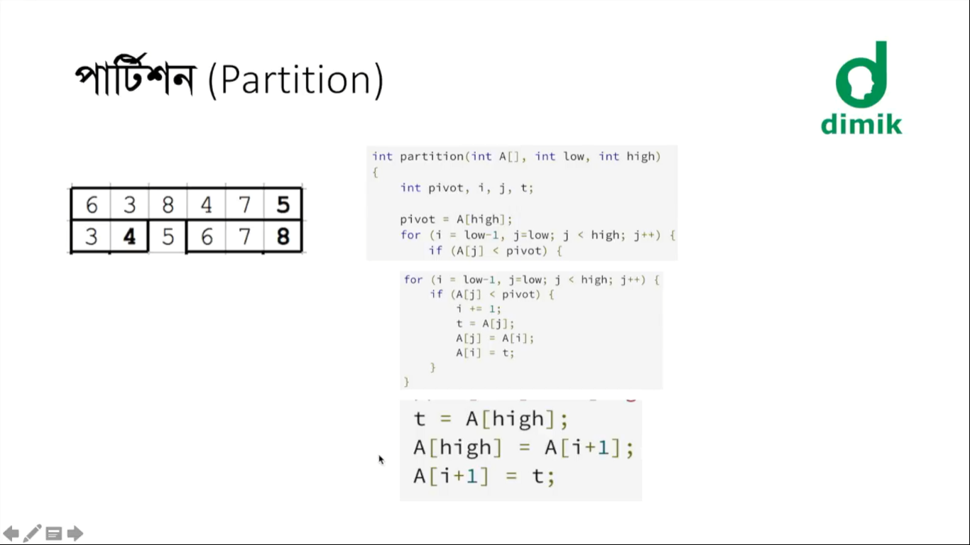

Slide 7
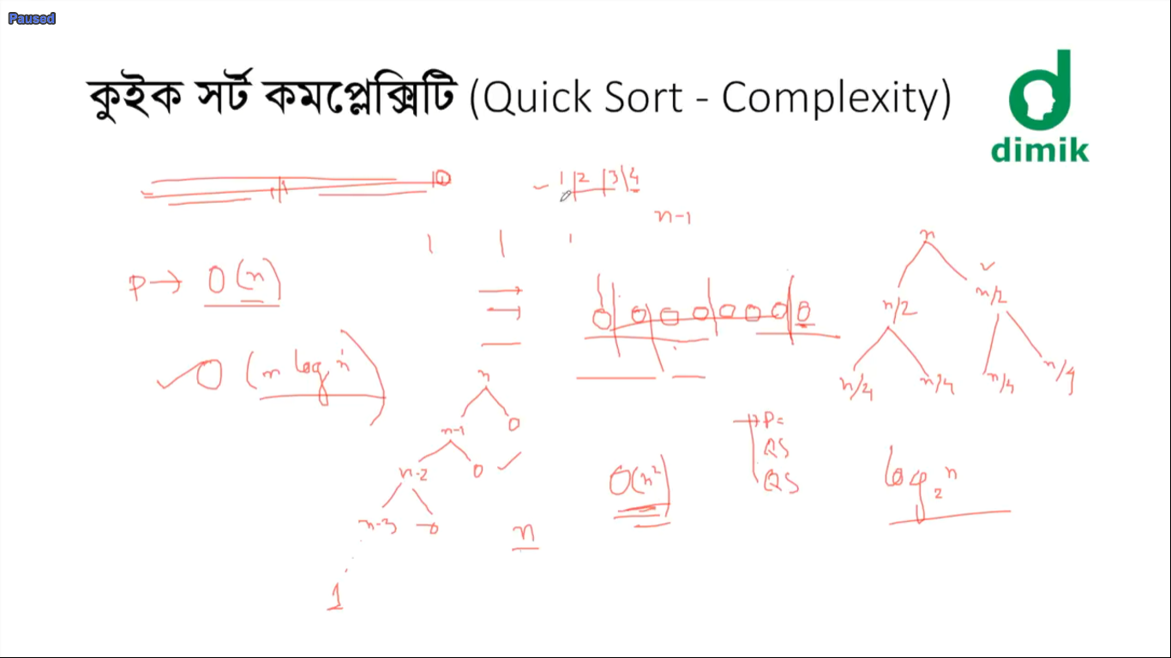

Slide 8
Tricks:
Do quick sort until the partition array size becomes less than 16
Do insertion sort for any array size of less than 16

