Slide 1
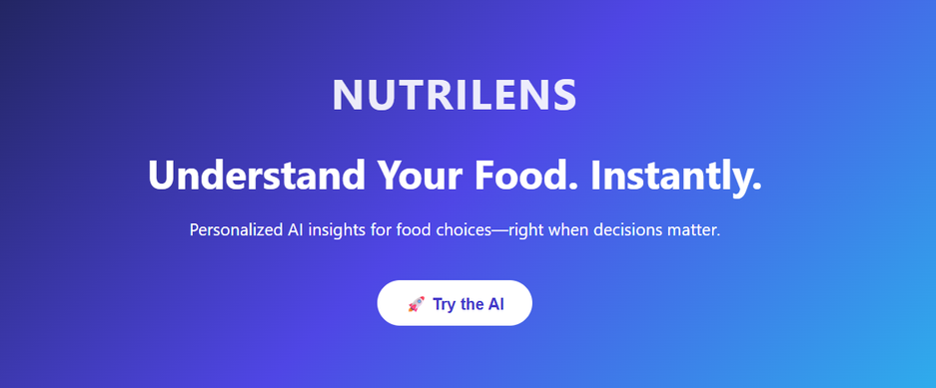
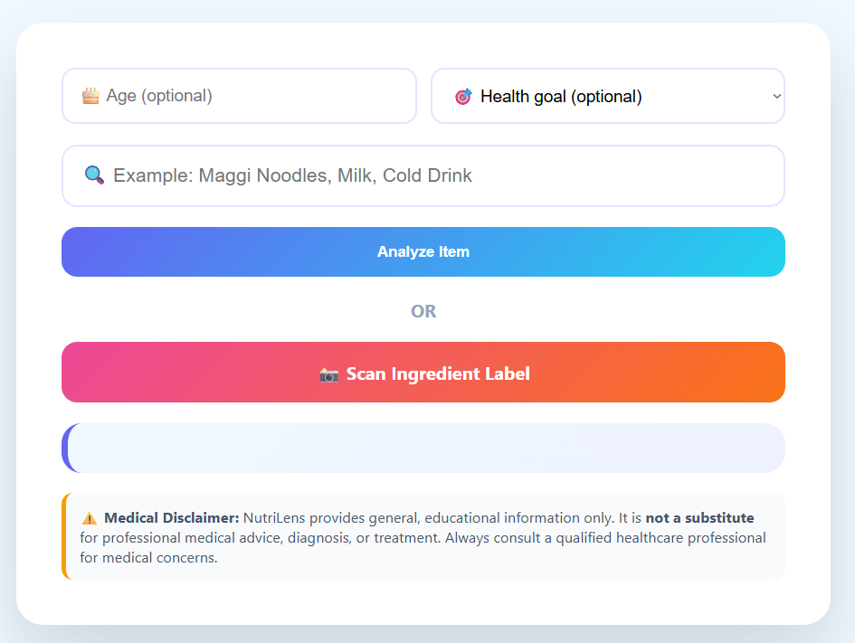

NutriLens: Understand Your Food
Hack Squad 4.0
.

Slide 2

Why Current Solutions Fail
Limitations of existing food apps
Raw Data
Manual Effort
Feature not Interface
Current solutions present users with raw data, lacking meaningful insights. This approach can lead to confusion, as consumers struggle to interpret the information effectively and make informed choices.
Many existing applications require users to conduct manual research and interpret complex information independently. This additional effort can be overwhelming, resulting in frustration and poor decision-making regarding food choices.
Often, AI capabilities are treated as mere add-ons rather than integral features. This results in a disjointed user experience, where the benefits of AI are not fully realized in food understanding.
3

Slide 3
Our Solution
NutriLens delivers an AI-native experience that provides instant clarity about food choices.
Users can effortlessly understand nutritional information and make informed decisions, ensuring a healthier lifestyle with every meal.

Slide 4
How NutriLens Works
Scan Food
AI Categorization
Personalized Insights
Smart Follow-Up
Users can effortlessly scan food items or enter names manually, initiating the process of understanding nutritional content and health insights tailored to their needs.
The NutriLens AI intelligently identifies the food category, utilizing advanced algorithms to provide accurate, relevant information based on the scanned item or entered name.
Based on user profiles and preferences, NutriLens delivers customized insights, helping individuals make informed choices about their dietary habits and nutritional needs effectively.
The application poses thoughtful follow-up questions to deepen the user’s understanding, ensuring that all relevant nutritional information is conveyed in an engaging manner.

Slide 5

AI-Native Features
Unlocking the potential of AI
Context-aware reasoning
Personalization
Confidence levels
Context-aware reasoning allows NutriLens to provide tailored insights by considering user preferences and dietary restrictions, ensuring relevant information at critical decision-making moments.
Personalization enhances user experience by adapting to individual age, health goals, and dietary needs, making it easier for users to connect with their food choices effectively.
Confidence levels indicate the AI's certainty about its assessments, empowering users to make informed choices based on the reliability of the information provided by NutriLens.
6

Slide 6
Safety & Responsibility
Upholding ethical standards in AI
Educational Only
No Diagnosis
Clear Disclaimers
NutriLens provides information designed for educational purposes, empowering users to make informed decisions about their food without replacing professional medical advice or guidance.
We emphasize that NutriLens does not offer diagnoses or treatment plans, ensuring that users are aware of its limitations and encouraging them to consult healthcare professionals when needed.
Transparency is key; NutriLens includes clear medical disclaimers to inform users about the nature of information provided, fostering trust and responsible use of AI technology in health contexts.
7

Slide 7
Impact
Transforming health education for all
Faster Decisions
Reduced Confusion
Scalable Health Education
NutriLens enables users to make quick, informed choices about their food, leading to healthier lifestyles and better eating habits in real time.
By simplifying complex food information, NutriLens alleviates consumer confusion, allowing individuals to easily understand food labels and ingredients.
NutriLens aims to provide widespread access to personalized nutrition insights, promoting health education and empowering users to take control of their dietary choices.
8

