Slide 1

Machine Learning Project Work
Presented to:
Prof. Claudio Sartori
Presented By:
Muhammad Zohaib Shafiq
Academic Year: 2021-2022

Slide 2
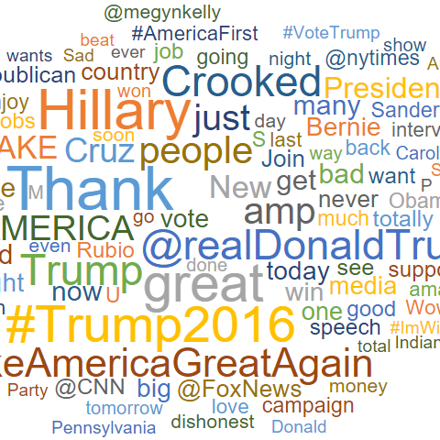
Introduction
Numerous industries are going though technological transformations that requires a need to handle unstructured data as well. But the biggest challenge here is to make use of this data and turn it into useful insights that could add value to company at the end. In this era of social media, it somehow easy and complex at the same time to know performance of the products, user feedback and in turn improve them. This could be done through sentiment analysis. By use of sentiment analysis any business can turn the data into tangible intelligence that can drive change.

Slide 3

Problem Statement
Twitter is a popular social microblogging app where users have full independence to express their opinions about products, topics, individuals etc. This is done in the form of tweets. In this project we classified tweets either positive or negative based on their context.

Slide 4
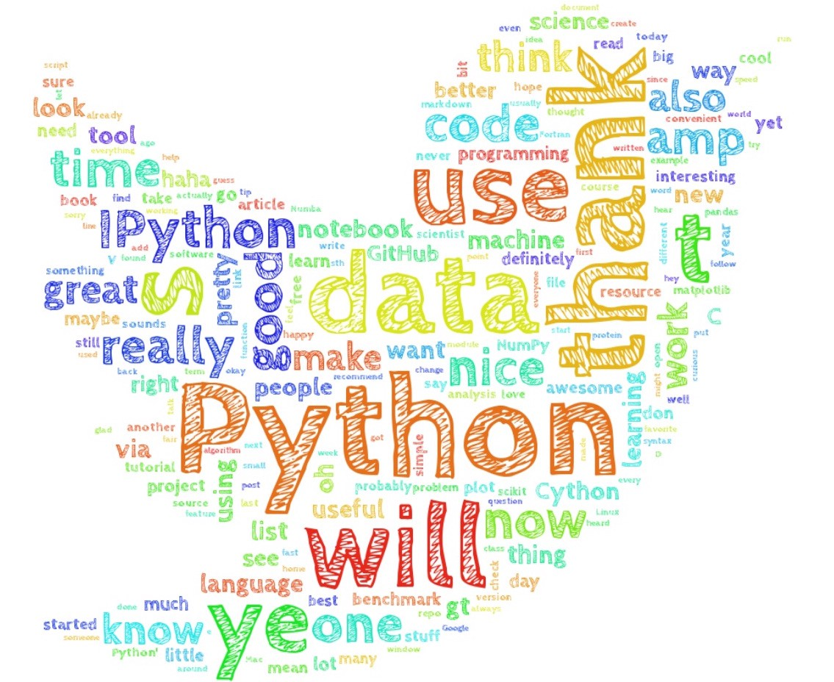
Dataset
Dataset is publicly available for academics on the Stanford repository. It was created using Twitter API which helps to retrieve tweets using a query.

Slide 5
Pre-Processing
Regular Expressions:
Also called regex patterns. They are used to match or replace a set of strings by the defined pattern.
We used them to pre process data in order to eliminate irrelevant information.
UP: @switchfoot http://twitpic.com/2y1zl - Awww, that's a bummer. You shoulda got David Carr of Third Day to do it. ;D
PP: @switchfoot that's a bummer. You shoulda got David Carr of Third Day to do it. ;D

Slide 6
Pre-Processing cont…
Stop words:
These are the most common words in any language (like articles, prepositions, pronouns, conjunctions, etc) and does not add much information to the text.
Stemming:
Stemming just removes or stems the last few characters of a word
Lemmatization:
Lemmatization considers the context and converts the word to its meaningful base form, which is called Lemma.

Slide 7
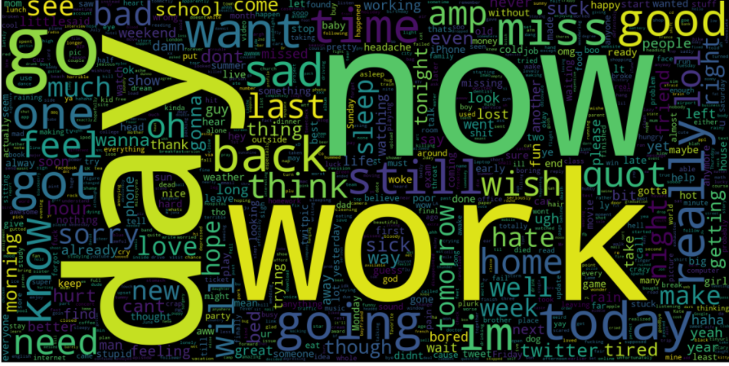
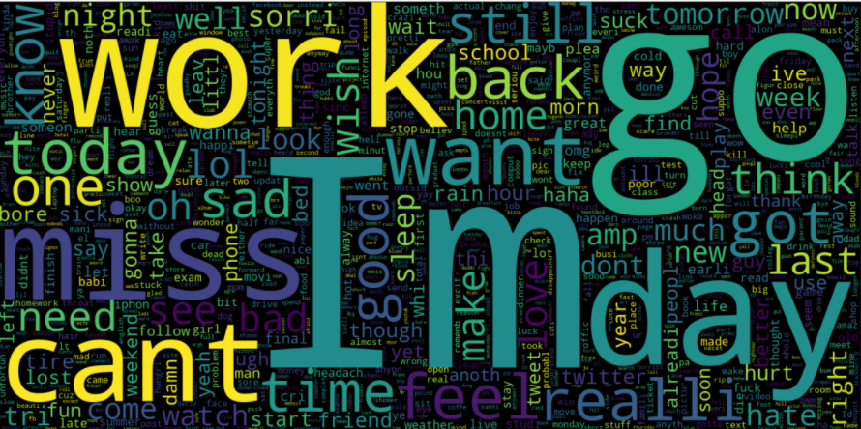
Word Cloud

Slide 8
Encoding
Sentence - 1: Good Boy
Sentence - 2: Good Girl
Sentence - 3: Boy Girl Good
Words | TF (Sent-1) | TF (Sent-2) | TF (Sent-3)
Good | ½ | ½ | 1/3
Boy | ½ | 0 | 1/3
Girl | 0 | ½ | 1/3
Term Frequency-Inverse Document Frequency (Tf-Idf):
In the this approach, words that are more common in one sentence and less common in others are given more weights, and since words are treated individually and every single word is converted to numeric form the context information is not retained.
N-gram:
They help us to retain the context by taking into account n number of neighbours (previous terms).
Words | IDF
Good | log(3/3) = 0
Boy | log(3/2)
Girl | log(3/2)
 | Feature-1 | Feature-2 | Feature-3
 | Good | Boy | Girl
Sent-1 | 0 | ½*log(3/2) | 0

Slide 9
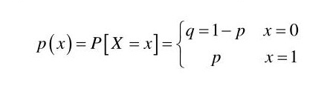
Naïve Bayes
Naive Bayes classifiers are a collection of classification algorithms based on Bayes’ Theorem.
Bernoulli Naive Bayes:
For features of binary nature we use Bernoulli naïve bayes. It is based on Bernoulli’s distribution.

Slide 10
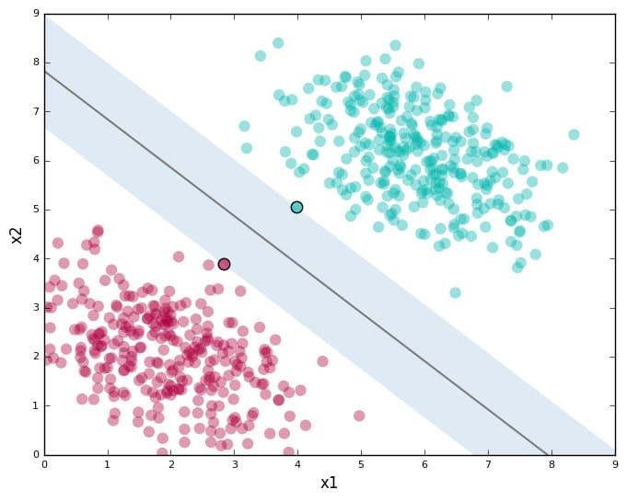
Support Vector Machine (SVM)
SVM:
Lies in supervised learning category.
Used in classification and regression task.
Decision Boundary/Hyper Plane
Support Vectors
Linear SVM:
It is always better to use linear SVM for linearly separable data.

Slide 11
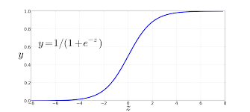
Logistic Regression
Predicts something true or false instead of giving continuous output. It is used for classification task.
Sigmoid function:
It try to convert independent variable into expression of probability in the range of 0 to 1 to predict dependent variables

Slide 12
Evaluation Metrics
Accuracy
Precision
Recall
F1-Score

Slide 13
Conclusion
Best Pre-Processing Approaches include removing:
Hyperlinks
Usernames
Repetitive characters
Best Performer: SVM
Least Performer: Naïve Bayes
Things to avoid in future:
Over Processing of data -> Bad Quality Data
Overfitting

Slide 14
Thank You

