Slide 1
Build It Live
Turning real developer questions into practical OutSystems proof points.
COMMUNITY ASKS
OUTSYSTEMS BUILDS
ASSETS COMPOUND
A lightweight DevRel pilot for practical demos, launch support, and reusable developer assets.
Build It Live / 1
Notes:
Open by positioning this as a DevRel engine, not a show pitch.
The simple premise: developers ask whether OutSystems can build something, and the team answers with a working build and reusable assets.
Keep the first slide short, then move quickly into the gap and the operating model.

Slide 2
THE OPPORTUNITY
Developers need proof they can reuse
OutSystems has strong capabilities, but developer audiences often need concrete examples before they believe a platform can help with their own work.
Practical examples
More real builds make the platform easier to understand, evaluate, and share.
Can OutSystems do this?
Launch proof
Feature announcements become stronger when paired with a fast, credible build.
That question is a demand signal. Build It Live turns it into proof.
Search visibility
Specific demos, repos, docs, and clips give search and AI answer engines better material to cite.
Build It Live / 2
Notes:
Frame the gap without sounding negative about existing content.
The key idea is demand capture: every good submission reveals a question developers already have.
Mention AEO only briefly unless the VP leans into it; the practical examples and launch support are likely the more immediate hooks.

Slide 3
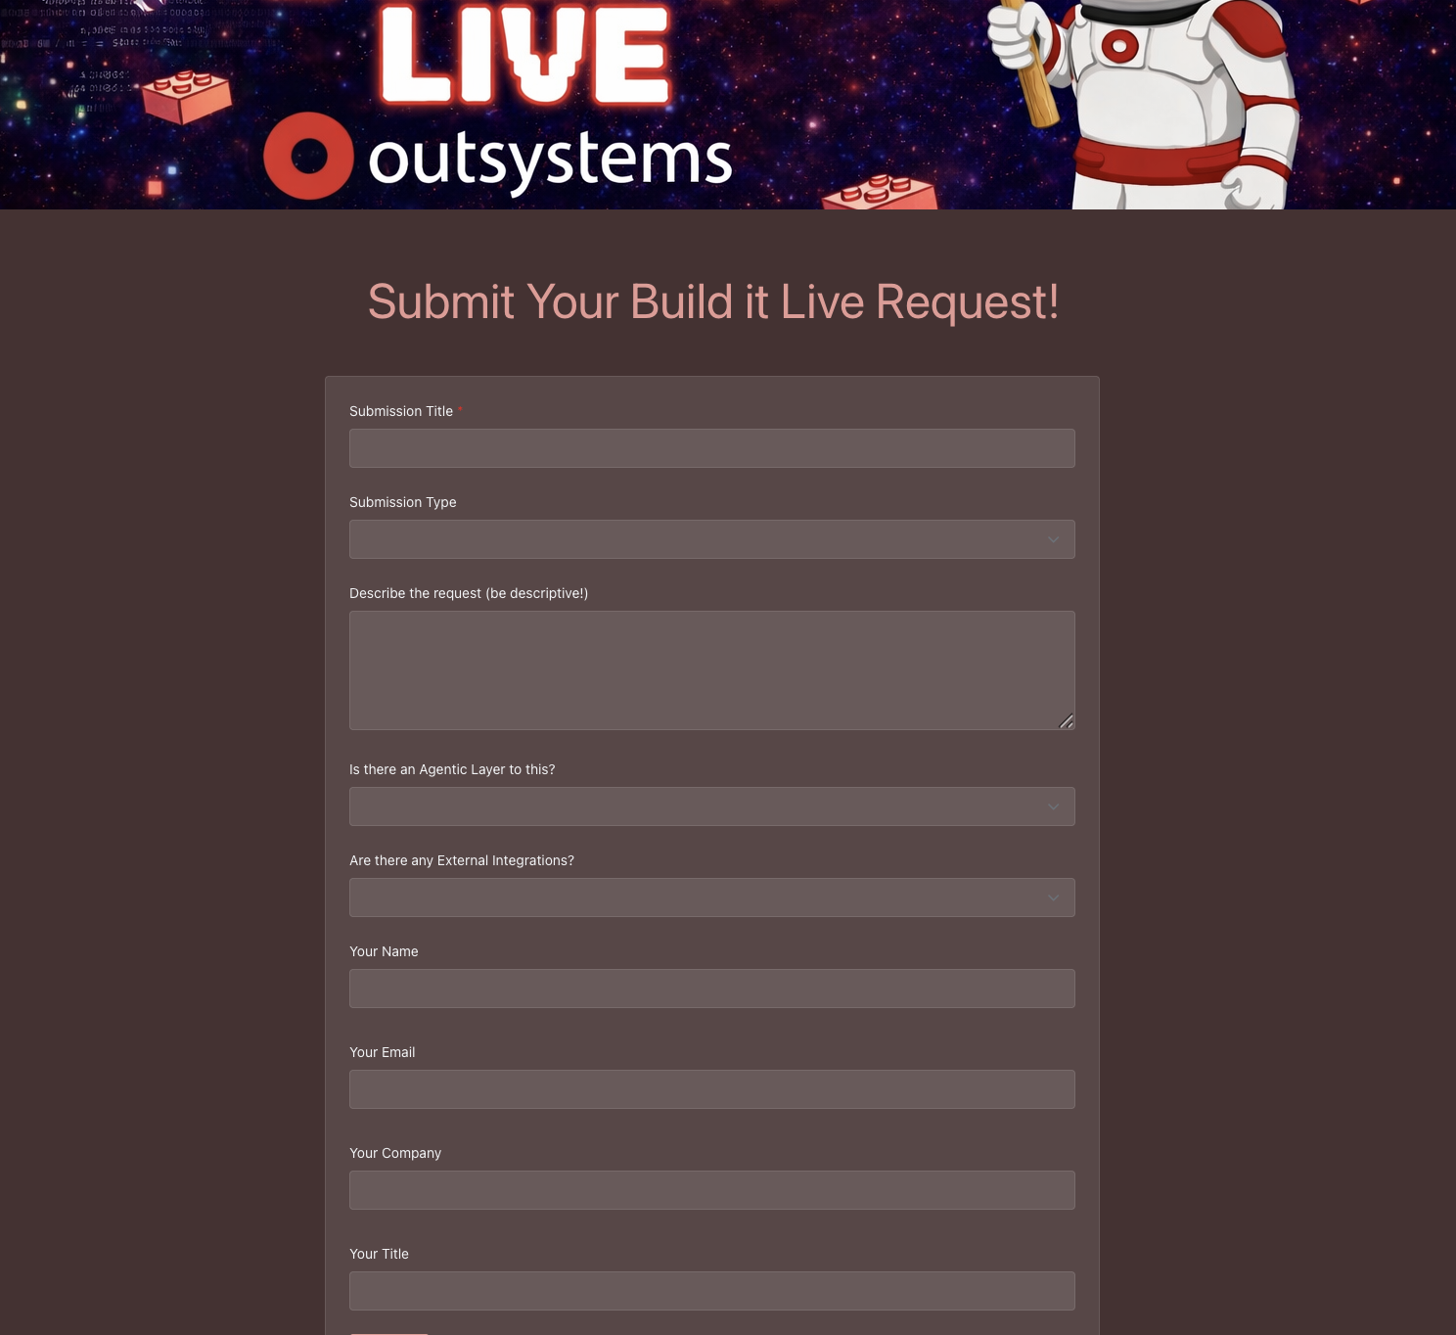
THE INTAKE LAYER
The engine starts with real requests
A simple submission flow lets internal teams, customers, partners, and community members tell DevRel what they want to see built.
Capture idea, use case, agentic layer, integrations, and submitter context.
Notify the team as requests arrive and build a reviewable backlog.
Group similar asks into higher-value episodes instead of treating every request as one-off.
already started
Build It Live / 3
Notes:
This is where you switch from idea to evidence.
Say that the screenshot is the first version of the intake surface, not the final brand experience.
The important part is that the mechanism exists: capture ideas, tag them, notify the team, and build a content backlog.

Slide 4
OPERATING MODEL
A request becomes a repeatable content motion
The workflow is deliberately simple so DevRel can pilot it before building a larger program around it.
Submit
Review
Group
Build
Publish
Reuse
Measure
Ideas arrive from internal and external audiences.
DevRel and product triage fit, timing, and risk.
Related asks become an episode theme.
Create the app, demo path, repo, and supporting notes.
Ship the long-form episode and derivative clips.
Package for Forge, GitHub, field teams, and docs.
Track demand, engagement, reuse, and follow-on asks.
Every episode improves the next loop: better backlog, clearer release examples, and more reusable proof points.
Build It Live / 4
Notes:
Walk the VP through this as a lightweight operating rhythm.
Emphasize that the team can group requests to avoid a scattered content calendar.
The loop is the real idea: submissions feed episodes, episodes feed assets, assets drive discovery, discovery creates more submissions.

Slide 5
EPISODE PACKAGE
One build becomes a reusable asset bundle
YouTube
Shorts
Example request
Full practical walkthrough with the story, build path, and decisions.
Three to five quick clips built around the demo's strongest moments.
Can OutSystems build an AI support triage app connected to an external service?
GitHub
Forge
OML files, setup steps, readme, architecture notes, and integration details.
Reusable app, component, connector, or starter when appropriate.
Episode result: a working app, a walkthrough, and implementation assets a developer can inspect or reuse.
Social and enablement
LinkedIn posts, launch snippets, and internal demo talking points.
Build It Live / 5
Notes:
This is the most important slide for making the idea feel operational.
The point is not that every episode needs every artifact. The point is that the default unit of work is a package, not a single video.
Use the example request to make the content bundle concrete.

Slide 6
WHY DEVREL SHOULD CARE
The value is bigger than video views
Build It Live creates a practical library of proof points that can support community, launches, search, and field teams at the same time.
Developer interest
Launch support
Search and AEO
Field reuse
Real examples lower the effort required to understand where OutSystems fits.
Release messages get an immediate build that shows the new capability in context.
Specific demos, readmes, and repos give search systems clearer answers to surface.
Sales and solutions teams get compact demos, scripts, and assets they can point to.
Measure the motion with submissions, watch time, short-form engagement, GitHub activity, Forge installs, community conversations, and internal reuse.
Build It Live / 6
Notes:
Use this slide to tie the idea to the VP's likely priorities.
Avoid selling it as a vanity content play. The reuse channels make it much more durable.
Metrics should be treated as learning signals in the pilot, not as a giant reporting burden.

Slide 7
LAUNCH ALIGNMENT
Feature releases get a practical companion
Announcements tell people what changed. Build It Live shows what the change unlocks.
1
Before launch
2
Launch week
3
After launch
Pull one or two release-aligned requests from the backlog.
Publish the companion build alongside the announcement.
Clip, document, package, and route the build to the right audiences.
Possible companion builds
Mentor-assisted app build | Codex-style developer workflow | External API integration | Early feature preview
Build It Live / 7
Notes:
This is the direct product-marketing and DevRel bridge.
Position launch alignment as optional but high-value: not every episode needs to be launch-tied, but releases are stronger when there is an immediate demo.
For vaporware or early features, suggest a controlled prototype or concept episode with the right framing.

Slide 8
RECOMMENDED NEXT STEP
Pilot the motion before scaling it
A small pilot can validate the format, operating rhythm, and asset reuse without committing to a large production machine.
Pilot mix
The ask
6
AI-assisted app build with Mentor
Approve a lightweight pilot lane, nominate release tie-ins, and identify reviewers who can help keep demos credible.
episodes
Codex-style developer workflow
over 8-10 weeks
External service integration
Decision needed: whether DevRel wants to sponsor the pilot and where it should sit in the upcoming content calendar.
Feature-release companion demo
Build It Live / 8
Notes:
End with a crisp ask instead of a generic thank-you slide.
This is deliberately scoped as a pilot: six episodes, 8-10 weeks, with clear learning metrics.
Ask whether DevRel would sponsor the pilot and where it could align with near-term launches.

