Slide 1


THE USE OF MOLECULAR INFORMATION IN LIVESTOCK SELECTION
Bioinformatics approaches in animal breeding
Summer
University of Zagreb University of Ljubljana
School
July 9-11, 2025 Zagreb
Brajković Vladimir, Shihabi Mario
Wednesday
9th July

Slide 2
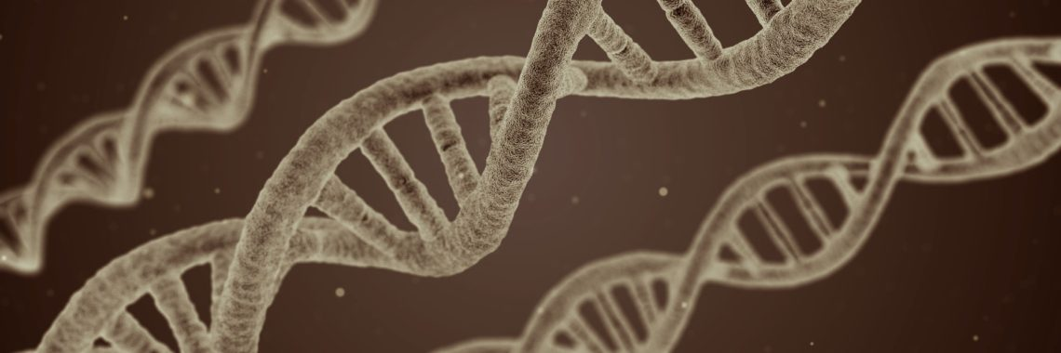
Contents
What is molecular information?
About DNA and genome
Genome composition
Single Nucleotide Polymorphisms (SNPs)
Associations with Phenotype
Usage of molecular information in livestock selection
Case study
Identification of Selection Signals on the X
chromosome in East Adriatic Sheep:
A New Complementary Approach
Bioinformatics approaches in animal breeding
Summer
School

Slide 3
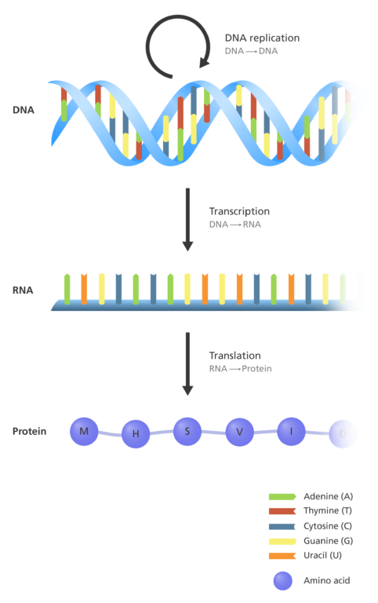
Central dogma of molecular biology
DNA – Deoxyribonucleic Acid
Double-stranded molecule
Stores entire genetic blueprint of individual
RNA – Ribonucleic Acid
Single-stranded molecule transcribed from DNA
messenger RNA (mRNA) - coding sequences
regulatory (miRNA) and structural forms (rRNA, tRNA)
Proteins
Structural and functional complex macromolecules
Synthesized by ribosomes based on mRNA templates
Molecular
information
Data at
DNA
RNA
or
protein level

Slide 4
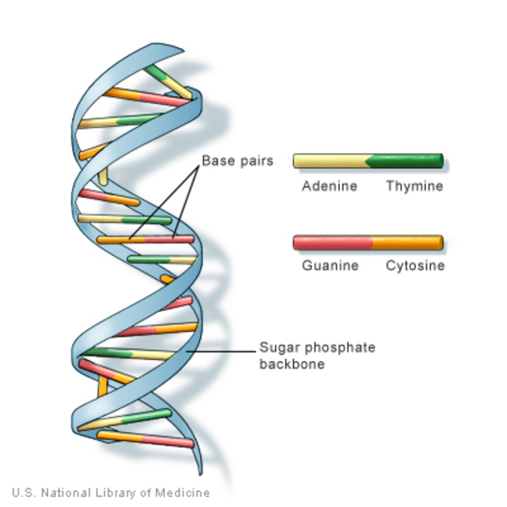
About DNA and genome
DNA (Deoxyribonucleic Acid) - hereditary material in all living organisms
It consists of: Deoxyribose sugar
Phosphate group
Nitrogenous bases:
Adenine (A)
Thymine (T)
Cytosine (C)
Guanine (G)
🔑 Only the nitrogenous bases vary among individuals
These nucleotide differences are the basis of genetic variation and thus the focus of genomics
Bioinformatics approaches in animal breeding
Summer
Genome - full set of DNA sequences in an organism
School

Slide 5
Simpler vs. Complex genome
Simpler organisms – Prokaryotes (e.g. Bacteria)
Typically single circular chromosome in cytoplasm
One copy of DNA (haploid)
Genomes are compact – fast replication, efficient adaptation
Genetic variation arises only through mutations
Trade-off between
genome simplicity (reproduction)
&
complexity (survival)
--------------------------------------------------------
'Nothing in Nature happens accidentally’
|
genome design reflects evolutionary strategy
Complex organisms – Eukaryotes (e.g. Livestock)
Multiple linear chromosomes enclosed in nucleus
Two copies of DNA (diploid)
Genomes are large – allow complex regulation and specialization
Genetic variation arises from both mutations and recombination
Recombination: exchange of genetic material during meiosis
– Enhances genetic diversity
– Breaks linkage between harmful and beneficial mutations

Slide 6
Livestock genome composition
♂
♂
Depends on species (e.g. cattle = 29 pairs)
♀
♀
♂
Consists of: X autosomes (non-sex chromosomes)
Sex chromosomes (X and Y)
Mitochondrial DNA (mtDNA)
♀
16.3 Kb ≈
Cattle
59 Mb ≈
139 Mb ≈
2.58 Gb ≈
Type | Inherited From | Recombines?
Autosomes | Both parents | Yes
mtDNA | Maternal only | No
X chromosome | Both (♀) / Mother (♂) | Yes (♀), No (♂)
Y chromosome | Paternal only (♂) | No
without
PAR

Slide 7
Livestock genome composition
GCC...ATT
TCCTAG.......................TATTTAAA
ATT...CCG
♂
♂
♀
TTCCAG......................TATATAAA
TTC...TGTG
------------------------------------------------------------------------------------------------------
GGC...ATT
ATCCAG......................TTATTTAA
GGC...TCTC
♀
♂
♀
TTTTAG......................TATATAAA
TTC...TGTG
16.3 Kb ≈
Cattle
59 Mb ≈
139 Mb ≈
2.58 Gb ≈

Slide 8
Obtaining molecular information
In the past, molecular information was not accessible
With technological advancement, molecular markers were developed
Many types were used, with microsatellites once being dominant
Today, Single Nucleotide Polymorphisms (SNPs) are the most widely applied markers
Obtaining complete genome data (WGS: Whole Genome Sequence) is now possible, but still costly if high accuracy is required

Slide 9
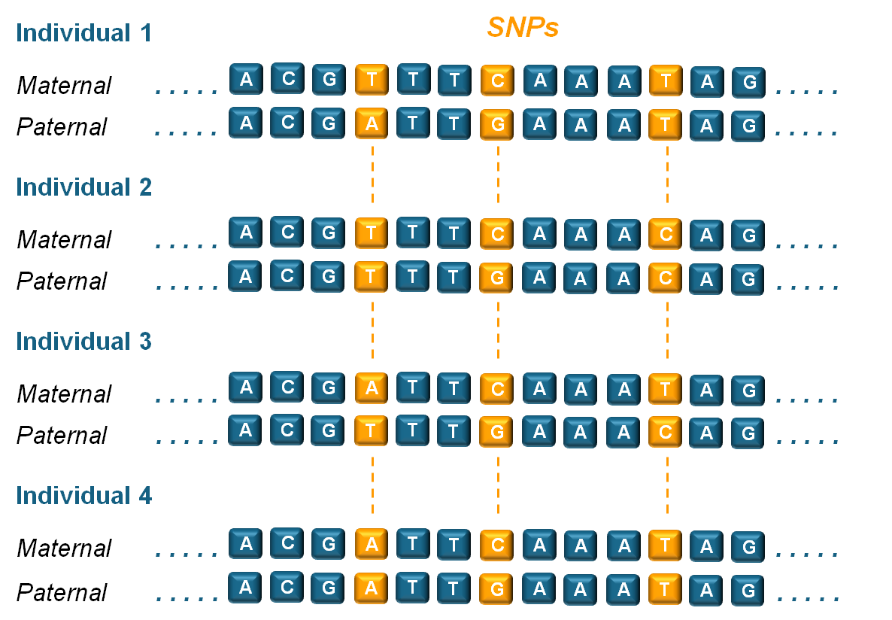
Single Nucleotide Polymorphisms (SNPs)
Most used molecular marker
Single base pair variations at specific genomic positions
Widespread occurrence and informative nature
Result from mutations spread by drift or selection
Found across whole genome, in both coding and non-coding regions
Most commonly obtained from SNP array data
SNP arrays genotype thousands of informative variants reliably and cost-effectively
Alternatively, SNPs can be extracted from WGS data (higher number, but lower per-SNP accuracy and often more noise than advantage)

Slide 10
Associations of molecular information & phenotype
Basic model that explains phenotype:
P = G + E + G×E
P – Phenotype
G – Genetic effects (mol. info. provides insights)
E – Environmental effects
G×E – Genotype by Environment Interaction
Genetic Component (G): different genetic models
Infinitesimal model – many genes with tiny effects
Oligogenic model – few genes with large effects
Mixed model – mostly small effects + few major genes
Different trait scenarios
P = G + E + G×E → most complex traits (e.g. milk yield, growth, fertility)
P ≈ G → traits mostly determined by genetics (e.g. eye color, monogenic diseases)
P ≈ E → traits strongly affected by environment (e.g. weight gain under extreme diet)

Slide 11
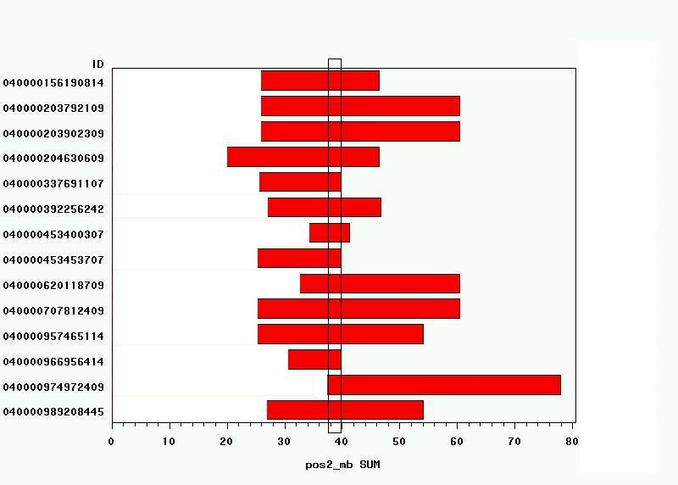
Associations of molecular information & phenotype
Example 1: Recessive disorder in Tyrol Grey
P ≈ G (monogenic trait)
Regions of chromosome 16 where all diaseased animals are homozygous
Occured in 2003
Neuromuscular disorder
Symptoms:
Disease breaks out at ~3 months of age
Loss of control over hind part of body
Gusti (*1972) in the pedigrees of all diseased animals
1 locus at MFN2 gene -> T/T disease
T/C & C/C healthy
Drogemuller et al. (2011)

Slide 12
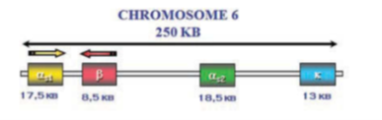
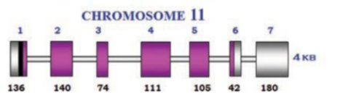
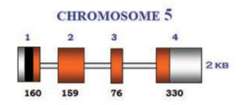
Associations of molecular information & phenotype
Example 2: Milk protein composition in dairy cattle
P = G + E + G×E (Polygenic trait with major genes)
Six genes are responsible for the synthesis of 95% of milk proteins
4 Casein fractions:
α_{S1}-CN, β-CN, α_{s2}-CN > calcium sensitive proteins are phylogenetically related
κ-Cn > phylogenetically related to fibrinogen
α-lactalbumin (α-LA) & β-lactoglobulin (β-LG)
α-LA > responsible for biosynthesis of lactose
β-LG > way protein that bindes with retinol
Casein fractions
β-LG
α-LA
Bovenhuis et al. (1992)
Notes:
Calcium-binding caseins: These three casein fractions have the ability to bind calcium ions (Ca²⁺) through their phosphorylated amino acid residues, particularly phosphoserine. Calcium is essential for the stability of casein micelles – it forms "bridges" between casein molecules, enabling them to assemble into stable structures.
κ-casein and fibrinogen analogy: Fibrinogen plays a role in blood clotting and fiber formation. κ-casein exhibits a similar ability to stabilize micellar structures – it acts as a "network" that maintains micelle integrity.

Slide 13
General applications of molecular information in livestock
Population
genetics
Conservation
genetics
Quantitative
genetics

Slide 14
Applications of molecular information in livestock selection
Genetic improvement of economically important traits – Milk yield, growth, fertility, carcass quality, disease resistance
Detection and management of genetic defects – Identification and elimination of carriers of harmful recessive alleles
Parentage verification and breed composition analysis – Ensures accuracy in breeding programs and conservation management
Selection for robustness and adaptability – Heat tolerance, disease resistance, stress resilience
Optimized mating strategies – Genomic information supports mating plans that maximize gain and
minimize inbreeding
….

Slide 15
Main categories of molecular information use
Evaluation of animals
→ Predicting breeding potential (e.g. GEBVs) → Used in: MAS, GS, mate selection
2. Evaluation of markers (SNPs)
→ Identifying SNPs associated with traits or populations → Used in: GWAS, selection signals

Slide 16
Core methods used in selection
Marker-Assisted Selection (MAS)
Uses markers linked to major genes or QTLs
Suitable for traits mainly controlled by major genes
Simple, but limited to known loci with large effects
Example: selection against recessive genetic disorders or for hornless (polled)
allele

Slide 17
Core methods used in selection
2. Genomic Selection (GS)
Uses genome-wide SNP data to predict Genomic Estimated Breeding Values (GEBVs)
Enables early evaluation of young animals
Powerful for complex (polygenic) traits
Reduces generation interval and increases selection accuracy
Uses statistical models like GBLUP, BayesA/B/C, LASSO

Slide 18
Core methods used in selection
3. Introgression of beneficial alleles
Controlled transfer of favorable alleles from one breed/population to another
Supported by molecular tracking using markers
Used in crossbreeding or gene introgression programs
Example: Booroola gene in sheep significantly increases ovulation rate and litter size (homozygous)

Slide 19
Core methods used in selection
4. Genomic mate selection
Matches animals based on genomic profiles
Helps maximize genetic gain while minimizing inbreeding
Crucial in small populations or conservation breeding

Slide 20
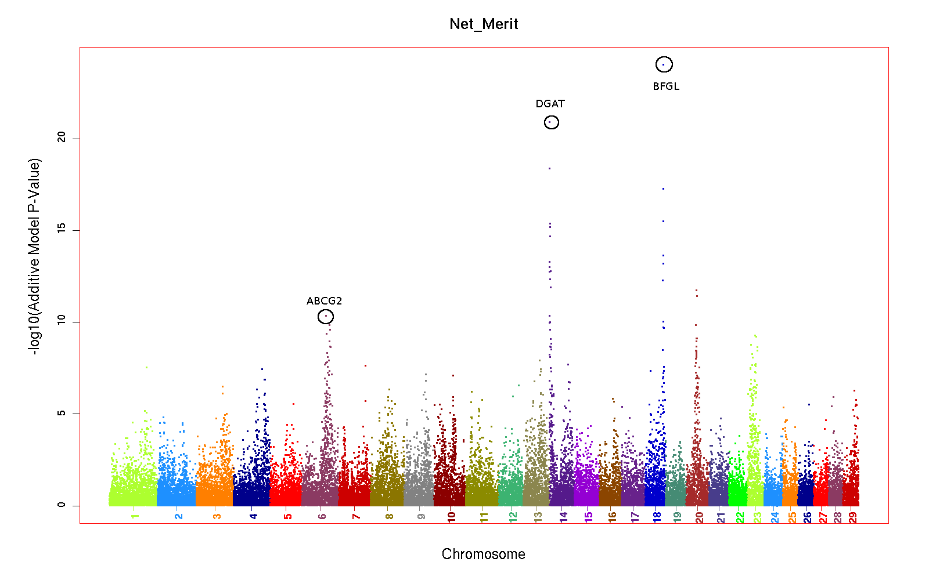
Core methods for exploring trait architecture and selection
Genome-Wide Association Studies (GWAS)
Statistical method that associates phenotypic traits with SNPs across genome
Identifies QTLs influencing traits (e.g. milk yield, fertility)
Supports development of better MAS and GS models
Findings often lead to discovery of candidate genes with functional relevance

Slide 21
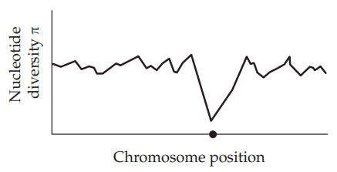
Core methods for exploring trait architecture and selection
2. Selection Signals
Genomic patterns indicating past selection events
Identify loci under natural and/or artificial selection
Reveal adaptation and breeding history
Useful in conservation and breed characterization

Slide 22
Modern Livestock Genomics – From Data to Application
📊 Big data challenge
Molecular datasets (e.g. SNP arrays, WGS) contain a high number of variables per sample
Complex trait analyses require advanced bioinformatics approaches
🧬 End of the Genomics-centric era?
Genomics is reaching maturity; SNP arrays and WGS are widely adopted
Yet, added value now comes from integration with other omics (transcriptomics, epigenomics)
📸 Rise of the Phenomics era
High-throughput phenotyping (e.g. sensors, imaging, metabolomics) enables large-scale, accurate phenotype collection
Accurate phenotypes = improved selection accuracy

Slide 23
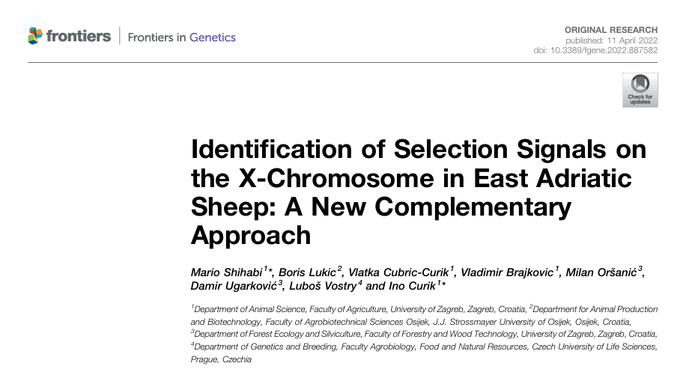
Case study
https://doi.org/10.3389/fgene.2022.887582

Slide 24




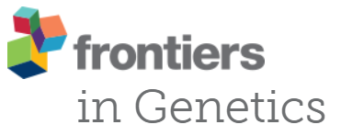

Identification of Selection Signals on the X-chromosome in East Adriatic Sheep: A New Complementary Approach
M. Shihabi, B. Lukic, V. Cubric-Curik, V. Brajkovic, M. Oršanić, D. Ugarković, L. Vostry, I. Curik
mshihabi@agr.hr; icurik@agr.hr

Slide 25
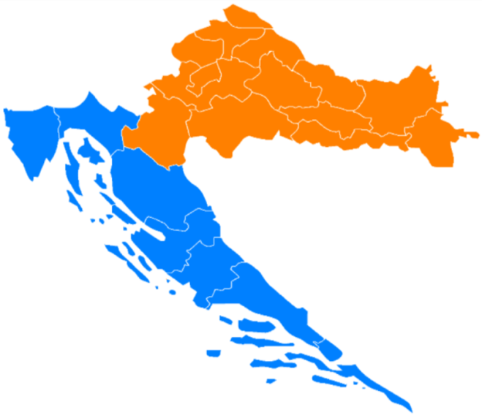
East Adriatic sheep
One of the most important livestock species in Croatia
Mainly in the coastal and mountainous regions (mostly kept extensively)
Eight indigenous breeds
Adriatic Croatia
Continental Croatia
(Cres Island Sheep, Dalmatian Pramenka, Dubrovnik Ruda, Istrian Sheep, Krk Island Sheep, Lika Pramenka, Pag Island Sheep and Rab Island Sheep)
Intensive artificial selection has never been practiced
Genomic composition → environmental adaptation + sustainable production

Slide 26
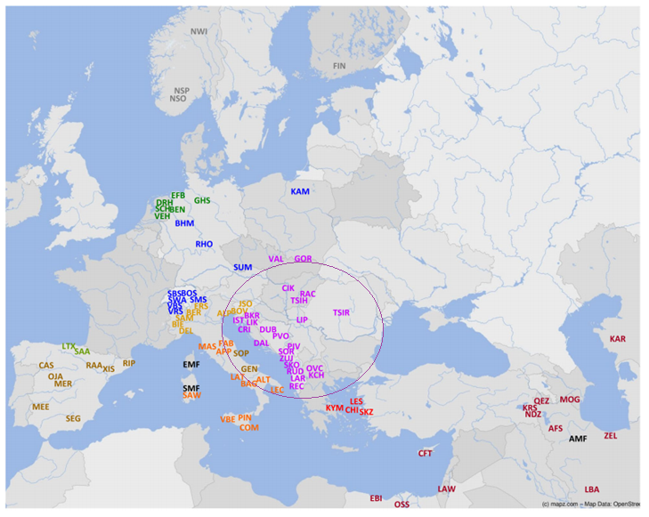
The origin of European sheep
Ciani et al. (2020)
Balkan sheep breeds form a genetically specific cluster that is distinct from other European sheep breeds

Slide 27
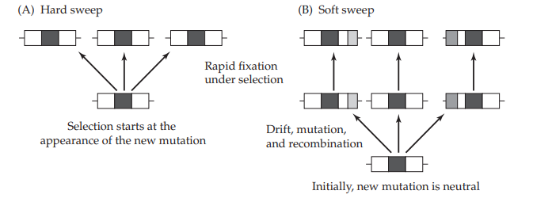
Positive selection signals
Increase of the frequency of certain alleles depending on the selection pressure
Regions with increased homozygosity (hitchhiking)
Hard sweep - Emerging desirable mutation
Soft sweep - Existing allele (previously neutral) - Multiple mutations whose frequency gradually increases

Slide 28




X-Chromosome
135 Mb; ~5 % genome size
Pseudo-Autosomal Region (PAR)
Mutation rate (0.015 mutations/Mb/generation)
Recombination rate (2/3)
Effective population size (3/4)
Linkage disequilibrium
Chr X vs autosome
Understudied in the analyses identifying positive selection signals
Better understanding of selection behaviour on the sex chromosome
Good potential for methodological improvements

Slide 29

Main objective
to identify signals of positive selection on the X
chromosome in East Adriatic sheep
Inter-population analyses
Intra-population analyses
1. extreme Runs Of Homozygosity islands (eROHi)
2. integrated Haplotype Score (iHS)
3. number of Segregating Sites by Length (nSL)
4. Haplotype Richness Drop (HRiD) → NEW APPROACH!
Gene Annotation

Slide 30


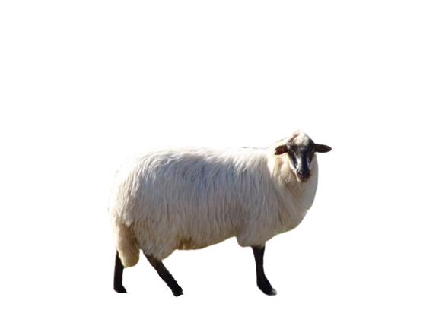
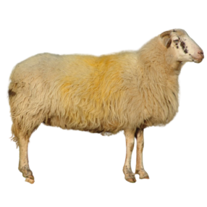
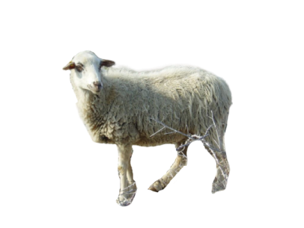
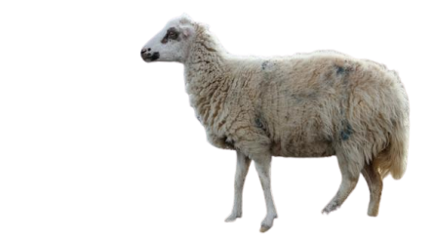
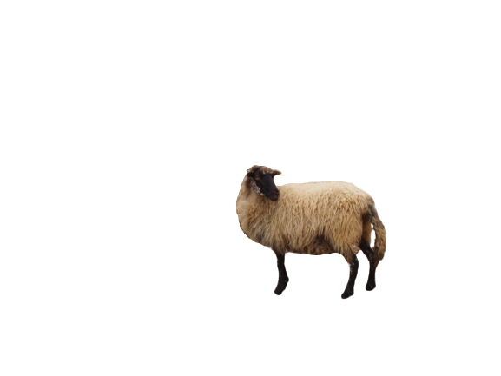
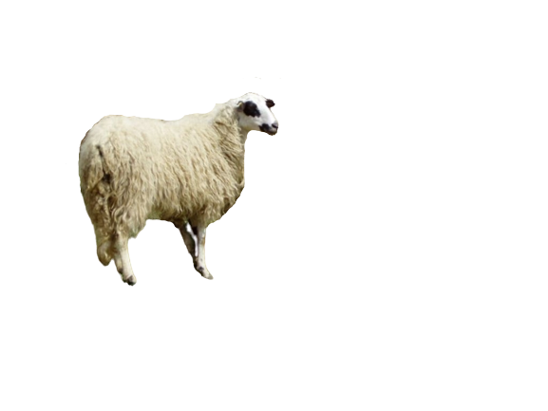
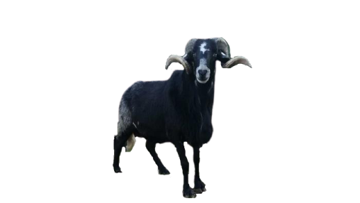
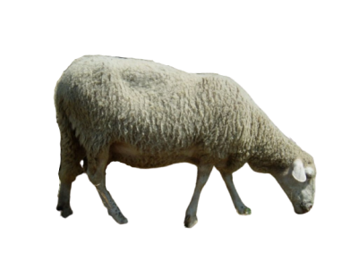
Quallity control:
chrX SNPs only
GenTrain score <0.4
GenCall score <=0.8
Genotype call rate <0.9
HWE 0.0000001
Duplicates
Individual call rate <0.95
27 questionable SNPs
18 983 SNPs
201 individuals
10 mouflons
Ancestral information
Data
East Adriatic sheep metapopulation (202 individuals) + 10 mouflons
100(101) ; 101 5 ; 5
Ovine Infinium® HD SNP BeadChip 600K
Krk Island Sheep
n = 20
Pag Island Sheep
n =45
Cres Island Sheep
n = 20
Rab Island Sheep
n = 20
Max gap = 232 kb
Mean gap = 7.13 kb
Istrian sheep
n = 25
Lika Pramenka
n = 20
Dalmatian Pramenka
n = 25(26)
Dubrovnik Ruda
n = 26

Slide 31

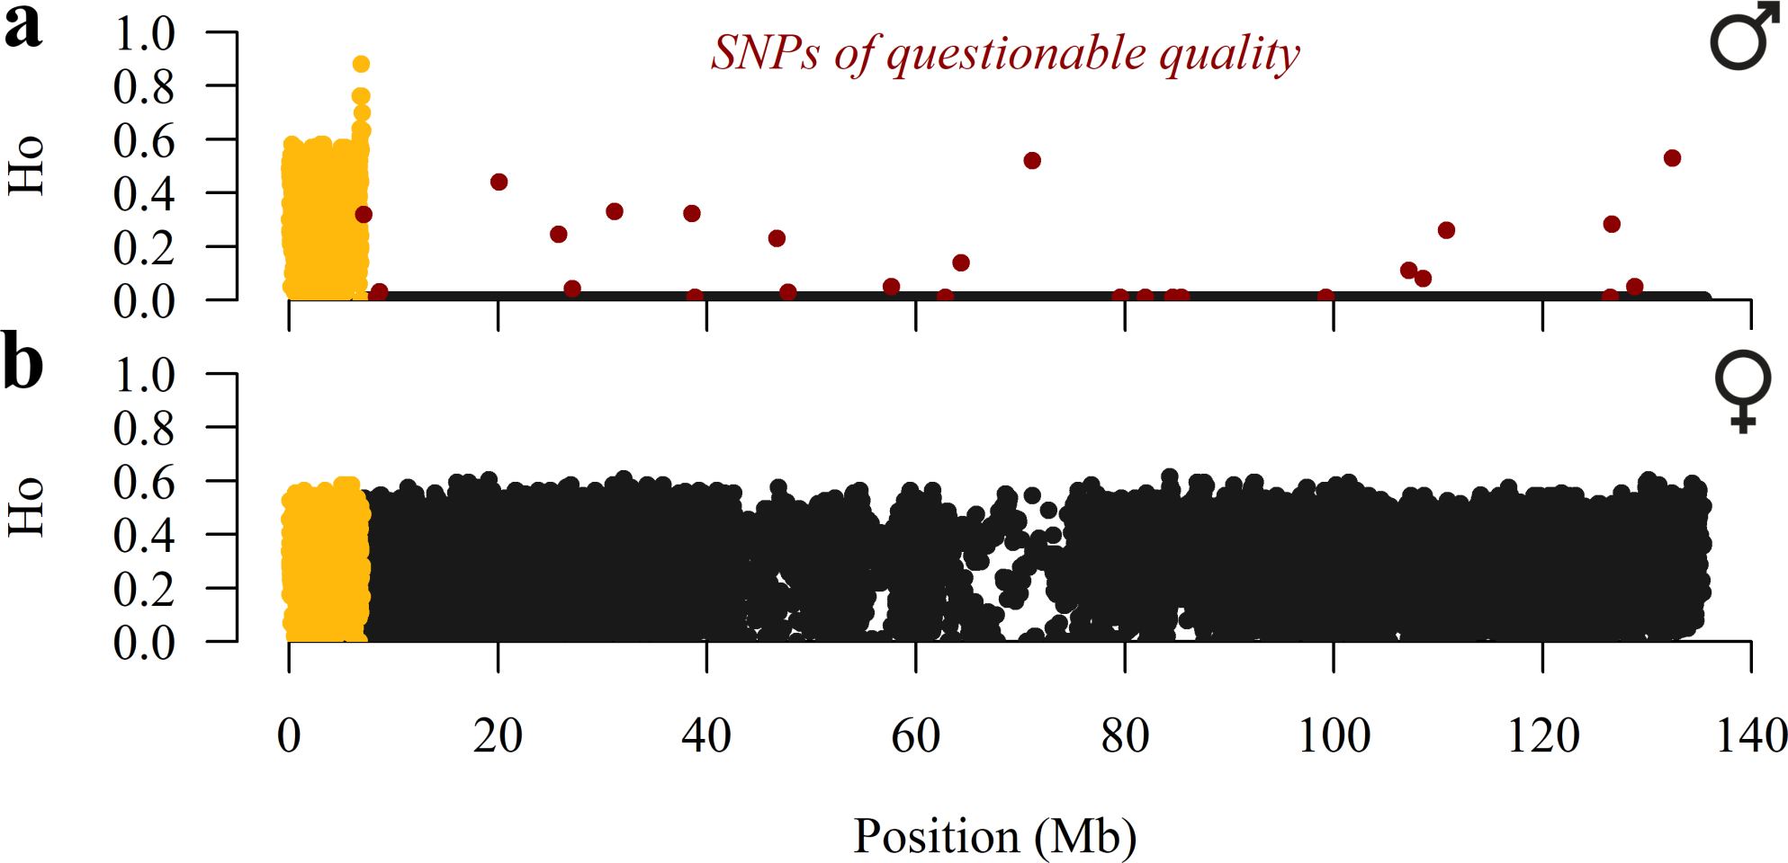
Pseudo-Autosomal Region (PAR)
(27)
0 – 7.04 Mb (1232 SNPs)

Slide 32
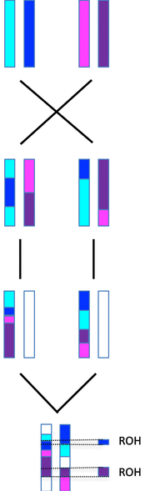
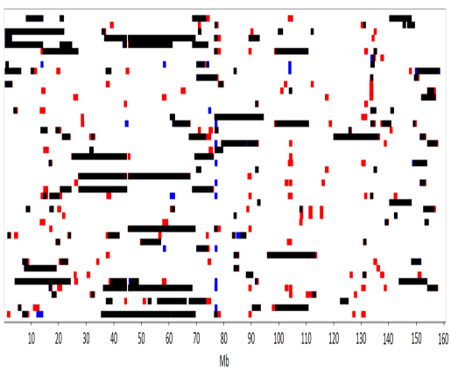

extreme ROH islands (eROHi)
101 individuals
six different length classes:
0.25 – 1 Mb
(no het or missing)
1 – 2 Mb
2 – 4 Mb
4 – 8 Mb
8 – 16 Mb
>16 Mb
Min SNP = 15
Max gap = 250 kb
Min density = 1 SNP / 20 kb
het and missing according to
Ferenčaković et al. (2013)
ROH frequency for each SNP
One-sided test
Consecutive SNPs with –log(P) >3.3
(40 individuals)

Slide 33


integrated Haplotype Score (iHS) number of Segregating Sites by Length (nSL)
--chrX Option
201 individuals
The VCF file recoded - ancestral allele (mouflons) = reference
- derived allele = alternative
iHS
nSL
rehh R package
selscan software
Two-sided
test
Normalisation inside frequency bin size of 0.025
Sliding window approach (500 kb size; 100 kb slide); SNPs with -log(P) >2 = outliers
nonoverlapping windows with >10% outliers

Slide 34

Haplotype Richness Drop (HRiD); new approach
100 individuals
On the X-chromosome without PAR, male genotypes are hemizygous, making it easy to derive exact
haplotypes of different lengths
the effective number of haplotypes of the ith sliding window under study
(formula is modified for the first and the last window)
If there is no selection, HRiD values should fluctuate around the value of one
The presence of positive selection leads to a sudden decrease in the effective number of haplotypes
(high positive HRiD values)
Lower sensitivity to variation in recombination rate
Wi
Wi+1
Wi+2
Wi
Wi+2
Wi+1

Slide 35
Haplotype Richness Drop (HRiD); new approach
Sliding window approach (size of 70 SNPs ≈ 500 kb; slide of 35 SNPs ≈ 250 kb)
One-sided test
windows with –log(P) >3.3
(HRiD = 2.8)
Median-joining network (MJN) = to illustrate the phylogenetic relationship between ancestral and
derived haplotypes in the each selection signal obtained
ancestral haplotypes = mouflons

Slide 36
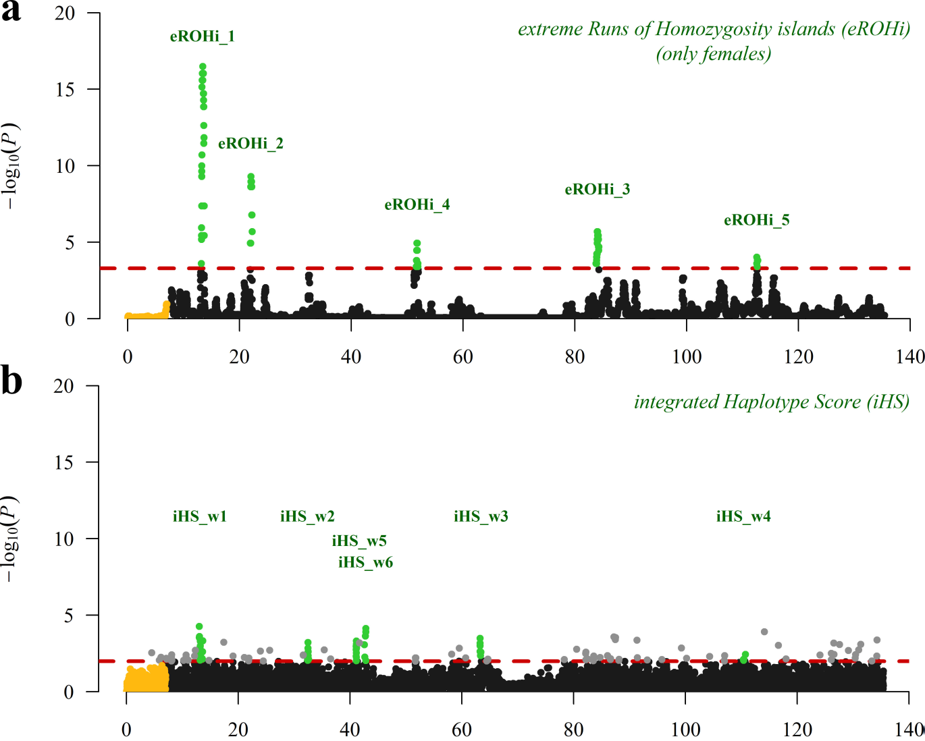
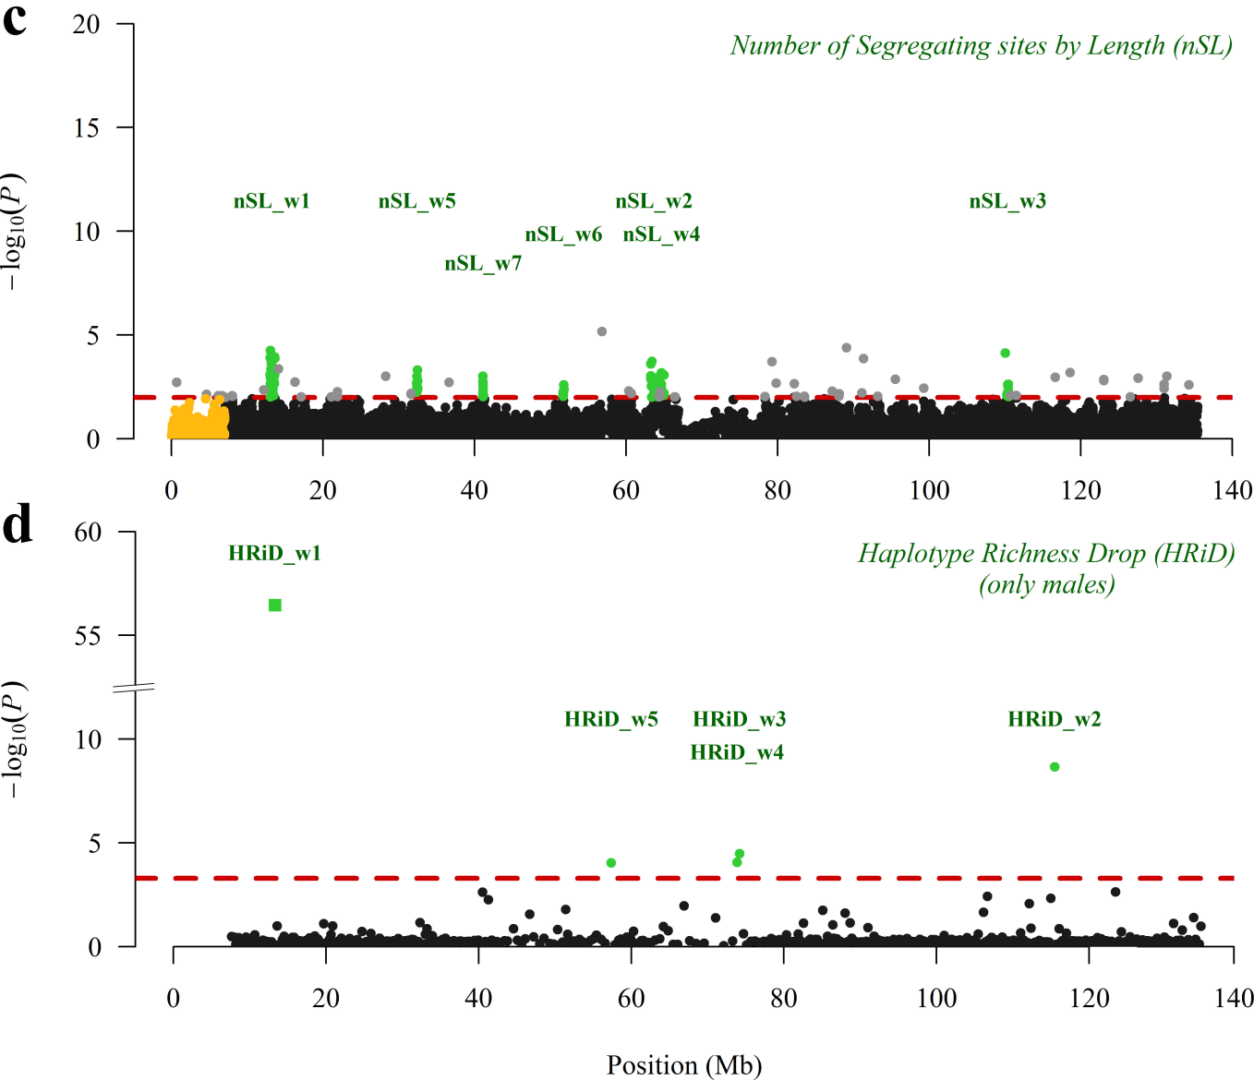
Visualisation of positive selection signals in the Manhattan plot

Slide 37
Description of mapping statistics and annotation of genes in selection signals by three classical (eROHi, iHS and nSL) approaches
Signal name | Position (Mb) | SNPs | -log(P) | Candidate genes under selection
eROHi_1 | 13.17-13.69 | 59/59 | 16.5 | CA5B, ZRSR2, AP1S2, GRPR
eROHi_2 | 21.96-22.26 | 35/35 | 9.3 | POLA1, ARX
eROHi_3 | 83.78-84.28 | 73/73 | 5.7 | No annotated genes found
eROHi_4 | 51.63-51.94 | 33/33 | 4.9 | DGKK, CCNB3
eROHi_5 | 112.53-112.72 | 11/11 | 4.0 | PLS3
iHS_w1 | 13.10-13.60 | 17/50 | 4.3 | TMEM27, CDC42, CA5B, ZRSR2, AP1S2, GRPR
iHS_w2 | 32.20-32.70 | 13/55 | 3.2 | No annotated genes found
iHS_w3 | 63.20-63.70 | 6/35 | 3.5 | RLIM, KIAA2022, ABCB7
iHS_w4 | 110.30-110.80 | 5/36 | 2.4 | DOCK11, WDR44, KLHL13
iHS_w5 | 41.00-41.50 | 9/65 | 3.3 | NDP, EFHC2
iHS_w6 | 42.50-43.00 | 6/60 | 4.1 | MIR221
nSL_w1 | 13.10-13.60 | 35/50 | 4.3 | TMEM27, CDC42, CA5B, ZRSR2, AP1S2, GRPR
nSL_w2 | 63.30-64.30 | 19/44 | 3.7 | KIAA2022, ABCB7, UPRT, ZDHHC15, MAGEE2
nSL_w3 | 110.10-110.60 | 12/39 | 4.1 | DOCK11
nSL_w4 | 64.60-65.10 | 10/39 | 3.2 | MAGT1, ATRX, FGF16
nSL_w5 | 32.30-32.80 | 14/61 | 3.3 | No annotated genes found
nSL_w6 | 51.40-51.90 | 8/56 | 2.6 | SHROOM4, DGKK, CCNB3
nSL_w7 | 41.00-41.50 | 9/65 | 3.0 | NDP, EFHC2

Slide 38
Description of mapping statistics and annotation of genes in selection signals by new HRiD approach
Signal name | Position (Mb) | n_{a} | n_{h} | HRiD | -log(P) | Candidate genes under selection
HRiD_w1 | 13.04-13.62 | 42 | 5.4 | 9.6 | 56.5 | TMEM27, CDC42, CA5B, ZRSR2, AP1S2, GRPR
HRiD_w2 | 115.30-115.73 | 36 | 13.3 | 4.2 | 8.7 | AMOT, LHFPL1
HRiD_w3 | 73.90-74.54 | 13 | 4.3 | 3.2 | 4.5 | DACH2
HRiD_w4 | 73.57-74.20 | 10 | 1.9 | 3.1 | 4.1 | CHM, DACH2
HRiD_w5 | 56.64-58.09 | 33 | 6.9 | 3.1 | 4.0 | AR, OPHN1, YIPF6

Slide 39
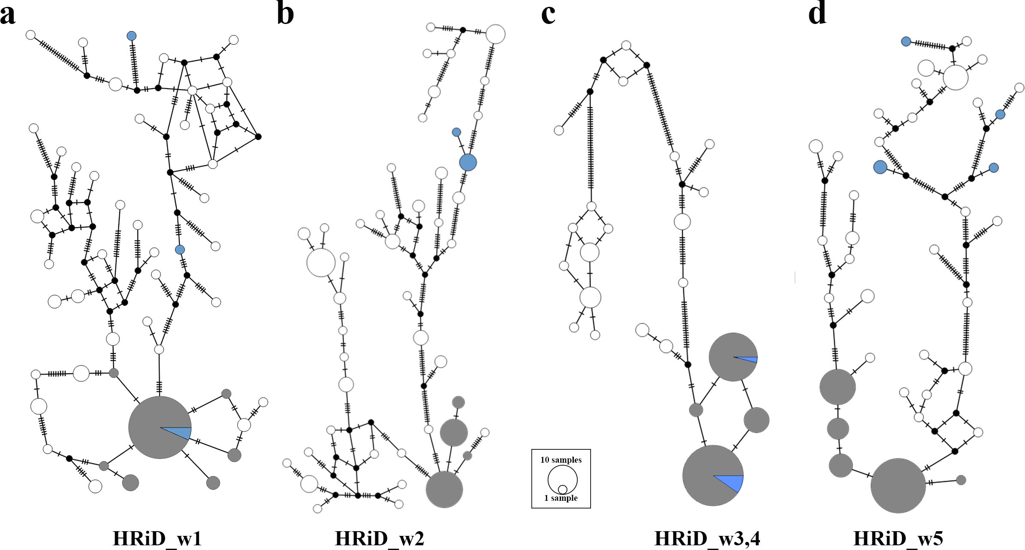
Median-joining network showing the phylogenetic relationship between ancestral and derived haplotypes inside selection signals identified by HRiD

Slide 40
Conclusions
14 positive selection signals with a total of 34 annotated genes were identified
Our results show that HRiD offers an interesting possibility to be used complementary to the
eROHi, iHS and nSL approaches or when only males are genotyped, which is often the case in
livestock where genomic breeding value estimates are routinely performed for males
Furthermore, we have shown that phylogenetic analyses can provide additional information when
performed within the selection signals identified by HRiD, particularly with respect to the ancestral
or derived status of the advantageous selected haplotypes
Overall, our results highlight the importance of the X-chromosome in the adaptive architecture of
domestic ruminants, while our novel HRiD approach opens new avenues for research

Slide 41
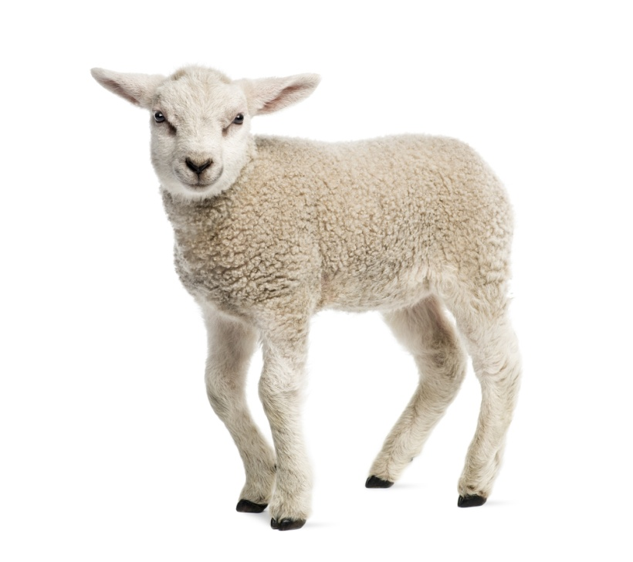


Thank you for your attention!
Croatian Science Foundation grant ANAGRAMS- IP-2018-01-7317 („Application of NGS in the Assessment of Genomic vaRiAbility in ruMinantS”).

