Slide 1

SupScenario
An Active Pedagogical Scenario Authoring Platform
with Collaboration and SCORM Export
Haroun Mzoughi
Bachelor’s Degree in Computer Science, Computer Engineering track
University of Tunis El Manar, Faculty of Sciences of Tunis
Supervisor: Mr. RAMZI ZOUAOUI
Academic year: 2025/2026
PFE Jury Defense
Notes:
Identity details: presentation-facts.md.

Slide 2
Context and problem
A single workspace for an authoring lifecycle
Educational scenarios often move across separate tools.
Design
Review
Deliver
Lessons, quizzes and learning paths
Comments, feedback and approval
SCORM or PDF for external LMS use
SupScenario keeps this work around one structured course document.
SupScenario | PFE Defense | 2
Notes:
Problem framing: presentation-facts.md.

Slide 3
Objectives and scope
The project focuses on the complete authoring path.
Create structured courses with lessons, quizzes, media and decision-oriented blocks
Support co-author work, comments, review actions and controlled publishing
Export learning content as SCORM 1.2 or PDF
Boundary
Learners consume exported packages through an external LMS. They do not use SupScenario directly.
SupScenario | PFE Defense | 3
Notes:
Implemented scope and user boundary: presentation-facts.md; ARCHITECTURE.md §3–4.

Slide 4
Users and functional workflow
Teachers and instructional designers
Create and structure course content
Co-authors
Edit shared scenarios and exchange comments
Administrators
Manage users and review submitted scenarios
LMS learners
Access exported SCORM packages outside the platform
SupScenario | PFE Defense | 4
Notes:
Target users: presentation-facts.md.

Slide 5
Development approach
An incremental implementation and validation cycle
1
2
3
Model the domain
Build core workflows
Validate behavior
Course document, roles, lifecycle
Authoring, collaboration, exports
Automated tests, build and manual demo path
The repository documents an iterative engineering process. No formal user-study result is claimed.
SupScenario | PFE Defense | 5
Notes:
Methodology statement constrained to repository evidence: ARCHITECTURE.md; presentation-facts.md.

Slide 6
System architecture
Implemented services and responsibility boundaries
Next.js 16 / React 19
NestJS 11 API
PostgreSQL
Frontend
Backend
Persistent data
Socket.IO
SCORM / PDF services
Groq / Pexels
Collaboration
Exports
Optional external services
SupScenario | PFE Defense | 6
Notes:
Architecture: ARCHITECTURE.md §3, §4; presentation-facts.md.

Slide 7
Security and access control
Authentication
JWT-based sessions protect dashboard routes and API access
Roles
Administrators have user-management and review responsibilities
Scenario access
Owners, shared co-authors and administrators receive checked access
Lifecycle and edits
Approval states and optimistic concurrency protect review and saves
Implementation note: a production deployment requires a strong random JWT secret.
SupScenario | PFE Defense | 7
Notes:
Access model: ARCHITECTURE.md §3.2, §4.2 and known issue §5; presentation-facts.md.

Slide 8
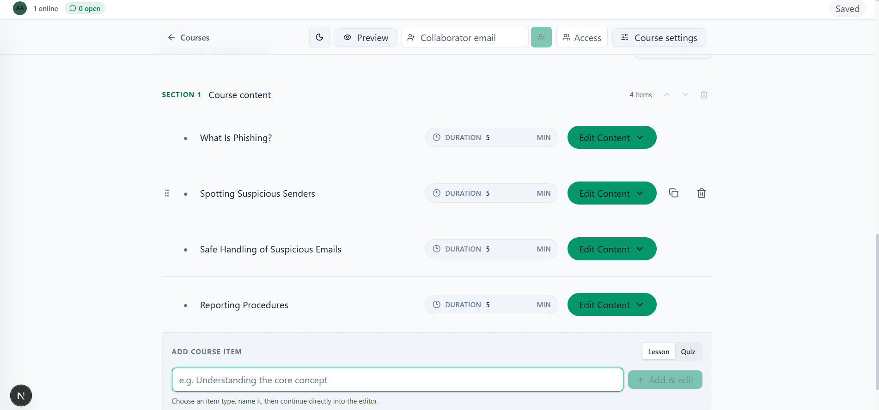
Course authoring experience
Lessons, quizzes, media and structured blocks in one editor
Structured course document
The editor keeps content in an ordered course structure rather than disconnected files.
Author control
Authors add lessons or quizzes and edit content before delivery.
SupScenario | PFE Defense | 8
Notes:
Screenshot: presentation-assets/course-editor.png. Editor behavior: ARCHITECTURE.md §4.1–4.2.

Slide 9
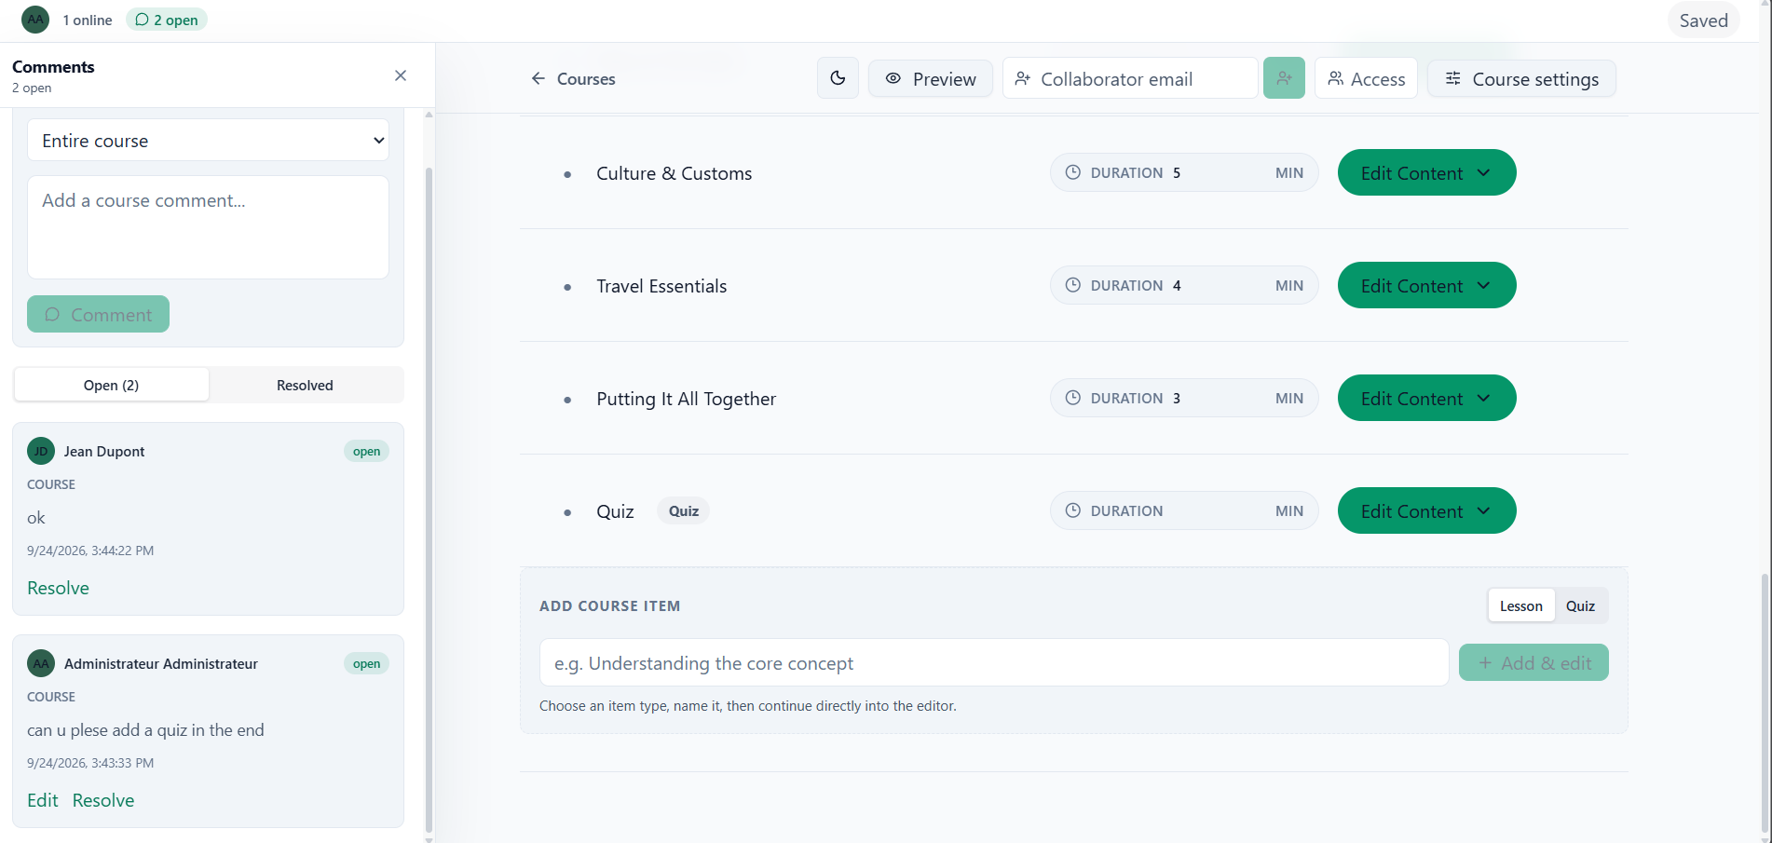
Collaboration and review
Co-authors work on shared scenarios with visible feedback
Scenario sharing grants co-author access
Comments support review and resolution
Real-time gateway tracks presence and element locks
Limit: presence and locks are process-local until shared storage supports multiple backend replicas.
SupScenario | PFE Defense | 9
Notes:
Screenshot: presentation-assets/collaboration-comments.png. Collaboration implementation and limitation: ARCHITECTURE.md §3.4, §4.3; presentation-facts.md.

Slide 10
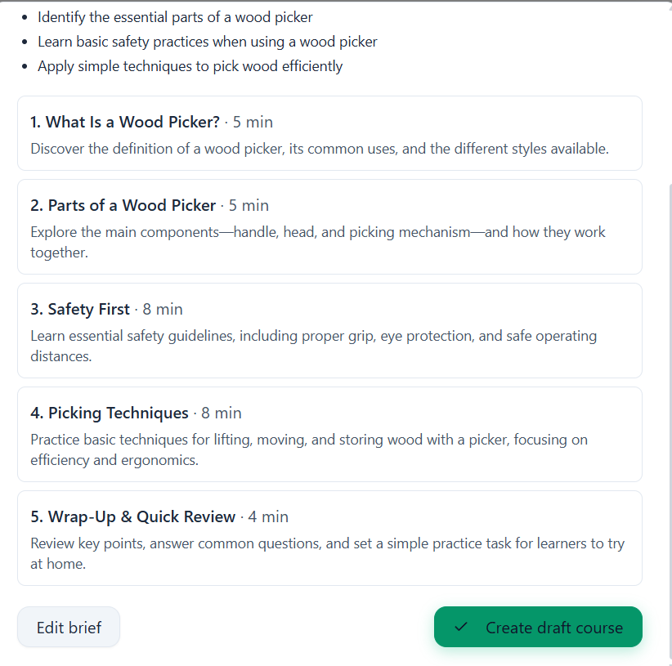
AI-assisted authoring
The author reviews every proposed change
Proposal model
The AI service returns a version-locked change set. The author can inspect it, then apply it explicitly.
Practical constraint
Groq tier limits can delay consecutive AI actions. Short cooldowns retry once; sustained use needs pacing.
SupScenario | PFE Defense | 10
Notes:
Screenshot: presentation-assets/ai-proposal-review.png. AI proposal behavior and rate-limit limitation: ARCHITECTURE.md §3.3, §6; presentation-facts.md.

Slide 11
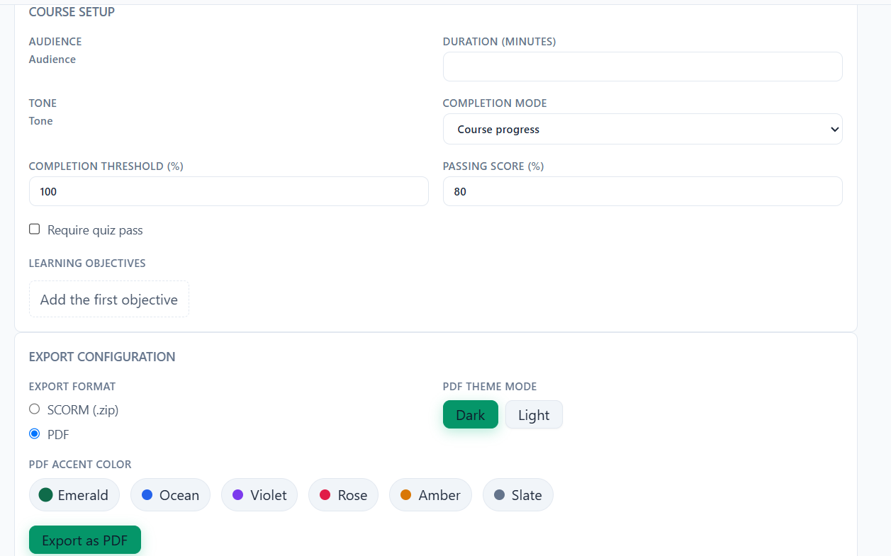
Export and delivery
Exported packages leave the platform for LMS delivery
SCORM 1.2
Package export and uploaded-package preview utility
PDF
Static export rendered through the PDF service
Delivery boundary
An external LMS hosts the learning package.
SupScenario | PFE Defense | 11
Notes:
Screenshot: presentation-assets/export-settings.png. Export implementation: ARCHITECTURE.md §3.5; presentation-facts.md.

Slide 12
Demonstration scenario
Prepared route for a short live walkthrough
1. Scenario list
›
2. Course editor
›
3. AI proposal review
›
4. Export
Recommended live focus: open a prepared scenario, show autosave, review an AI proposal, then open export settings.
Use a disposable account and a scenario without private information.
SupScenario | PFE Defense | 12
Notes:
Demo route: presentation-facts.md.

Slide 13
Validation and quality assurance
Automated tests
Backend service and unit tests cover auth, users, scenarios, media/resources, AI-course behavior and SCORM services
Behavior under test
Lifecycle transitions, access checks, AI proposal validation, media behavior and upload safety guards
Build validation
Repository commands: npm run test and npm run build
No coverage percentage, performance benchmark or SCORM certification is claimed.
SupScenario | PFE Defense | 13
Notes:
Validation scope: presentation-facts.md.

Slide 14
Achieved contribution
SupScenario connects the parts of pedagogical scenario production that otherwise remain separate.
Unified authoring
A structured course document holds lessons, quizzes and media blocks
Controlled collaboration
Shared access, comments, review actions and conflict-aware autosave
AI under author control
Suggestions remain proposals until an author chooses to apply them
Interoperable delivery
SCORM 1.2 and PDF exports support delivery outside the platform
SupScenario | PFE Defense | 14
Notes:
Contribution summary from verified implementation: ARCHITECTURE.md §3–4; presentation-facts.md.

Slide 15
Current limitations
Known constraints guide the next engineering steps
Multi-replica collaboration needs shared presence and lock storage
SCORM packages reference hosted external media, limiting fully offline use
Free or on-demand Groq limits can delay repeated AI requests
Some branching blocks have richer PDF rendering than SCORM rendering
Before staging or production use, replace the local development JWT secret with a strong random secret.
SupScenario | PFE Defense | 15
Notes:
Known limitations: presentation-facts.md; ARCHITECTURE.md §5.

Slide 16
Conclusion and future work
SupScenario delivers an implemented authoring workflow from structured course creation to controlled review and export.
Future work
Bundle media for offline SCORM delivery
Complete SCORM renderers for all decision block types
Share collaboration state across backend replicas
Assess direct LMS workflows or self-hosted models when justified
Thank you
Questions?
SupScenario | PFE Defense | 16
Notes:
Future work: presentation-facts.md; ARCHITECTURE.md §5–6.

