Slide 1
RNA Atlas Explorer — Filters & Metrics
What each selection criterion means, an example it keeps vs one it drops, and how much of the 7,757-fold curated set each removes.
Live: ddc01lh56i5th.cloudfront.net

Slide 2
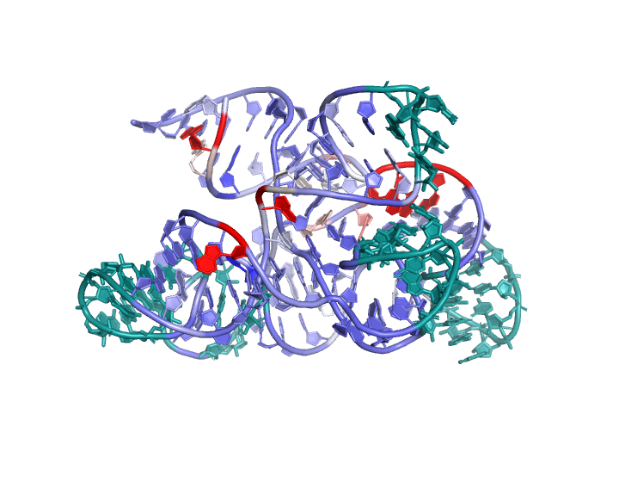
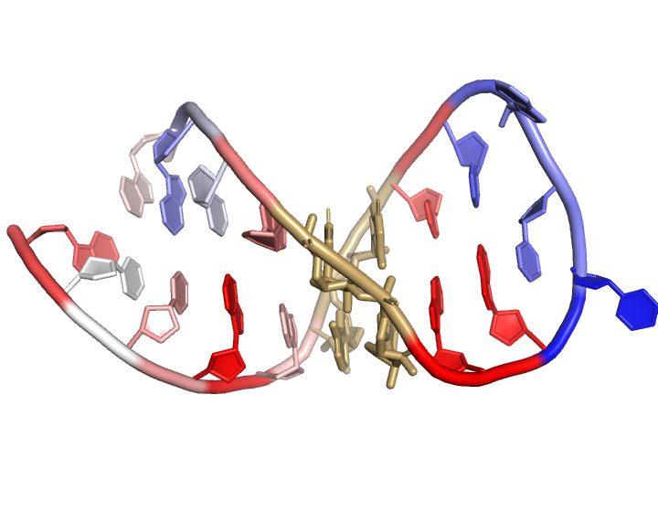
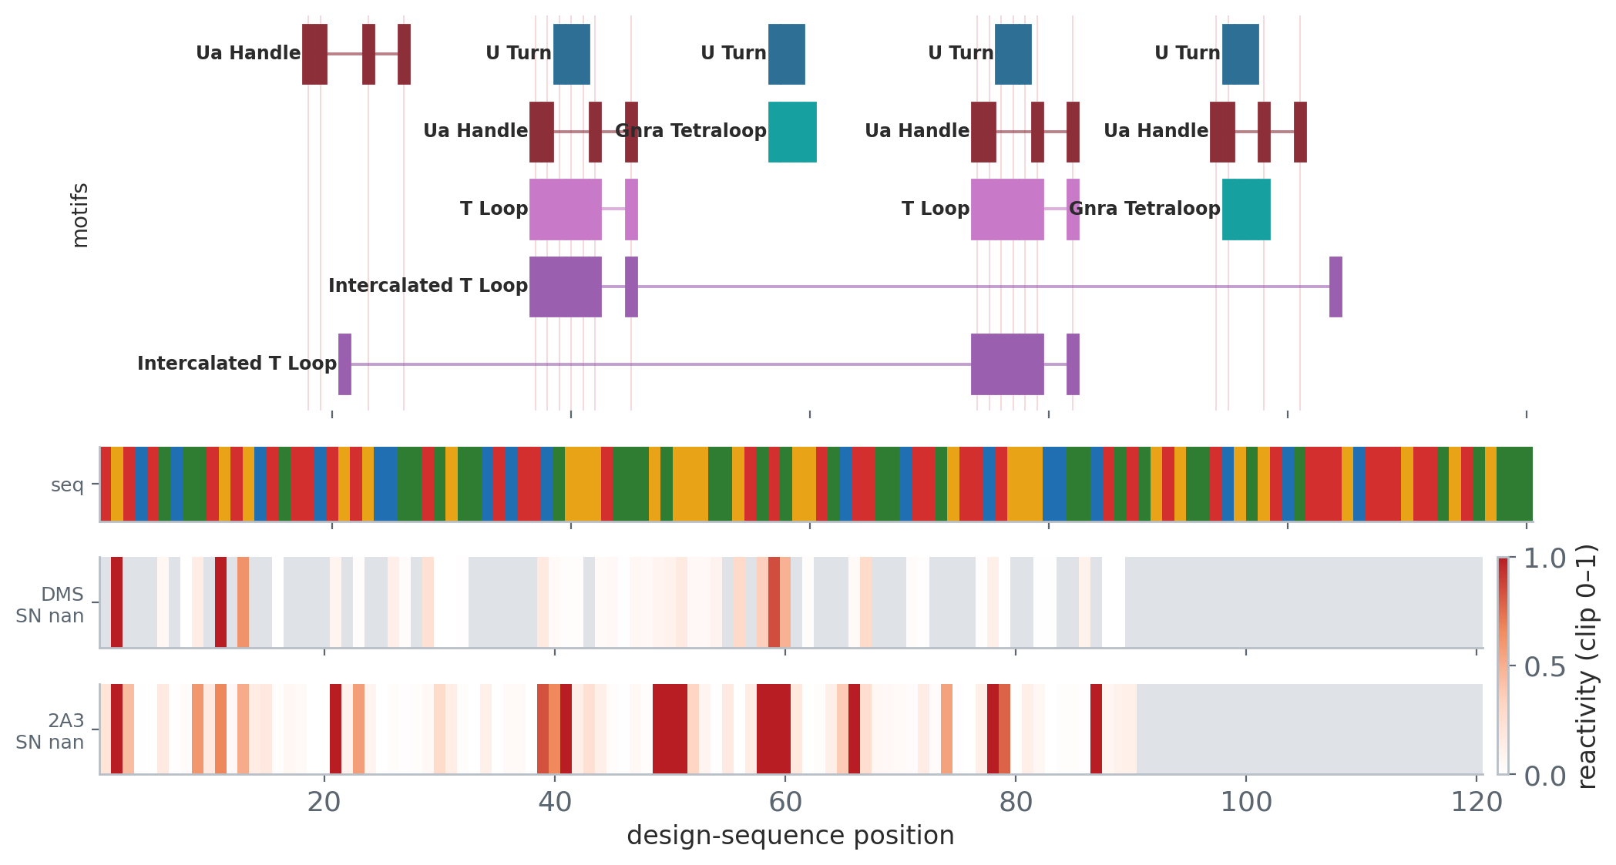
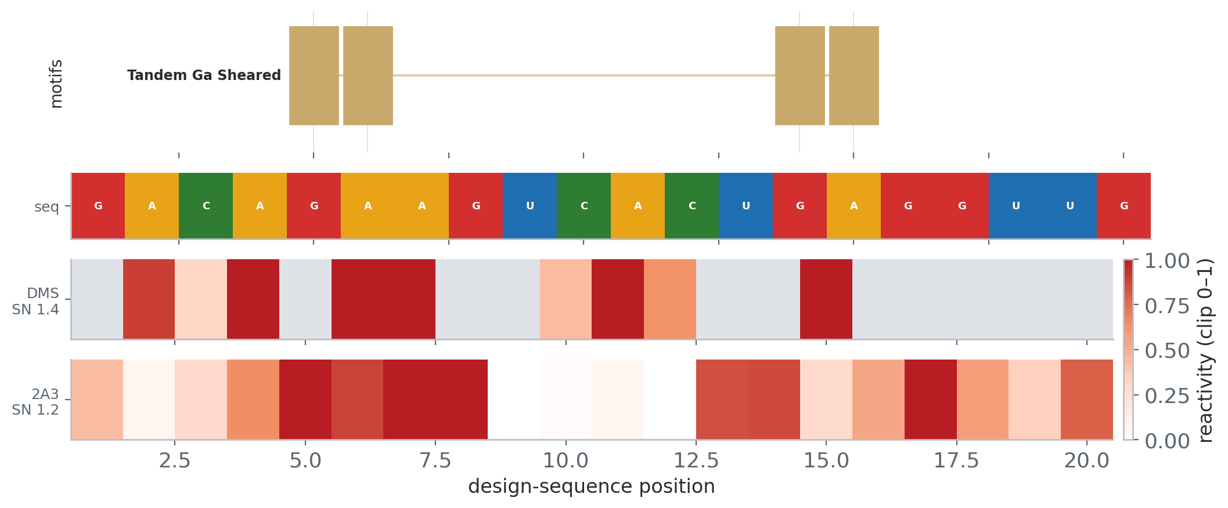
Length ≥ 40 nt
Short constructs are mostly trivial hairpins; we keep design regions ≥ 40 nt.
Drops 6,132 of 7,757 folds (79.1%) · keeps 1,625
KEEP — strong example
DROP — removed by this filter
value: 120
0771575-ribonanza2f
natural RNA — RNAcentral_130_dedup
120 nt · pLDDT 88
novelty TM1 0.421
nearest 2IHX_B — Solution Structure of the Rous Sarcoma
SHAPE agr 0.3973
compact 0.7167 · paired 0.6167 · 2 tert
value: 20
5355308-ribonanza2e
gRNAde design — target PDB 8FNF_1_m
20 nt · pLDDT 97
novelty TM1 0.437
nearest 6WLH_B — RNA complex of WT1 zinc finger transcr
SHAPE agr -0.1144
compact 0.4 · paired 0.5 · 1 tert

Slide 3
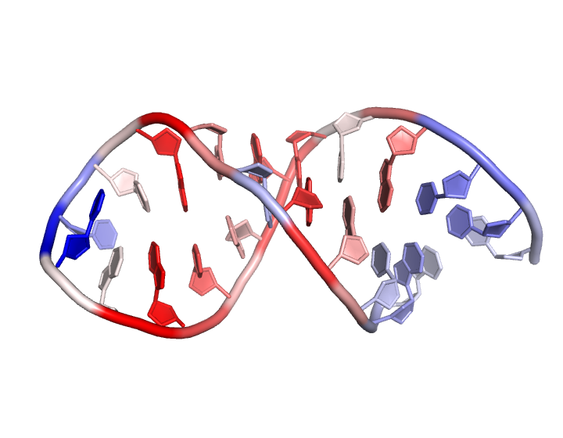
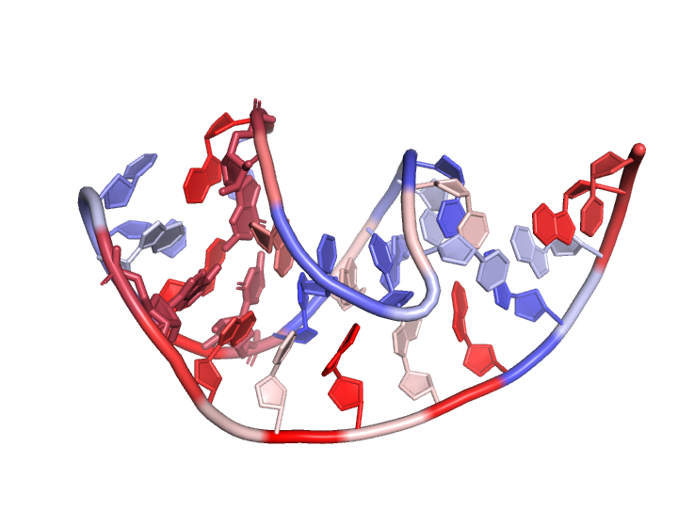
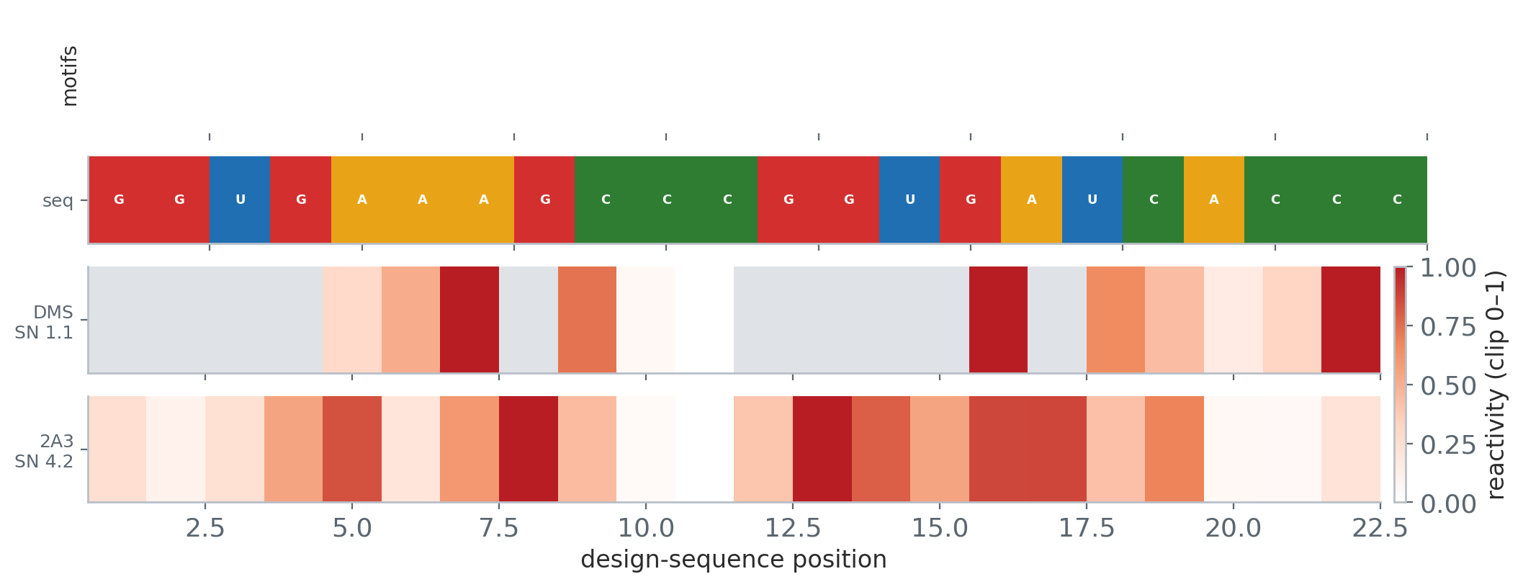
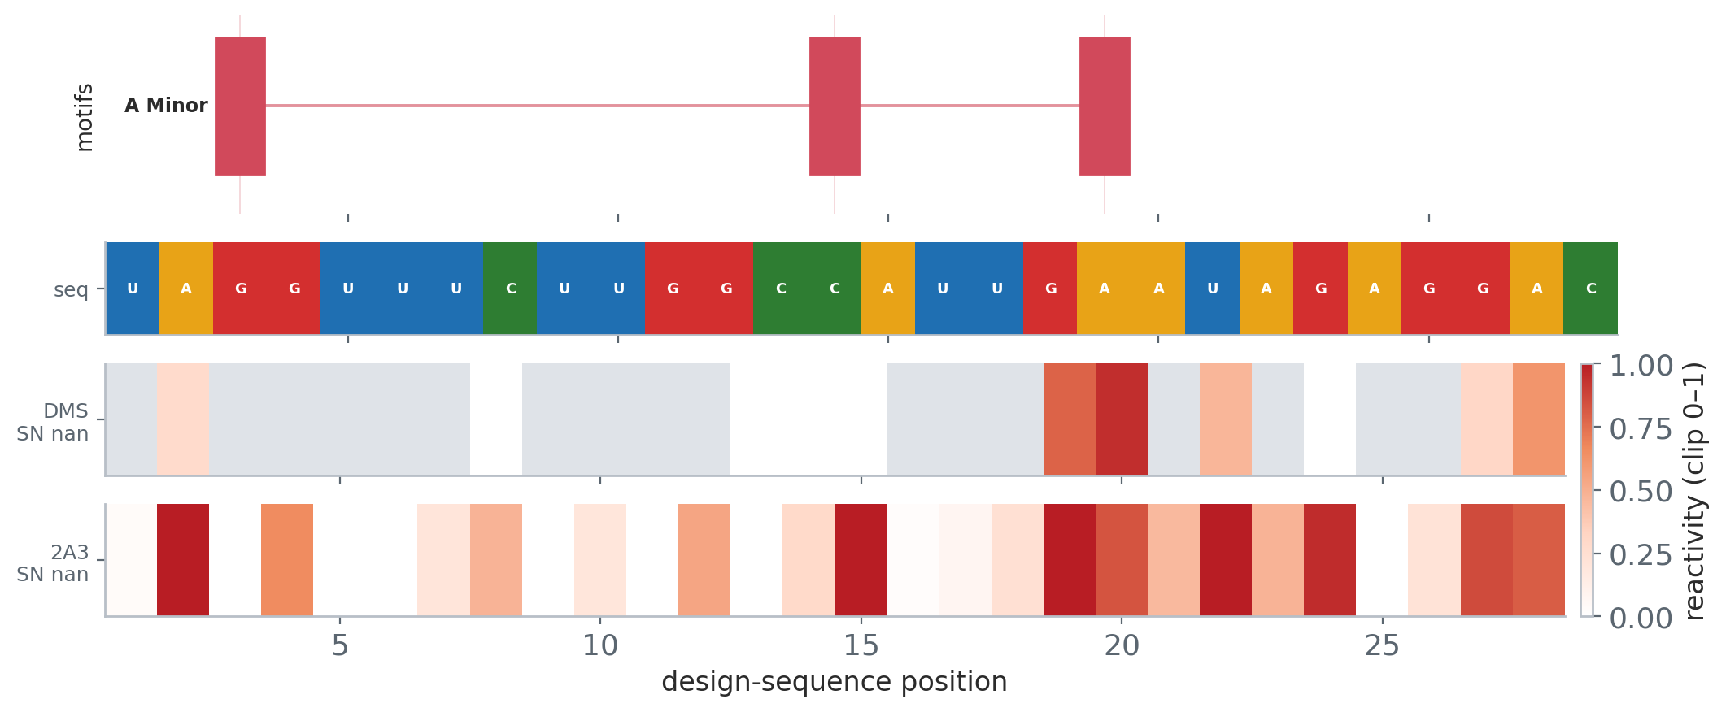
pLDDT ≥ 90
Model confidence. The pool bar is 85; tightening to 90 keeps the most confident folds.
Drops 5,915 of 7,757 folds (76.3%) · keeps 1,842
KEEP — strong example
DROP — removed by this filter
value: 97.763
5932026-ribonanza2a
gRNAde design — target PDB 1KD3_1_A-B
22 nt · pLDDT 98
novelty TM1 0.450
nearest 2L3C_B — Solution structure of ADAR2 dsRBM1 bou
SHAPE agr -0.3351
compact 0.1364 · paired 0.6364 · 0 tert
value: 85.0
1742929-ribonanza2h
natural RNA · RNAcentral100
28 nt · pLDDT 85
novelty TM1 0.373
nearest 1M82_A — SOLUTION STRUCTURE OF THE COMPLEMENTAR
SHAPE agr 0.2331
compact 0.25 · paired 0.5714 · 1 tert

Slide 4
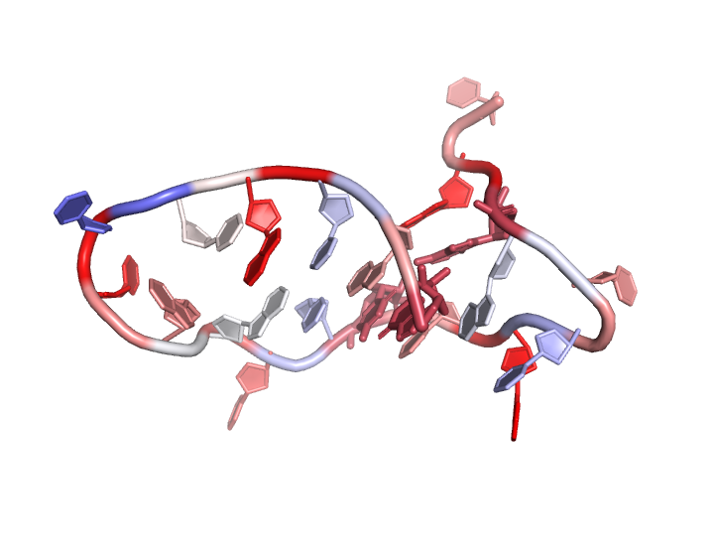
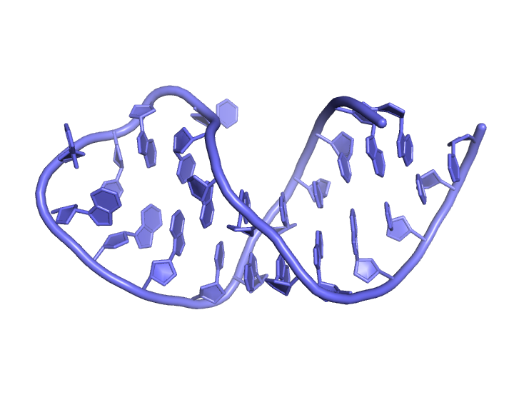
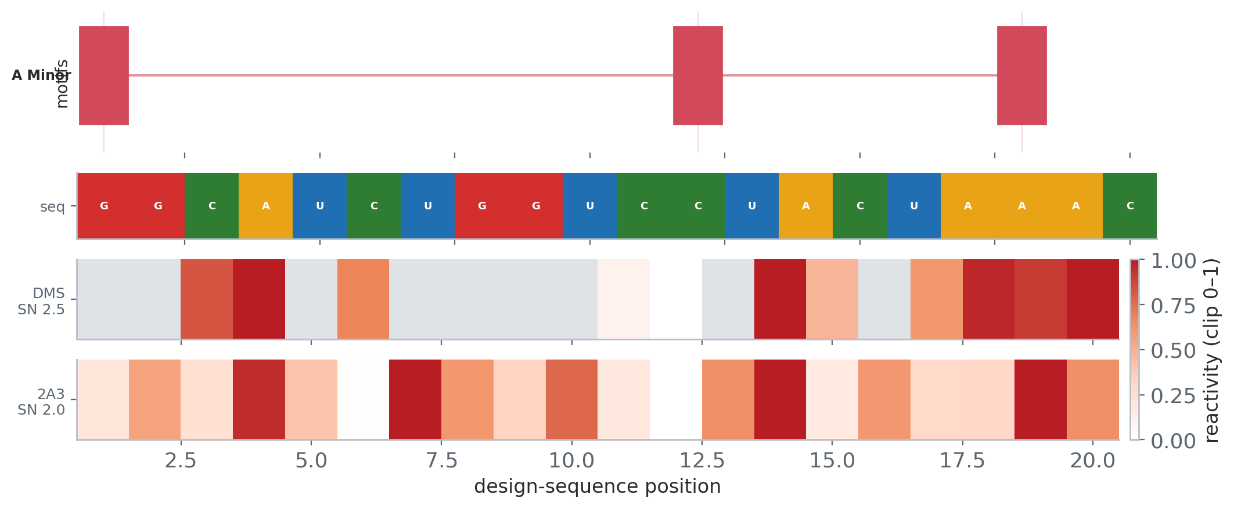
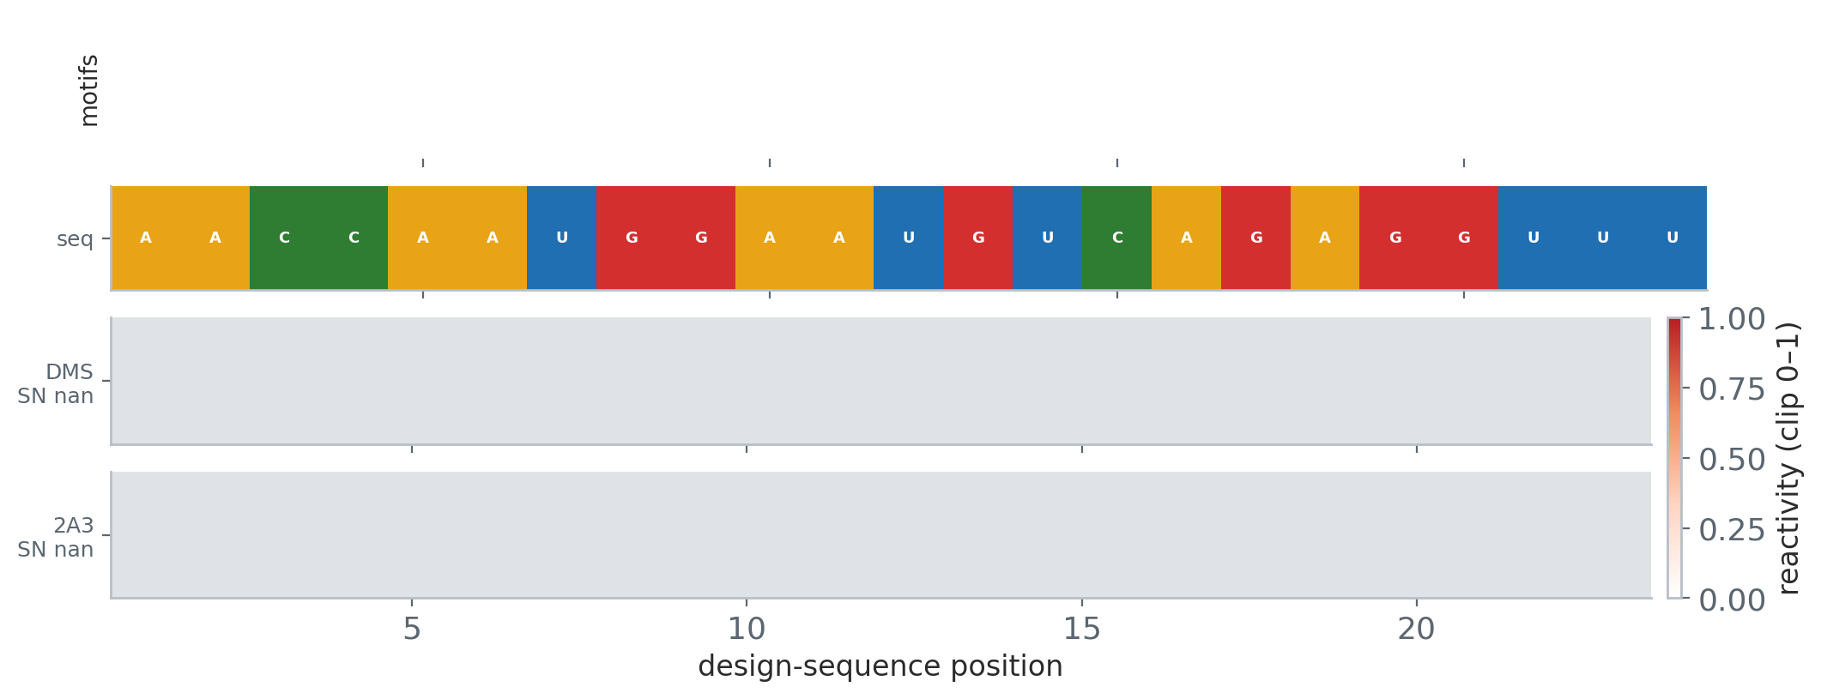
Novelty (best_tm1 ≤ 0.40)
TM1 to the closest v341 PDB-RNA chain; lower = more novel. ≤ 0.40 = clearly unlike known folds.
Drops 4,312 of 7,757 folds (55.6%) · keeps 3,445
KEEP — strong example
DROP — removed by this filter
value: 0.0
7214726-ribonanza2d
gRNAde design — target PDB 4PQU_1_T
20 nt · pLDDT 92
novelty TM1 0.000
nearest
SHAPE agr 0.5282
compact 0.3 · paired 0.3 · 1 tert
value: 0.45
3270371-ribonanza2f
natural RNA · RNAcentral_130_dedup
23 nt · pLDDT 96
novelty TM1 0.450
nearest 1RFR_A — NMR structure of the 30mer stemloop-D
SHAPE agr —
compact 0.3913 · paired 0.5217 · 0 tert

Slide 5
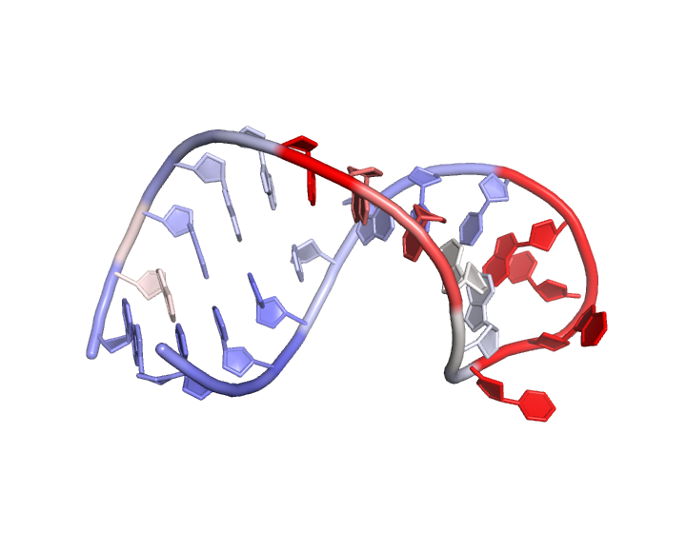
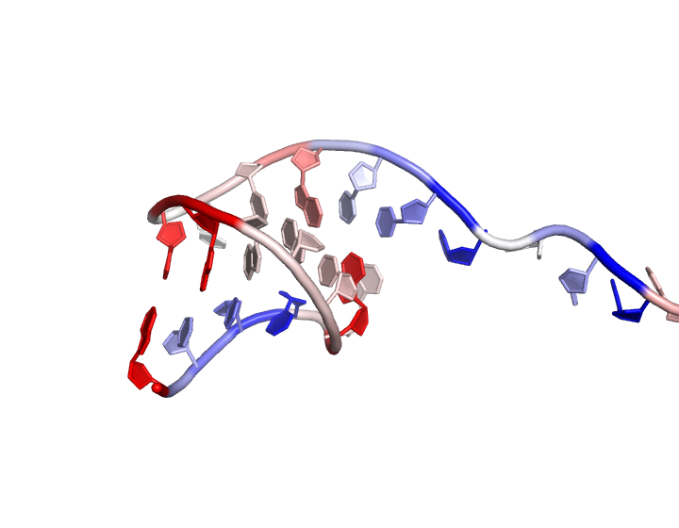
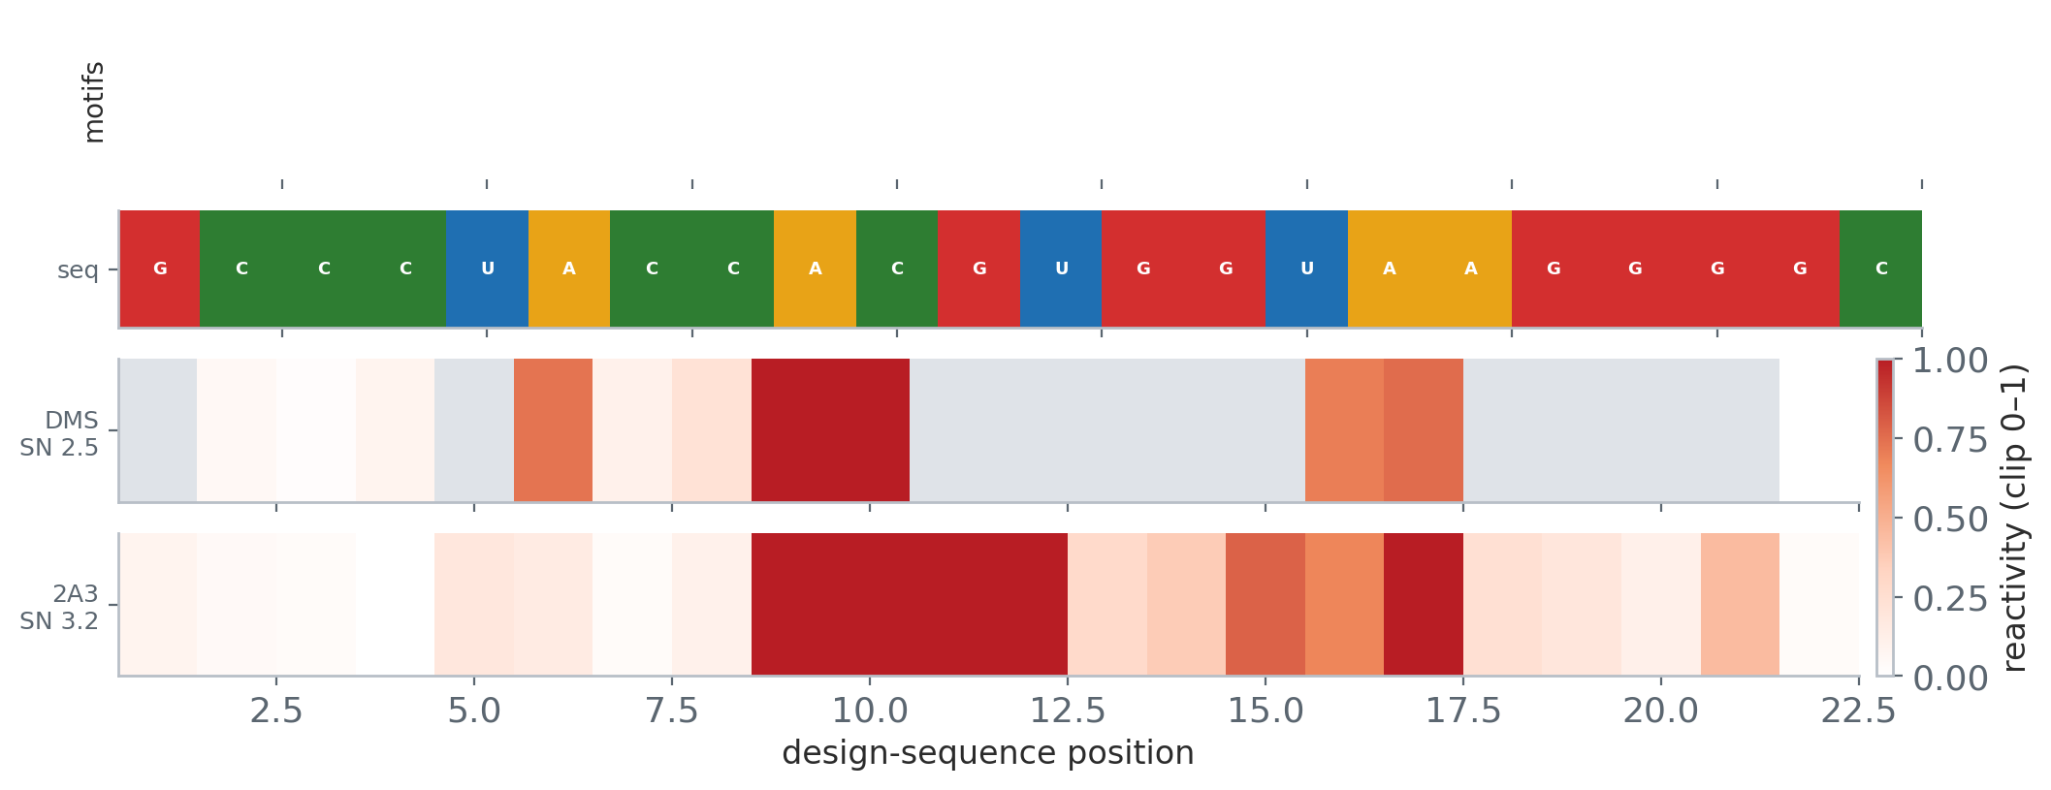
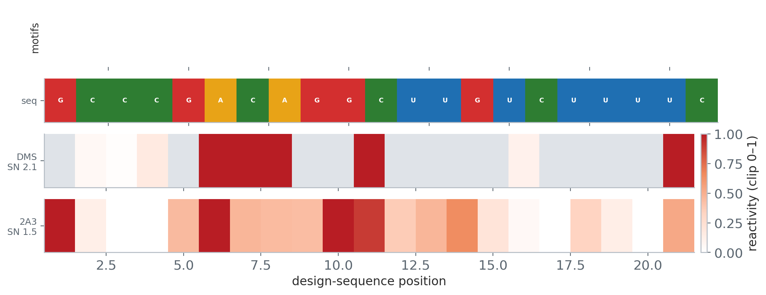
SHAPE-supported
Chemical mapping backs the fold: tertiary residues protected, or reactivity agrees with pairing.
Drops 3,235 of 7,757 folds (41.7%) · keeps 4,522
KEEP — strong example
DROP — removed by this filter
value: 0.877
6900360-ribonanza2e
gRNAde design — target PDB 3CGQ_1_B-A
22 nt · pLDDT 92
novelty TM1 0.433
nearest 2IXY_A — Solution structure of the apical stem-
SHAPE agr 0.8773
compact 0.0455 · paired 0.7273 · 0 tert
value: -0.563
4584040-ribonanza2d
gRNAde design — target PDB 6BJG_1_D
21 nt · pLDDT 87
novelty TM1 0.295
nearest 8QO5_A — Conserved Structures and Dynamics in 5
SHAPE agr -0.5632
compact 0.1905 · paired 0.6667 · 0 tert

Slide 6
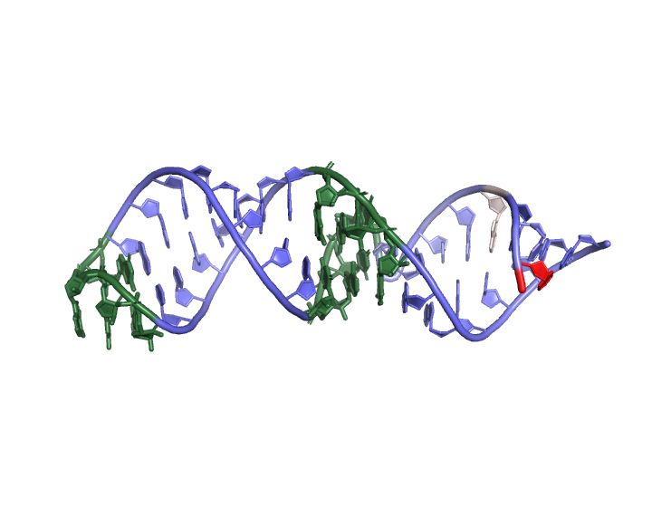
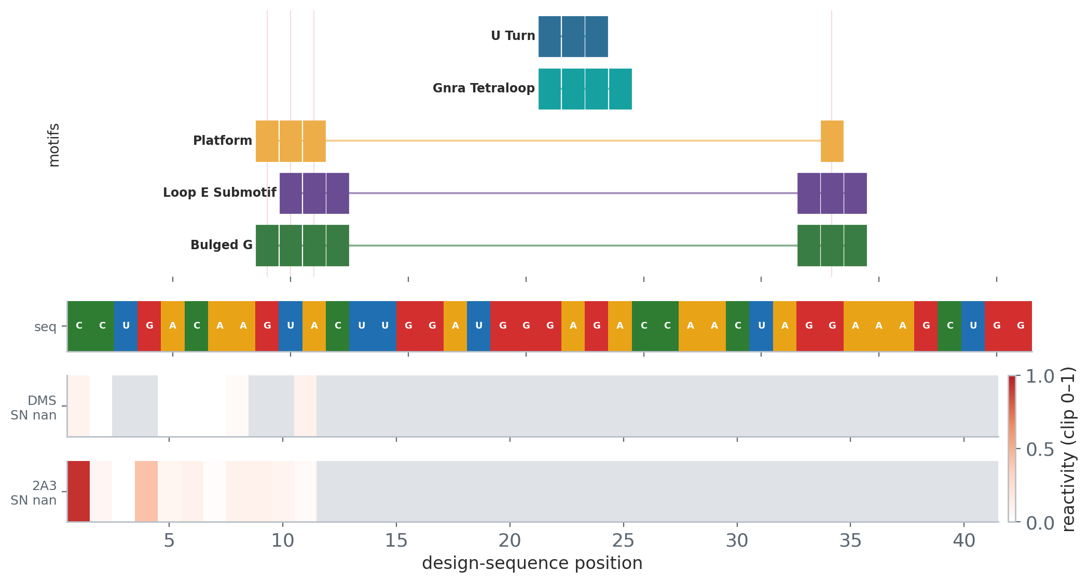
SHAPE agreement ≥ 0.2
Correlation of 2A3 reactivity with unpaired positions; + = mapping supports the predicted fold.
Drops 3,654 of 7,757 folds (47.1%) · keeps 4,103
KEEP — strong example
DROP — removed by this filter
value: 0.877
6900360-ribonanza2e
gRNAde design — target PDB 3CGQ_1_B-A
22 nt · pLDDT 92
novelty TM1 0.433
nearest 2IXY_A — Solution structure of the apical stem-
SHAPE agr 0.8773
compact 0.0455 · paired 0.7273 · 0 tert
value: -0.591
1037281-ribonanza2f
natural RNA · RNAcentral_130_dedup
41 nt · pLDDT 92
novelty TM1 0.441
nearest 1MNX_A — The Solution Structure of the Loop E R
SHAPE agr -0.5907
compact 0.439 · paired 0.4878 · 1 tert

Slide 7
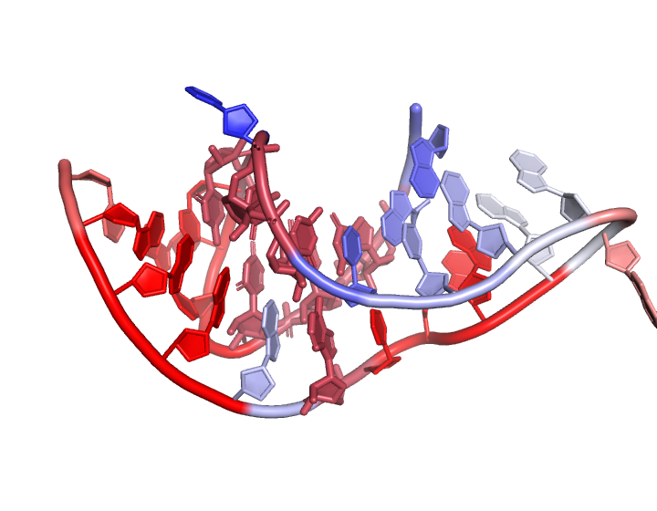
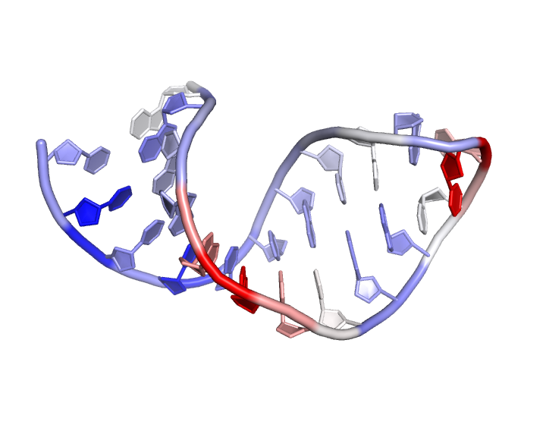
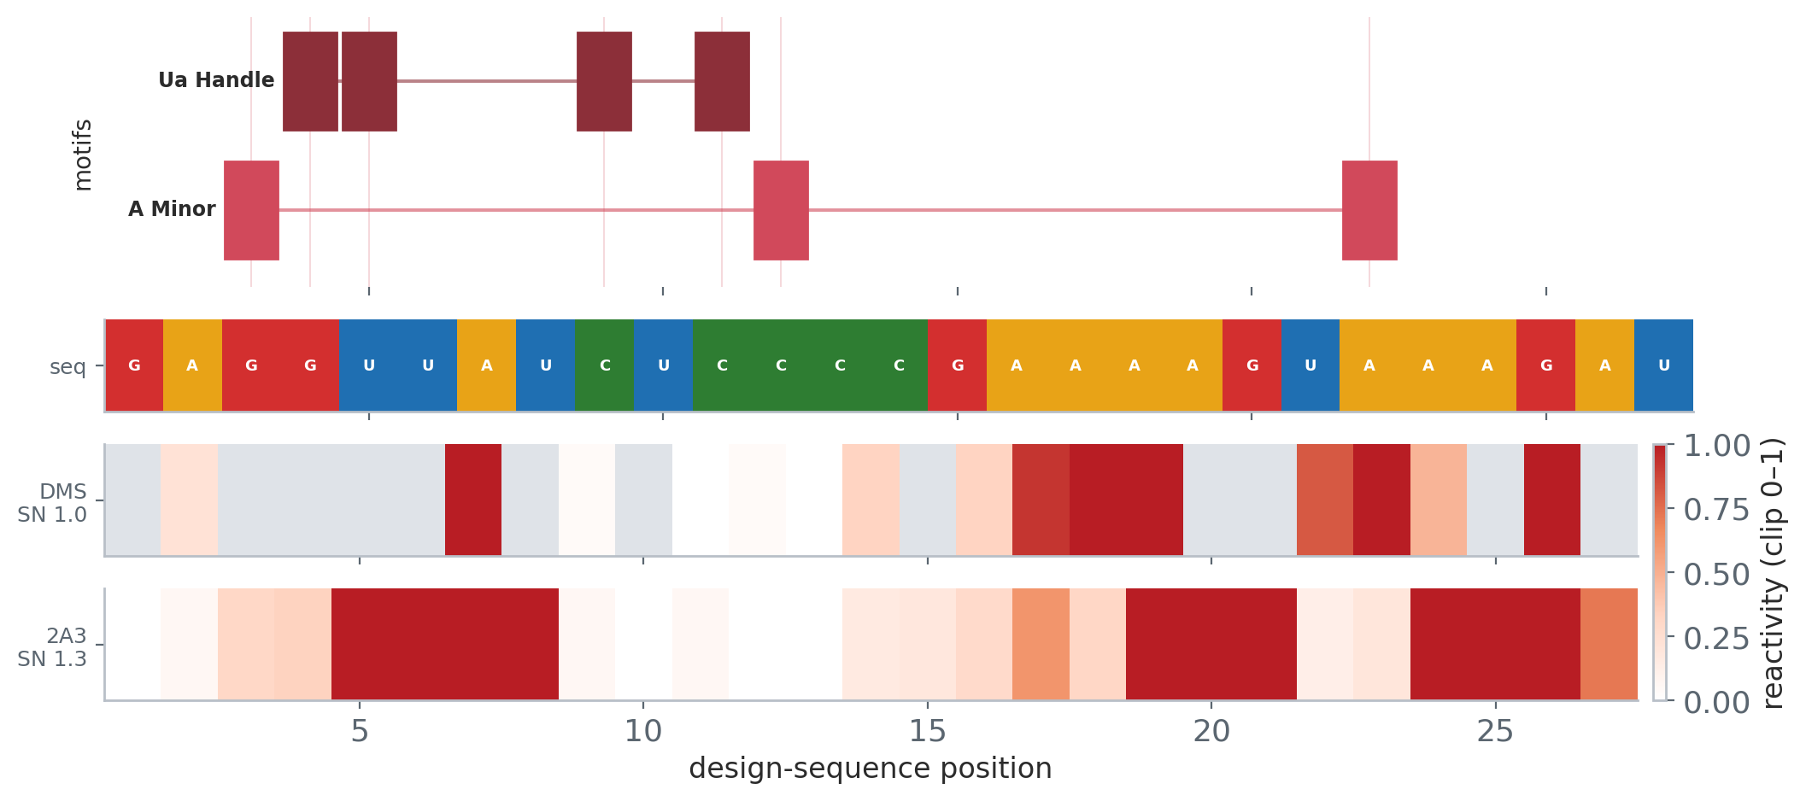
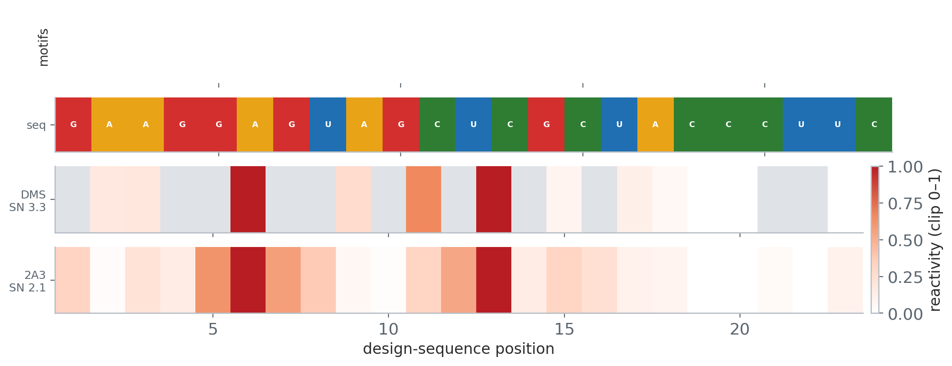
Compactness ≥ 0.4
C1′ contact ratio (globularity proxy); higher = more compact, extended chains score near 0.
Drops 4,308 of 7,757 folds (55.5%) · keeps 3,449
KEEP — strong example
DROP — removed by this filter
value: 0.852
6701814-ribonanza2c
gRNAde design — target PDB 3K1V_1_A
27 nt · pLDDT 91
novelty TM1 0.384
nearest 2AP0_A — Solution Structure of the C27A ScYLV P
SHAPE agr 0.1612
compact 0.8519 · paired 0.4444 · 2 tert
value: 0.0
5963544-ribonanza2d
gRNAde design — target PDB 2PJP_1_B
23 nt · pLDDT 97
novelty TM1 0.436
nearest 8QO3_A — Conserved Structures and Dynamics in 5
SHAPE agr 0.6095
compact 0.0 · paired 0.7826 · 0 tert

Slide 8
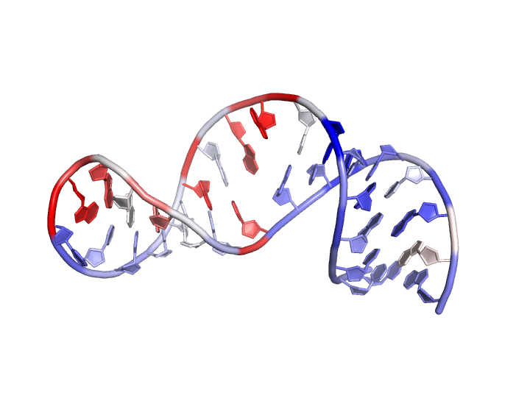
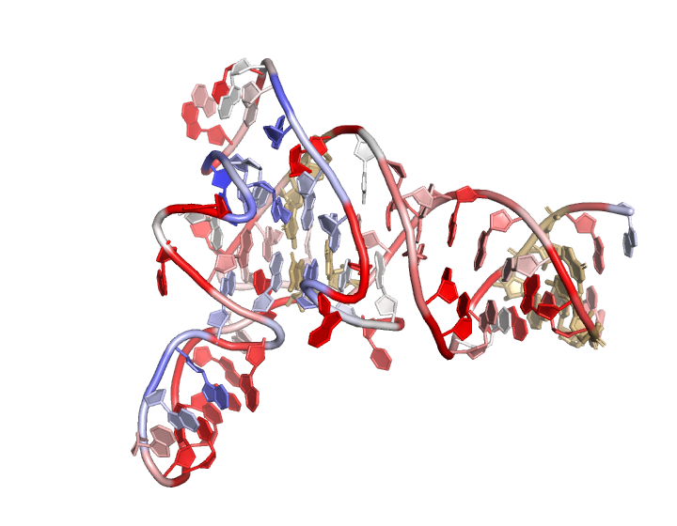
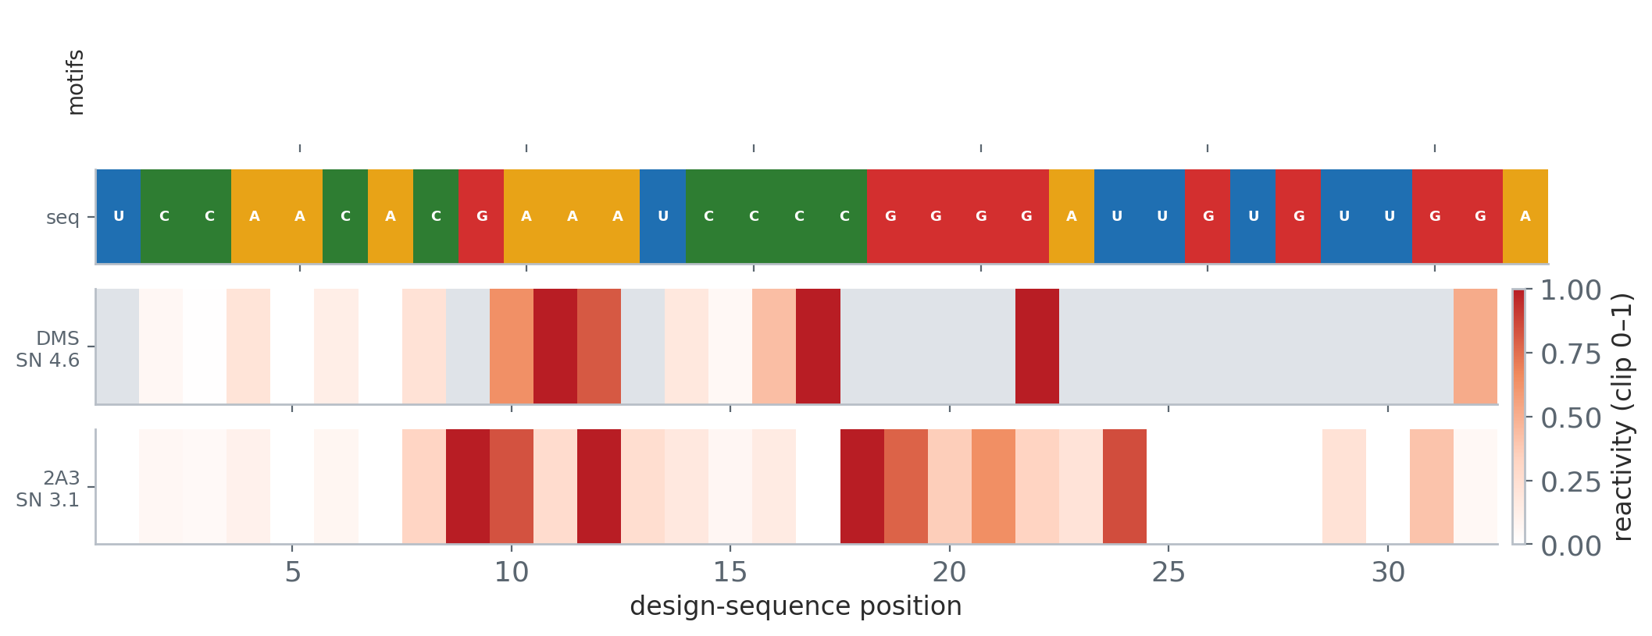
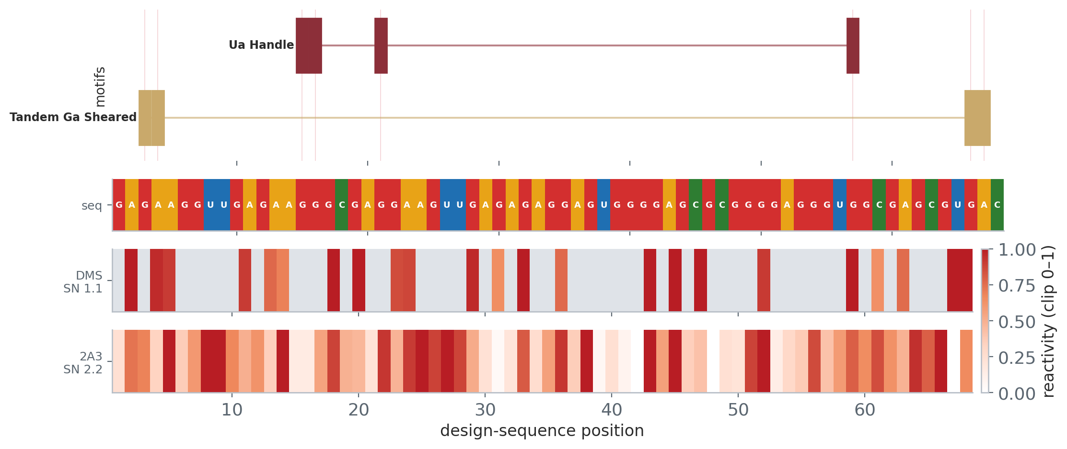
Base-paired ≥ 0.5
Fraction of paired positions in the predicted secondary structure; higher = more structured.
Drops 2,754 of 7,757 folds (35.5%) · keeps 5,003
KEEP — strong example
DROP — removed by this filter
value: 0.875
4427832-ribonanza2d
gRNAde design — target PDB 7KI3_1_F-E
32 nt · pLDDT 87
novelty TM1 0.428
nearest 2L3J_B — The solution structure of the ADAR2 ds
SHAPE agr 0.5364
compact 0.3125 · paired 0.875 · 0 tert
value: 0.118
3287527-ribonanza2b
gRNAde design — target PDB 7UWS_1_H
68 nt · pLDDT 85
novelty TM1 0.432
nearest 6VVJ_A — Cap1G-TPUA
SHAPE agr -0.116
compact 0.3824 · paired 0.1176 · 2 tert

Slide 9
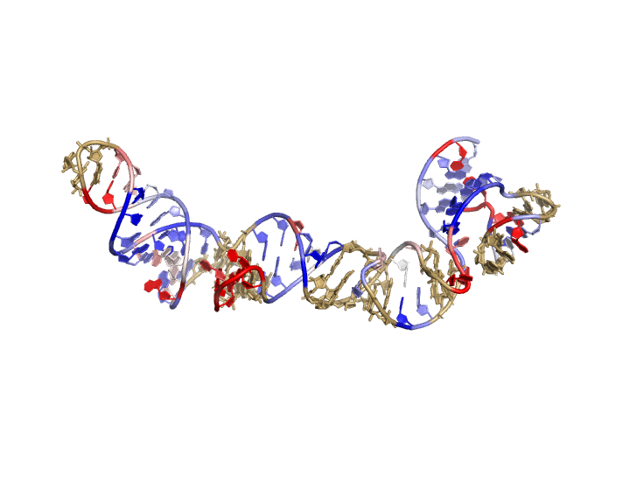
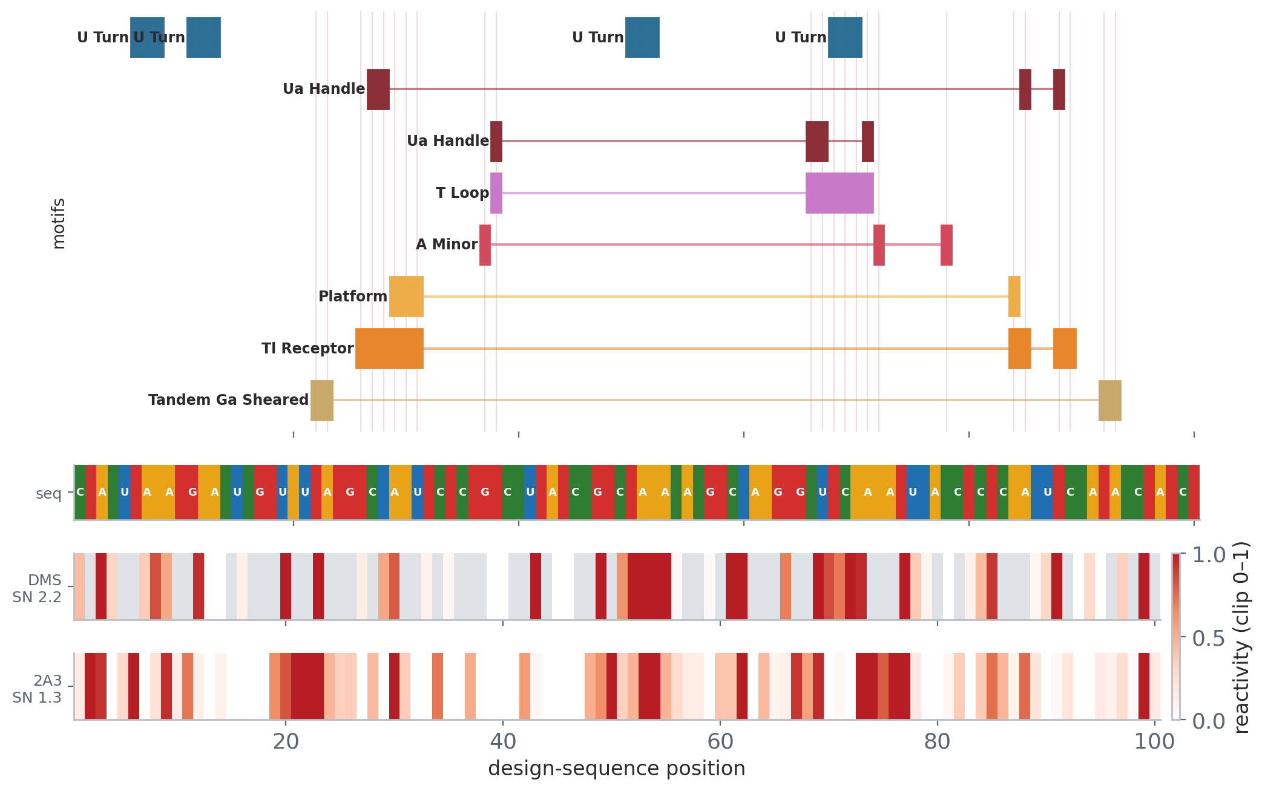
≥ 1 tertiary motif
Carries a Rosetta tertiary motif (A-minor, TL-receptor, T-loop, …) — a real 3D interaction.
Drops 4,251 of 7,757 folds (54.8%) · keeps 3,506
KEEP — strong example
DROP — removed by this filter
value: 6
2570713-ribonanza2d
UW design AK_002872
100 nt · pLDDT 85
novelty TM1 0.425
nearest 6VVJ_A — Cap1G-TPUA
SHAPE agr 0.473
compact 0.57 · paired 0.52 · 6 tert
value: 0
5932026-ribonanza2a
gRNAde design — target PDB 1KD3_1_A-B
22 nt · pLDDT 98
novelty TM1 0.450
nearest 2L3C_B — Solution structure of ADAR2 dsRBM1 bou
SHAPE agr -0.3351
compact 0.1364 · paired 0.6364 · 0 tert

Slide 10
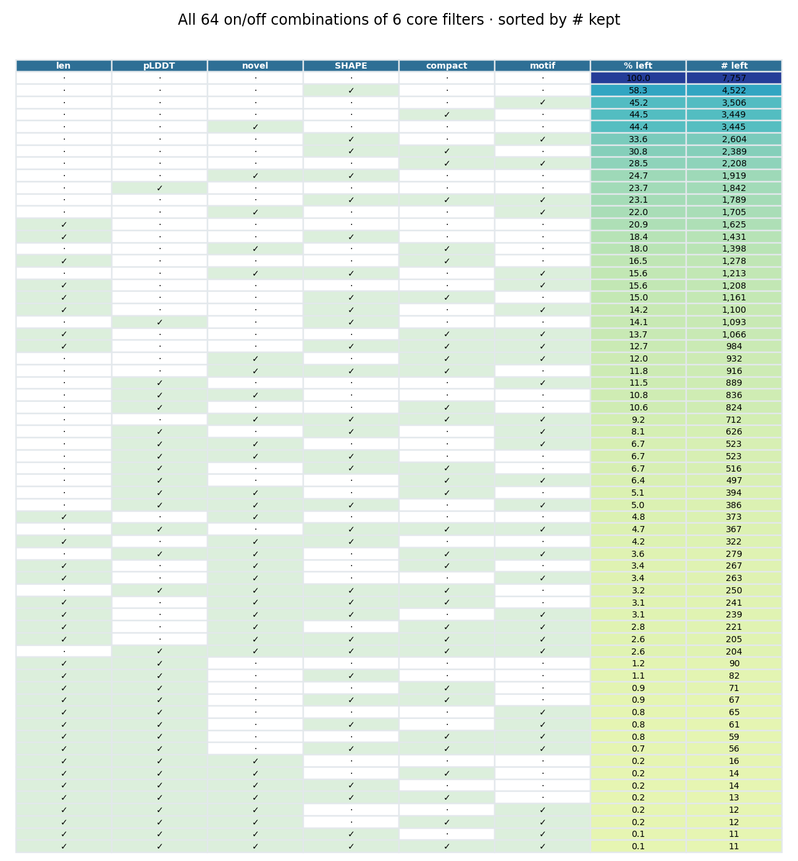
Filter combinations — what survives
How to read
• Each row = one on/off combination of the 6 core filters (✓ = applied).
• All 64 combinations; top row = no filters (all 7,757).
• “% left” / “# left” = folds passing every applied filter (AND).
• Sorted by # kept — tightest combinations at the bottom.
• Filters overlap, so stacking them removes less than the sum of each alone.
• Full table (incl. all 8 filters): combinations.csv.

Slide 11
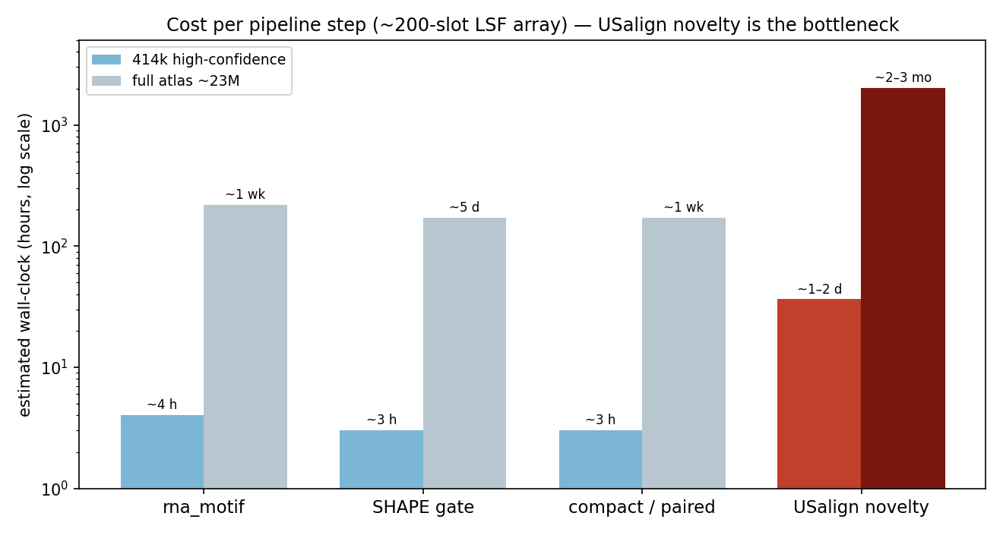
Scaling to the full predicted atlas — cost & bottleneck
Everything here is computed for the 7,757 curated folds. Running the same pipeline atlas-wide is gated by one step.
Bottleneck
USalign novelty: ~0.5–3 min/fold. Every other step is seconds or sub-second.
Feasible
414k high-confidence set: ~1–2 days on a ~200-slot LSF array.
Impractical
Full ~23M atlas: novelty alone is ~2–3 months on a 200-slot array — and most are low-confidence. Even the cheap steps become week-scale.
Recommended
Run the full pipeline over the 414k strict index; skip novelty on the low-confidence rest (or throw far more slots at it).

Slide 12
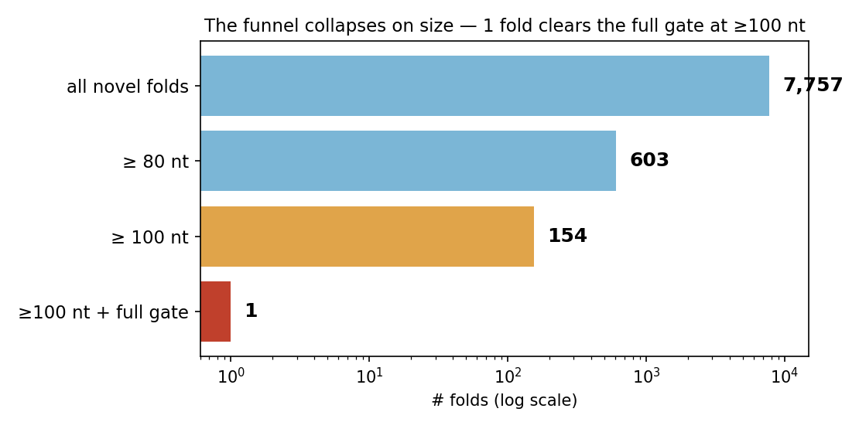
Target selection collapses on size
The hard reality
• Un-assisted single-particle cryo-EM of RNA wants ~150+ nt (~50 kDa).
• Ribonanza-2 design regions cap ~130 nt — so every candidate is small for cryo-EM.
• Of 7,757 novel folds, only 154 are ≥100 nt and just 1 clears the full quality gate.
→ The decision that sets the list:
• Accept Fab/scaffold-assisted cryo-EM? If yes → hundreds of small but striking folds open up.
• If no → we’re limited to the ~12 largest, fully de-risked folds.

Slide 13
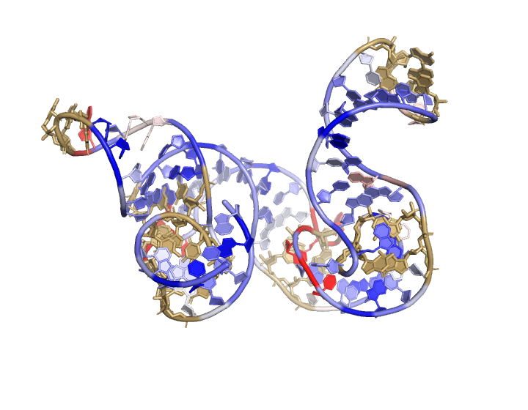
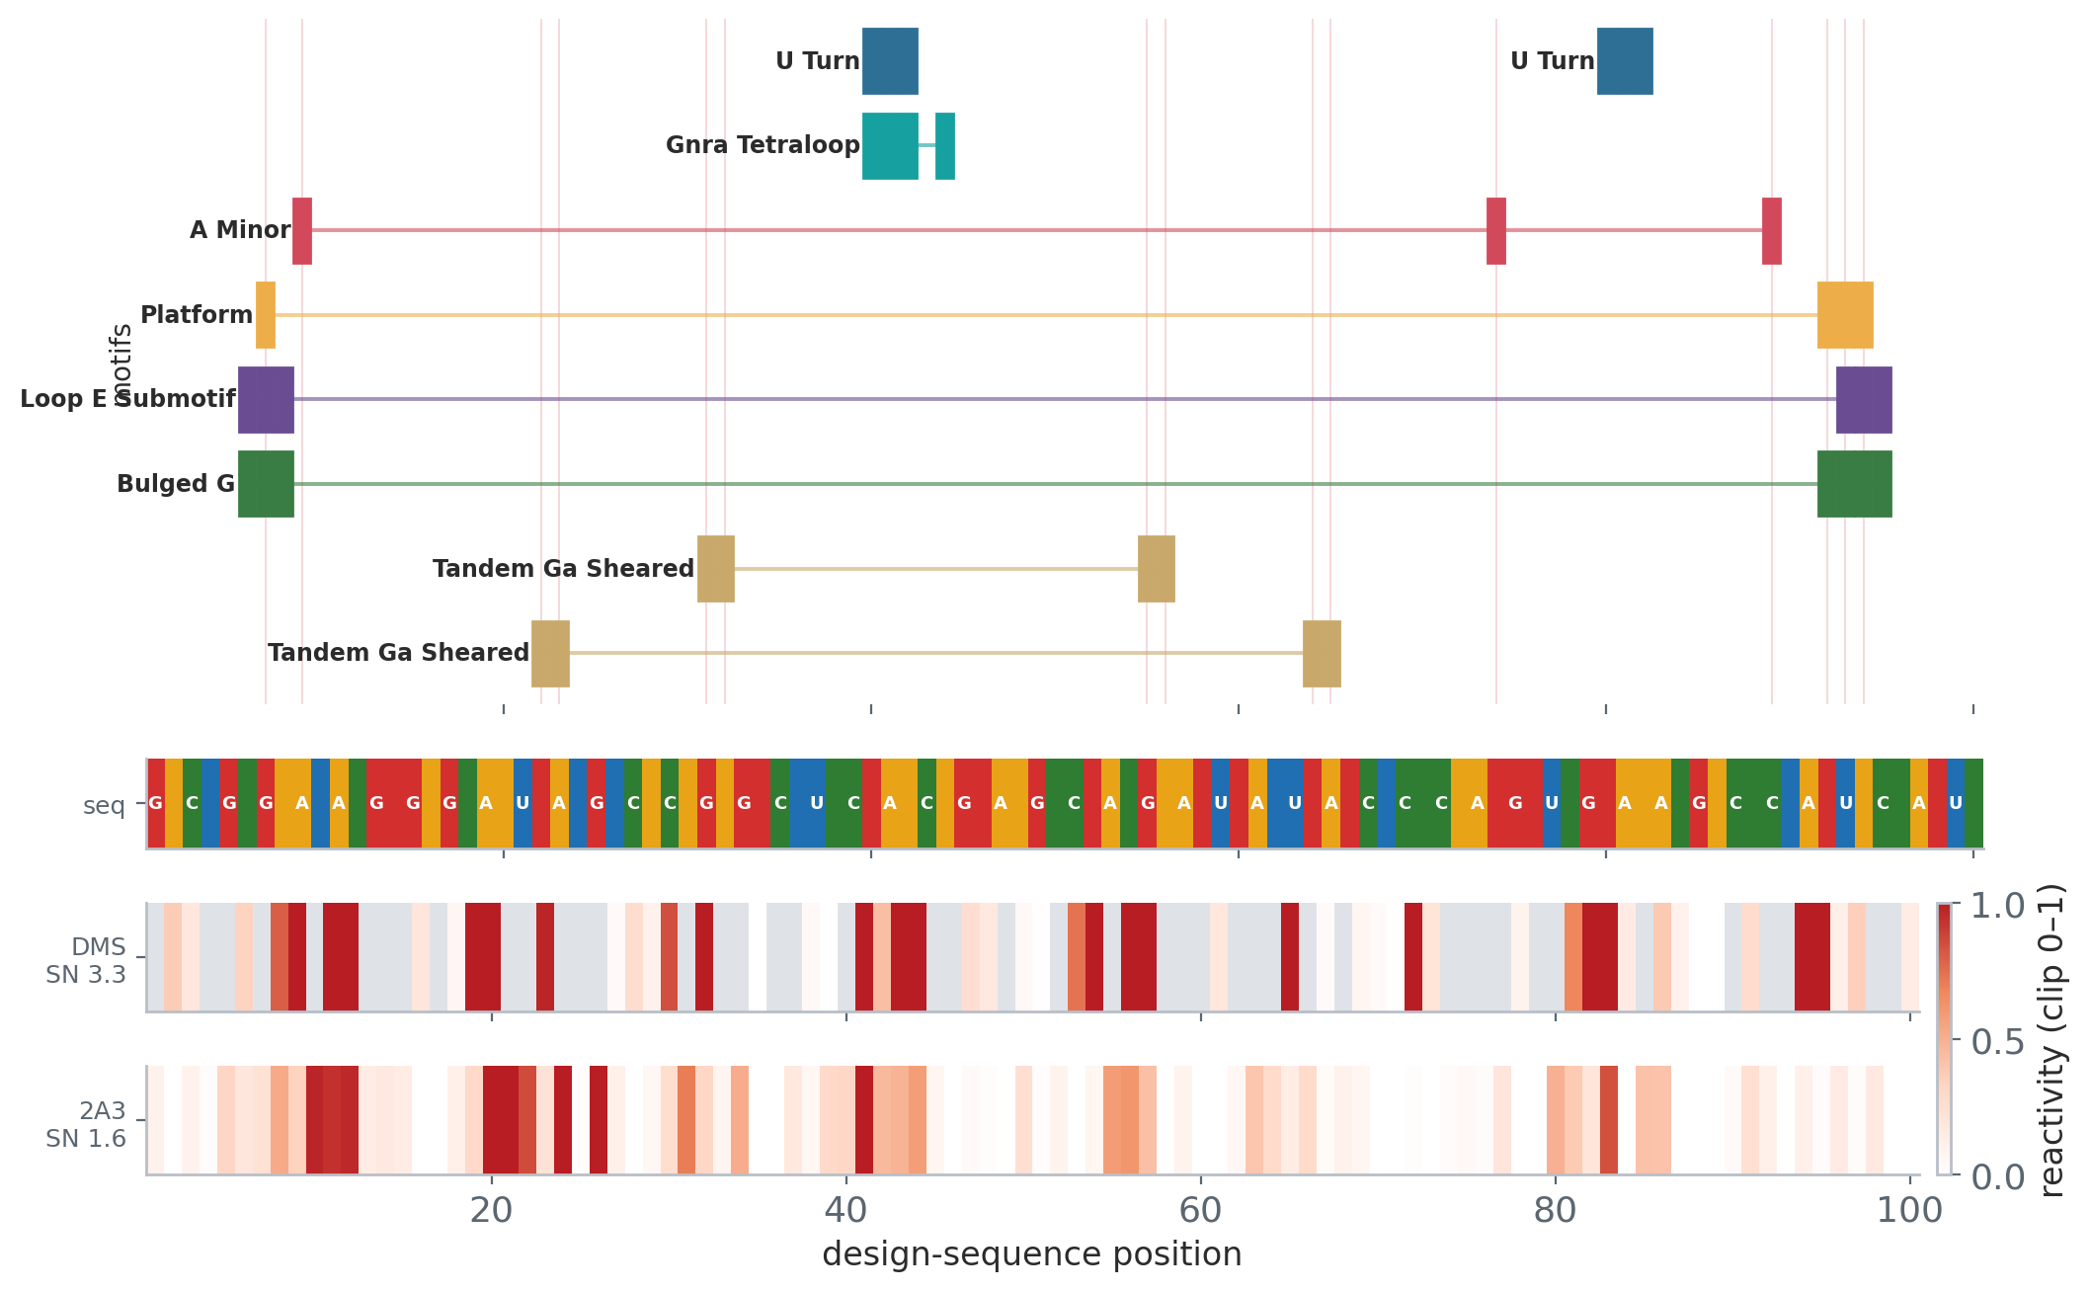
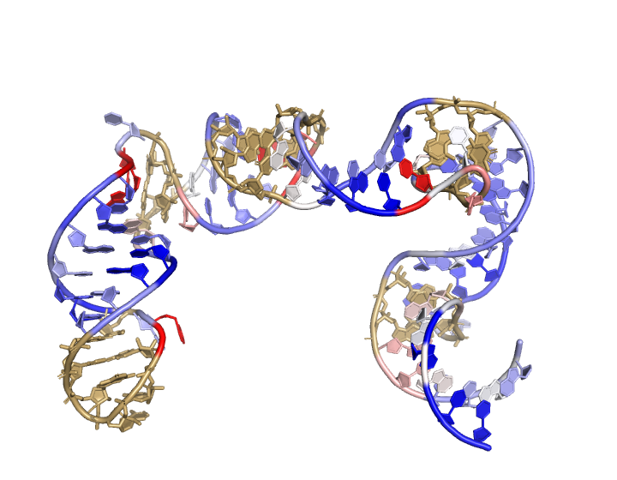
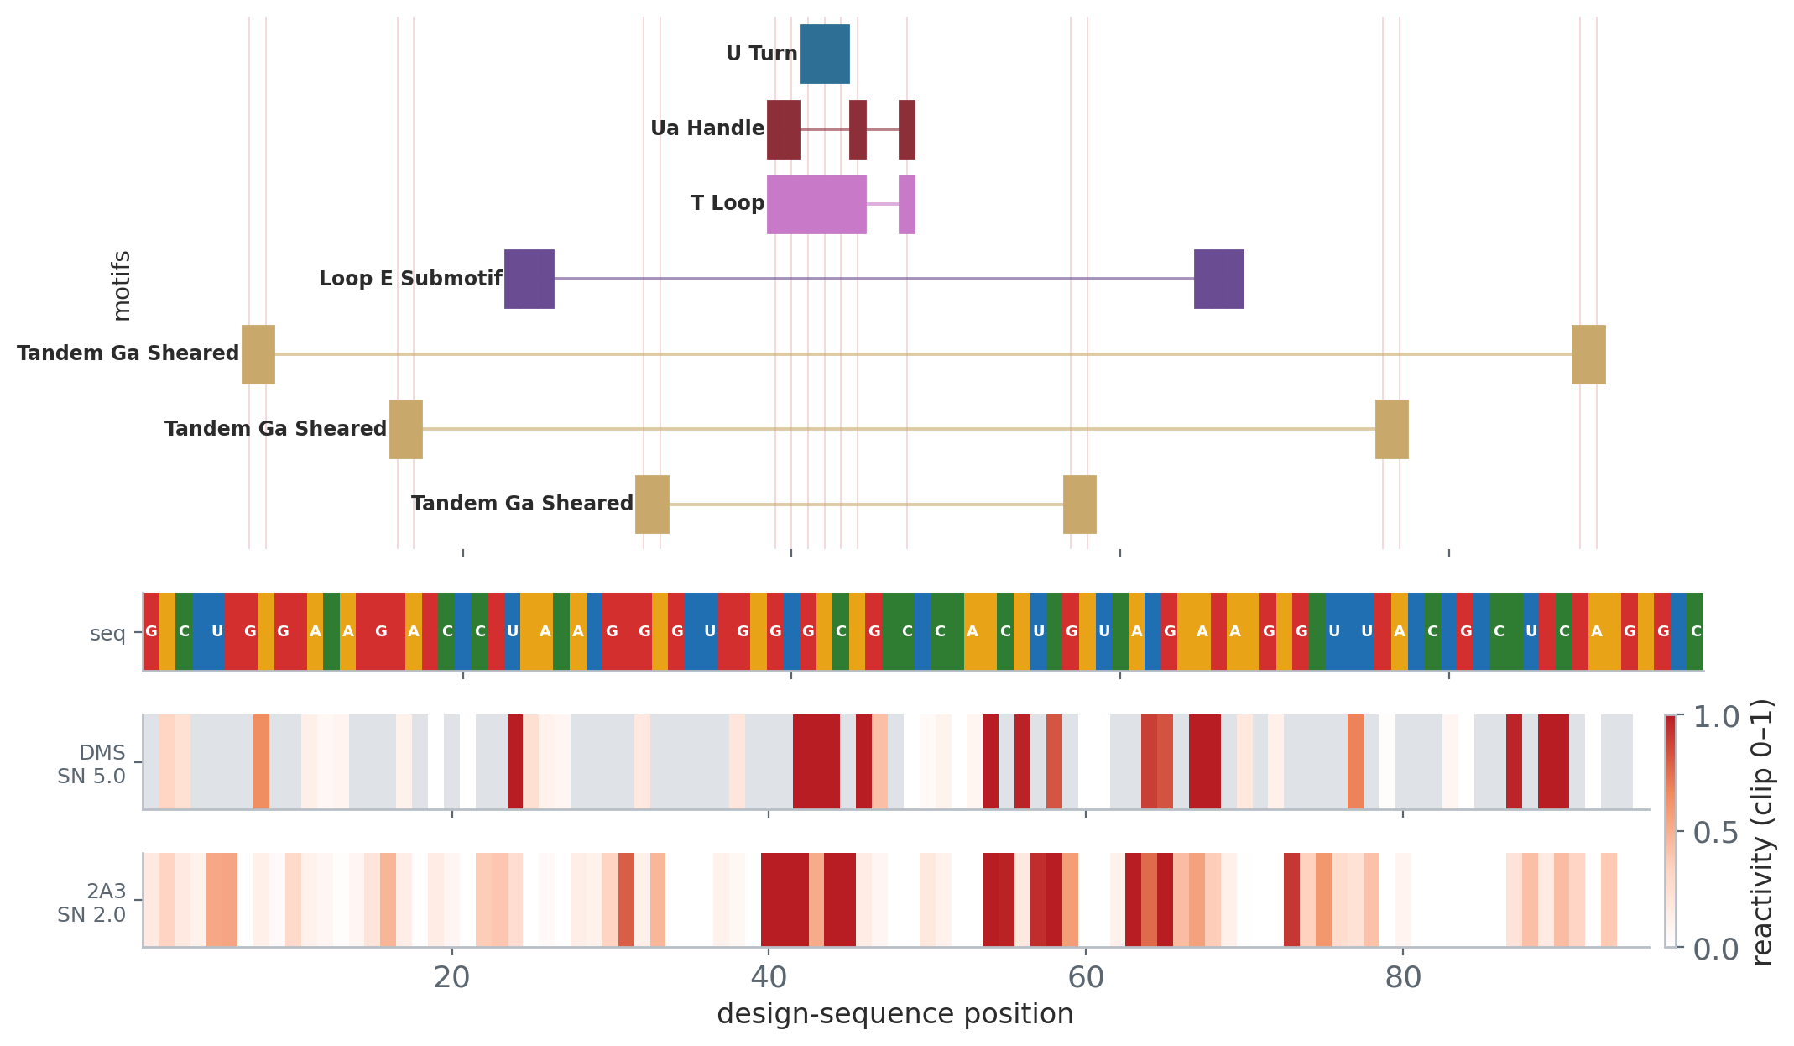
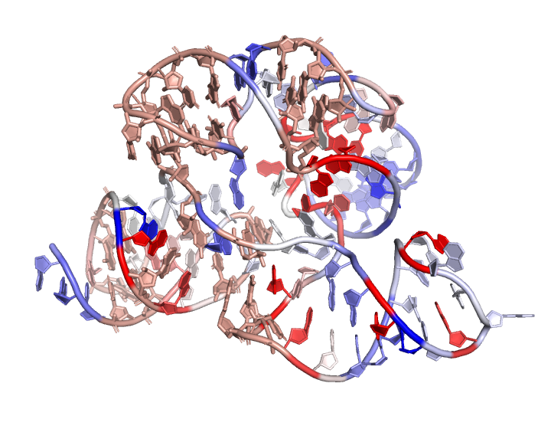
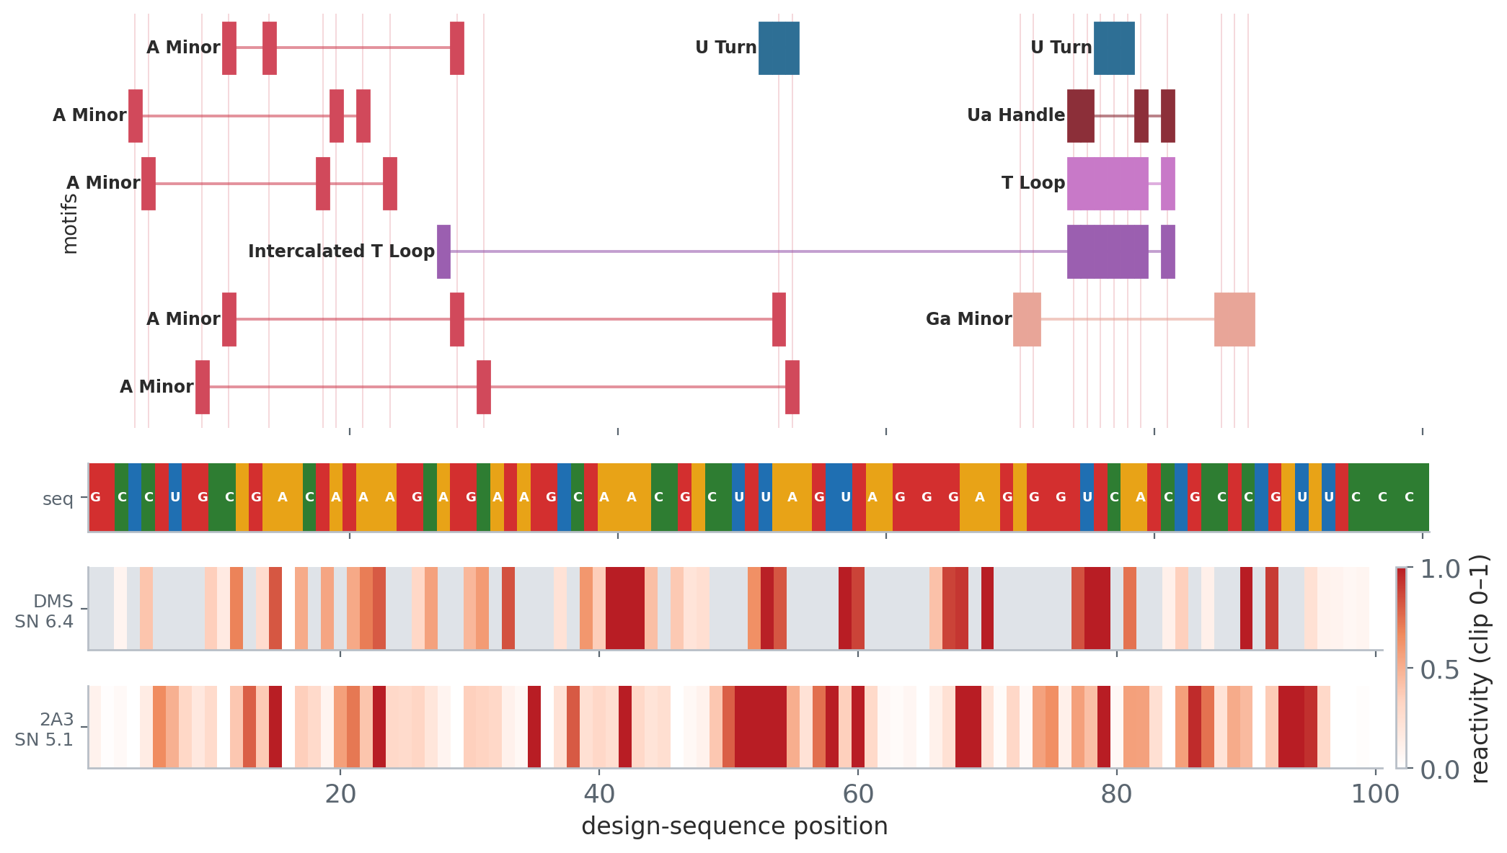
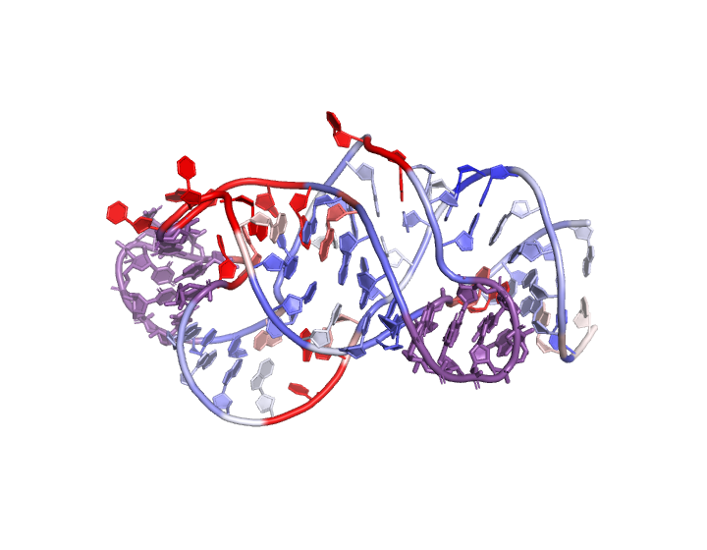
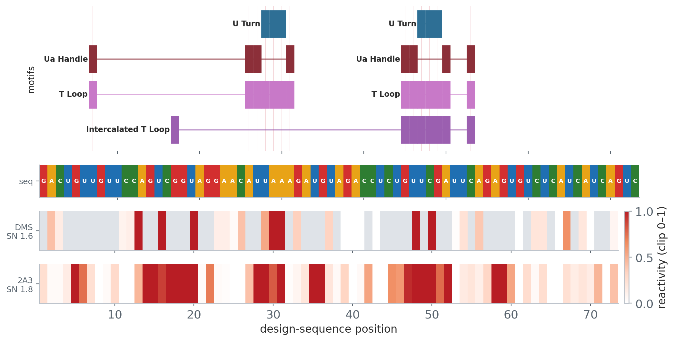
Proposed list — two routes (rank, then curate together)
Route A · Largest, fully de-risked (12)
len ≥ 80 · pLDDT ≥ 88 · SHAPE-supported · compact ≥ 0.5 · novel (TM1 ≤ 0.40) · ≥1 tertiary
Best shot at a usable map with least scaffolding; mostly RNAMake assemblies ~90–100 nt.
Route B · Most striking architecture (103)
novel · SHAPE-supported · pseudoknot · rare tertiary motif
Smaller → cryo-EM needs a chaperone/scaffold, but high scientific interest.
4146783-ribonanza2e · 100 nt
RNAMake assembly (from 4WT8, 6TH6)
tm 0.40 · agr 0.5321 · comp 0.62 · 3t
7979215-ribonanza2d · 95 nt
RNAMake assembly (from 1NJP, 5J7L)
tm 0.40 · agr 0.5029 · comp 0.6632 · 3t
3066731-ribonanza2d · 100 nt
UW design AK_002812_2098945_003
tm 0.38 · agr 0.3637 · comp 0.59 · 4t · PK
7803325-ribonanza2c · 73 nt
RNAMake assembly (from 5ZEB, 6ZJ3)
tm 0.37 · agr 0.5992 · comp 0.6027 · 2t · PK
More Route A candidates:
0900292-ribonanza2d 95 nt · RNAMake assembly (from 5MMM, 6ZVI) · tm 0.39 · agr 0.4749 · comp 0.5789 · 2t
5868329-ribonanza2d 94 nt · RNAMake assembly (from 5E81, 7ST2) · tm 0.38 · agr 0.4766 · comp 0.5319 · 1t
More Route B candidates:
4286710-ribonanza2c 24 nt · gRNAde design — target PDB 6W62_1_B · tm 0.40 · agr 0.4968 · comp 0.4167 · 3t · PK
5993836-ribonanza2e 72 nt · RNAMake assembly (from 6JXM, 6YW5) · tm 0.38 · agr 0.4076 · comp 0.6667 · 2t · PK
3D colored by 2A3 reactivity (blue protected→red reactive) + motif sticks; tracks = sequence · DMS · 2A3 · motifs. Mostly synthetic designs — large+SHAPE+novel natural pool is near-empty. Pull ~5–8/route → ~10–15 portfolio.

Slide 14
What de-risks a cryo-EM slot — and the axis we’re missing
cryo-EM is expensive — each metric buys a piece of confidence before we commit:
• Model says it folds — pLDDT + gPDE.
• Experiment says it folds (orthogonal!) — SHAPE agreement — guards against a confidently-wrong model.
• It’s a compact single particle — compactness (C1′ contact ratio) + base-paired fraction.
• It’s worth solving — novelty vs the PDB + the nearest-entry title as a sanity check.
• It’s interesting — tertiary motifs, pseudoknots.
The axis we don’t yet measure: rigidity / single dominant conformation
A floppy, multi-conformer RNA gives no usable map regardless of how it scores above. We have one prediction per fold, so we can’t see conformational spread.
Proposal: before committing, re-predict each shortlisted fold with N seeds and keep the low inter-seed-RMSD (single rigid fold) ones — cheap for a ~10–30 shortlist.

Slide 15
Open questions for the discussion
1. What size can the cryo-EM team realistically attempt — and are they open to Fab / scaffold assistance for < ~150 nt?
2. RNA-only targets, or RNA–protein complexes?
3. Natural (F–H, more reliably folded) vs synthetic (A–E, more novel) — and what mix?
4. Hard-require experimental SHAPE support, or allow model-only candidates?
5. How many targets are we scoping — ~5 hero targets, or a ~20–30 shortlist?
Proposal: bring the explorer to the meeting, tune thresholds live, and walk the top of the ranked list together.

