Slide 1
Greek Music Sentiment Analysis
Michael Zouros

Slide 2
Problem to Solve
Audio (song) classification to a specific Sentiment according to the Valence-Arousal 2D Model
Implementation in Python3 with the use of various libraries (OpenCV, Numpy, Matplotlib/Seaborn, Pydub/Librosa, Sklearn/Keras)
Github repo: https://github.com/mzouros/dl_gmsa

Slide 3
Data Collection
Approximately 10k Greek songs were collected spanning from the Interwar Period (1920-1940) and Greek Junta / Dictatorship (1967-1974), until today (2021)
The songs collected were in various forms (.mp3, .wma, .wav) and their aggregated size exceeds 120 GB
Initial Dataset: https://raw.githubusercontent.com/mzouros/dl_gmsa/main/Greek_Songs_List.txt

Slide 4
Data Preparation
Data Cleanup:
Remove any unnecessary files (.txt, .jpg, .zip, etc)
Delete songs with generic names (eg. Track01)
Delete duplicate songs
Try and narrow down live performance songs
Data Matching:
Create folders for each Singer OR Songwriter OR Lyricist OR Producer (according to Spotify's registries) and assort each song to a single specific folder (locally)
Create the same folders on Spotify, then search which of the songs in our DB is a registry on Spotify. For each matching, insert the song to its corresponding folder
1 by 1 matching each song to its Spotify counterpart. Rename each song of the dataset according to Spotify's Track name registries

Slide 5
Data Validation & Feature Extraction
Data Validation:
Deal with bad matching / misspellings
Validate Playlist names (Spotify) against Album names (locally)
Validate Playlist track names (Spotify) against Album track names (locally)
Feature Extraction:
Feature extraction via Spotify's API and export data to .csv
Some of the features extracted were Danceability, Energy, Valence, Liveness and Loudness
Song Features: https://github.com/mzouros/dl_gmsa/blob/main/Spotify_Tracks.csv

Slide 6
Data Preprocessing
Transform .mp3 and .wma files to .wav
Resample all tracks to 8k Hz (or keep their original frequency) and to monophonic (mono) sound
Create songs' sentiments classification logic, according to Arousal-Valence Model
Classify each song to a specific sentiment according to its values from the .csv file

Slide 7
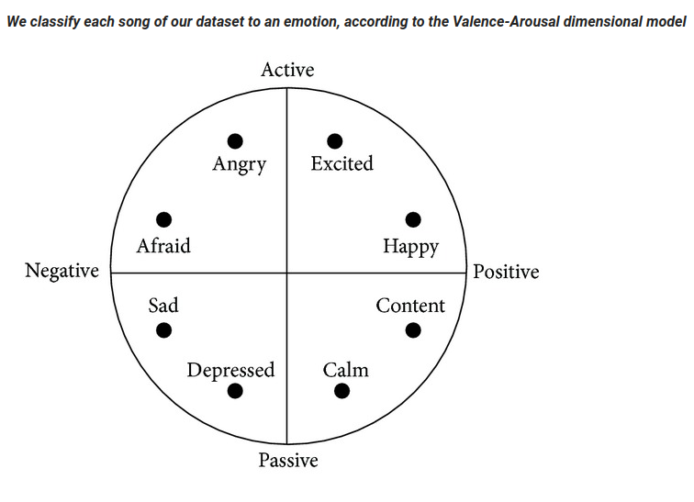
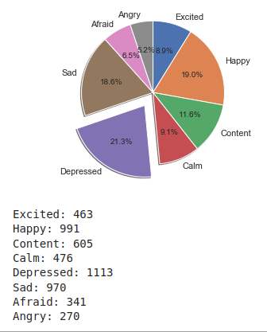
Valence-Arousal Model & Classified Songs

Slide 8
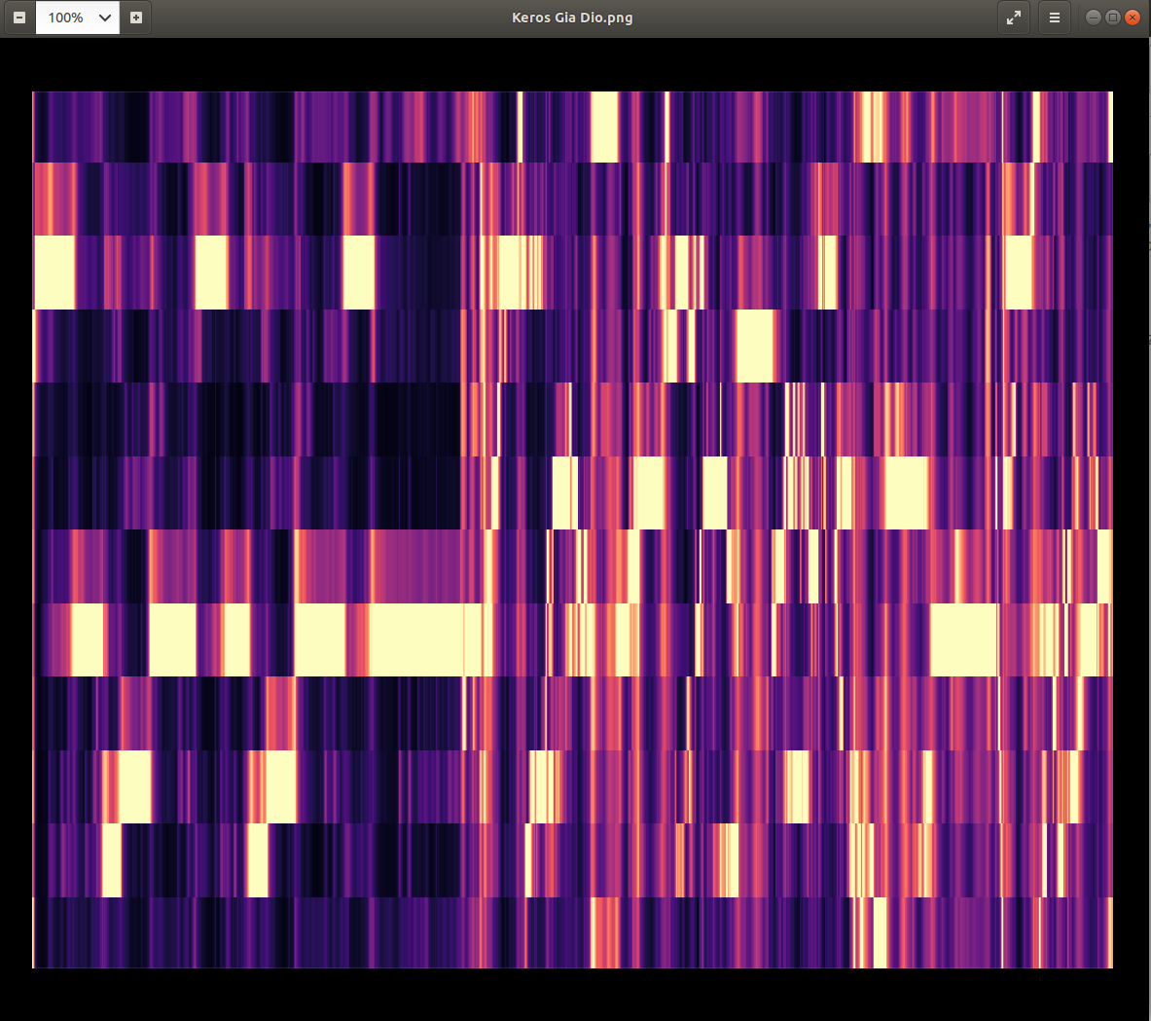
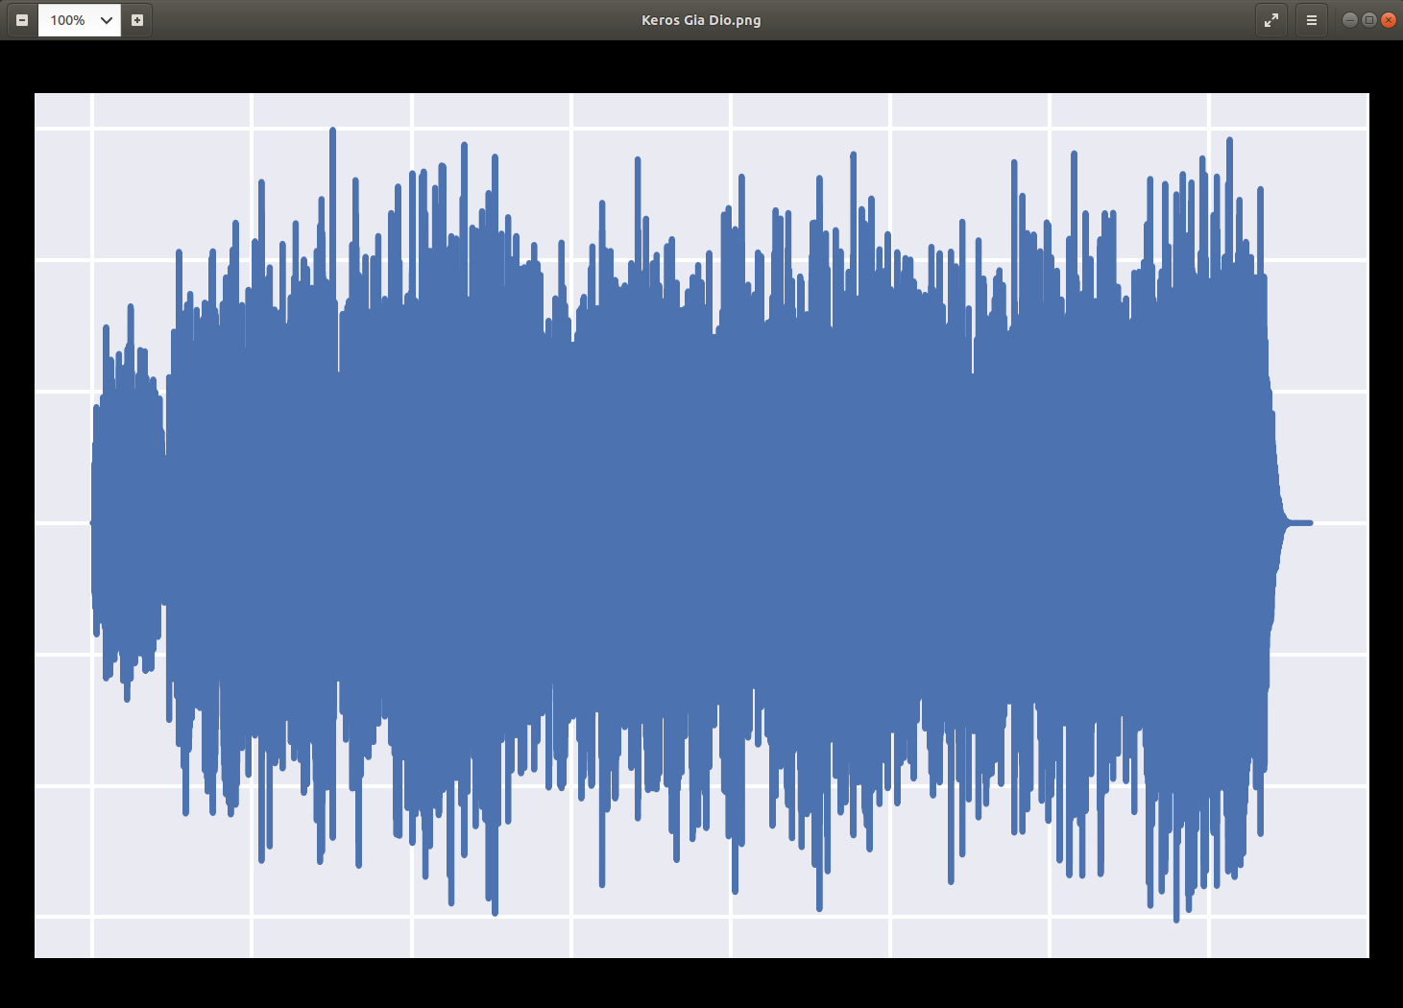
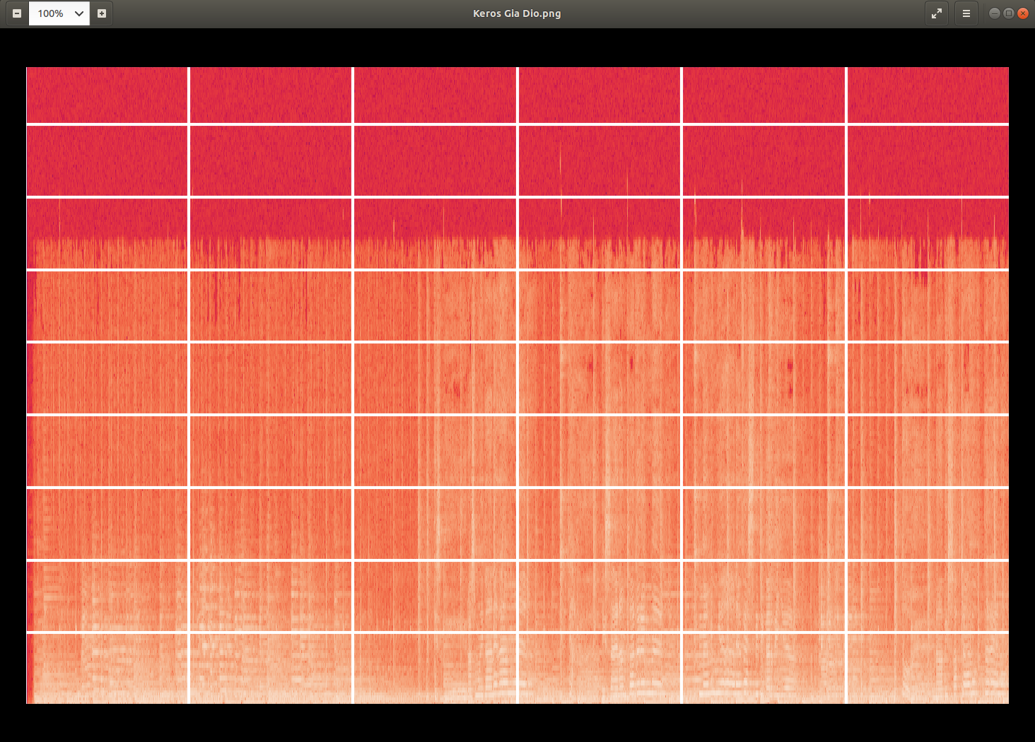
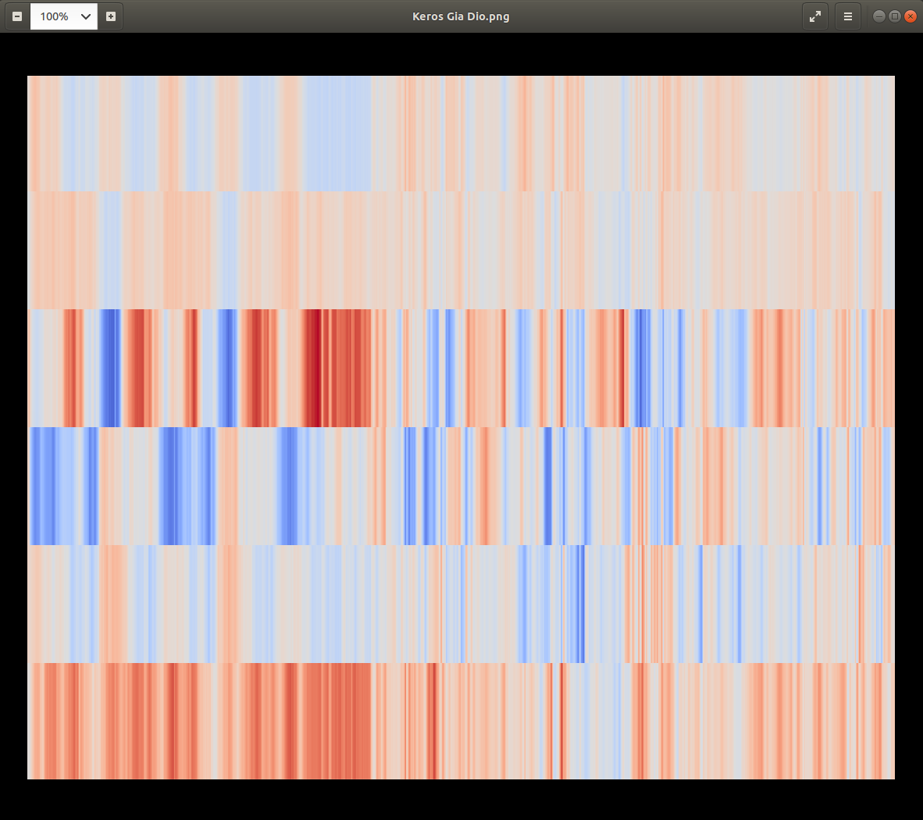
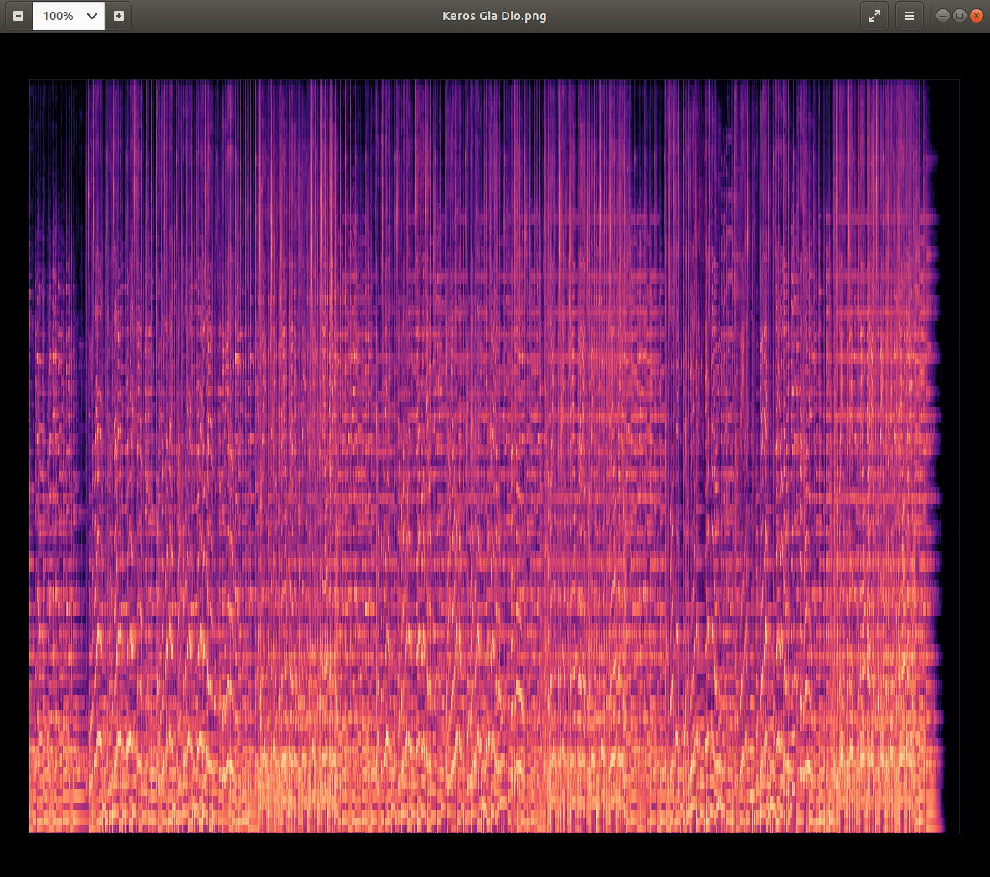
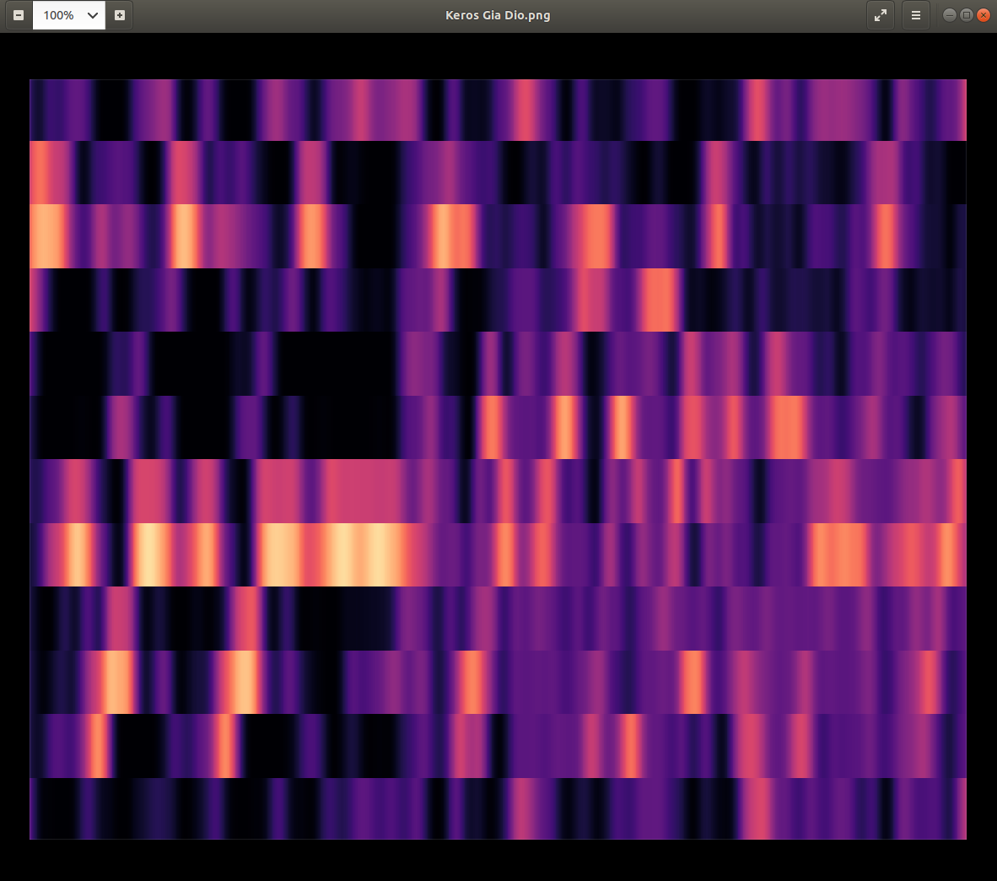
Data Exploration
Optical:
Waveforms
Spectograms
Mel Spectograms
Chromas
Tonnetz
CENS
Features:
MFCCs
STFTs
ZCRs

Slide 9
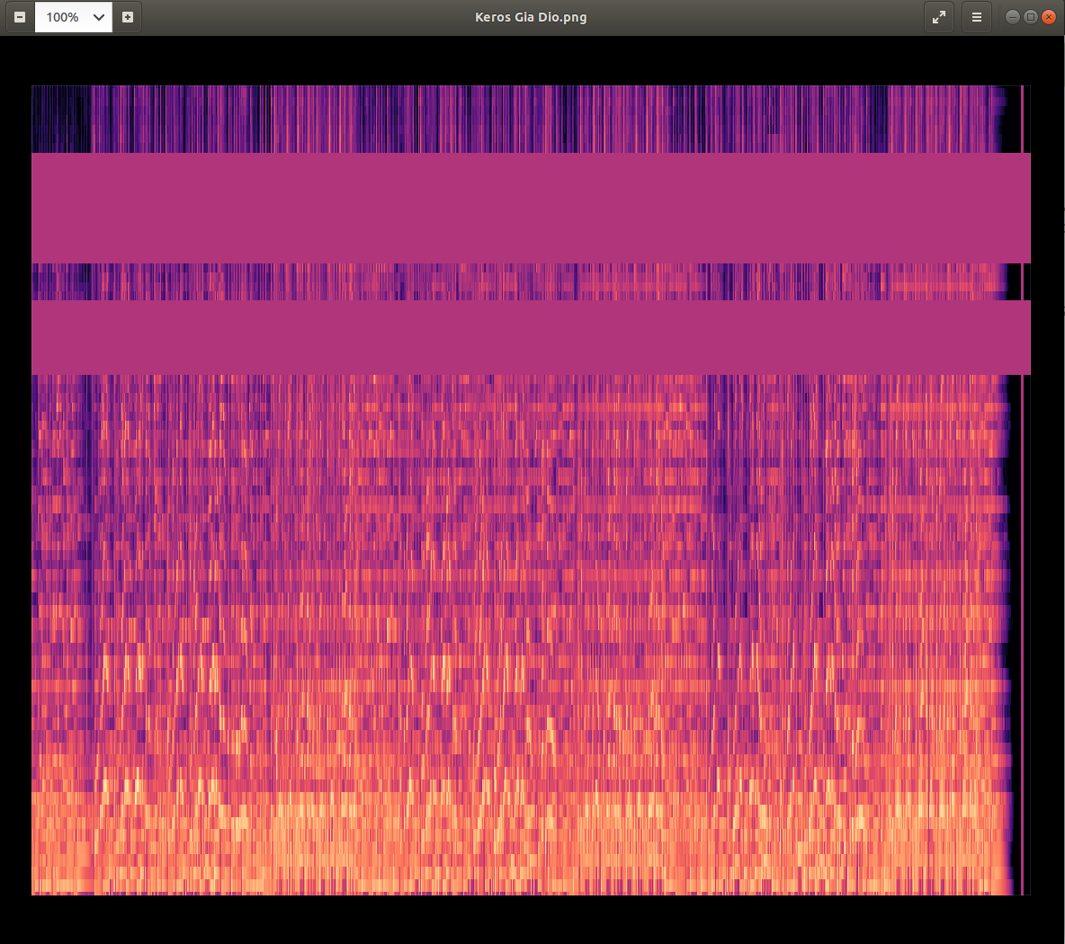
Data Revision & Augmentation
After experimenting with the initial dataset:
Consider more data (via SpecAugmentation - Frequency Mask)
Reconsider total of images per sentiment category (500 images for each category - 4k images), so to have the perfect balanced set
Reconsider image size from 128x128 to 256x256

Slide 10
CNN Implementation
Lots of different architectures have been tested, resulting on similar results (<0.4 validation accuracy)
In all the architectures our model seems to not be able to learn after a while
Tried most of overfitting avoidance techniques (kernel regularization, batch normalization, dropout, ES)
Tried with different model sizes (layers, nodes), batch sizes, kernel & stride sizes, dropout values, number of epochs
Tried with a perfect balanced set of 500 samples for each sentiment (4k samples total) - after data augmentation

Slide 11
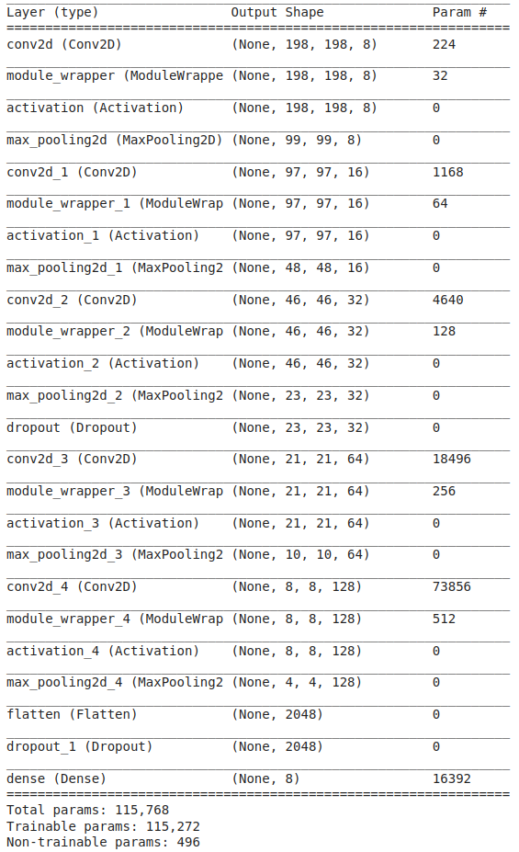
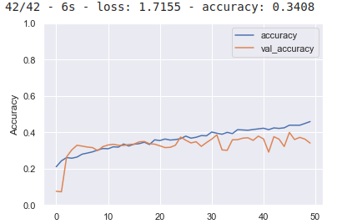
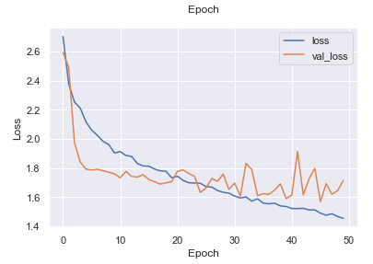
CNN Results

Slide 12
Discussion
Problems during implementation:
1 by 1 matching very time consuming
Lots of duplicates required extra work (eg Stavros Xarxakos and Stavros Ksarhakos, both indicating the same Artist)
Spotify classifies as Artists singers, songwriters, lyricists and producers. Need to take all of those into consideration when searching if a specific song in our dataset exists as a registry in Spotify
Annotating an audio recording is challenging. How many emotions should we define to recognize?
Emotions are subjective, people would interpret it differently. It is hard to define the notion of emotions.
Audio Analysis through image classification tend to have bad accuracy results (<0.5) (https://towardsdatascience.com/whats-wrong-with-spectrograms-and-cnns-for-audio-processing-311377d7ccd)

Slide 13
Future Work
Experiment with:
Bigger Dataset (10k+ images)
Bigger image size (maybe 512x512)
Pre-trained Classifiers
Classification in 4 sentiments (Happy, Calm, Sad, Angry) instead of 8
Different NN architectures (eg CNN-RNN in parallel)
Instead of feature extraction through Spotify's API, use an Annotation App, so volunteers individuals can annotate according to their belief (eg. AnnoEmo app)

Slide 14
Food for Thought:
How Spotify quantify its track's variables is not clear, but usually in fuzzy logic, a team of specialists define the pertinence degree between qualitative aspects
A happy song may have sad lyrics and vice versa. A more realistic song sentiment analysis would require both text and sound analysis and classification.

Slide 15
References
https://github.com/tyiannak/basic_audio_handling/blob/master/notebobok.ipynb
https://github.com/tyiannak/multimodalAnalysis/tree/master/audio
https://betterprogramming.pub/how-to-extract-any-artists-data-using-spotify-s-api-python-and-spotipy-4c079401bc37
https://www.linkedin.com/pulse/how-spotify-knows-your-feelings-almost-exploratory-data-martins/
https://hackernoon.com/how-to-use-machine-learning-to-color-your-lighting-based-on-music-mood-bi163u8l
https://link.springer.com/article/10.1007/s11042-019-08192-x
https://towardsdatascience.com/music-genre-recognition-using-convolutional-neural-networks-cnn-part-1-212c6b93da76
and many more..

Slide 16
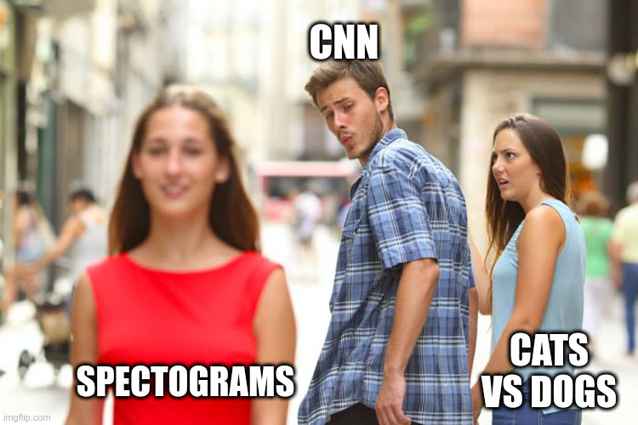
Thank you!

