Slide 1

CS377 Discussion 6
Outline for today
  Review of week 6
  Common concurrency bugs
  Deadlock, starvation, liveness
  Lab 2 Bounded Buffer
Computer Science
Computer Science
Disc 4, page

Slide 2
Review of week 6
What is the reader/writer problem?
What are correctness properties for the reader/writer problem?
What is starvation? What is starvation in terms of the reader/writer problem?
How can you write a ReadWrite lock to favor reads?
How can you write a ReadWrite lock to favor writers?
What is the Dining Philosophers Problem?
What is a solution to the Dining Philosopher’s Problem?
Computer Science
Computer Science
Disc 4, page

Slide 3
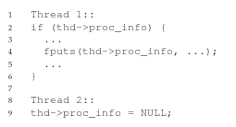
Bugs in threaded code
Race conditions
  Atomicity-violation bugs
Computer Science
Computer Science
Disc 4, page

Slide 4
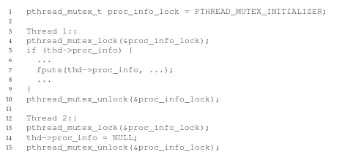
Bugs in threaded code
Race conditions
  Atomicity-violation bugs
Computer Science
Computer Science
Disc 4, page

Slide 5
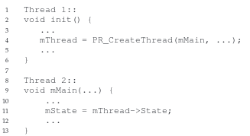
Bugs in threaded code
Race conditions
  Order-violation bugs
Computer Science
Computer Science
Disc 4, page

Slide 6
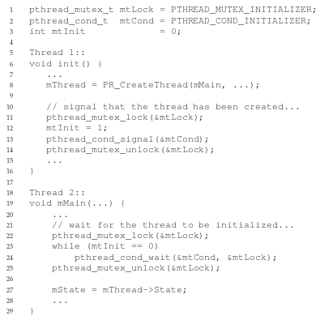
Bugs in threaded code
Race conditions
  Order-violation bugs
Computer Science
Computer Science
Disc 4, page

Slide 7

Bugs in threaded code
Deadlock
  All threads are waiting and no progress is made
Liveness: some progress is being made (no deadlock)
Starvation: constantly denied access to a resource
Computer Science
Computer Science
Disc 4, page

Slide 8
Project 2: Bounded Buffer
Review code
Computer Science
Computer Science
Disc 4, page

