Slide 1



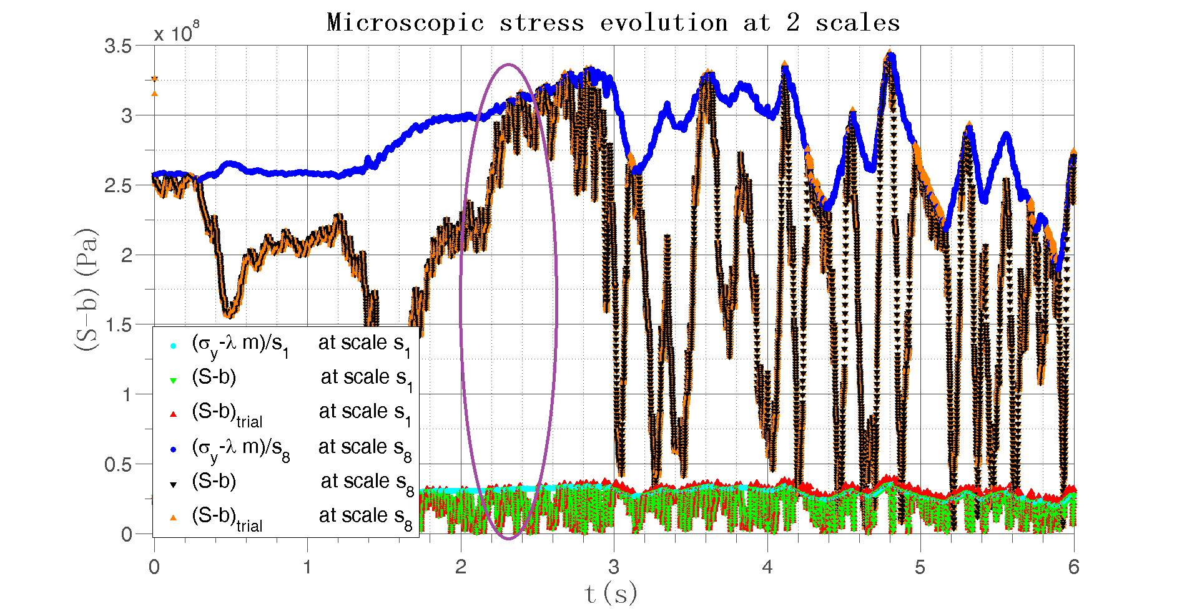
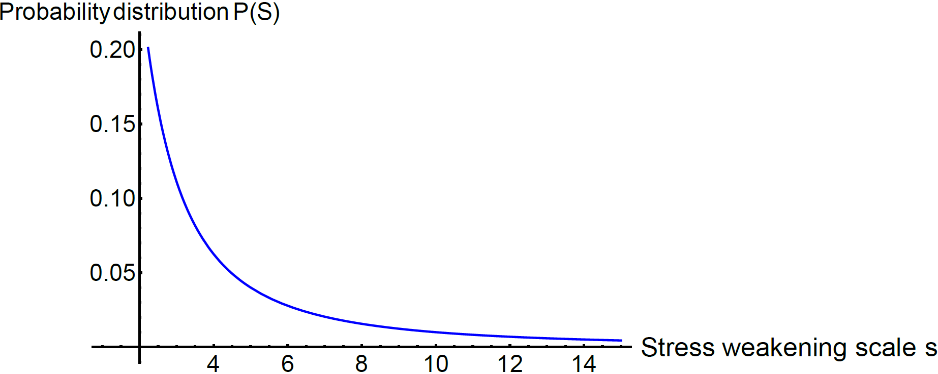
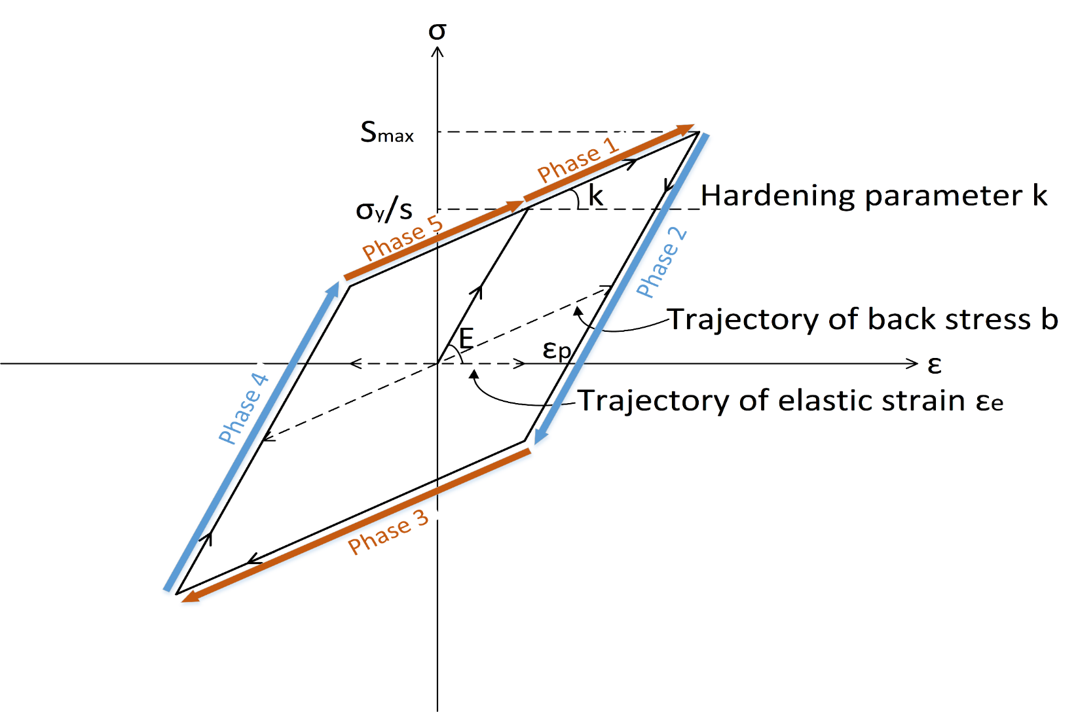
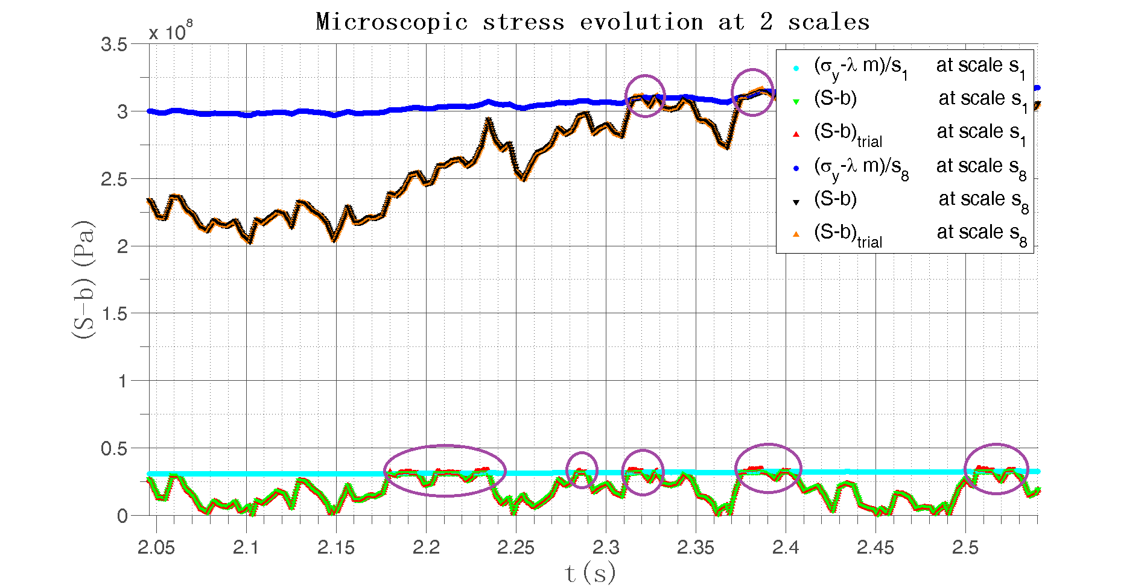
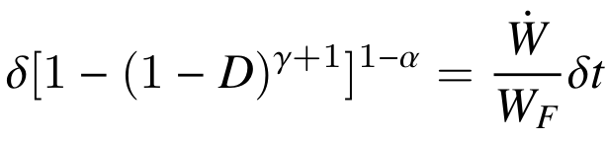
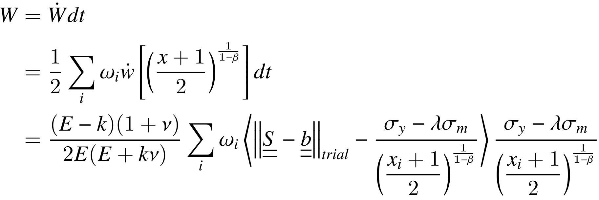
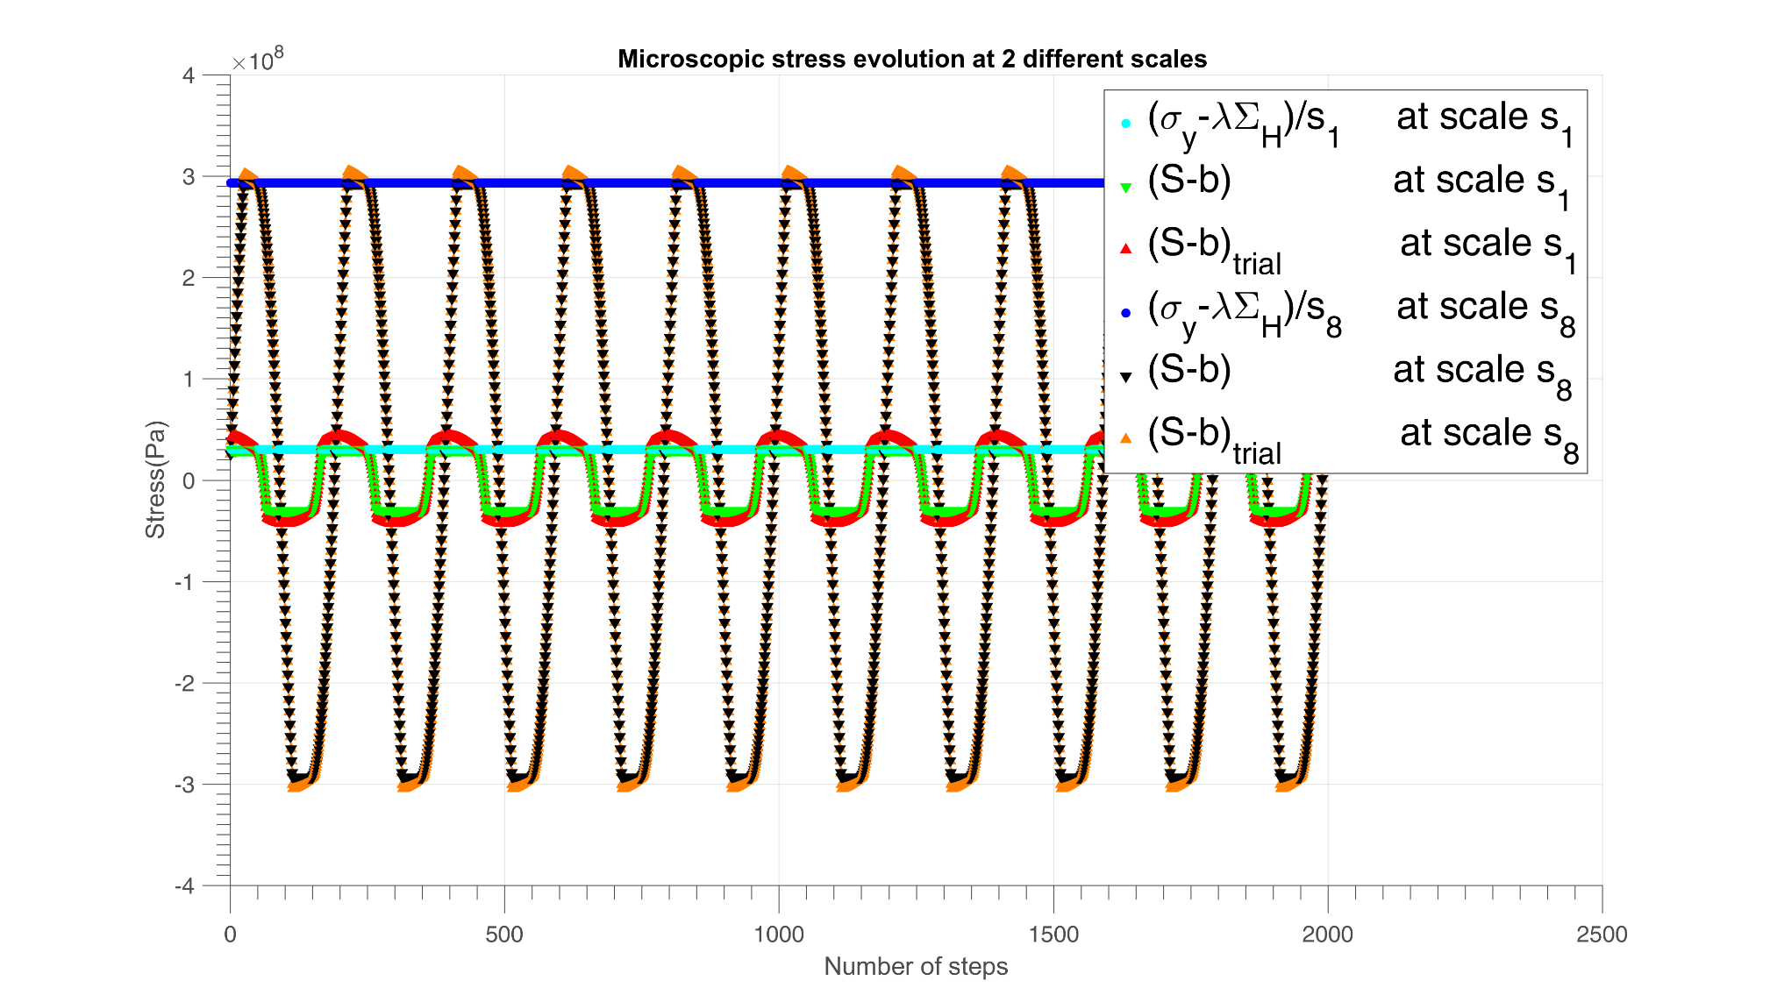
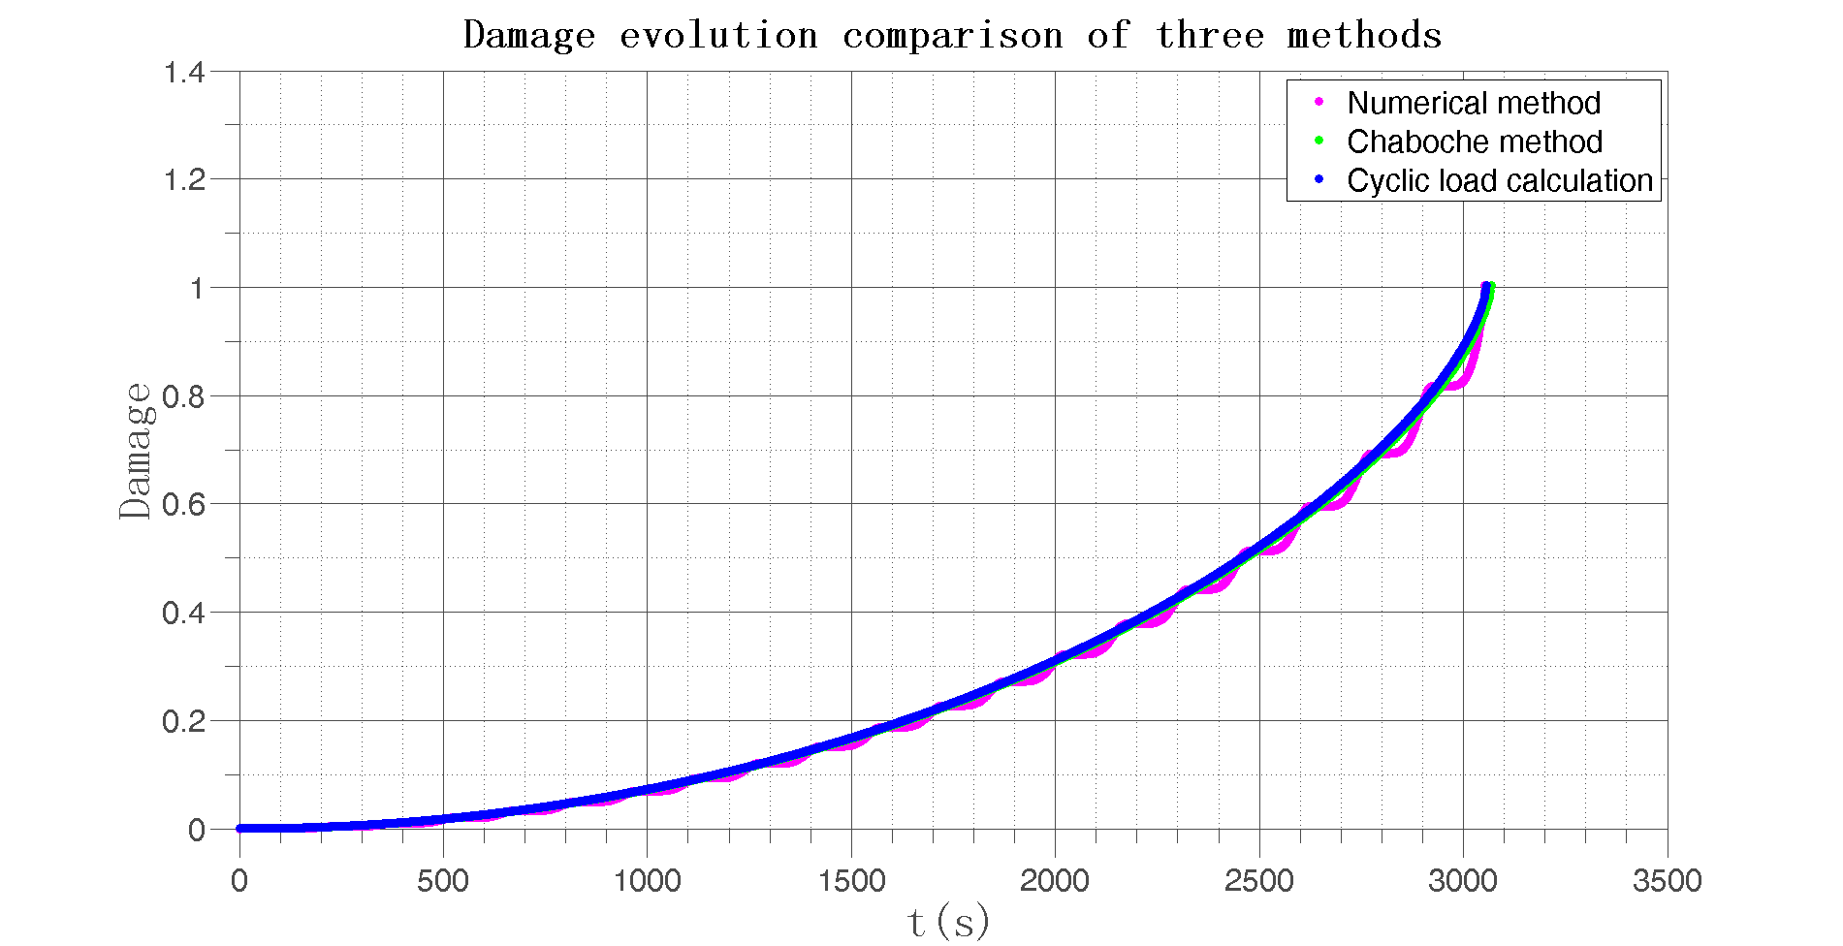
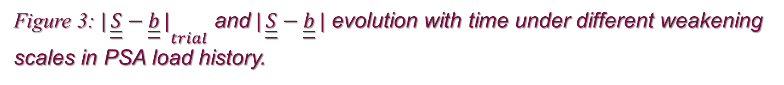
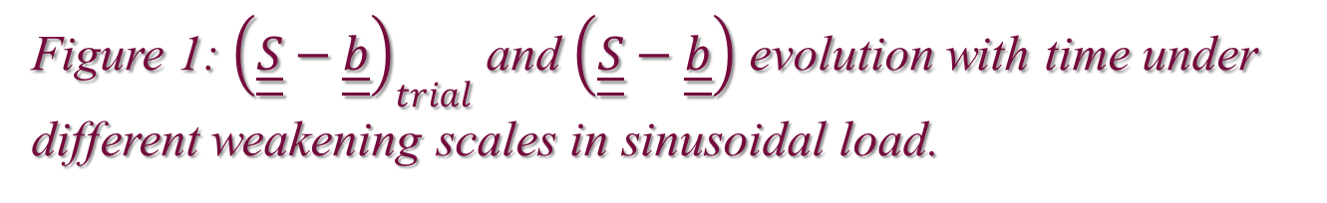

A new strategy for fatigue analysis in presence of general multiaxial time varying loadings
Zepeng MA, Patrick Le Tallec, Habibou Maitournam
Laboratory of Solid Mechanics, Ecole Polytechnique, 91128 Palaiseau Cedex, France
BACKGROUND
ANALYTICAL PROCESSES
3D real data loading test
The object of this work is to propose an energy based fatigue approach which handles multidimensional time varying loading histories.
Our fundamental thought is to assume that the energy dissipated at small scales governs fatigue at failure.
Instead of using the number of cycles, we use the concept of loading history.
Weakening scales and cyclic loading analysis
We assume the weakening scales have a probability distribution of power law:
1. Elastic regime, in phase 2 and 4, there is ${\dot{ε}}^{P}\left(s,M,t\right)=0$, then $\left|S−b\right|<\left(σ_{y}−λσ_{m}\right)/s$
Plastic regime according to plastic flow rule, with increasing plastic deformation, in phase 5 and 1, there is
${\dot{ε}}^{P}\left(s,M,t\right)=γ\frac{\underline{\underline{S}}\left(s\right)−\underline{\underline{b}}\left(s\right)}{\left\|\underline{\underline{S}}\left(s\right)−\underline{\underline{b}}\left(s\right)\right\|}>0$ with $γ>0$, then $\underline{\underline{S}}−\underline{\underline{b}}=\left(σ_{y}−λσ_{m}\right)/s$ and $\underline{\underline{\dot{S}}}−\underline{\dot{\underline{b}}}=0$
Plastic regime in the other direction, in phase 3, there is ${\dot{ε}}^{P}\left(s,M,t\right)<0$, then $\underline{\underline{S}}−\underline{\underline{b}}=−\left(σ_{y}−λσ_{m}\right)/s$ and
$$\underline{\underline{\dot{S}}}−\underline{\dot{\underline{b}}}=0$$
Integration rules for energy dissipation rate $\dot{W}$ and damage $δD$
Instead of doing the scale integration directly which can be difficult for complex loading, the Gaussian Quadrature rule with Legendre points is used to give the value of local dissipated energy rate.
Figure 3: ${|\left.\left.\underline{\underline{S}}−\underline{\underline{b}}\right.|\right.}_{trial}$ and$|\left.\left.\underline{\underline{S}}−\underline{\underline{b}}\right.|\right.$ evolution with time under different weakening scales in PSA load history.
PROPOSE
At each material points, there is a stochastic distribution of weak points which will undergo strong plastic yielding, which contribute to energy dissipation without affecting the overall macroscopic stress.
Mean stress effect is taken into account in mesoscopic yield function and non-linear damage accumulation law are also considered in our model.
Fatigue will then be determined from the plastic shakedown cycle.
Figure 4: Circled area magnification in Figure 4 where in the circled area there is${|\left.\left.\underline{\underline{S}}−\underline{\underline{b}}\right.|\right.}_{trial}>σ_{y}$.
CONCLUSIONS
We work on the stress tensor directly in 3D analysis in stead of using the multidimensional equivalent stress.
This approach takes into account impurities and hardness in the material and is applicable to any multiaxial load geometry.
The small step-by-step strategy does not ignore small fluctuations in load history.
Simple cyclic loading test
REFERENCES
M. Maitournam, C. Krebs, A. Galtier, A multiscale fatigue life model for complex cyclic multiaxial loading, International Journal of Fatigue.
S. Bosia, A. Constantinescu, Fast time-scale average for a mesoscopic high cycle fatigue criterion, International Journal of Fatigue.
J. Lemaitre, J.-L. Chaboche, Mechanics of solid materials, Cambridge university press, 1990.
Legendre Gauss Quadrature weights and nodes, https://www.mathworks.com/matlabcentral/fileexchange/4540-legendre-gauss-quadrature-weights-and-nodes, accessed: 2004-05-11.
Figure 1: ${\left(\underline{\underline{S}}−\underline{\underline{b}}\right)}_{trial}$ and $\left(\underline{\underline{S}}−\underline{\underline{b}}\right)$ evolution with time under different weakening scales in sinusoidal load.
ACKNOWLEDGEMENT
Contact info : zepeng.ma@polytechnique.edu
Figure 2:Damage evolution with time under sinusoidal load with three different methods.
This work is supported by PSA group.

