Slide 1
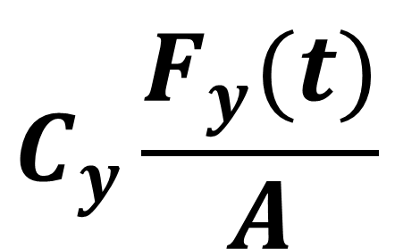
$$C_{y}\frac{F_{y}(t)}{A}$$

