Slide 1
Gauss Quadrature Rule of Integration
Major: All Engineering Majors
Authors: Autar Kaw, Charlie Barker
http://numericalmethods.eng.usf.edu
Transforming Numerical Methods Education for STEM Undergraduates
http://numericalmethods.eng.usf.edu

Slide 2
Gauss Quadrature Rule of Integration http://numericalmethods.eng.usf.edu

Slide 3

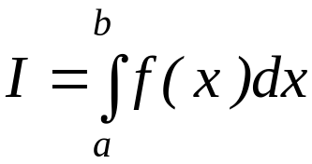
What is Integration?
Integration
y
f(x)
The process of measuring the area under a curve.
Where:
f(x) is the integrand
a= lower limit of integration
b= upper limit of integration
a
b
x
http://numericalmethods.eng.usf.edu

Slide 4
Two-Point Gaussian Quadrature Rule
http://numericalmethods.eng.usf.edu

Slide 5
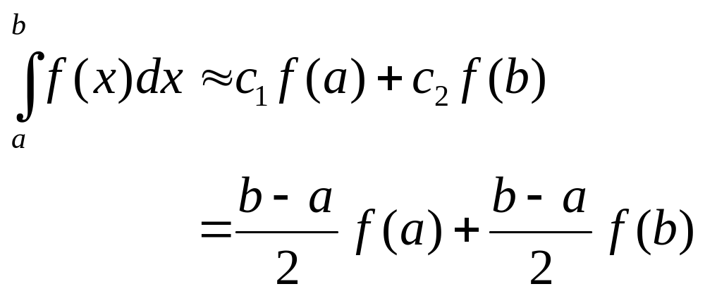
Basis of the Gaussian Quadrature Rule
Previously, the Trapezoidal Rule was developed by the method
of undetermined coefficients. The result of that development is
summarized below.
http://numericalmethods.eng.usf.edu

Slide 6
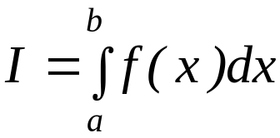

Basis of the Gaussian Quadrature Rule
The two-point Gauss Quadrature Rule is an extension of the Trapezoidal Rule approximation where the arguments of the function are not predetermined as a and b but as unknowns
x₁ and x₂. In the two-point Gauss Quadrature Rule, the integral is approximated as
http://numericalmethods.eng.usf.edu

Slide 7

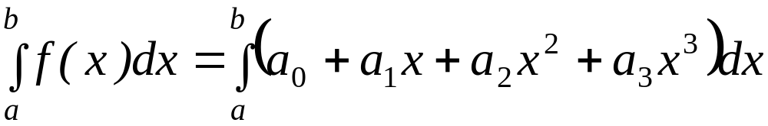
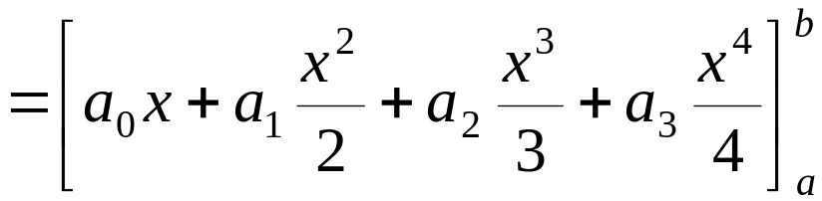
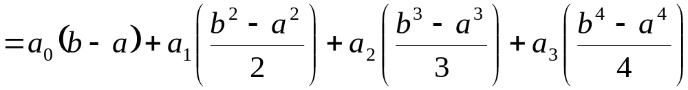
Basis of the Gaussian Quadrature Rule
The four unknowns x₁, x₂, c₁ and c₂ are found by assuming that the formula gives exact results for integrating a general third order polynomial,
Hence
http://numericalmethods.eng.usf.edu

Slide 8
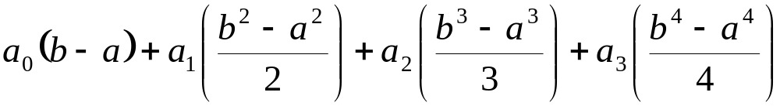
Basis of the Gaussian
Quadrature Rule
It follows that
Equating Equations the two previous two expressions yield
http://numericalmethods.eng.usf.edu

Slide 9
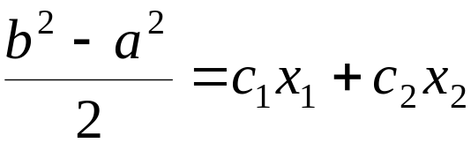

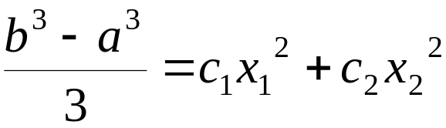
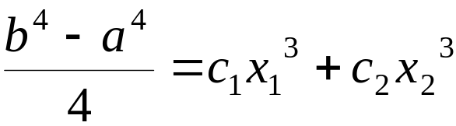
Basis of the Gaussian Quadrature Rule
Since the constants a₀, a₁, a₂, a₃ are arbitrary
http://numericalmethods.eng.usf.edu

Slide 10
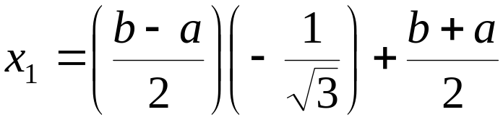
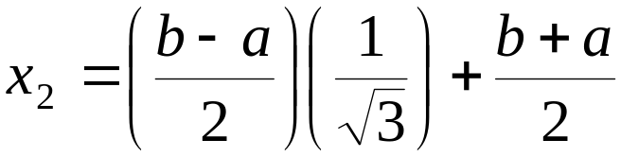
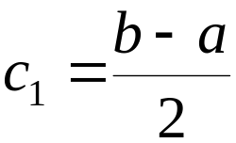
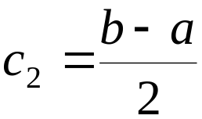
Basis of Gauss Quadrature
The previous four simultaneous nonlinear Equations have only one acceptable solution,
http://numericalmethods.eng.usf.edu

Slide 11
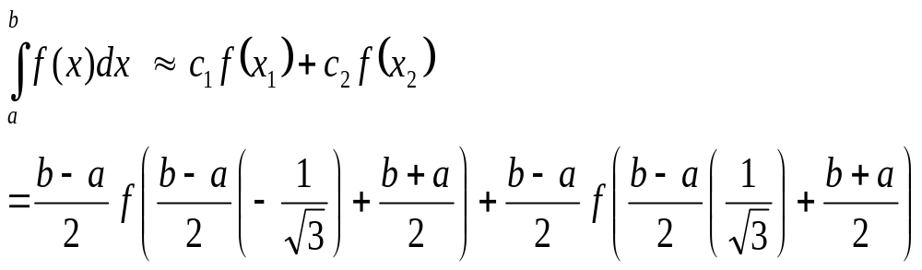
Basis of Gauss Quadrature
Hence Two-Point Gaussian Quadrature Rule
http://numericalmethods.eng.usf.edu

Slide 12
Higher Point Gaussian Quadrature Formulas
http://numericalmethods.eng.usf.edu

Slide 13
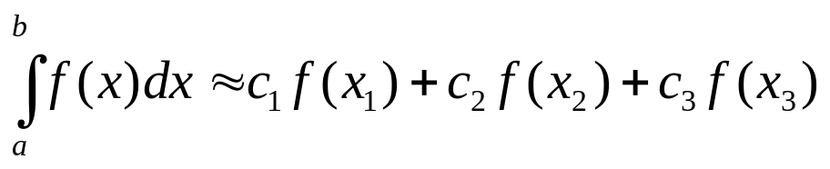
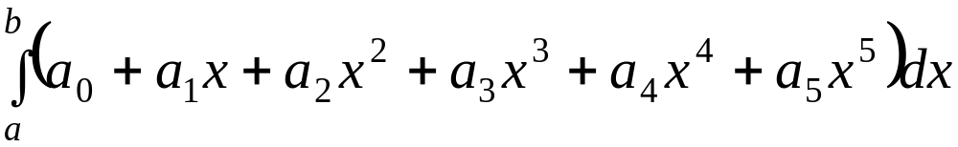
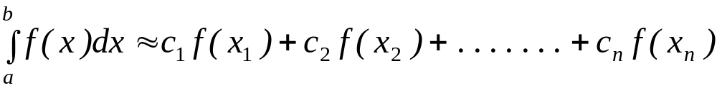
Higher Point Gaussian Quadrature Formulas
is called the three-point Gauss Quadrature Rule.
The coefficients c₁, c₂, and c₃, and the functional arguments x₁, x₂, and x₃
are calculated by assuming the formula gives exact expressions for
integrating a fifth order polynomial
General n-point rules would approximate the integral
http://numericalmethods.eng.usf.edu

Slide 14
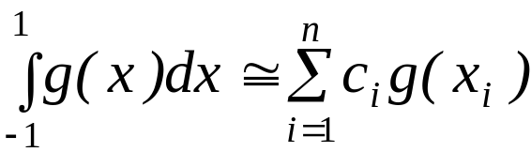
Arguments and Weighing Factors for n-point Gauss Quadrature Formulas
Table 1: Weighting factors c and function
arguments x used in Gauss Quadrature
Formulas.
In handbooks, coefficients and
arguments given for n-point
Points | Weighting Factors | Function Arguments
2 | c₁ = 1.000000000 c₂ = 1.000000000 | x₁ = -0.577350269 x₂ = 0.577350269
3 | c₁ = 0.555555556 c₂ = 0.888888889 c₃ = 0.555555556 | x₁ = -0.774596669 x₂ = 0.000000000 x₃ = 0.774596669
4 | c₁ = 0.347854845 c₂ = 0.652145155 c₃ = 0.652145155 c₄ = 0.347854845 | x₁ = -0.861136312 x₂ = -0.339981044 x₃ = 0.339981044 x₄ = 0.861136312
Gauss Quadrature Rule are
given for integrals
as shown in Table 1.
http://numericalmethods.eng.usf.edu

Slide 15
Arguments and Weighing Factors for n-point Gauss Quadrature Formulas
Table 1 (cont.) : Weighting factors c and function arguments x used in Gauss Quadrature Formulas.
Points | Weighting Factors | Function Arguments
5 | c₁ = 0.236926885 c₂ = 0.478628670 c₃ = 0.568888889 c₄ = 0.478628670 c₅ = 0.236926885 | x₁ = -0.906179846 x₂ = -0.538469310 x₃ = 0.000000000 x₄ = 0.538469310 x₅ = 0.906179846
6 | c₁ = 0.171324492 c₂ = 0.360761573 c₃ = 0.467913935 c₄ = 0.467913935 c₅ = 0.360761573 c₆ = 0.171324492 | x₁ = -0.932469514 x₂ = -0.661209386 x₃ = -0.2386191860 x₄ = 0.2386191860 x₅ = 0.661209386 x₆ = 0.932469514
http://numericalmethods.eng.usf.edu

Slide 16
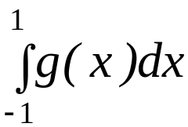
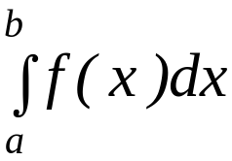







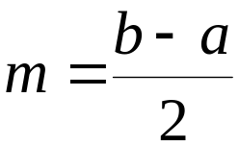
Arguments and Weighing Factors for n-point Gauss Quadrature Formulas
So if the table is given for
integrals, how does one solve
?
The answer lies in that any integral with limits of
can be converted into an integral with limits
Let
If then
Such that:
If then
http://numericalmethods.eng.usf.edu

Slide 17
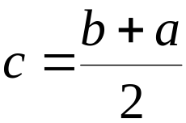
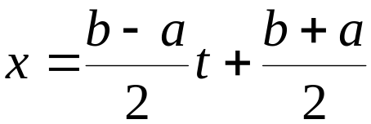
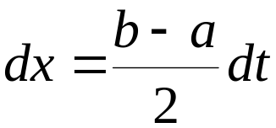
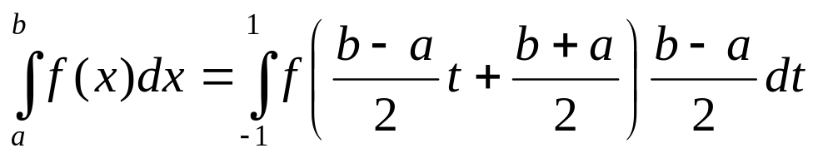
Arguments and Weighing Factors for n-point Gauss Quadrature Formulas
Then
Hence
Substituting our values of x, and dx into the integral gives us
http://numericalmethods.eng.usf.edu

Slide 18
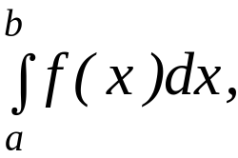
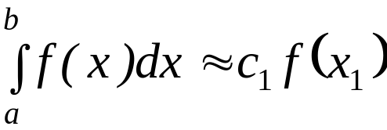
Example 1
For an integral
derive the one-point Gaussian Quadrature
Rule.
Solution
The one-point Gaussian Quadrature Rule is
http://numericalmethods.eng.usf.edu

Slide 19

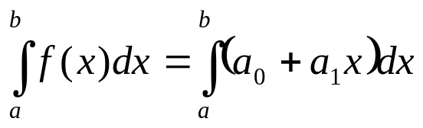
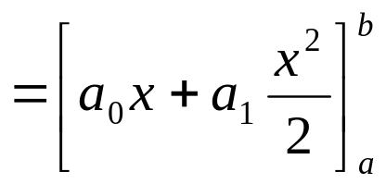
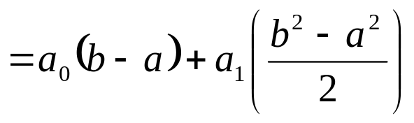
Solution
The two unknowns x₁, and c₁ are found by assuming that the formula gives exact results for integrating a general first order polynomial,
http://numericalmethods.eng.usf.edu

Slide 20
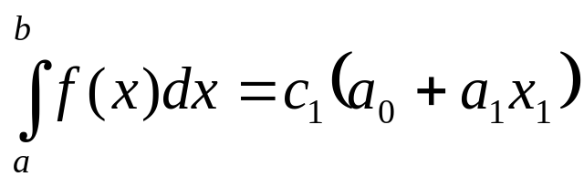
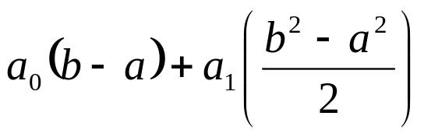

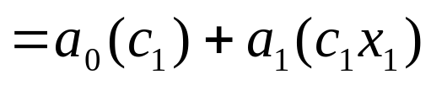
Solution
It follows that
Equating Equations, the two previous two expressions yield
http://numericalmethods.eng.usf.edu

Slide 21
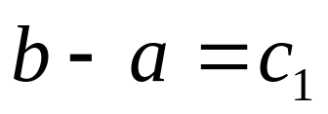
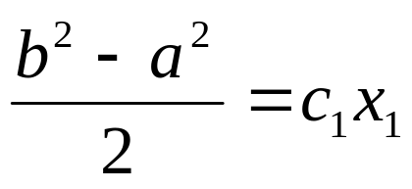

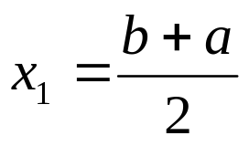
Basis of the Gaussian Quadrature Rule
Since the constants a₀, and a₁ are arbitrary
giving
http://numericalmethods.eng.usf.edu

Slide 22
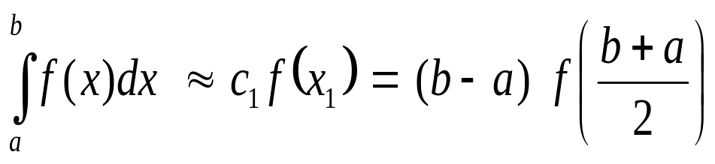
Solution
Hence One-Point Gaussian Quadrature Rule
http://numericalmethods.eng.usf.edu

Slide 23
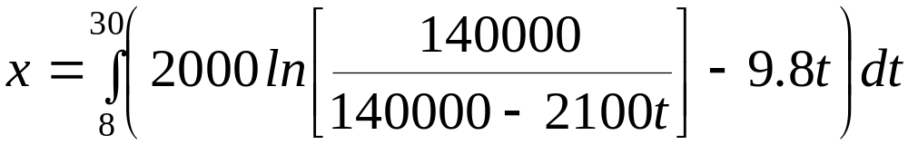


Example 2
a)
Use two-point Gauss Quadrature Rule to approximate the distance
covered by a rocket from t=8 to t=30 as given by
Find the true error, for part (a).
Also, find the absolute relative true error, for part (a).
b)
c)
http://numericalmethods.eng.usf.edu

Slide 24
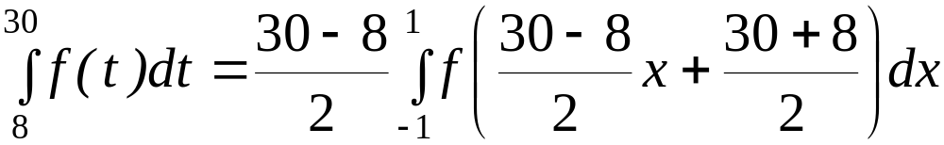
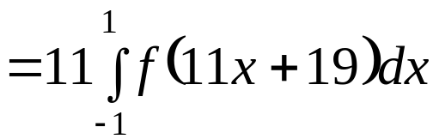
Solution
First, change the limits of integration from [8,30] to [-1,1]
by previous relations as follows
http://numericalmethods.eng.usf.edu

Slide 25




Solution (cont)
Next, get weighting factors and function argument values from Table 1
for the two point rule,
http://numericalmethods.eng.usf.edu

Slide 26
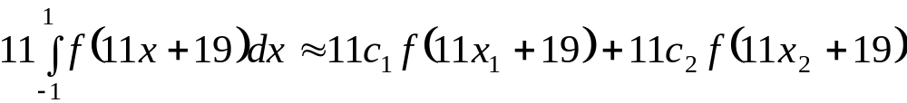

Solution (cont.)
Now we can use the Gauss Quadrature formula
http://numericalmethods.eng.usf.edu

Slide 27
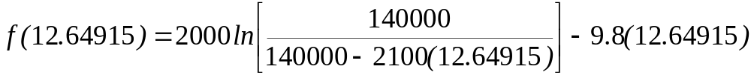

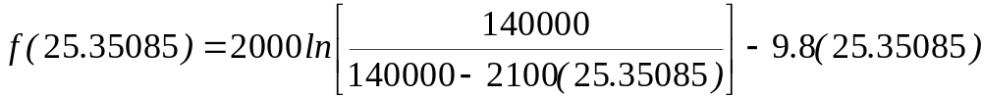

Solution (cont)
since
http://numericalmethods.eng.usf.edu

Slide 28



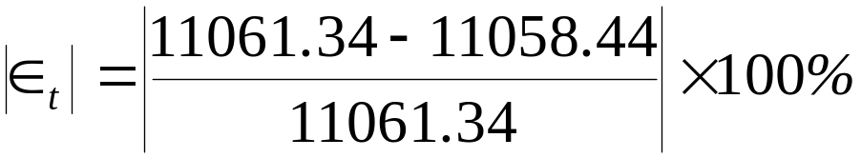

Solution (cont)
b)
The true error, , is
c)
The absolute relative true error,
, is (Exact value = 11061.34m)
http://numericalmethods.eng.usf.edu

Slide 29
Additional Resources
For all resources on this topic such as digital audiovisual lectures, primers, textbook chapters, multiple-choice tests, worksheets in MATLAB, MATHEMATICA, MathCad and MAPLE, blogs, related physical problems, please visit
http://numericalmethods.eng.usf.edu/topics/gauss_quadrature.html

Slide 30
THE END
http://numericalmethods.eng.usf.edu

