Slide 1
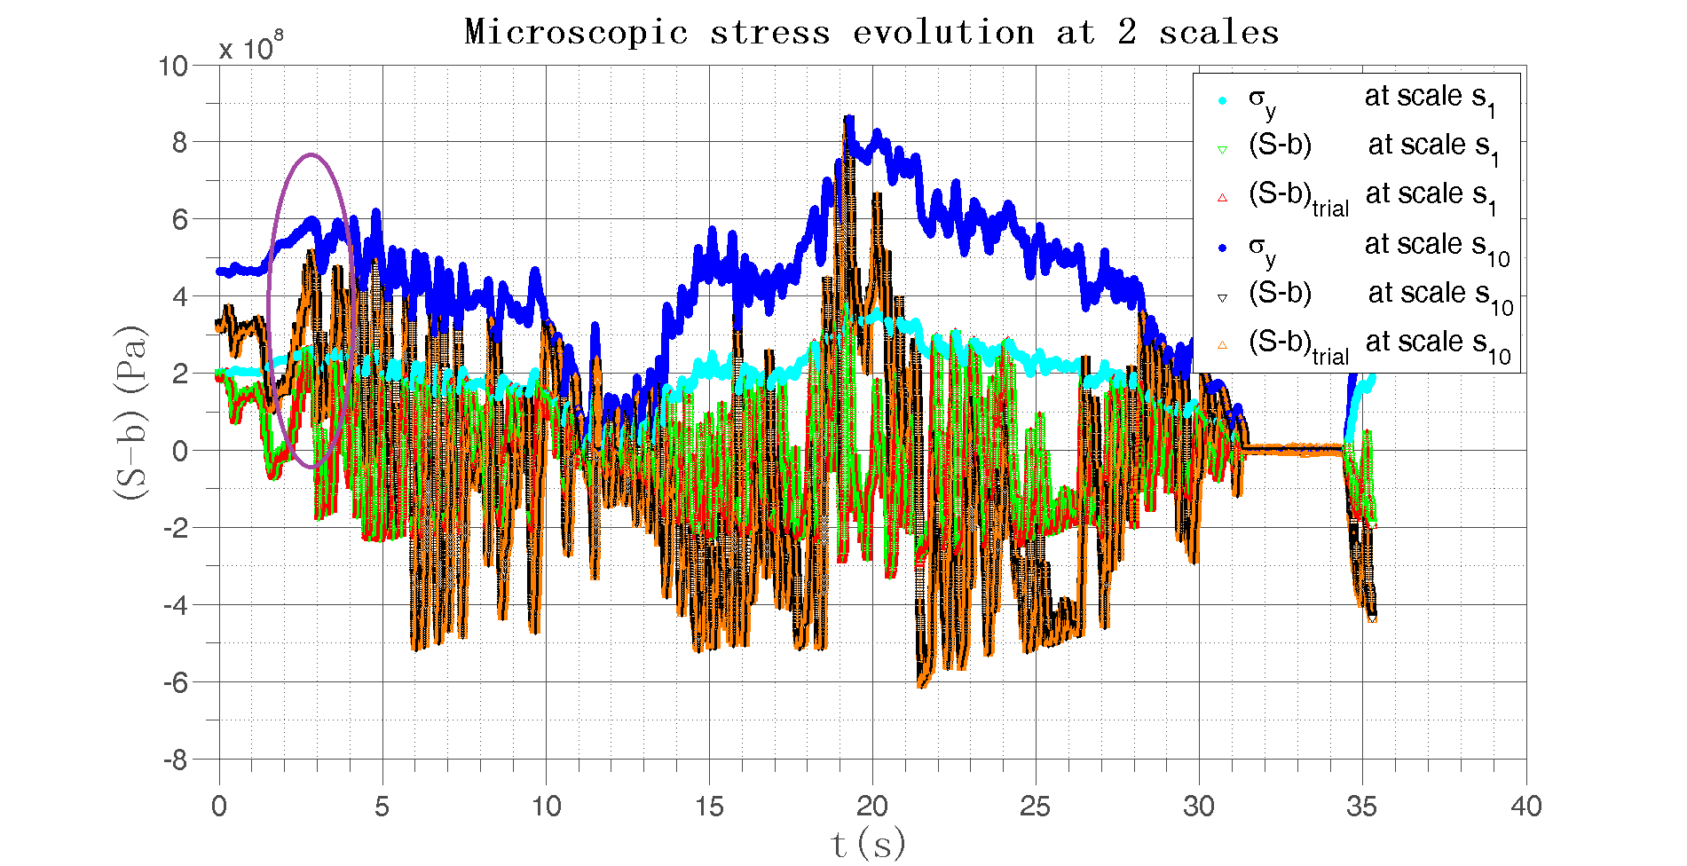
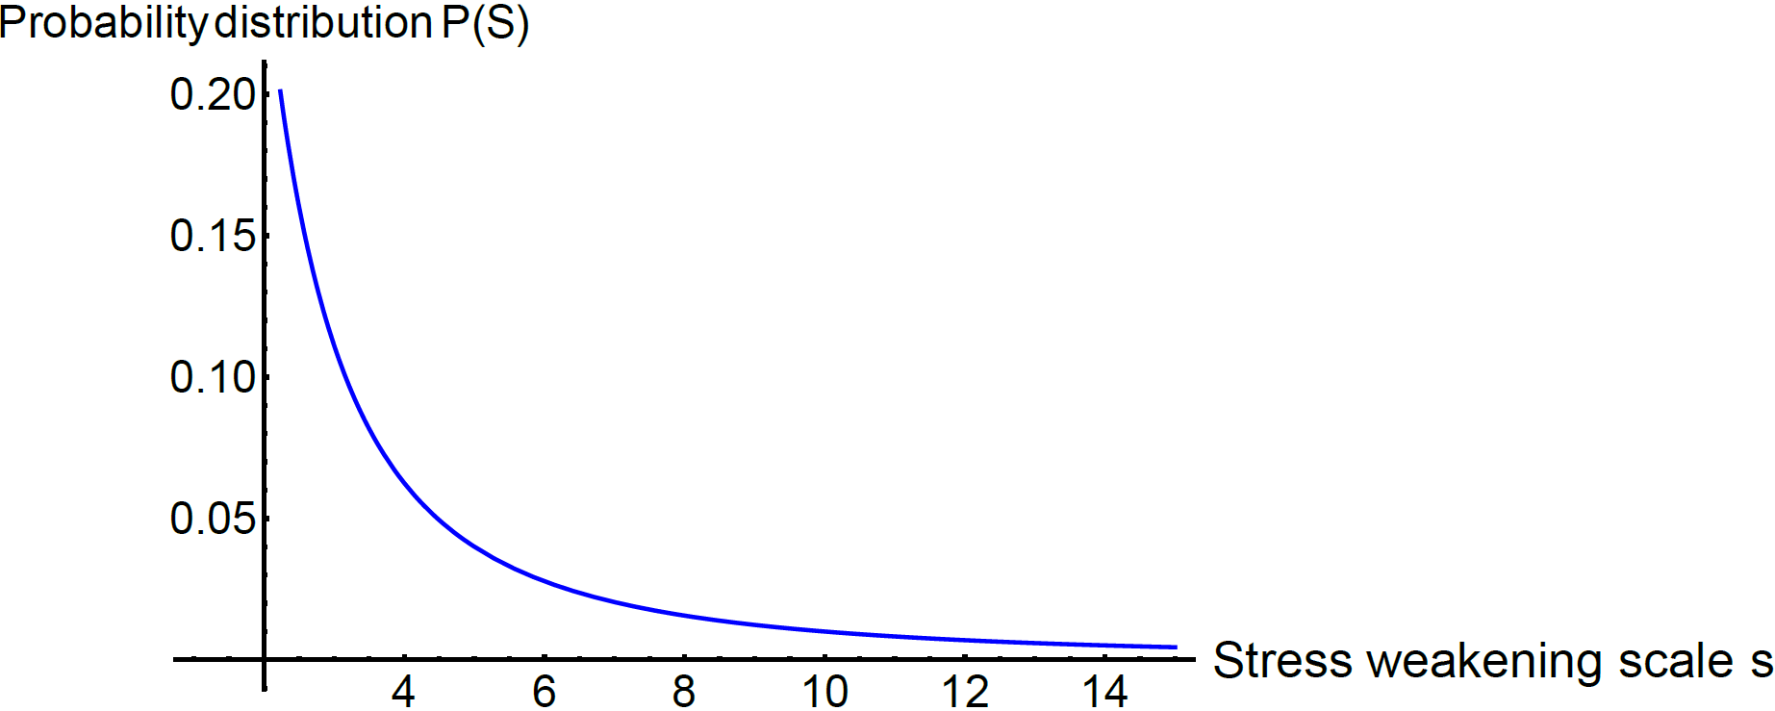
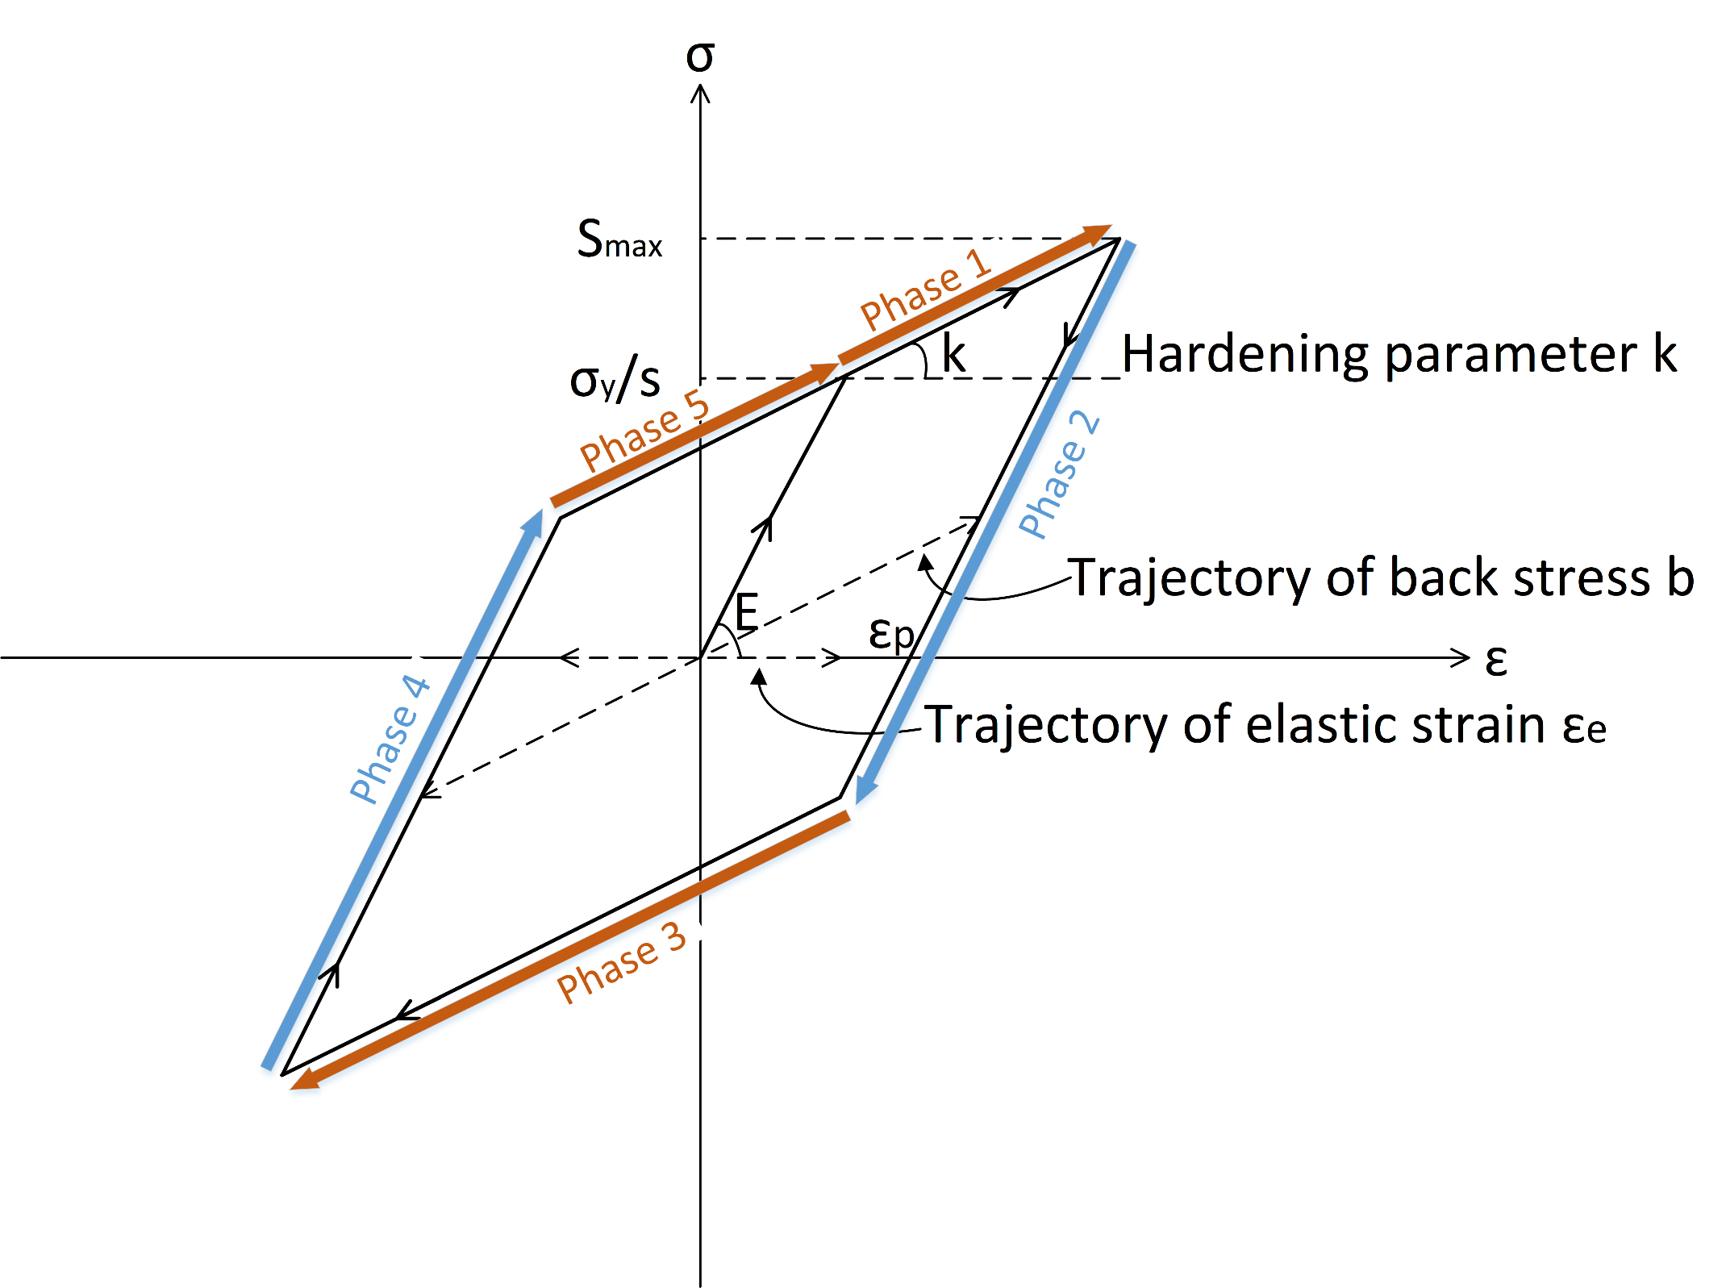


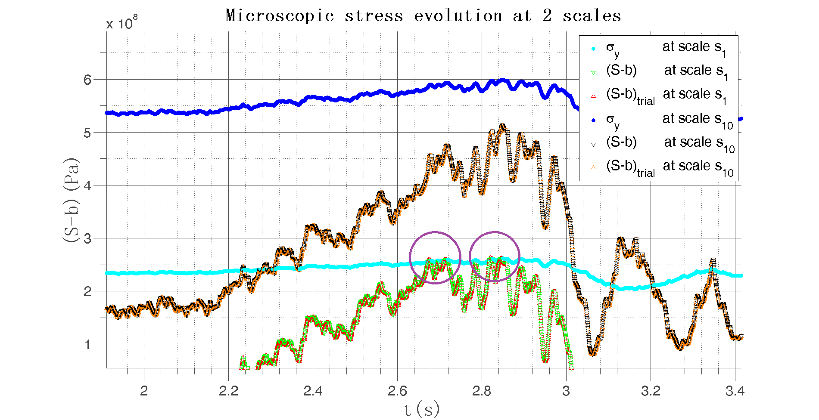
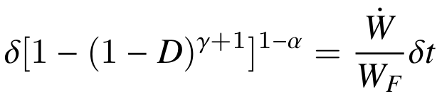
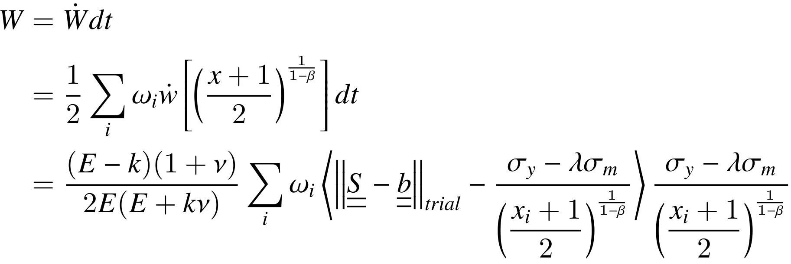
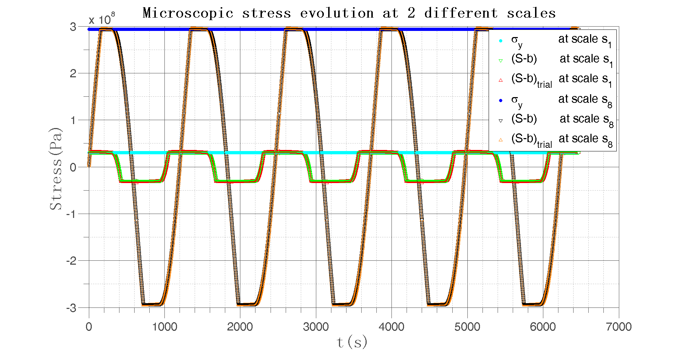
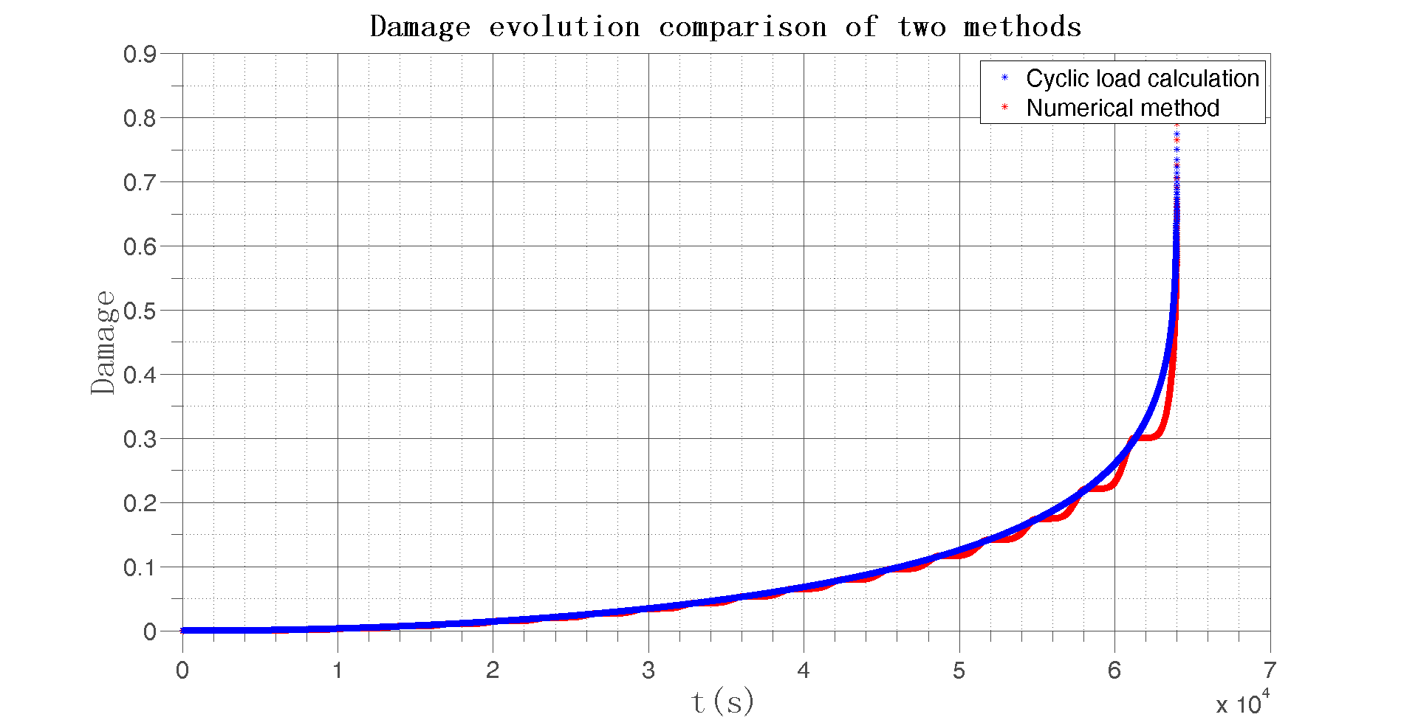
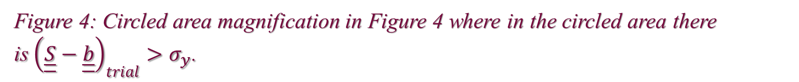


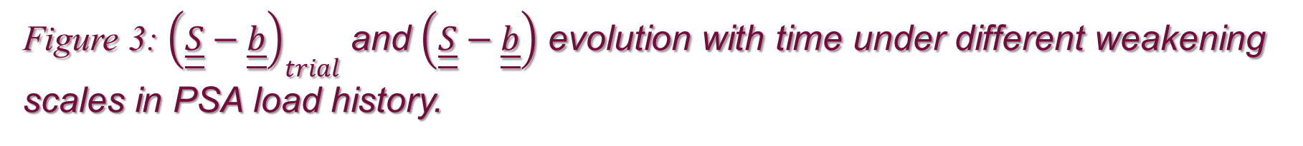
A new strategy for fatigue analysis in presence of general multiaxial time varying loadings
Zepeng MA, Patrick Le Tallec, Habibou Maitournam
Laboratory of Solid Mechanics, Ecole Polytechnique, 91128 Palaiseau Cedex, France
BACKGROUND
METHODS AND ANALYSIS
3D real data loading test
The object of this work is to propose an energy based fatigue approach which takes into account impurities and hardness in the material.
The proposal of our model is to consider a plastic behavior at the mesoscopic scale with a dependence of the yield function not only on the deviatoric part of the stress but also on the hydro static part.
A kinematic hardening under the assumptions of associative plasticity is also considered.
Weakening scales
We assume the weakening scales have a probability distribution of power law:
1. Elastic regime, in phase 2 and 4, there is ${\dot{ε}}^{P}\left(s,M,t\right)=0$, then $\left|S−b\right|<\left(σ_{y}−λσ_{m}\right)/s$
Plastic regime according to plastic flow rule, with increasing plastic deformation, in phase 5 and 1, there is
${\dot{ε}}^{P}\left(s,M,t\right)=γ\frac{\underline{\underline{S}}\left(s\right)−\underline{\underline{b}}\left(s\right)}{\left\|\underline{\underline{S}}\left(s\right)−\underline{\underline{b}}\left(s\right)\right\|}>0$ with $γ>0$, then $\underline{\underline{S}}−\underline{\underline{b}}=\left(σ_{y}−λσ_{m}\right)/s$ and $\underline{\underline{\dot{S}}}−\underline{\dot{\underline{b}}}=0$
Plastic regime in the other direction, in phase 3, there is ${\dot{ε}}^{P}\left(s,M,t\right)<0$, then $\underline{\underline{S}}−\underline{\underline{b}}=−\left(σ_{y}−λσ_{m}\right)/s$ and
$$\underline{\underline{\dot{S}}}−\underline{\dot{\underline{b}}}=0$$
Integration rules for energy dissipation rate $\dot{W}$ and damage $δD$
Instead of doing the scale integration directly which can be difficult for complex loading, the Gaussian Quadrature rule with Legendre points is used to give the value of local dissipated energy rate.
Figure 3: ${\left(\underline{\underline{S}}−\underline{\underline{b}}\right)}_{trial}$ and $\left(\underline{\underline{S}}−\underline{\underline{b}}\right)$ evolution with time under different weakening scales in PSA load history.
PROPOSE
Figure 4: Circled area magnification in Figure 4 where in the circled area there is${\left(\underline{\underline{S}}−\underline{\underline{b}}\right)}_{trial}>σ_{y}$.
Our fundamental thought is to assume that the local dissipated energy at small scale governs fatigue at failure.
The structure is elastic at the macroscopic scale. At each material points, there is a stochastic distribution of weak points which will undergo strong plastic yielding, which contribute to energy dissipation without affecting the overall macroscopic stress.
Instead of using the number of cycles, we use the concept of loading time. We also take into account the nonlinearity of damage accumulation.
CONCLUSIONS
The strategy can be made more complex by introducing a local space averaging process in the calculation of the local damage, and by taking more general plastic flows. The energy based fatigue approach takes into account impurities and hardness in the material which affect the fatigue life. The load sequence effects for complex multiaxial loading history are included in damage accumulation process. The small step-by-step strategy does not ignore small fluctuations in the load history. In addition, it can take into account any type of micro plasticity law and multiaxial load geometry.
Simple cyclic loading test
REFERENCES
M. Maitournam, C. Krebs, A. Galtier, A multiscale fatigue life model for complex cyclic multiaxial loading, International Journal of Fatigue.
S. Bosia, A. Constantinescu, Fast time-scale average for a mesoscopic high cycle fatigue criterion, International Journal of Fatigue.
J. Lemaitre, J.-L. Chaboche, Mechanics of solid materials, Cambridge university press, 1990.
Legendre Gauss Quadrature weights and nodes, https://www.mathworks.com/matlabcentral/fileexchange/4540-legendre-gauss-quadrature-weights-and-nodes, accessed: 2004-05-11.
Figure 1: ${\left(\underline{\underline{S}}−\underline{\underline{b}}\right)}_{trial}$ and $\left(\underline{\underline{S}}−\underline{\underline{b}}\right)$ evolution with time under different weakening scales in sinusoidal load.
Figure 2:Damage evolution with time under sinusoidal load with two different methods.
Email : zepeng.ma@polytechnique.edu. This research supported by PSA group.

