Slide 1
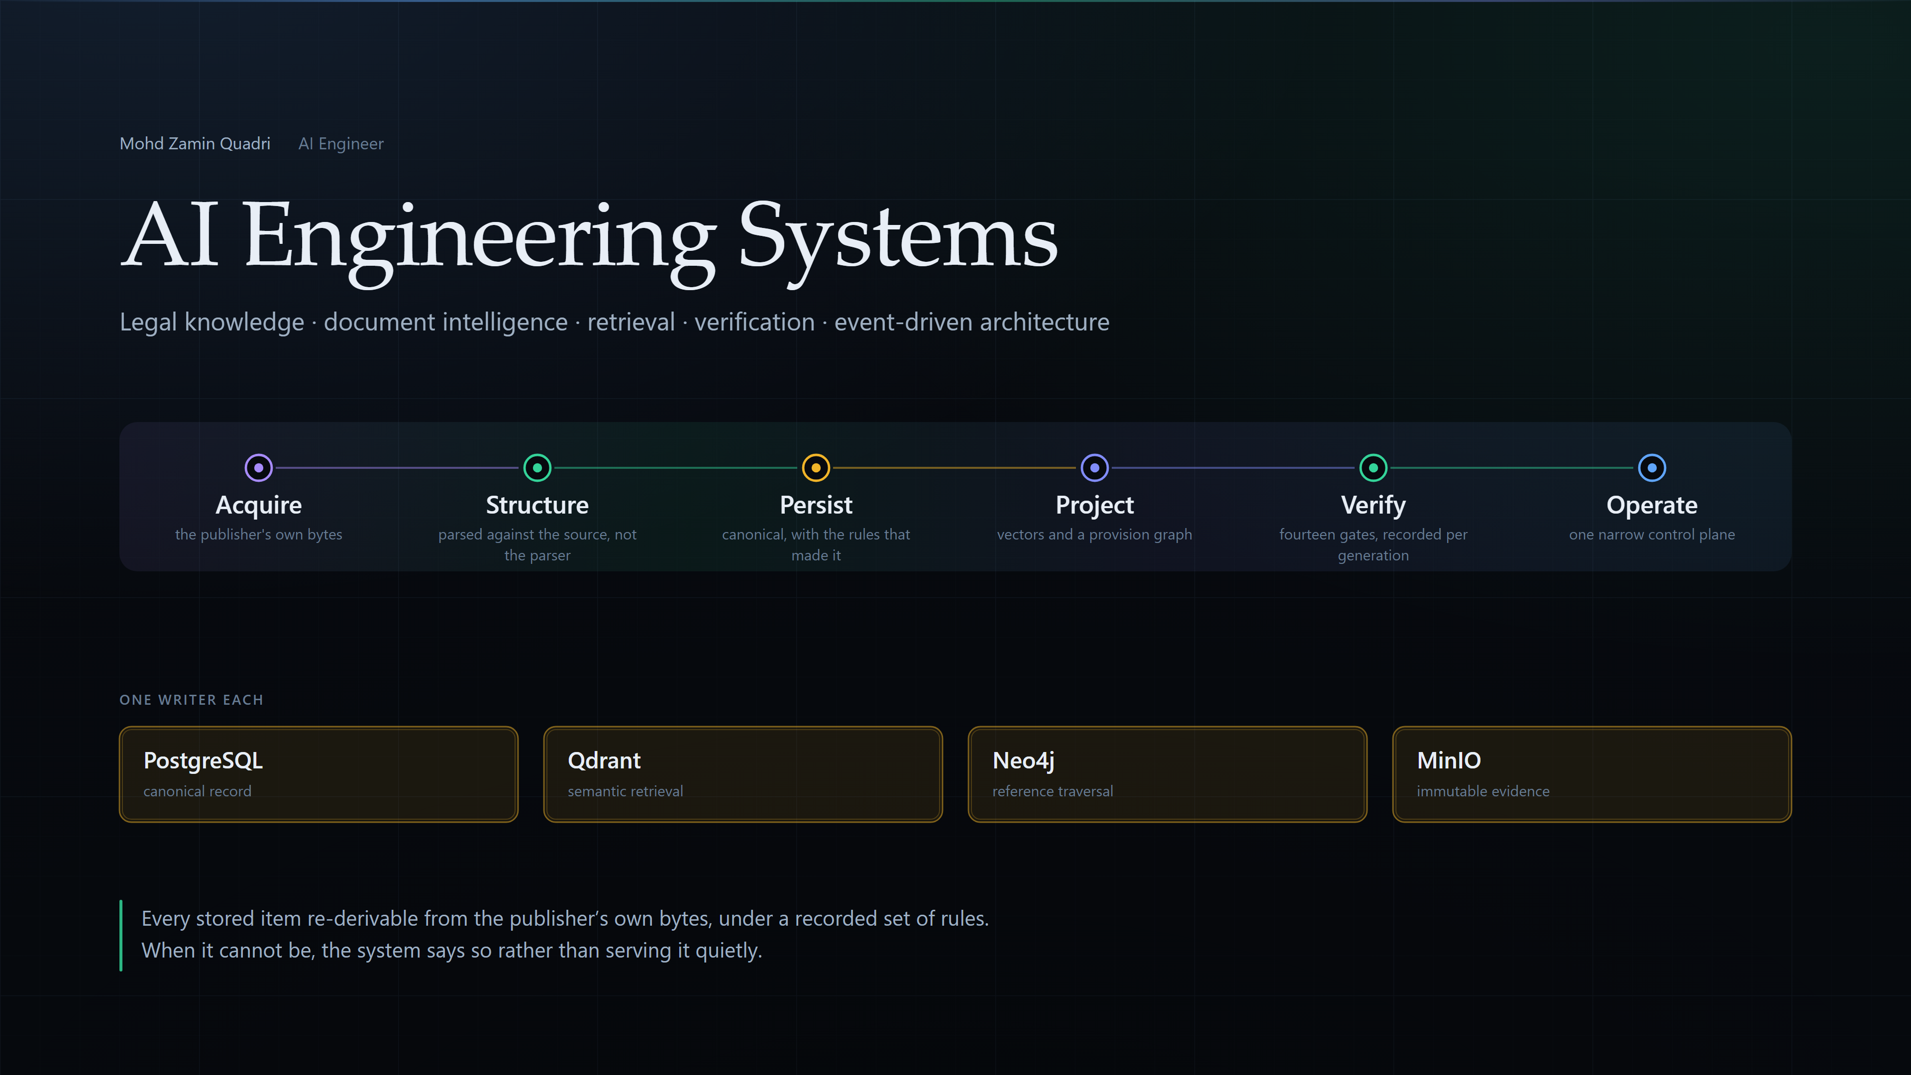
AI Engineering Systems
Mohd Zamin Quadri — AI Engineer, BP-ITCS
Legal knowledge infrastructure · document intelligence · retrieval · verification
Four of five services implemented; three more extended
Mohd Zamin Quadri · AI Engineer · BP-ITCS — every claim traceable to a file
01

Slide 2
What was actually hard about it?
From legal source to trusted machine knowledge
Authoritative law changes without telling you, in two unrelated XML markup families
Extract it for retrieval and you hold three representations that can each drift from the source
So the problem was provenance and operational control — not retrieval
Mohd Zamin Quadri · AI Engineer · BP-ITCS — every claim traceable to a file
02

Slide 3
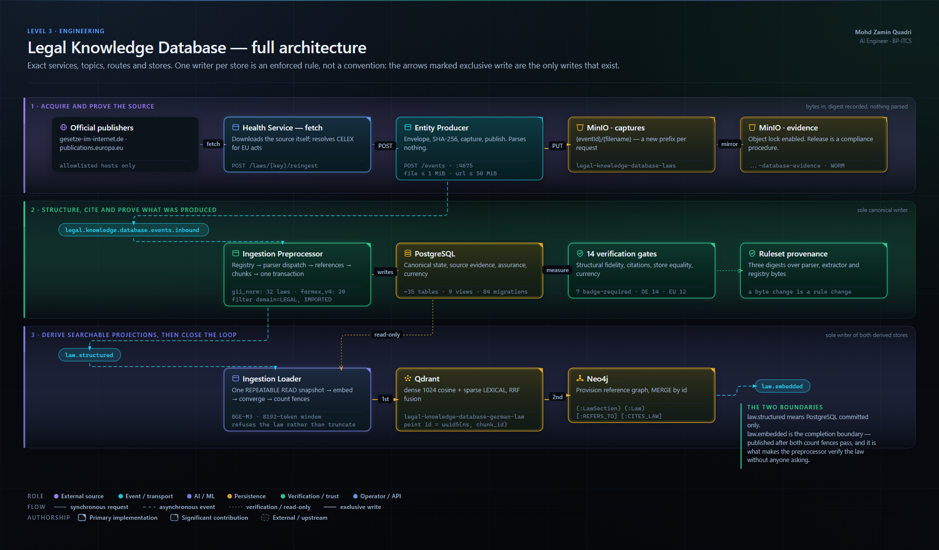
How does it fit together?
End-to-end legal knowledge architecture
Five services: a three-stage ingestion pipeline, plus a two-part control plane
Three Kafka topics; one law maps to one partition, so generations cannot race
Exactly one service writes each store — enforced by deleting the path that violated it
Mohd Zamin Quadri · AI Engineer · BP-ITCS — every claim traceable to a file
03

Slide 4
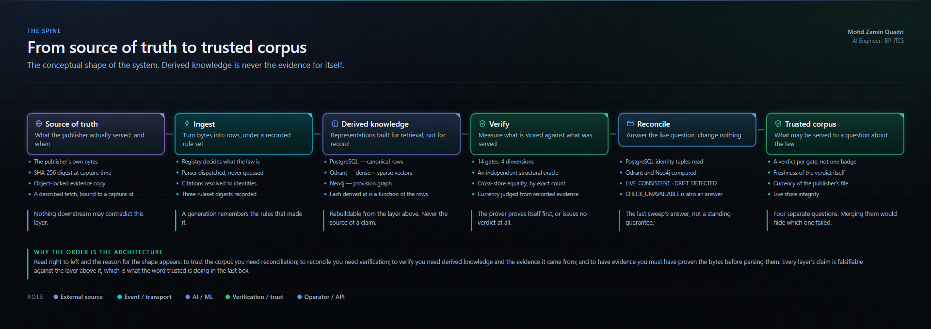
What happens to one law?
Source → trusted corpus
Bytes are hashed before anything interprets them
The structural denominator is built independently of the parser
law.structured means PostgreSQL only; law.embedded is the completion boundary
Mohd Zamin Quadri · AI Engineer · BP-ITCS — every claim traceable to a file
04

Slide 5
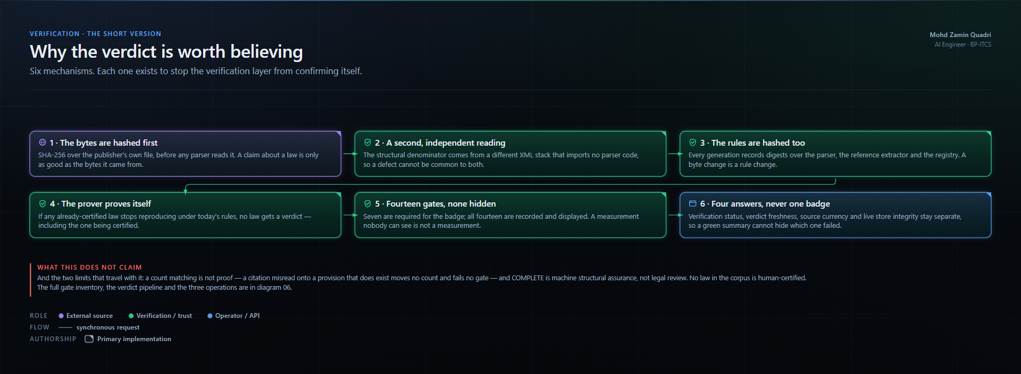
How do you know it is right?
Verification and reconciliation
14 gates; 7 required for the badge, all 14 recorded and shown
The prover proves itself first, or issues no verdict for any law
A count matching is not proof — and the diagram says so
Mohd Zamin Quadri · AI Engineer · BP-ITCS — every claim traceable to a file
05

Slide 6
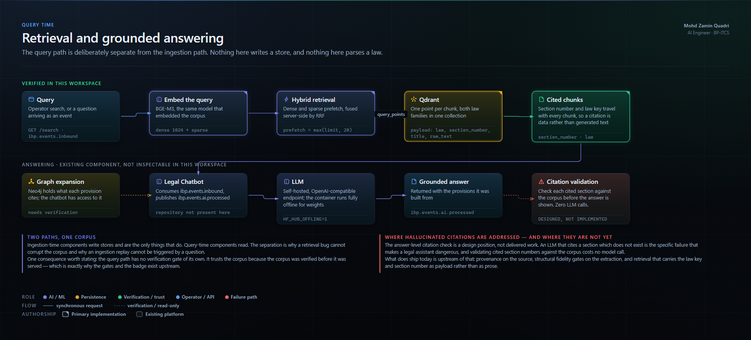
How is a question answered?
The query path
BGE-M3 dense + sparse in one pass, fused server-side by RRF
Citations travel as payload, not as generated prose
The loader refuses a whole law rather than store a truncated embedding
Mohd Zamin Quadri · AI Engineer · BP-ITCS — every claim traceable to a file
06

Slide 7
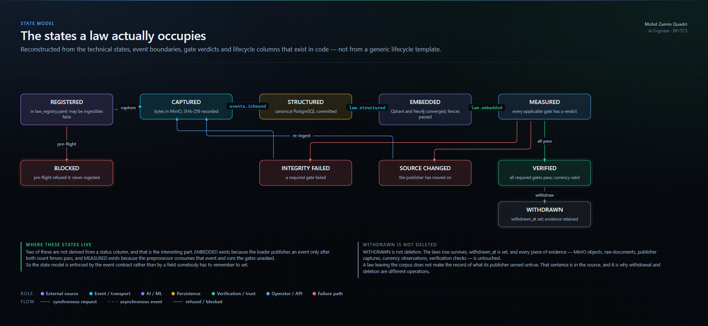
What happens when it breaks?
Failure, recovery and operational control
Fifteen documented failures, each with its recovery — or the statement that none exists
Redelivery is safe because identity is derived, never generated
No dead-letter topic on the legal pipeline: stated as a gap, not hidden
Mohd Zamin Quadri · AI Engineer · BP-ITCS — every claim traceable to a file
07

Slide 8
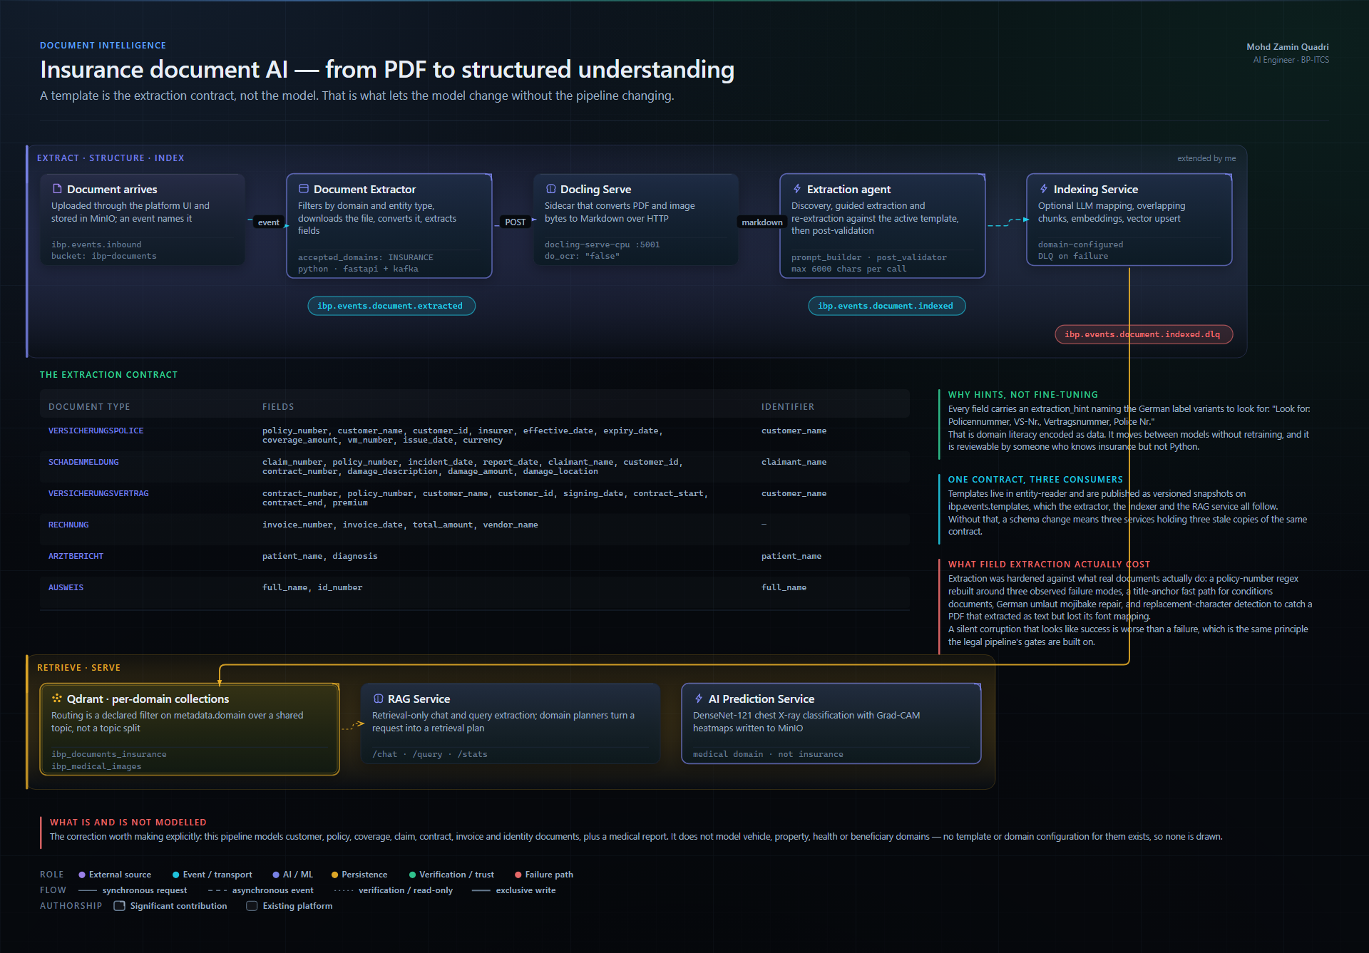
What else runs on the platform?
Document intelligence
Docling conversion, then template-driven LLM field extraction with post-validation
A template is the extraction contract, not the model — six document types
Hardened against real documents: rebuilt regexes, umlaut repair, replacement-character detection
Mohd Zamin Quadri · AI Engineer · BP-ITCS — every claim traceable to a file
08

Slide 9
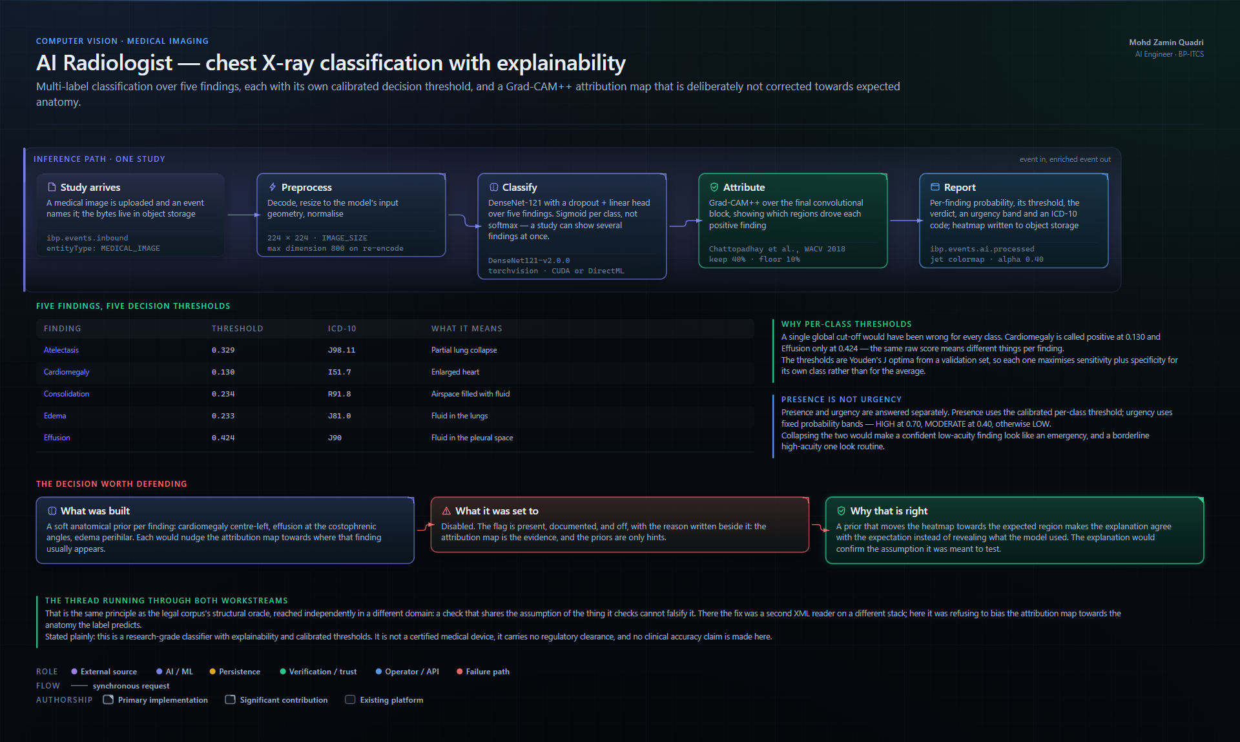
Is there computer vision too?
Chest X-ray classification — a research prototype
Internal project name “AI Radiologist” — not a medical device, not clinically deployed
DenseNet-121 over five findings, sigmoid per class — a study can show several at once
One calibrated threshold per finding (Youden's J), plus ICD-10 and an urgency band
Grad-CAM++ attribution, with anatomical priors built and then deliberately switched off
Mohd Zamin Quadri · AI Engineer · BP-ITCS — every claim traceable to a file
09

Slide 10
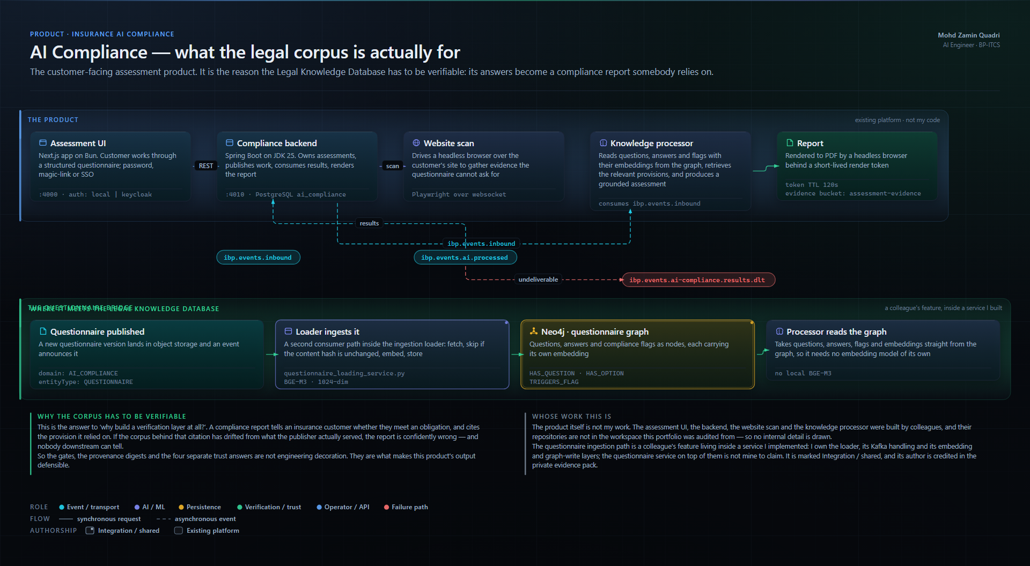
What is all of it actually for?
AI Compliance — the product the corpus serves
A questionnaire plus a headless-browser site scan become a grounded, cited compliance report
A report that cites a drifted provision is confidently wrong — which is why the corpus is verified
The product is a colleague's work; I built the corpus and the service the questionnaire path runs in
Mohd Zamin Quadri · AI Engineer · BP-ITCS — every claim traceable to a file
10

Slide 11
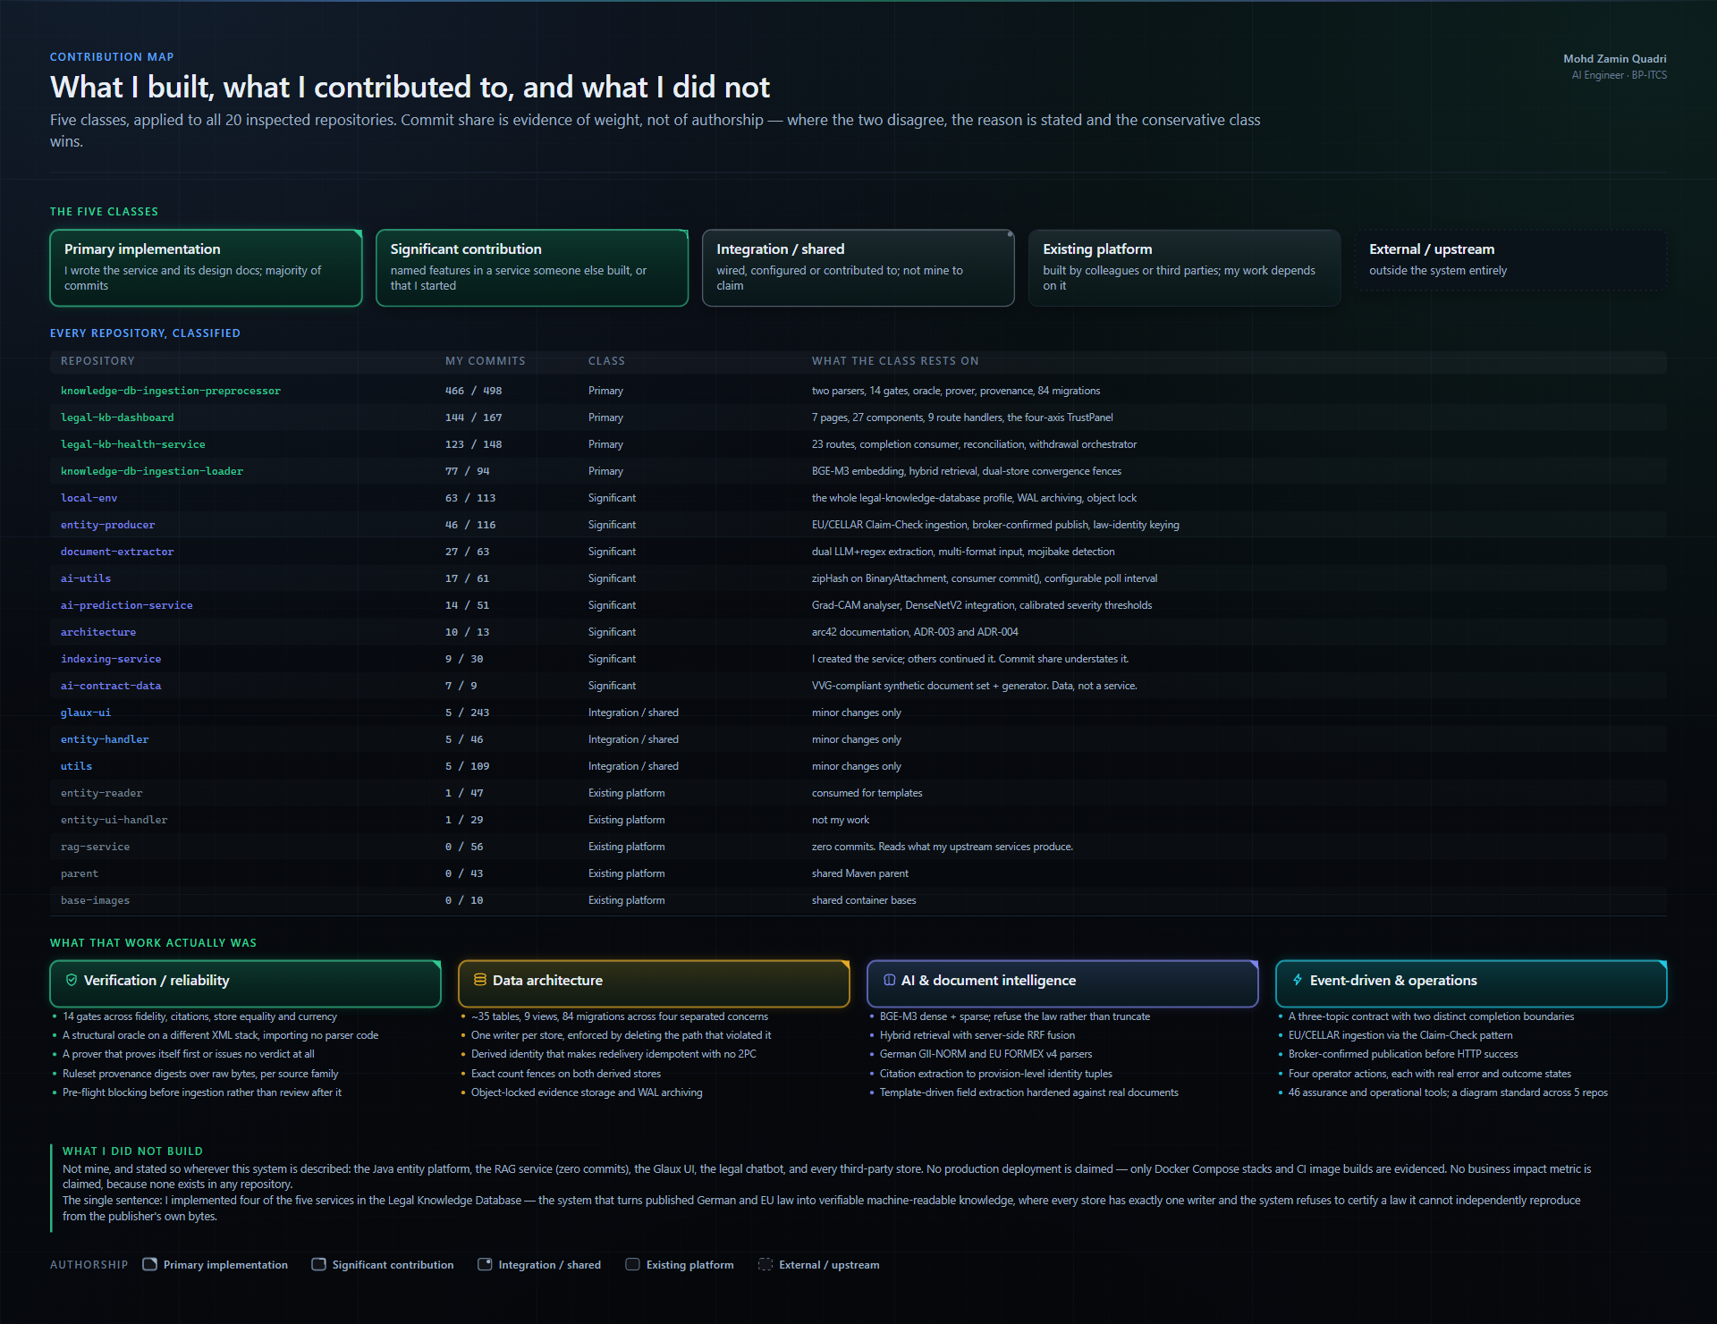
What did you personally build?
What I built, and what I did not
Primary: preprocessor, loader, health service, dashboard — four of the system's five services
Significant: entity producer, document extractor, indexing service (which I created), ai-utils
Not mine: the Java entity platform, the RAG service, the chatbot, every third-party store
Mohd Zamin Quadri · AI Engineer · BP-ITCS — every claim traceable to a file
11

Slide 12
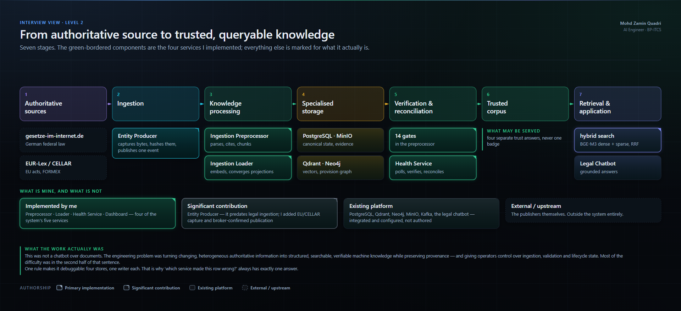
What would you do differently?
Engineering lessons and design principles
Keep: one writer per store; derive identity; refuse rather than approximate
Change: add a dead-letter path; generate the gate list once; content-address the captures
The lesson: a measurement nobody can falsify is not a measurement
Mohd Zamin Quadri · AI Engineer · BP-ITCS — every claim traceable to a file
12

